Slide 1
On Efficient Constructions of Optical Priority Queues
Jay Cheng
Department of Electrical Engineering
National Tsing Hua University
Hsinchu, Taiwan 30013, R.O.C.
E-mail: jcheng@ee.nthu.edu.tw

Slide 2
Outline
Motivation
Definition of a Priority Queue
The Operations of a Priority Queue
Our SDL Construction
An Example of Our SDL Construction
Complexity Analysis for Constructions With Maximum Buffer Sizes
Conclusion

Slide 3
Outline
Motivation
Definition of a Priority Queue
The Operations of a Priority Queue
Our SDL Construction
An Example of Our SDL Construction
Complexity Analysis for Constructions With Maximum Buffer Sizes
Conclusion

Slide 4
Motivation
One of the challenging problems towards all-optical packet-switching is the design of optical buffers for conflict resolution among packets competing for the same resources.
As photons cannot be easily stopped, stored, and forwarded, one way to “store” optical packets without converting them into other media is
to direct optical packets through optical Switches and fiber Delay Lines (SDL) so that the packets appear at the right place and at the right time.
The delay of
the packet is 6.
6

Slide 5
Motivation
One of the challenging problems towards all-optical packet-switching is the design of optical buffers for conflict resolution among packets competing for the same resources.
As photons cannot be easily stopped, stored, and forwarded, one way to “store” optical packets without converting them into other media is
to direct optical packets through optical Switches and fiber Delay Lines (SDL) so that the packets appear at the right place and at the right time.
4
The delay of
the packet is 6.
6

Slide 6
Motivation
One of the challenging problems towards all-optical packet-switching is the design of optical buffers for conflict resolution among packets competing for the same resources.
As photons cannot be easily stopped, stored, and forwarded, one way to “store” optical packets without converting them into other media is
to direct optical packets through optical Switches and fiber Delay Lines (SDL) so that the packets appear at the right place and at the right time.
4
The delay of
the packet is 6.
0

Slide 7
Motivation
One of the challenging problems towards all-optical packet-switching is the design of optical buffers for conflict resolution among packets competing for the same resources.
As photons cannot be easily stopped, stored, and forwarded, one way to “store” optical packets without converting them into other media is
to direct optical packets through optical Switches and fiber Delay Lines (SDL) so that the packets appear at the right place and at the right time.
Recent advances in SDL constructions have shown that there exist
systematic methods for constructing various types of optical queues,
including output-buffered switches, FIFO multiplexers, FIFO queues,
LIFO queues, priority queues, linear compressors, linear decompressors,
non-overtaking delay lines, and flexible delay lines. Priority queues is one of the most general and versatile types of queues.
In this work, we focus on the constructions of optical priority queues.

Slide 8
Outline
Motivation
Definition of a Priority Queue
The Operations of a Priority Queue
Our SDL Construction
An Example of Our SDL Construction
Complexity Analysis for Constructions With Maximum Buffer Sizes
Conclusion

Slide 9
Basic Assumptions
Time is slotted and synchronized.
Packets are of the same size so that a packet can be transmitted through a link within a time slot.
An optical M × M crossbar switch is a network element with M input links and M output links that can realize all of the M! permutations between its inputs and outputs.
A fiber delay line with delay d is a network element with one input link and one output link that requires d time slots for a packet to traverse through.

Slide 10
Definition of a Priority Queue
Buffer size
Arrival link
B
Departure link
a(t)
Priority queue
with buffer B
d(t)
c(t)
l(t)
Control input link
Loss link
(P1) Flow conservation
Packets arriving from the arrival link are either stored in the buffer or transmitted through the departure link or the loss link.
(P2) Non-idling
(P3) Maximum buffer usage
(P4) Priority departure
(P5) Priority loss

Slide 11
Definition of a Priority Queue
Buffer size
Arrival link
B
Departure link
a(t)
Priority queue
with buffer B
d(t)
c(t)
l(t)
Control input link
Loss link
(P1) Flow conservation
If c(t)=1 and there are packets in the queue at time t, then there is a departure packet at time t;
otherwise, there is no departure packet at time t.
(P2) Non-idling
(P3) Maximum buffer usage
(P4) Priority departure
(P5) Priority loss

Slide 12
Definition of a Priority Queue
Buffer size
Arrival link
B
Departure link
a(t)
Priority queue
with buffer B
d(t)
c(t)
l(t)
Control input link
Loss link
(P1) Flow conservation
(P2) Non-idling
If there is a buffer overflow at time t,
then there is a loss packet at time t;
otherwise, there is no loss packet at time t.
(P3) Maximum buffer usage
(P4) Priority departure
(P5) Priority loss

Slide 13
Definition of a Priority Queue
Buffer size
Arrival link
B
Departure link
a(t)
Priority queue
with buffer B
d(t)
c(t)
l(t)
Control input link
Loss link
(P1) Flow conservation
(P2) Non-idling
(P3) Maximum buffer usage
If there is a departure packet at time t, then that packet is the highest-priority packet in the queue at time t.
(P4) Priority departure
(P5) Priority loss

Slide 14
Definition of a Priority Queue
Buffer size
Arrival link
B
Departure link
a(t)
Priority queue
with buffer B
d(t)
c(t)
l(t)
Control input link
Loss link
(P1) Flow conservation
(P2) Non-idling
(P3) Maximum buffer usage
(P4) Priority departure
If there is a loss packet at time t,
then that packet is the lowest-priority packet in the queue at time t.
(P5) Priority loss

Slide 15
Outline
Motivation
Definition of a Priority Queue
The Operations of a Priority Queue
Our SDL Construction
An Example of Our SDL Construction
Complexity Analysis for Constructions With Maximum Buffer Sizes
Conclusion

Slide 16
The Operations of a Priority Queue (B=9)
Electronic Random Access Memory
c(t)

Slide 17
The Operations of a Priority Queue (B=9)
t = 1
1
c(t)=0
(P1) Flow conservation: Packets arriving from the arrival link are either
stored in the buffer or transmitted through the departure link or the loss link.

Slide 18
The Operations of a Priority Queue (B=9)
t = 1
t = 2
2
1
c(t)=0
c(t)=1
(P2) Non-idling: If c(t)=1 and there are packets in the queue at time t, then there is
a departure packet at time t; otherwise, there is no departure packet at time t.
(P4) Priority departure: If there is a departure packet at time t, then that packet is
the highest-priority packet in the queue at time t.

Slide 19
The Operations of a Priority Queue (B=9)
t = 2
t = 3
1
1
2
c(t)=1
c(t)=0

Slide 20
The Operations of a Priority Queue (B=9)
t = 3
t = 4
3
1
2
c(t)=0
c(t)=0

Slide 21
The Operations of a Priority Queue (B=9)
t = 4
t = 5
4
1
2
c(t)=0
c(t)=0
3

Slide 22
The Operations of a Priority Queue (B=9)
t = 6
t = 5
4
4
4
5
1
2
c(t)=0
c(t)=0
3

Slide 23
The Operations of a Priority Queue (B=9)
t = 6
t = 7
1
5
6
1
2
4
5
2
3
c(t)=0
c(t)=0
3
4

Slide 24
The Operations of a Priority Queue (B=9)
t = 7
t = 8
5
6
7
2
6
5
3
c(t)=0
c(t)=0
1
4

Slide 25
The Operations of a Priority Queue (B=9)
t = 8
t = 9
8
5
7
2
6
3
c(t)=0
c(t)=0
1
4

Slide 26
The Operations of a Priority Queue (B=9)
t = 9
t = 10
8
5
7
2
8
9
6
3
c(t)=0
c(t)=0
1
4

Slide 27
The Operations of a Priority Queue (B=9)
t = 10
t = 11
5
5
6
7
8
2
9
10
7
6
3
c(t)=0
c(t)=0
8
1
4
9
(P3) Maximum buffer usage: If there is a buffer overflow at time t, then there is
a loss packet at time t; otherwise, there is no loss packet at time t.
(P5) Priority loss: If there is a loss packet at time t, then that packet is
the lowest-priority packet in the queue at time t.

Slide 28
Outline
Motivation
Definition of a Priority Queue
The Operations of a Priority Queue
Our SDL Construction
An Example of Our SDL Construction
Complexity Analysis for Constructions With Maximum Buffer Sizes
Conclusion

Slide 29
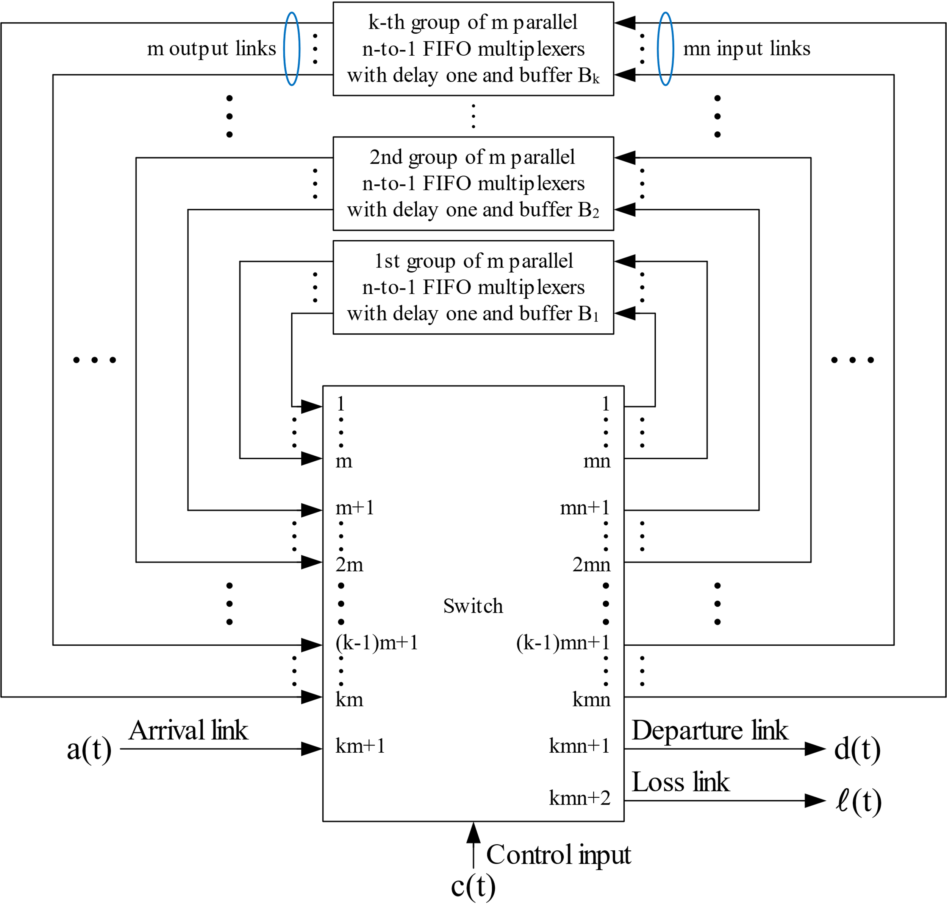
Our SDL Construction
k groups of FIFO multiplexers
with delay one
A (kmn+2) × (kmn+2) switch
In this work, we show that such a feedback system can be operated as an optical priority queue under a simple priority-based routing policy.

Slide 30


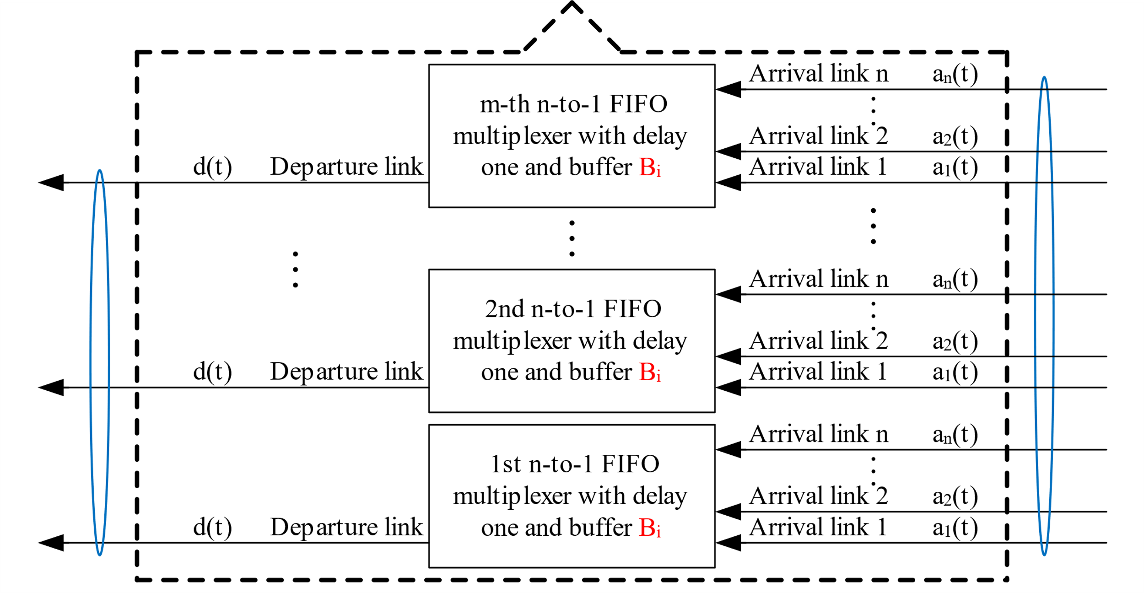
Our SDL Construction

Slide 31
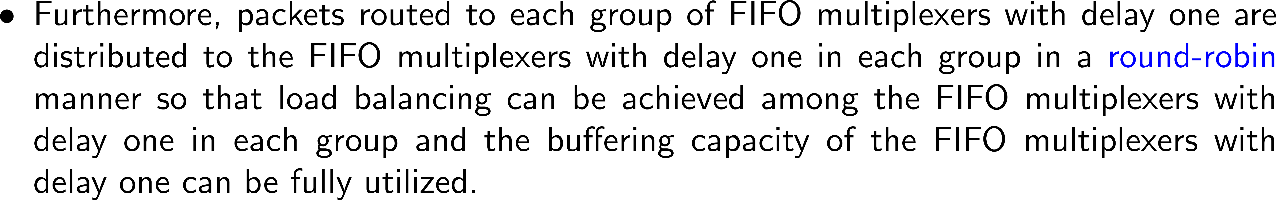
Priority-Based Routing Policy
Notes:
%By IguanaTex%
%Size: 18pts
\begin{document}
\begin{itemize}
\item The idea behind the priority-based routing policy
is to associate with each group of FIFO multiplexers with delay one
a unique range of buffering tags.
\end{itemize}
\end{document}
\begin{document}
\begin{itemize}
\item Packets that have to be buffered in the queue and have buffering tags in a specific range
are routed to the group of FIFO multiplexers with delay one
associated with that specific range of buffering tags.
\end{itemize}
\end{document}
\begin{document}
\begin{itemize}
\item Furthermore, packets routed to each group of FIFO multiplexers with delay one
are distributed to the FIFO multiplexers with delay one in each group
in a {\color{blue}round-robin} manner
so that load balancing can be achieved
among the FIFO multiplexers with delay one in each group
and the buffering capacity of the FIFO multiplexers with delay one
can be fully utilized.
\end{itemize}
\end{document}

Slide 32
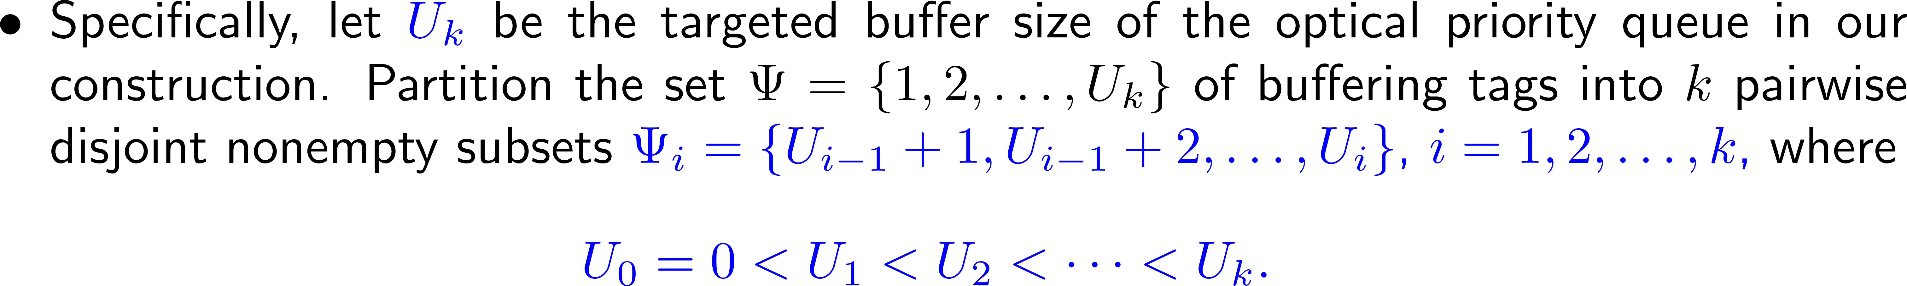
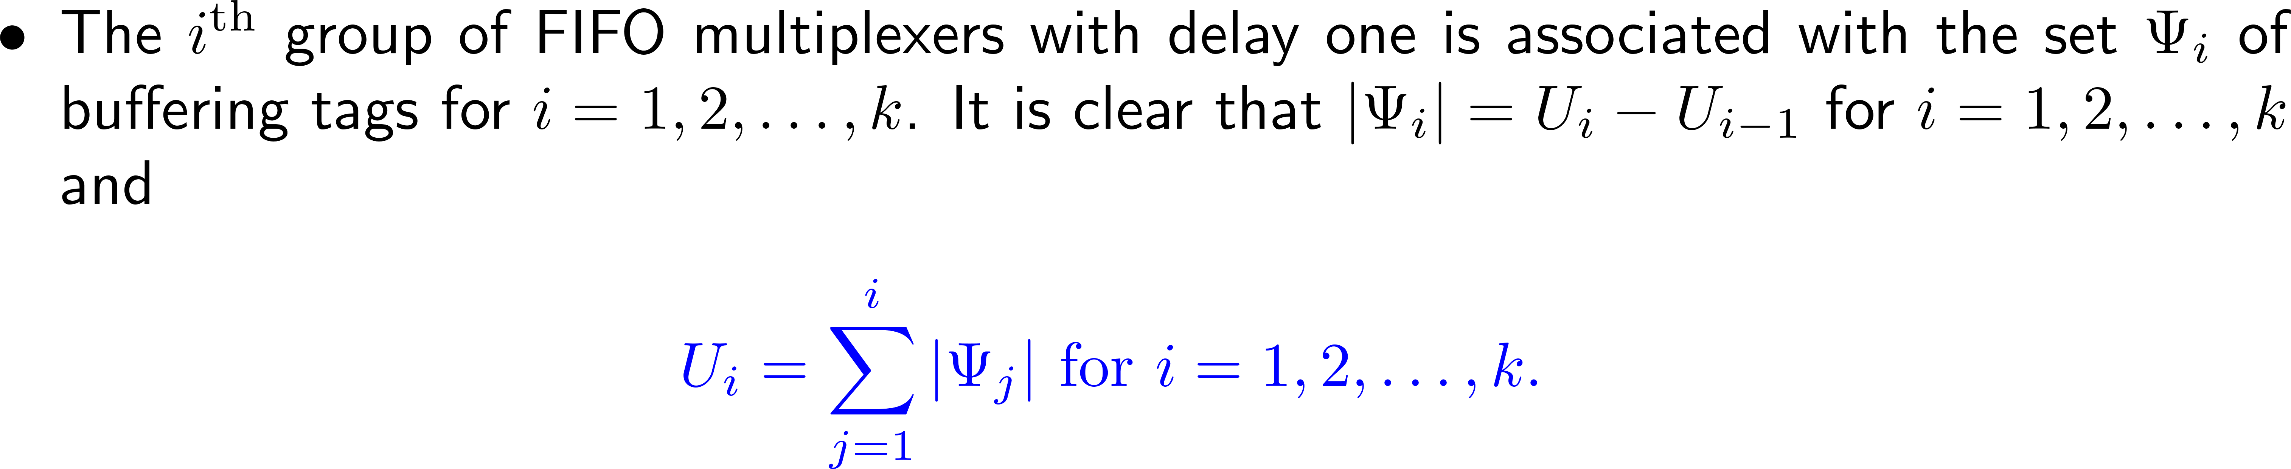
Priority-Based Routing Policy
Notes:
%By IguanaTex%
%Size: 18pts
\begin{document}
\begin{itemize}
\item
Specifically, let {\color{blue}$U_k$} be the targeted buffer size
of the optical priority queue in our construction.
Partition the set $\Psi=\{1,2,\ldots,U_k\}$ of buffering tags
into $k$ pairwise disjoint nonempty subsets
{\color{blue}$\Psi_i=\{U_{i-1}+1,U_{i-1}+2,\ldots,U_i\}$, $i=1,2,\ldots,k$,}
where
\beq{contiguity condition-2}
{\color{blue}U_0=0<U_1<U_2<\cdots<U_k.} \nn
\eeq
\end{itemize}
\end{document}
\begin{document}
\begin{itemize}
\item
The $i^{\textrm{th}}$ group of FIFO multiplexers with delay one
is associated with the set $\Psi_i$ of buffering tags for $i=1,2,\ldots,k$.
It is clear that $|\Psi_i|=U_i-U_{i-1}$ for $i=1,2,\ldots,k$ and
\beq{contiguity condition-3}
{\color{blue}U_i=\sum_{j=1}^{i}|\Psi_j| \textrm{ for } i=1,2,\ldots,k.} \nn
\eeq
\end{itemize}
\end{document}
\begin{document}
\begin{itemize}
\item
Let {\color{blue}$L_i=U_{i-1}+1$} so that we can write {\color{blue}$\Psi_i=\{L_i,L_i+1,\ldots,U_i\}$ for $i=1,2,\ldots,k$.}
Note that $L_1=U_0+1=1$ and $L_i\leq U_i$ for $i=1,2,\ldots,k$.
\end{itemize}
\end{document}
\begin{document}
\begin{itemize}
\item
At the {\color{blue}beginning} of time $t$,
we assign a tag $i$ to a packet
if it is the $i^{\rm{th}}$ highest priority packet
among all of the packets in the queue at time $t$,
and we operate the crossbar switch according to the following priority-based routing policy
for all $t\geq 1$.
\end{itemize}
\end{document}

Slide 33
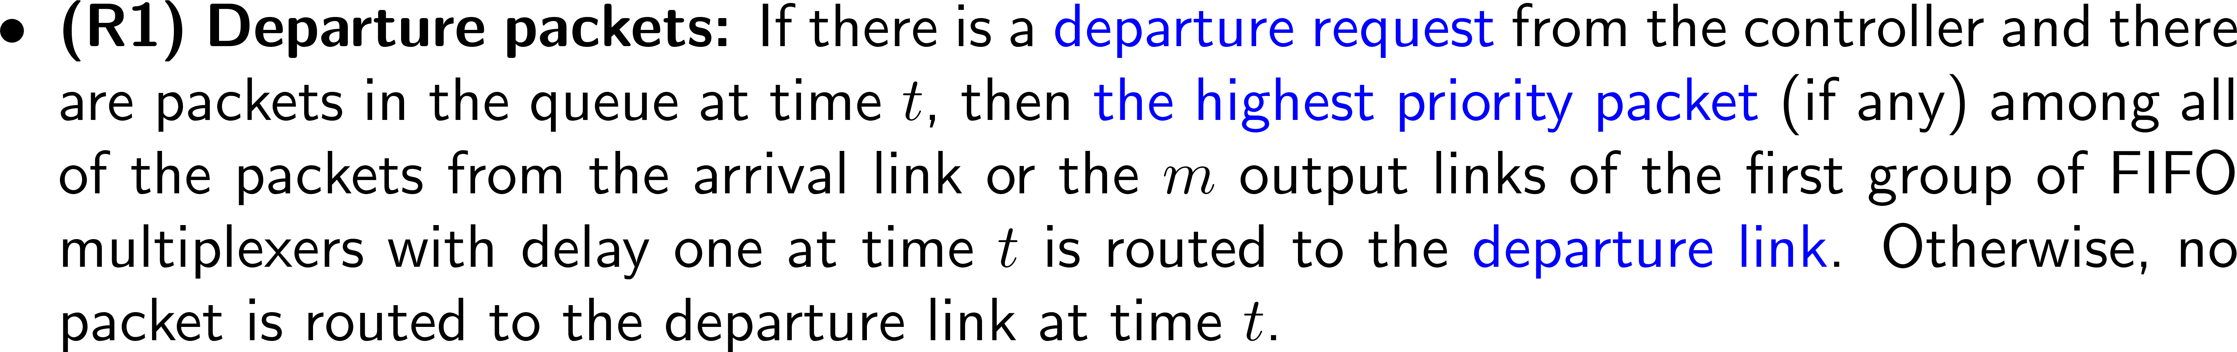
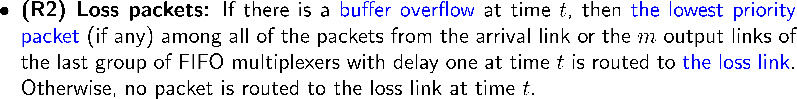
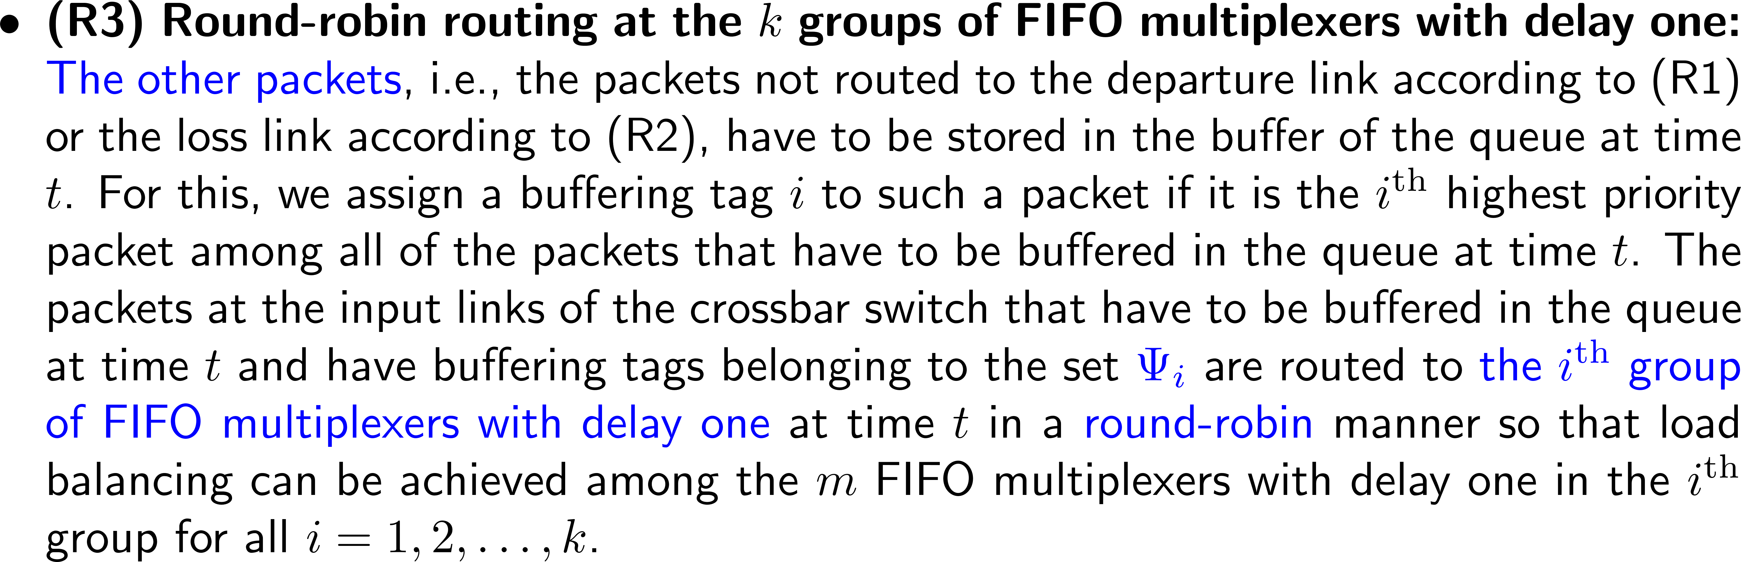
Priority-Based Routing Policy
Notes:
%By IguanaTex%
%Size: 18pts
\begin{document}
\begin{itemize}
\item {\bf (R1) Departure packets:}
If there is a {\color{blue}departure request} from the controller
and there are packets in the queue at time $t$,
then {\color{blue}the highest priority packet} (if any)
among all of the packets from the arrival link or the $m$ output links
of the first group of FIFO multiplexers with delay one at time $t$
is routed to the {\color{blue}departure link}.
Otherwise, no packet is routed to the departure link at time $t$.
\end{itemize}
\end{document}
\begin{document}
\begin{itemize}
\item {\bf (R2) Loss packets:}
If there is a {\color{blue}buffer overflow} at time $t$,
then {\color{blue}the lowest priority packet} (if any)
among all of the packets from the arrival link or the $m$ output links
of the last group of FIFO multiplexers with delay one at time $t$
is routed to {\color{blue}the loss link}.
Otherwise, no packet is routed to the loss link at time $t$.
\end{itemize}
\end{document}
\begin{document}
\begin{itemize}
\item
{\bf (R3) Round-robin routing at the $k$ groups of FIFO multiplexers with delay one:}
{\color{blue}The other packets},
i.e., the packets not routed to the departure link
according to (R1) or the loss link according to (R2),
have to be stored in the buffer of the queue at time $t$.
For this, we assign a buffering tag $i$ to such a packet
if it is the $i^{\rm{th}}$ highest priority packet
among all of the packets that have to be buffered in the queue at time $t$.
The packets at the input links of the crossbar switch
that have to be buffered in the queue at time $t$
and have buffering tags belonging to the set {\color{blue}$\Psi_i$} are routed to
{\color{blue}the $i^{\textrm{th}}$ group of FIFO multiplexers with delay one} at time $t$ in a {\color{blue}round-robin} manner
so that load balancing can be achieved among the $m$ FIFO multiplexers with delay one
in the $i^{\textrm{th}}$ group for all $i=1,2,\ldots,k$.
\end{itemize}
\end{document}

Slide 34
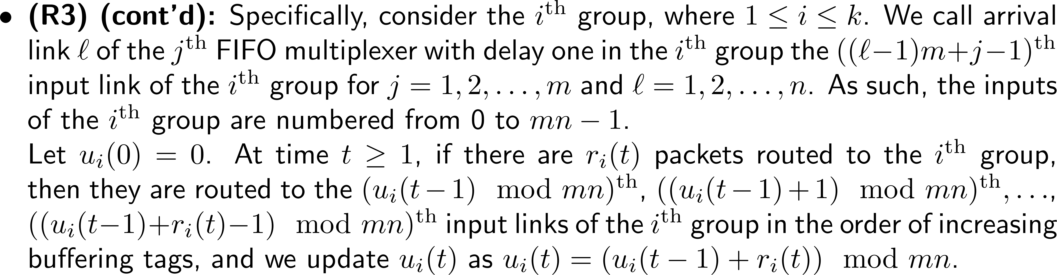
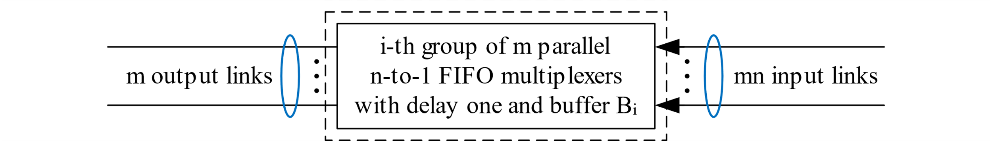
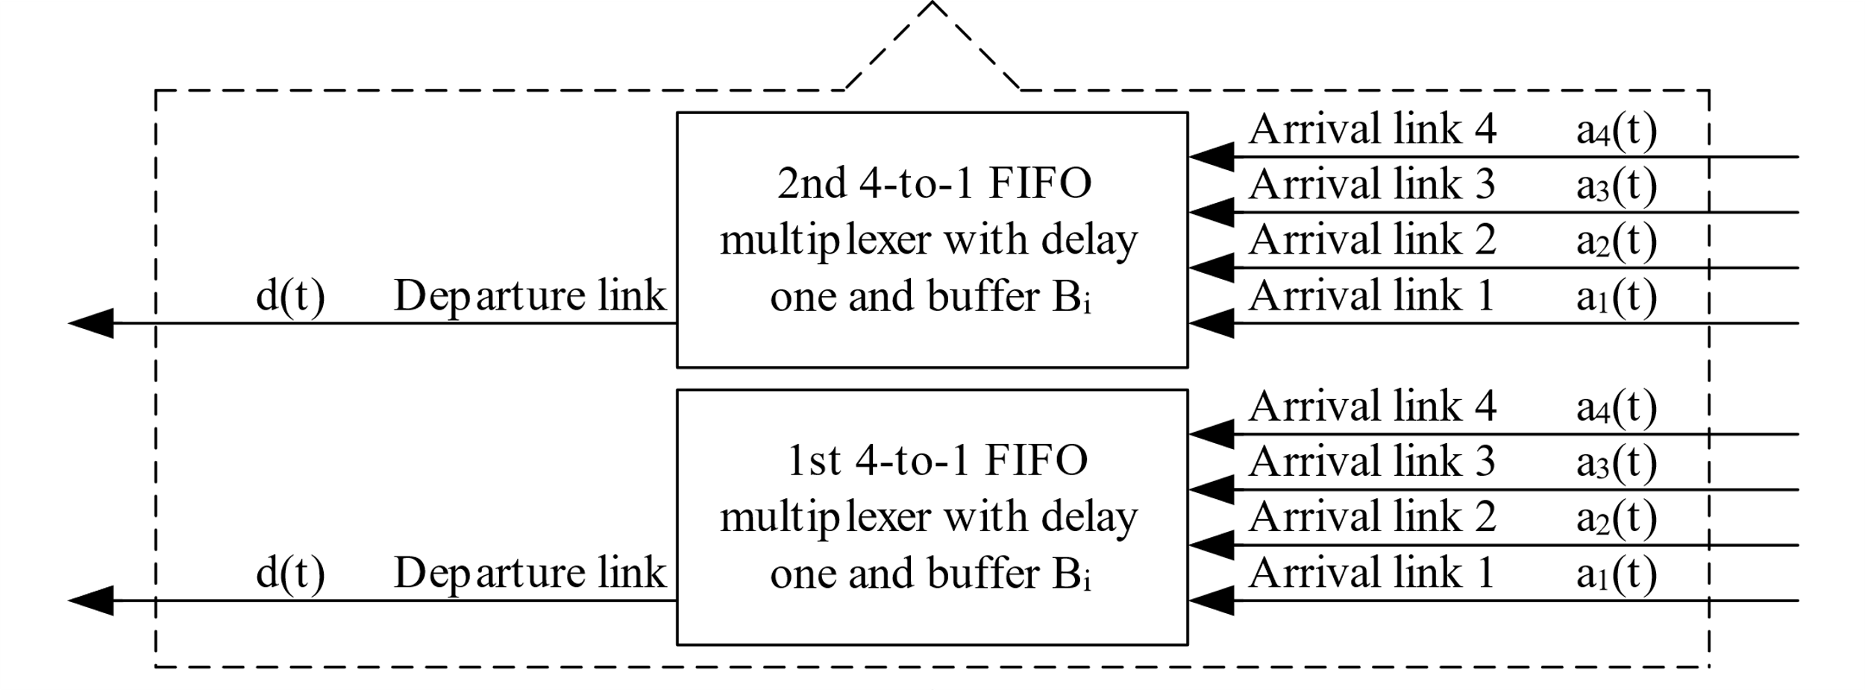








Priority-Based Routing Policy
Notes:
%By IguanaTex%
%Size: 18pts
\begin{document}
\begin{itemize}
\item
{\bf (R3) (cont'd):}
Specifically, consider the $i^{\textrm{th}}$ group, where $1\leq i\leq k$.
We call arrival link $\ell$ of the $j^{\textrm{th}}$ FIFO multiplexer with delay one
in the $i^{\textrm{th}}$ group the $((\ell-1)m+j-1)^{\textrm{th}}$ input link
of the $i^{\textrm{th}}$ group for $j=1,2,\ldots,m$ and $\ell=1,2,\ldots,n$.
As such, the inputs of the $i^{\textrm{th}}$ group are numbered from 0 to $mn-1$.\\
Let $u_i(0)=0$.
At time $t\geq 1$, if there are $r_i(t)$ packets routed to the $i^{\textrm{th}}$ group,
then they are routed to the $(u_i(t-1)\mod mn)^{\textrm{th}}$,
$((u_i(t-1)+1)\mod mn)^{\textrm{th}},\ldots$, $((u_i(t-1)+r_i(t)-1)\mod mn)^{\textrm{th}}$
input links of the $i^{\textrm{th}}$ group in the order of increasing buffering tags,
and we update $u_i(t)$ as $u_i(t)=(u_i(t-1)+r_i(t))\mod mn$.
\end{itemize}
\end{document}

Slide 35
Priority-Based Routing Policy
Notes:
%By IguanaTex%
%Size: 18pts
\begin{document}
\begin{itemize}
\item
{\bf (R3) (cont'd):}
Specifically, consider the $i^{\textrm{th}}$ group, where $1\leq i\leq k$.
We call arrival link $\ell$ of the $j^{\textrm{th}}$ FIFO multiplexer with delay one
in the $i^{\textrm{th}}$ group the $((\ell-1)m+j-1)^{\textrm{th}}$ input link
of the $i^{\textrm{th}}$ group for $j=1,2,\ldots,m$ and $\ell=1,2,\ldots,n$.
As such, the inputs of the $i^{\textrm{th}}$ group are numbered from 0 to $mn-1$.\\
Let $u_i(0)=0$.
At time $t\geq 1$, if there are $r_i(t)$ packets routed to the $i^{\textrm{th}}$ group,
then they are routed to the $(u_i(t-1)\mod mn)^{\textrm{th}}$,
$((u_i(t-1)+1)\mod mn)^{\textrm{th}},\ldots$, $((u_i(t-1)+r_i(t)-1)\mod mn)^{\textrm{th}}$
input links of the $i^{\textrm{th}}$ group in the order of increasing buffering tags,
and we update $u_i(t)$ as $u_i(t)=(u_i(t-1)+r_i(t))\mod mn$.
\end{itemize}
\end{document}
\begin{document}
\begin{itemize}
\item It is clear that $u_i(t)$ is the index of the input link of the $i^{\textrm{th}}$ group
that will be firstly used by the packets routed to the $i^{\textrm{th}}$ group at time $t$.
\end{itemize}
\end{document}

Slide 36
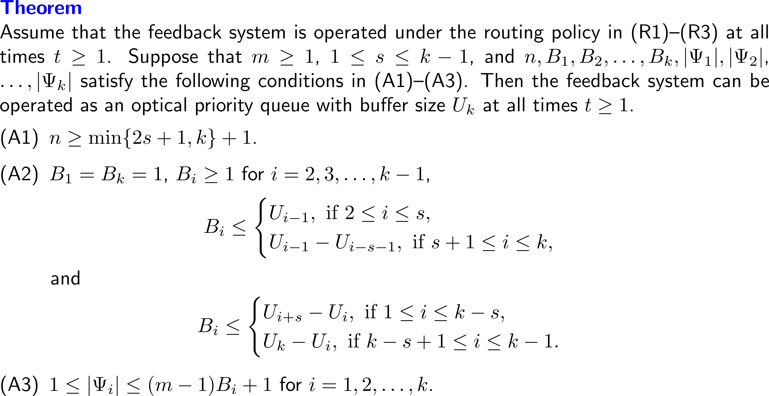
Our SDL Construction
Notes:
%By IguanaTex%
%Size: 18pts
\begin{document}
\noindent{\textbf{\color{blue}Theorem}}\\
Assume that the feedback system is operated under the routing policy in (R1)--(R3) at all times $t\geq 1$.
Suppose that $m\geq 1$, $1\leq s\leq k-1$,
and $n,B_1,B_2,\ldots,B_k,|\Psi_1|,|\Psi_2|$, $\ldots,|\Psi_k|$
satisfy the following conditions in (A1)--(A3).
Then the feedback system can be operated as an optical priority queue with buffer size $U_k$
at all times $t\geq 1$.
\bdescription
\item[\textnormal{(A1)}] $n\geq \min\{2s+1,k\}+1$.
\item[\textnormal{(A2)}] $B_1=B_k=1$, $B_i\geq 1$ for $i=2,3,\ldots,k-1$,
\beq{}
B_i\leq
\bcases
U_{i-1}, \textrm{ if } 2\leq i\leq s,\\
U_{i-1}-U_{i-s-1}, \textrm{ if } s+1\leq i\leq k,
\ecases \nn
\eeq
and
\beq{}
B_i\leq
\bcases
U_{i+s}-U_i, \textrm{ if } 1\leq i\leq k-s,\\
U_k-U_i, \textrm{ if } k-s+1\leq i\leq k-1.
\ecases \nn
\eeq
\item[\textnormal{(A3)}] $1\leq |\Psi_i|\leq (m-1)B_i+1$ for $i=1,2,\ldots,k$.
\edescription
\end{document}

Slide 37
Outline
Motivation
Definition of a Priority Queue
The Operations of a Priority Queue
Our SDL Construction
An Example of Our SDL Construction
Complexity Analysis for Constructions With Maximum Buffer Sizes
Conclusion

Slide 38
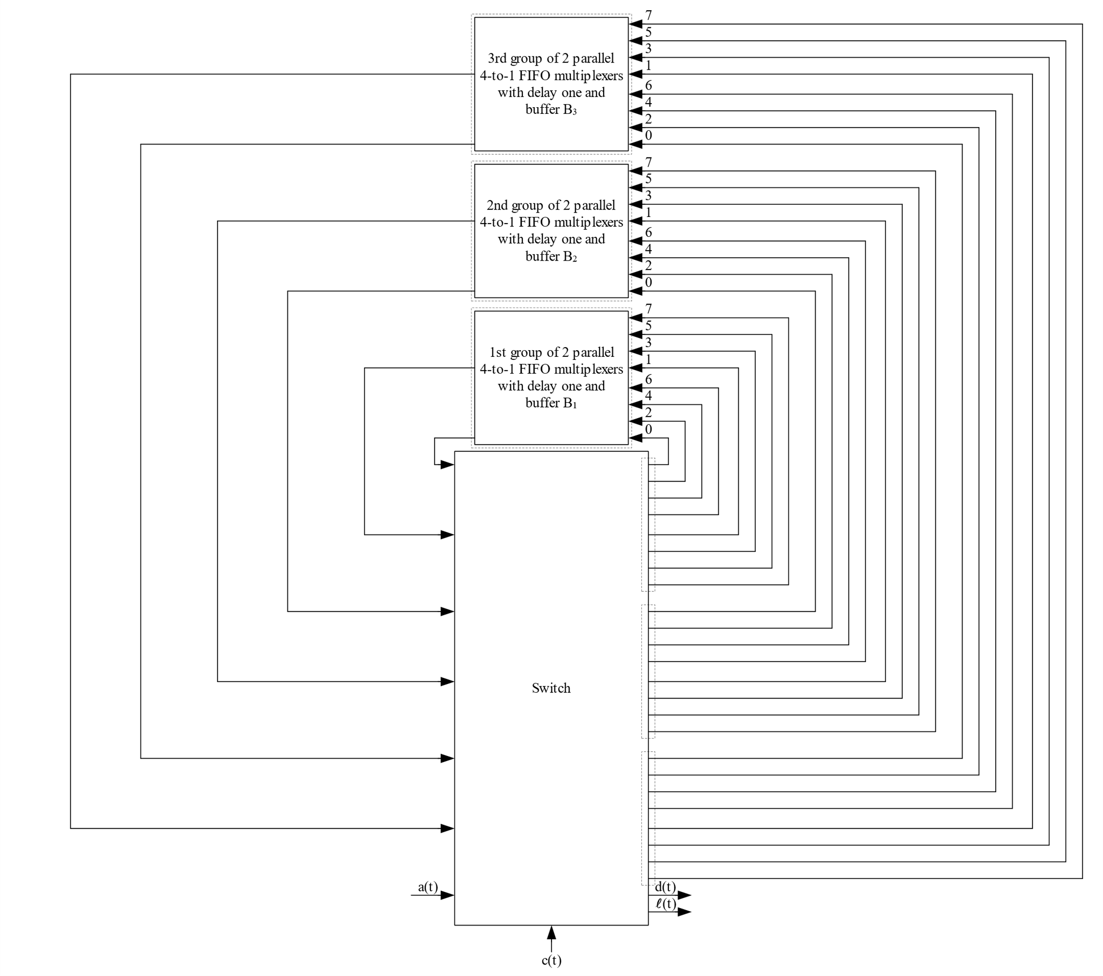
An Example: k=3, m=2, s=1, n=4
k=3

Slide 39
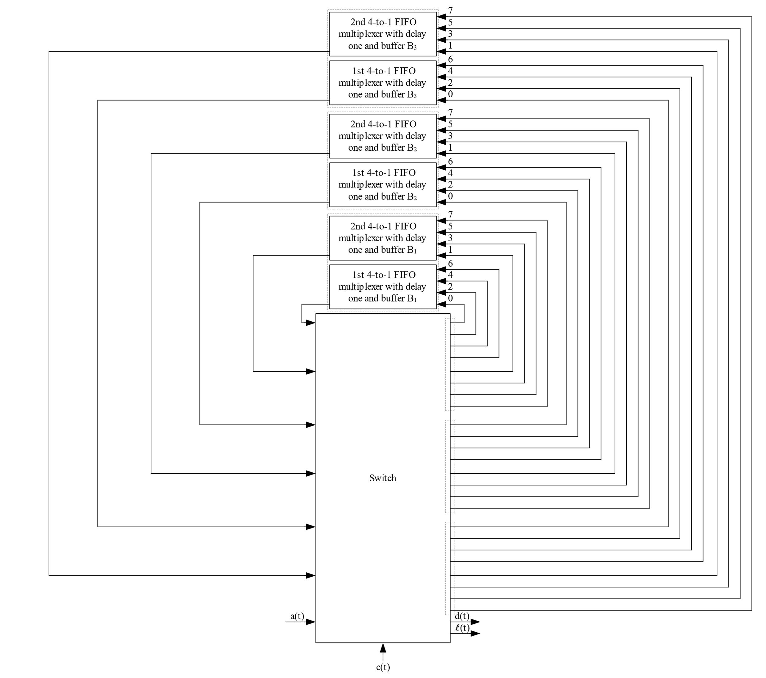
An Example: k=3, m=2, s=1, n=4
n=4
m=2

Slide 40
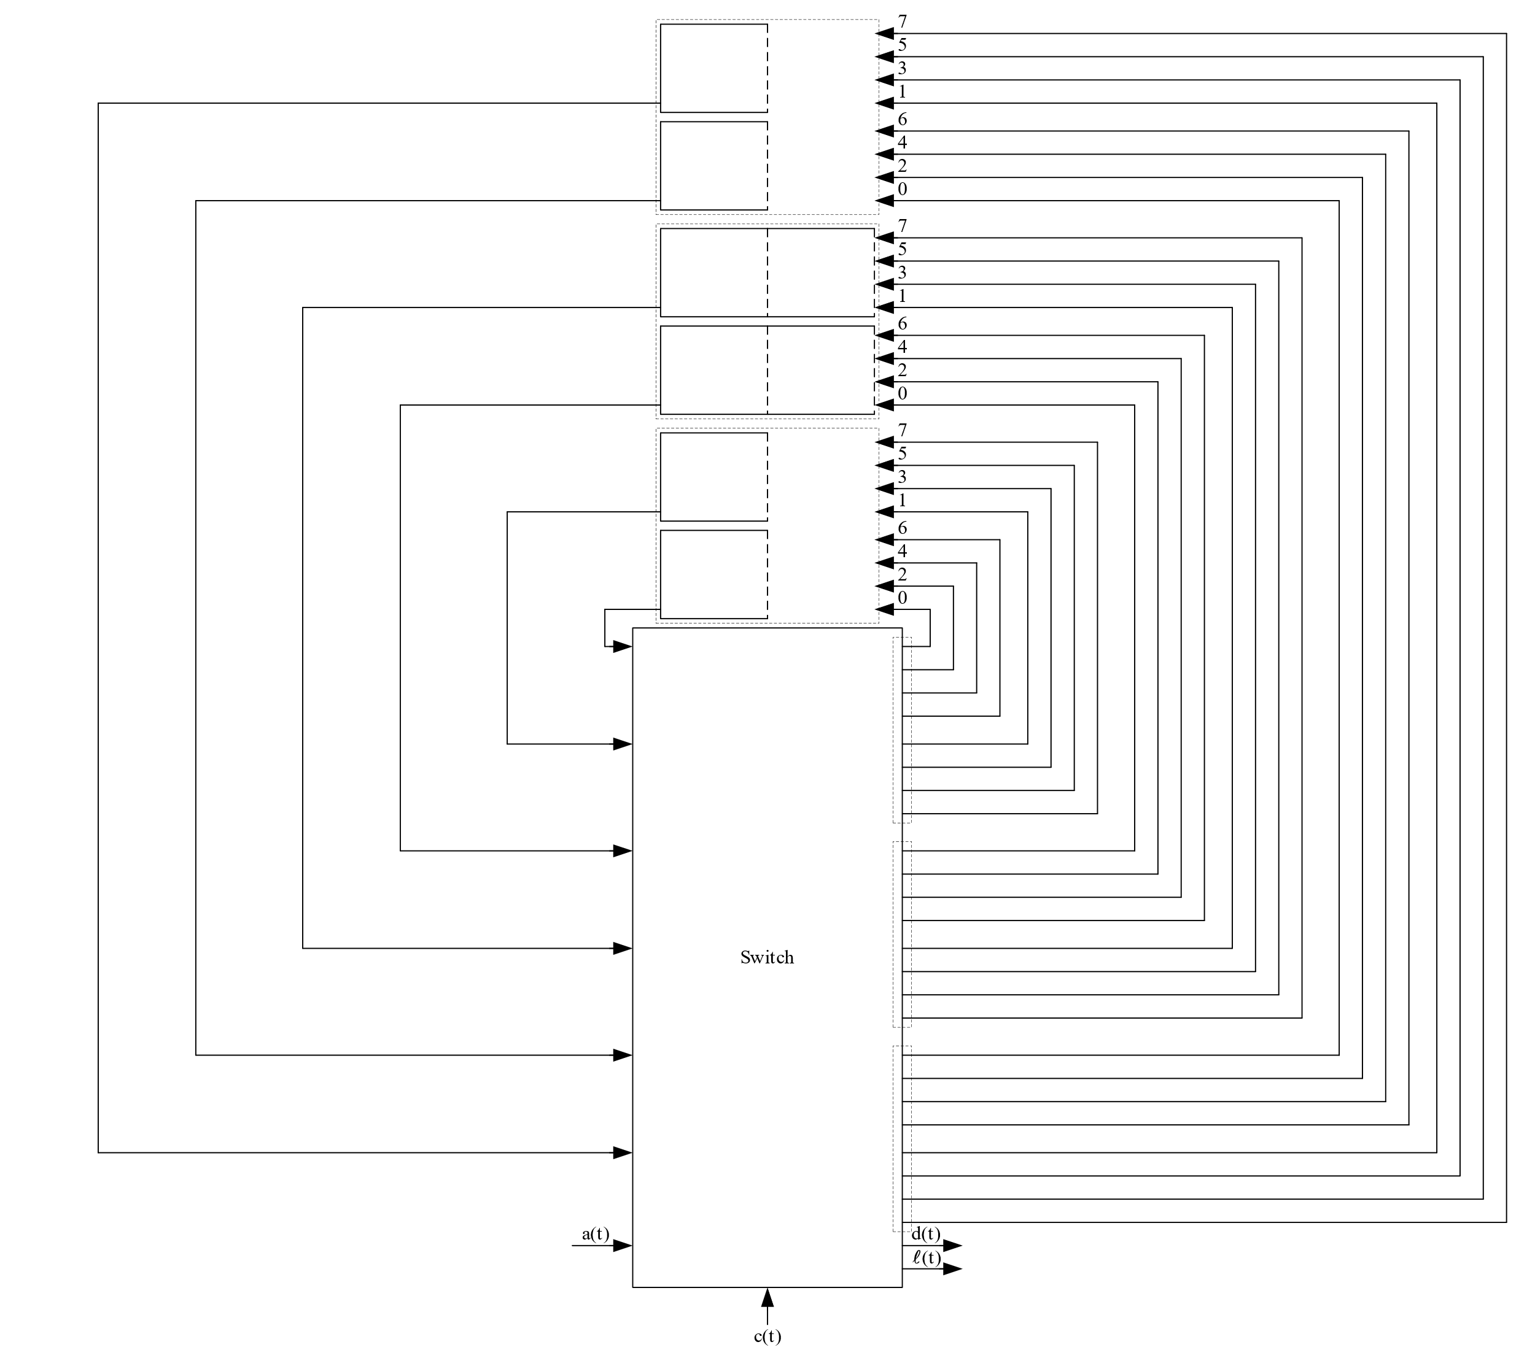
An Example: k=3, m=2, s=1, n=4
B₃=1
B₂=2
B₁=1

Slide 41
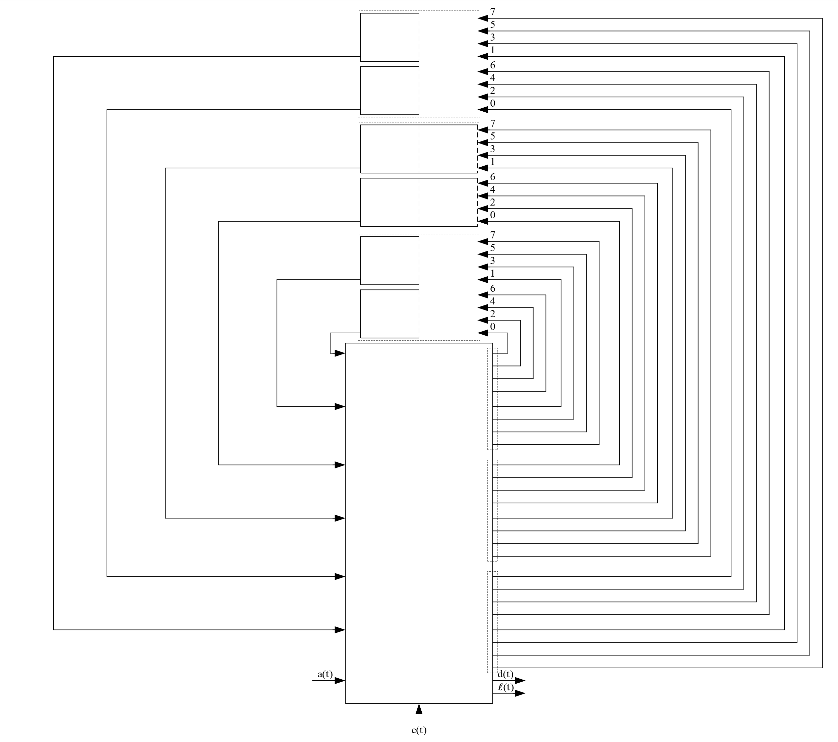
An Example: k=3, m=2, s=1, n=4
t = 0
c(t) = 0
B₁=1
Ψ₁={1, 2}
B₂=2
Ψ₂={3, 4, 5}
B₃=1
Ψ₃={6, 7}
u₁(t)=0
u₂(t)=0
u₃(t)=0

Slide 42
An Example: k=3, m=2, s=1, n=4
t = 1
c(t) = 0
B₁=1
Ψ₁={1, 2}
B₂=2
Ψ₂={3, 4, 5}
B₃=1
Ψ₃={6, 7}
1∈Ψ₁
u₁(t-1) mod 8 = 0
u₁(t-1)=0
u₂(t-1)=0
u₃(t-1)=0
1

Slide 43
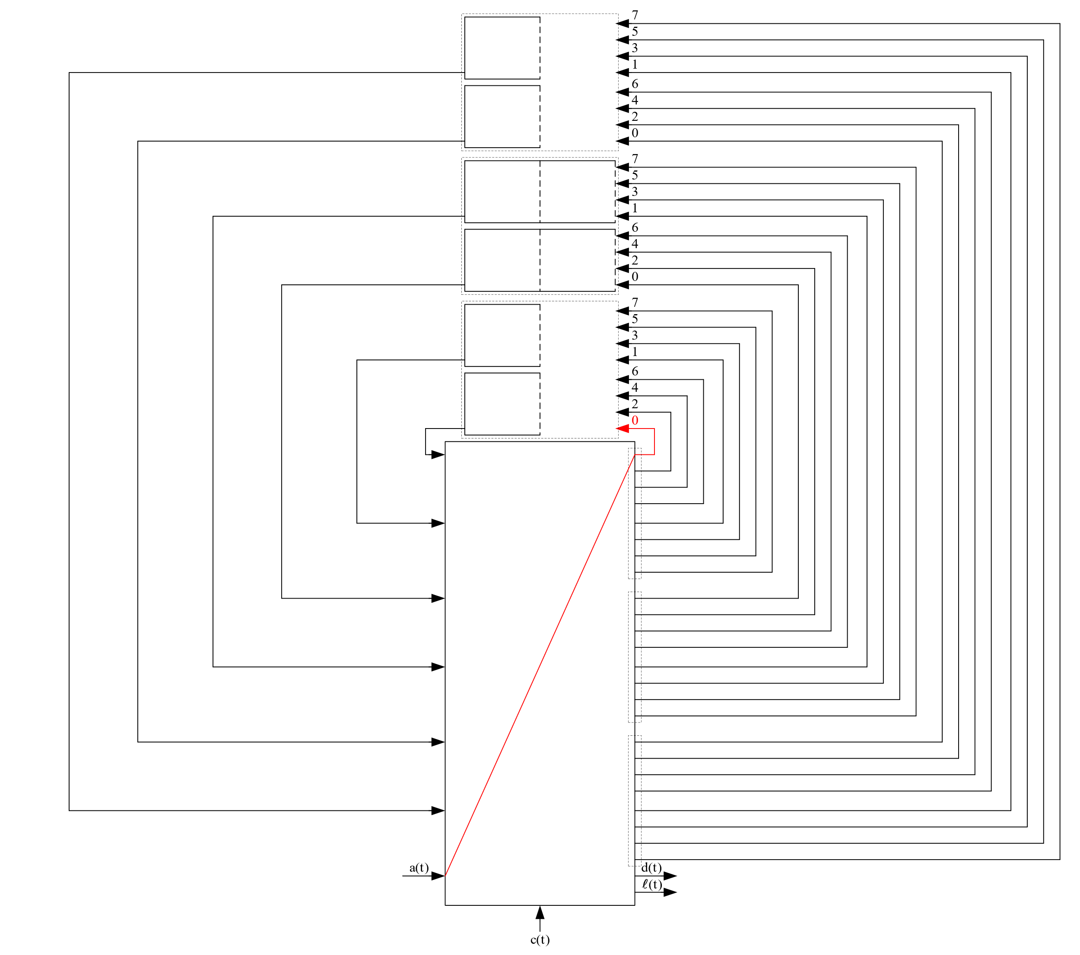
An Example: k=3, m=2, s=1, n=4
t = 1
c(t) = 0
B₁=1
Ψ₁={1, 2}
B₂=2
Ψ₂={3, 4, 5}
B₃=1
Ψ₃={6, 7}
u₁(t-1)=0
u₂(t-1)=0
u₃(t-1)=0
1

Slide 44
An Example: k=3, m=2, s=1, n=4
t = 1
c(t) = 0
B₁=1
Ψ₁={1, 2}
B₂=2
Ψ₂={3, 4, 5}
B₃=1
Ψ₃={6, 7}
1
u₁(t)=1
u₂(t)=0
u₃(t)=0

Slide 45
An Example: k=3, m=2, s=1, n=4
t = 2
c(t) = 0
B₁=1
Ψ₁={1, 2}
B₂=2
Ψ₂={3, 4, 5}
B₃=1
Ψ₃={6, 7}
1
2
u₁(t-1)=1
u₂(t-1)=0
u₃(t-1)=0
1

Slide 46
An Example: k=3, m=2, s=1, n=4
t = 2
c(t) = 0
B₁=1
Ψ₁={1, 2}
B₂=2
Ψ₂={3, 4, 5}
B₃=1
Ψ₃={6, 7}
2
1, 2∈Ψ₁
u₁(t-1) mod 8 = 1
u₁(t-1)+1 mod 8 = 2
u₁(t-1)=1
u₂(t-1)=0
u₃(t-1)=0
1

Slide 47
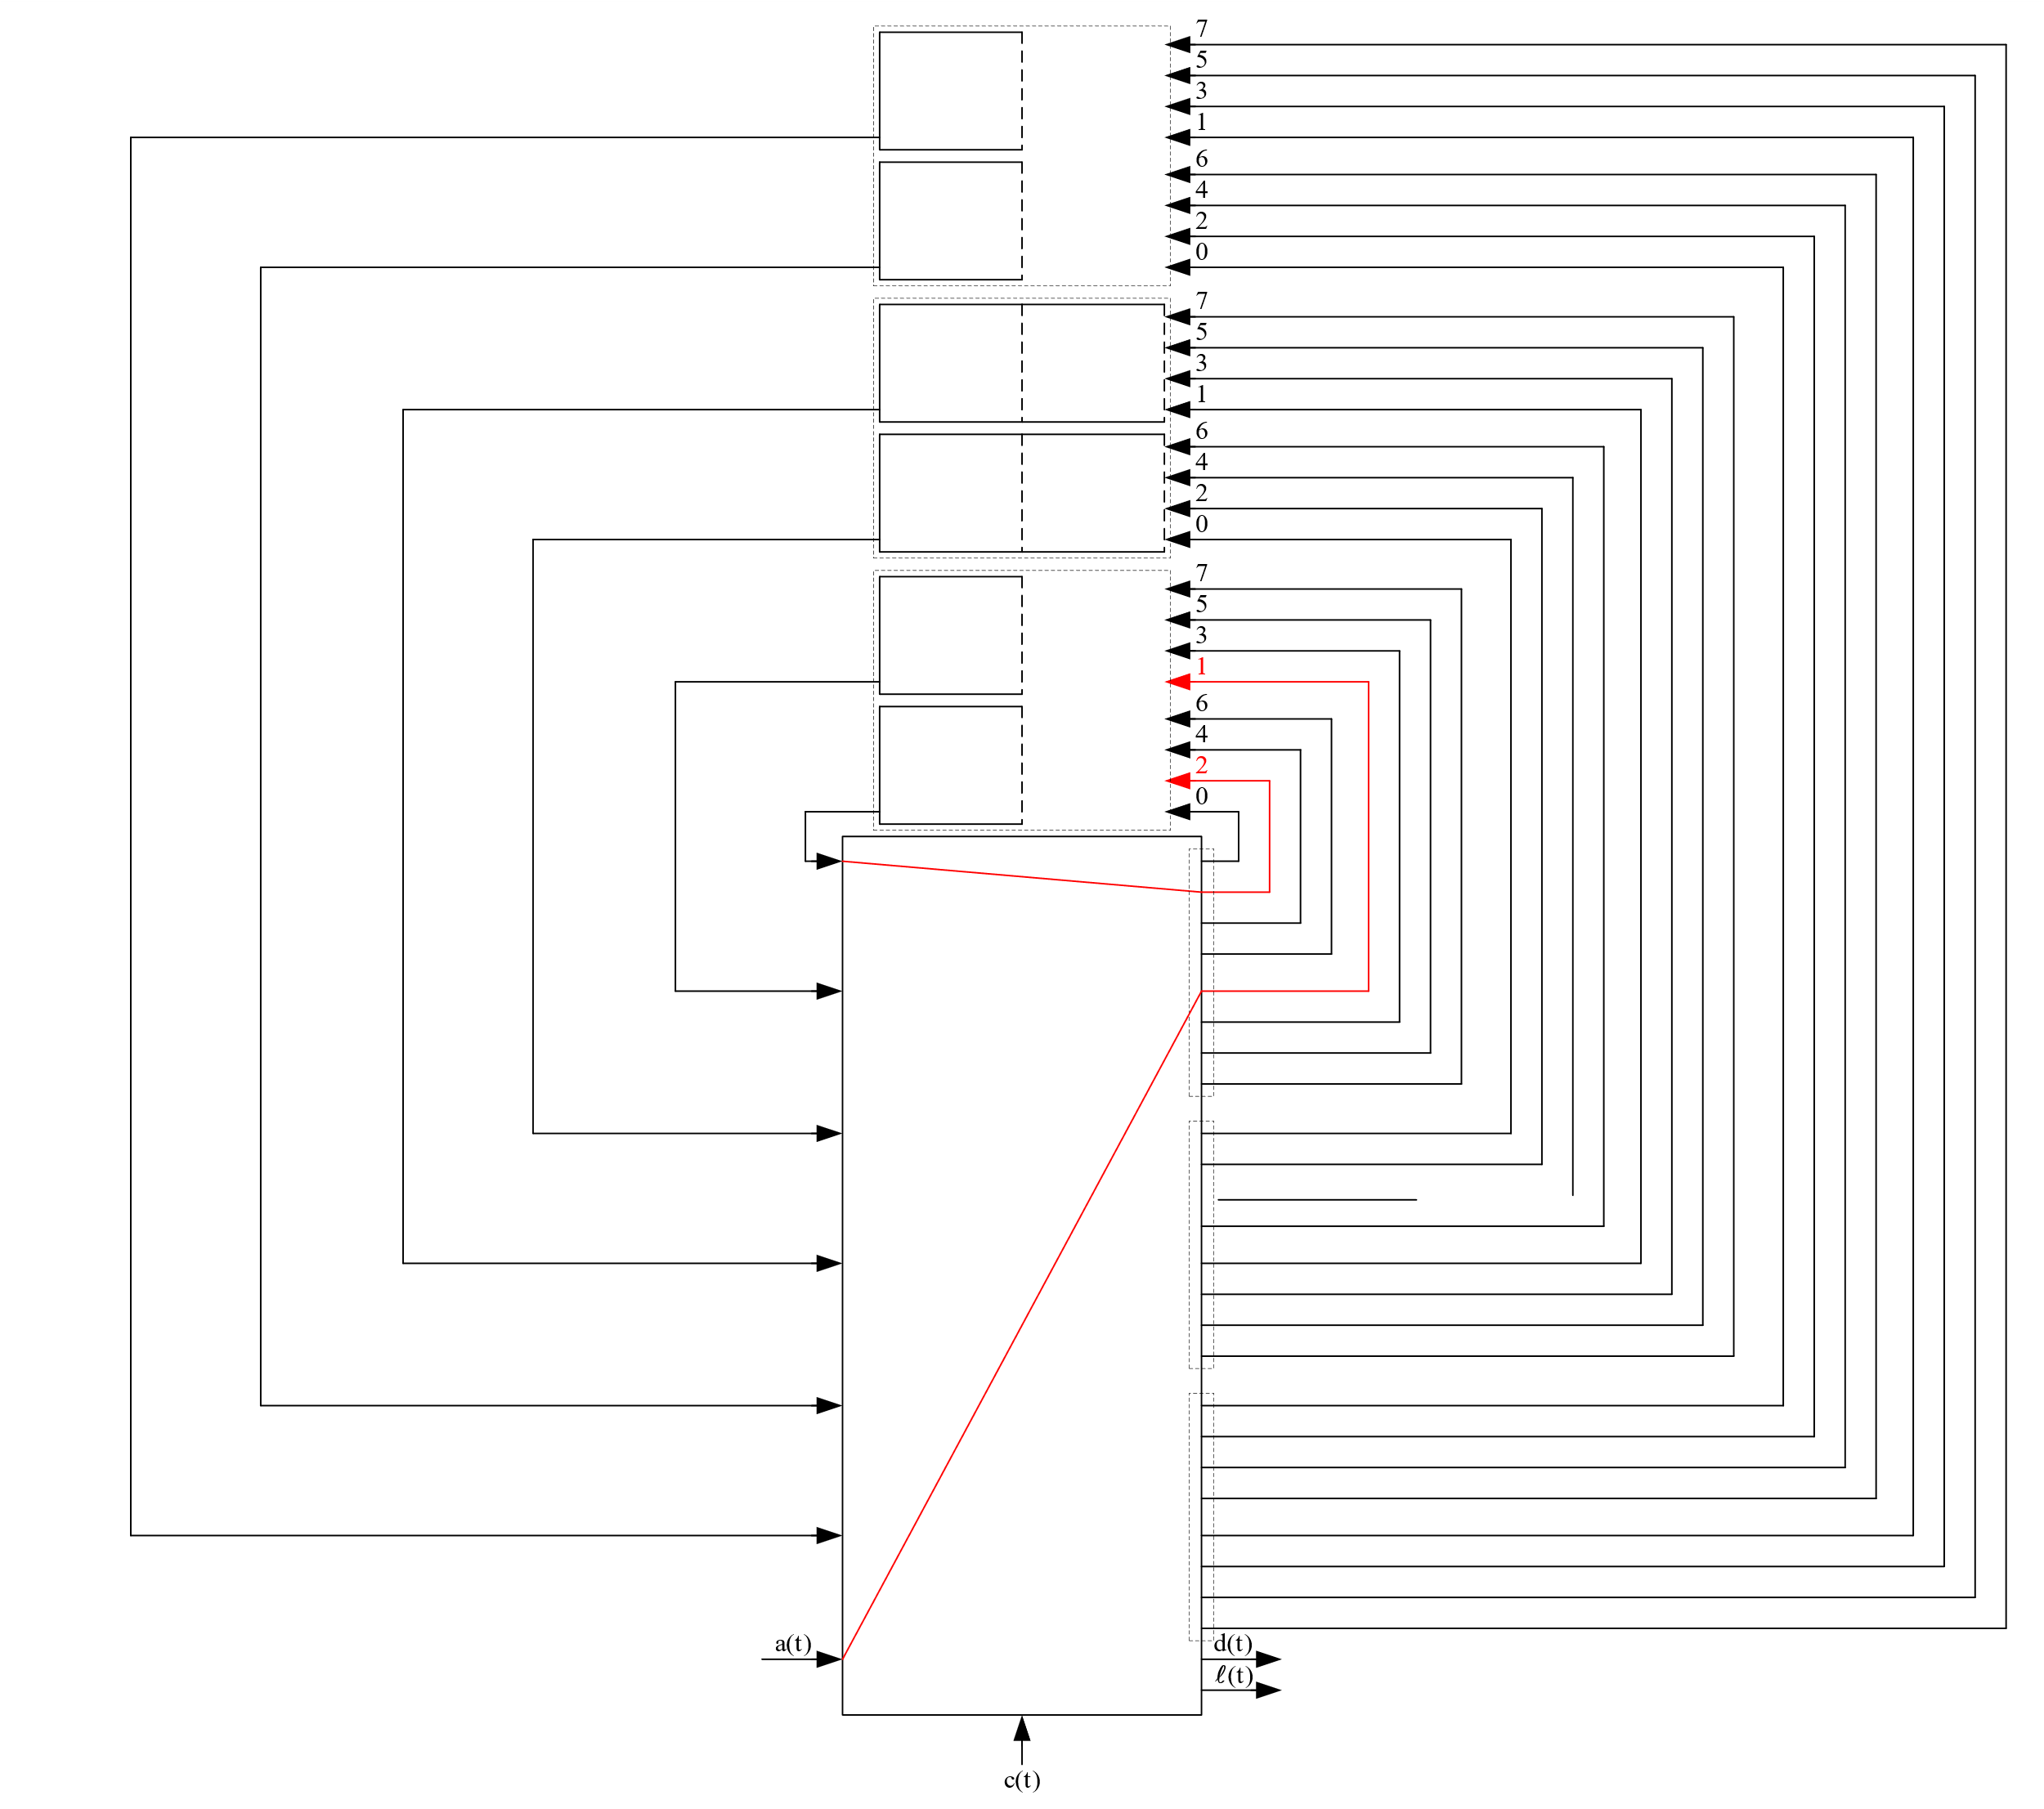
An Example: k=3, m=2, s=1, n=4
t = 2
c(t) = 0
B₁=1
Ψ₁={1, 2}
B₂=2
Ψ₂={3, 4, 5}
B₃=1
Ψ₃={6, 7}
2
u₁(t-1)=1
u₂(t-1)=0
u₃(t-1)=0
1

Slide 48
An Example: k=3, m=2, s=1, n=4
t = 2
c(t) = 0
B₁=1
Ψ₁={1, 2}
B₂=2
Ψ₂={3, 4, 5}
1
B₃=1
Ψ₃={6, 7}
2
u₁(t)=3
u₂(t)=0
u₃(t)=0

Slide 49
An Example: k=3, m=2, s=1, n=4
t = 3
c(t) = 0
B₁=1
Ψ₁={1, 2}
B₂=2
Ψ₂={3, 4, 5}
1
2
B₃=1
Ψ₃={6, 7}
2
3
u₁(t-1)=3
u₂(t-1)=0
u₃(t-1)=0
1

Slide 50
An Example: k=3, m=2, s=1, n=4
t = 3
c(t) = 0
B₁=1
Ψ₁={1, 2}
B₂=2
Ψ₂={3, 4, 5}
2
B₃=1
Ψ₃={6, 7}
3
1, 2∈Ψ₁
u₁(t-1) mod 8 = 3
u₁(t-1)+1 mod 8 = 4
u₁(t-1)=3
3∈Ψ₂
u₂(t-1) mod 8 = 0
u₂(t-1)=0
u₃(t-1)=0
1

Slide 51
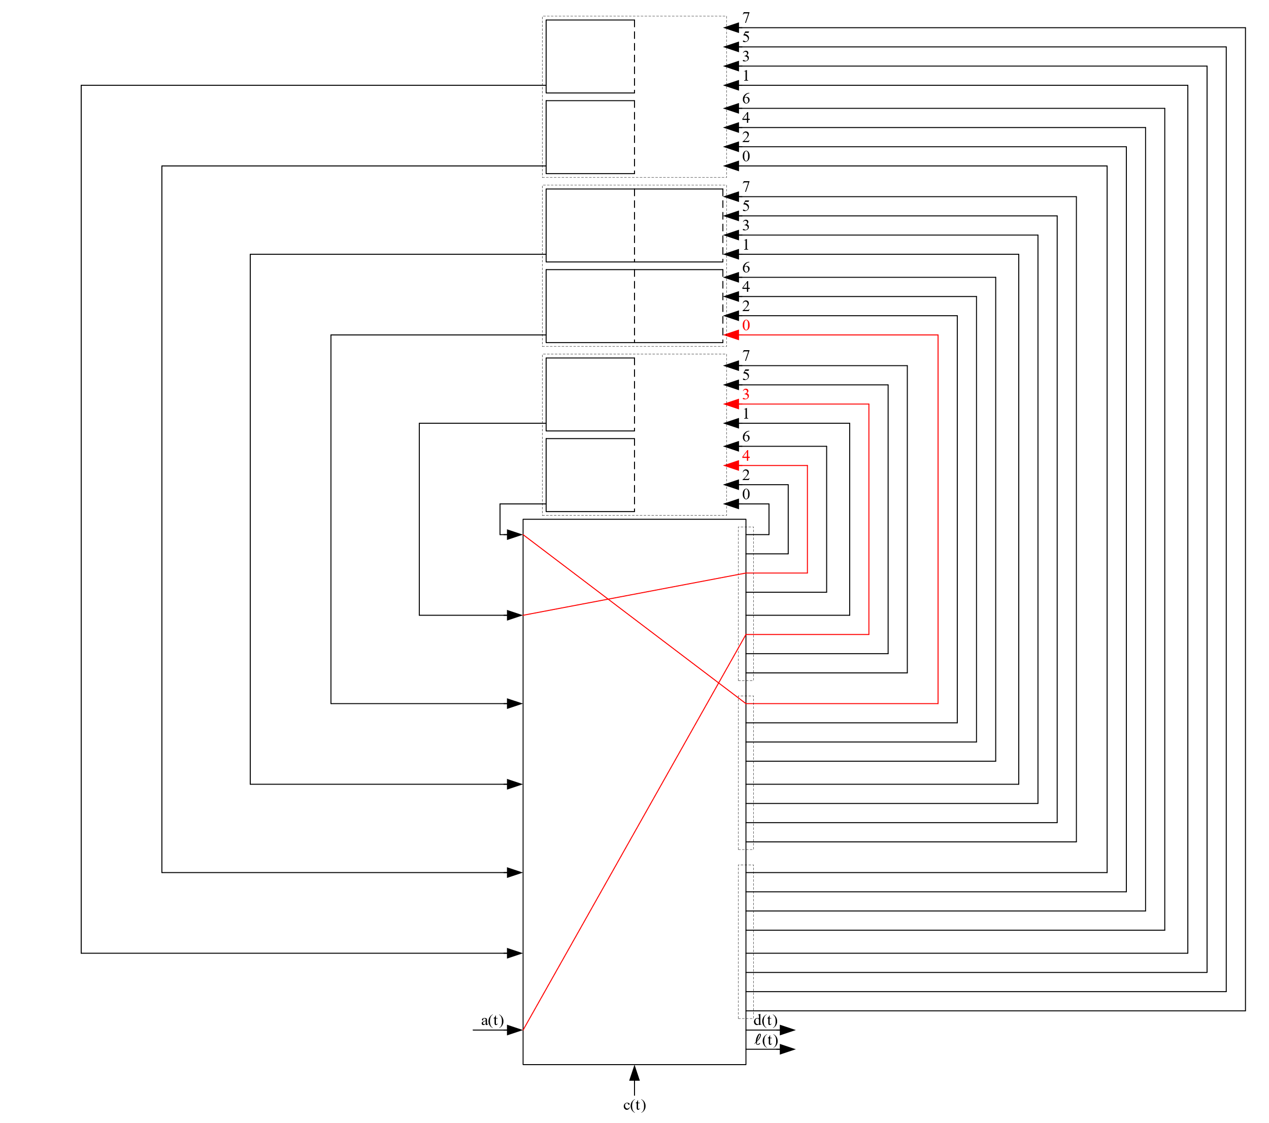
An Example: k=3, m=2, s=1, n=4
t = 3
c(t) = 0
B₁=1
Ψ₁={1, 2}
B₂=2
Ψ₂={3, 4, 5}
B₃=1
Ψ₃={6, 7}
3
2
u₁(t-1)=3
u₂(t-1)=0
u₃(t-1)=0
1

Slide 52
An Example: k=3, m=2, s=1, n=4
t = 3
c(t) = 0
B₁=1
Ψ₁={1, 2}
3
B₂=2
Ψ₂={3, 4, 5}
1
B₃=1
Ψ₃={6, 7}
2
u₁(t)=5
u₂(t)=1
u₃(t)=0

Slide 53
An Example: k=3, m=2, s=1, n=4
t = 4
c(t) = 0
B₁=1
Ψ₁={1, 2}
3
B₂=2
Ψ₂={3, 4, 5}
1
B₃=1
Ψ₃={6, 7}
2
u₁(t-1)=5
u₂(t-1)=1
u₃(t-1)=0
4

Slide 54
An Example: k=3, m=2, s=1, n=4
t = 4
c(t) = 0
B₁=1
Ψ₁={1, 2}
3
B₂=2
Ψ₂={3, 4, 5}
1
B₃=1
Ψ₃={6, 7}
2
1, 2∈Ψ₁
u₁(t-1) mod 8 = 5
u₁(t-1)+1 mod 8 = 6
u₁(t-1)=5
3, 4∈Ψ₂
u₂(t-1) mod 8 = 1
u₂(t-1)+1 mod 8 = 2
u₂(t-1)=1
u₃(t-1)=0
4

Slide 55
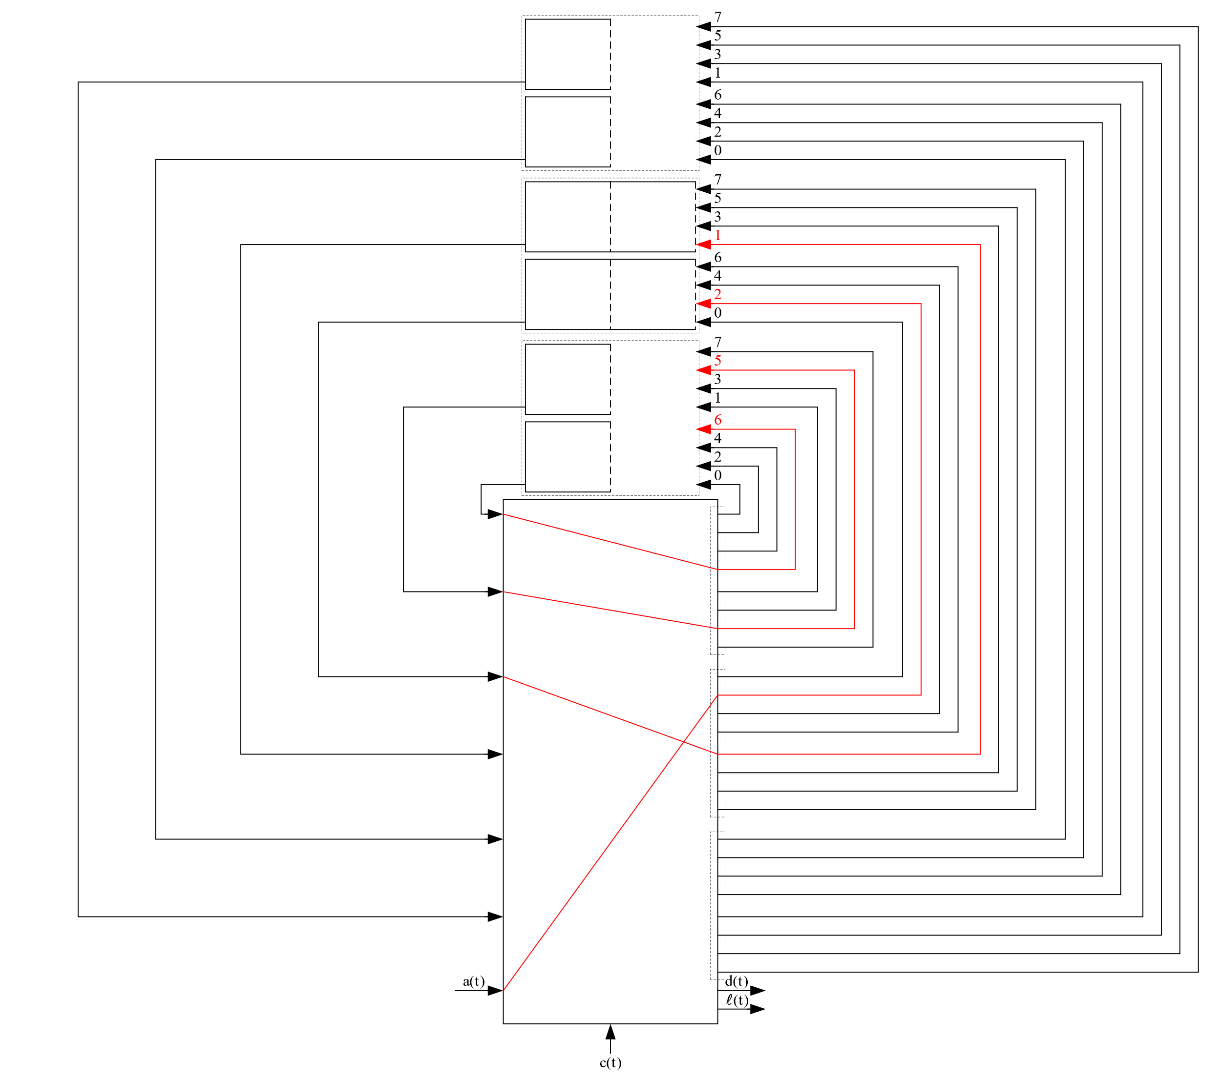
An Example: k=3, m=2, s=1, n=4
t = 4
c(t) = 0
B₁=1
Ψ₁={1, 2}
B₂=2
Ψ₂={3, 4, 5}
B₃=1
Ψ₃={6, 7}
2
1
u₁(t-1)=5
3
u₂(t-1)=1
u₃(t-1)=0
4

Slide 56
An Example: k=3, m=2, s=1, n=4
t = 4
c(t) = 0
3
B₁=1
Ψ₁={1, 2}
4
B₂=2
Ψ₂={3, 4, 5}
1
B₃=1
Ψ₃={6, 7}
2
u₁(t)=7
u₂(t)=3
u₃(t)=0

Slide 57
An Example: k=3, m=2, s=1, n=4
t = 5
c(t) = 0
3
4
B₁=1
Ψ₁={1, 2}
4
5
B₂=2
Ψ₂={3, 4, 5}
1
B₃=1
Ψ₃={6, 7}
2
u₁(t-1)=7
u₂(t-1)=3
u₃(t-1)=0
3

Slide 58
An Example: k=3, m=2, s=1, n=4
t = 5
c(t) = 0
4
B₁=1
Ψ₁={1, 2}
5
B₂=2
Ψ₂={3, 4, 5}
1
B₃=1
Ψ₃={6, 7}
2
1, 2∈Ψ₁
u₁(t-1) mod 8 = 7
u₁(t-1)+1 mod 8 = 0
u₁(t-1)=7
3, 4, 5∈Ψ₂
u₂(t-1) mod 8 = 3
u₂(t-1)+1 mod 8 = 4
u₂(t-1)+2 mod 8 = 5
u₂(t-1)=3
u₃(t-1)=0
3

Slide 59
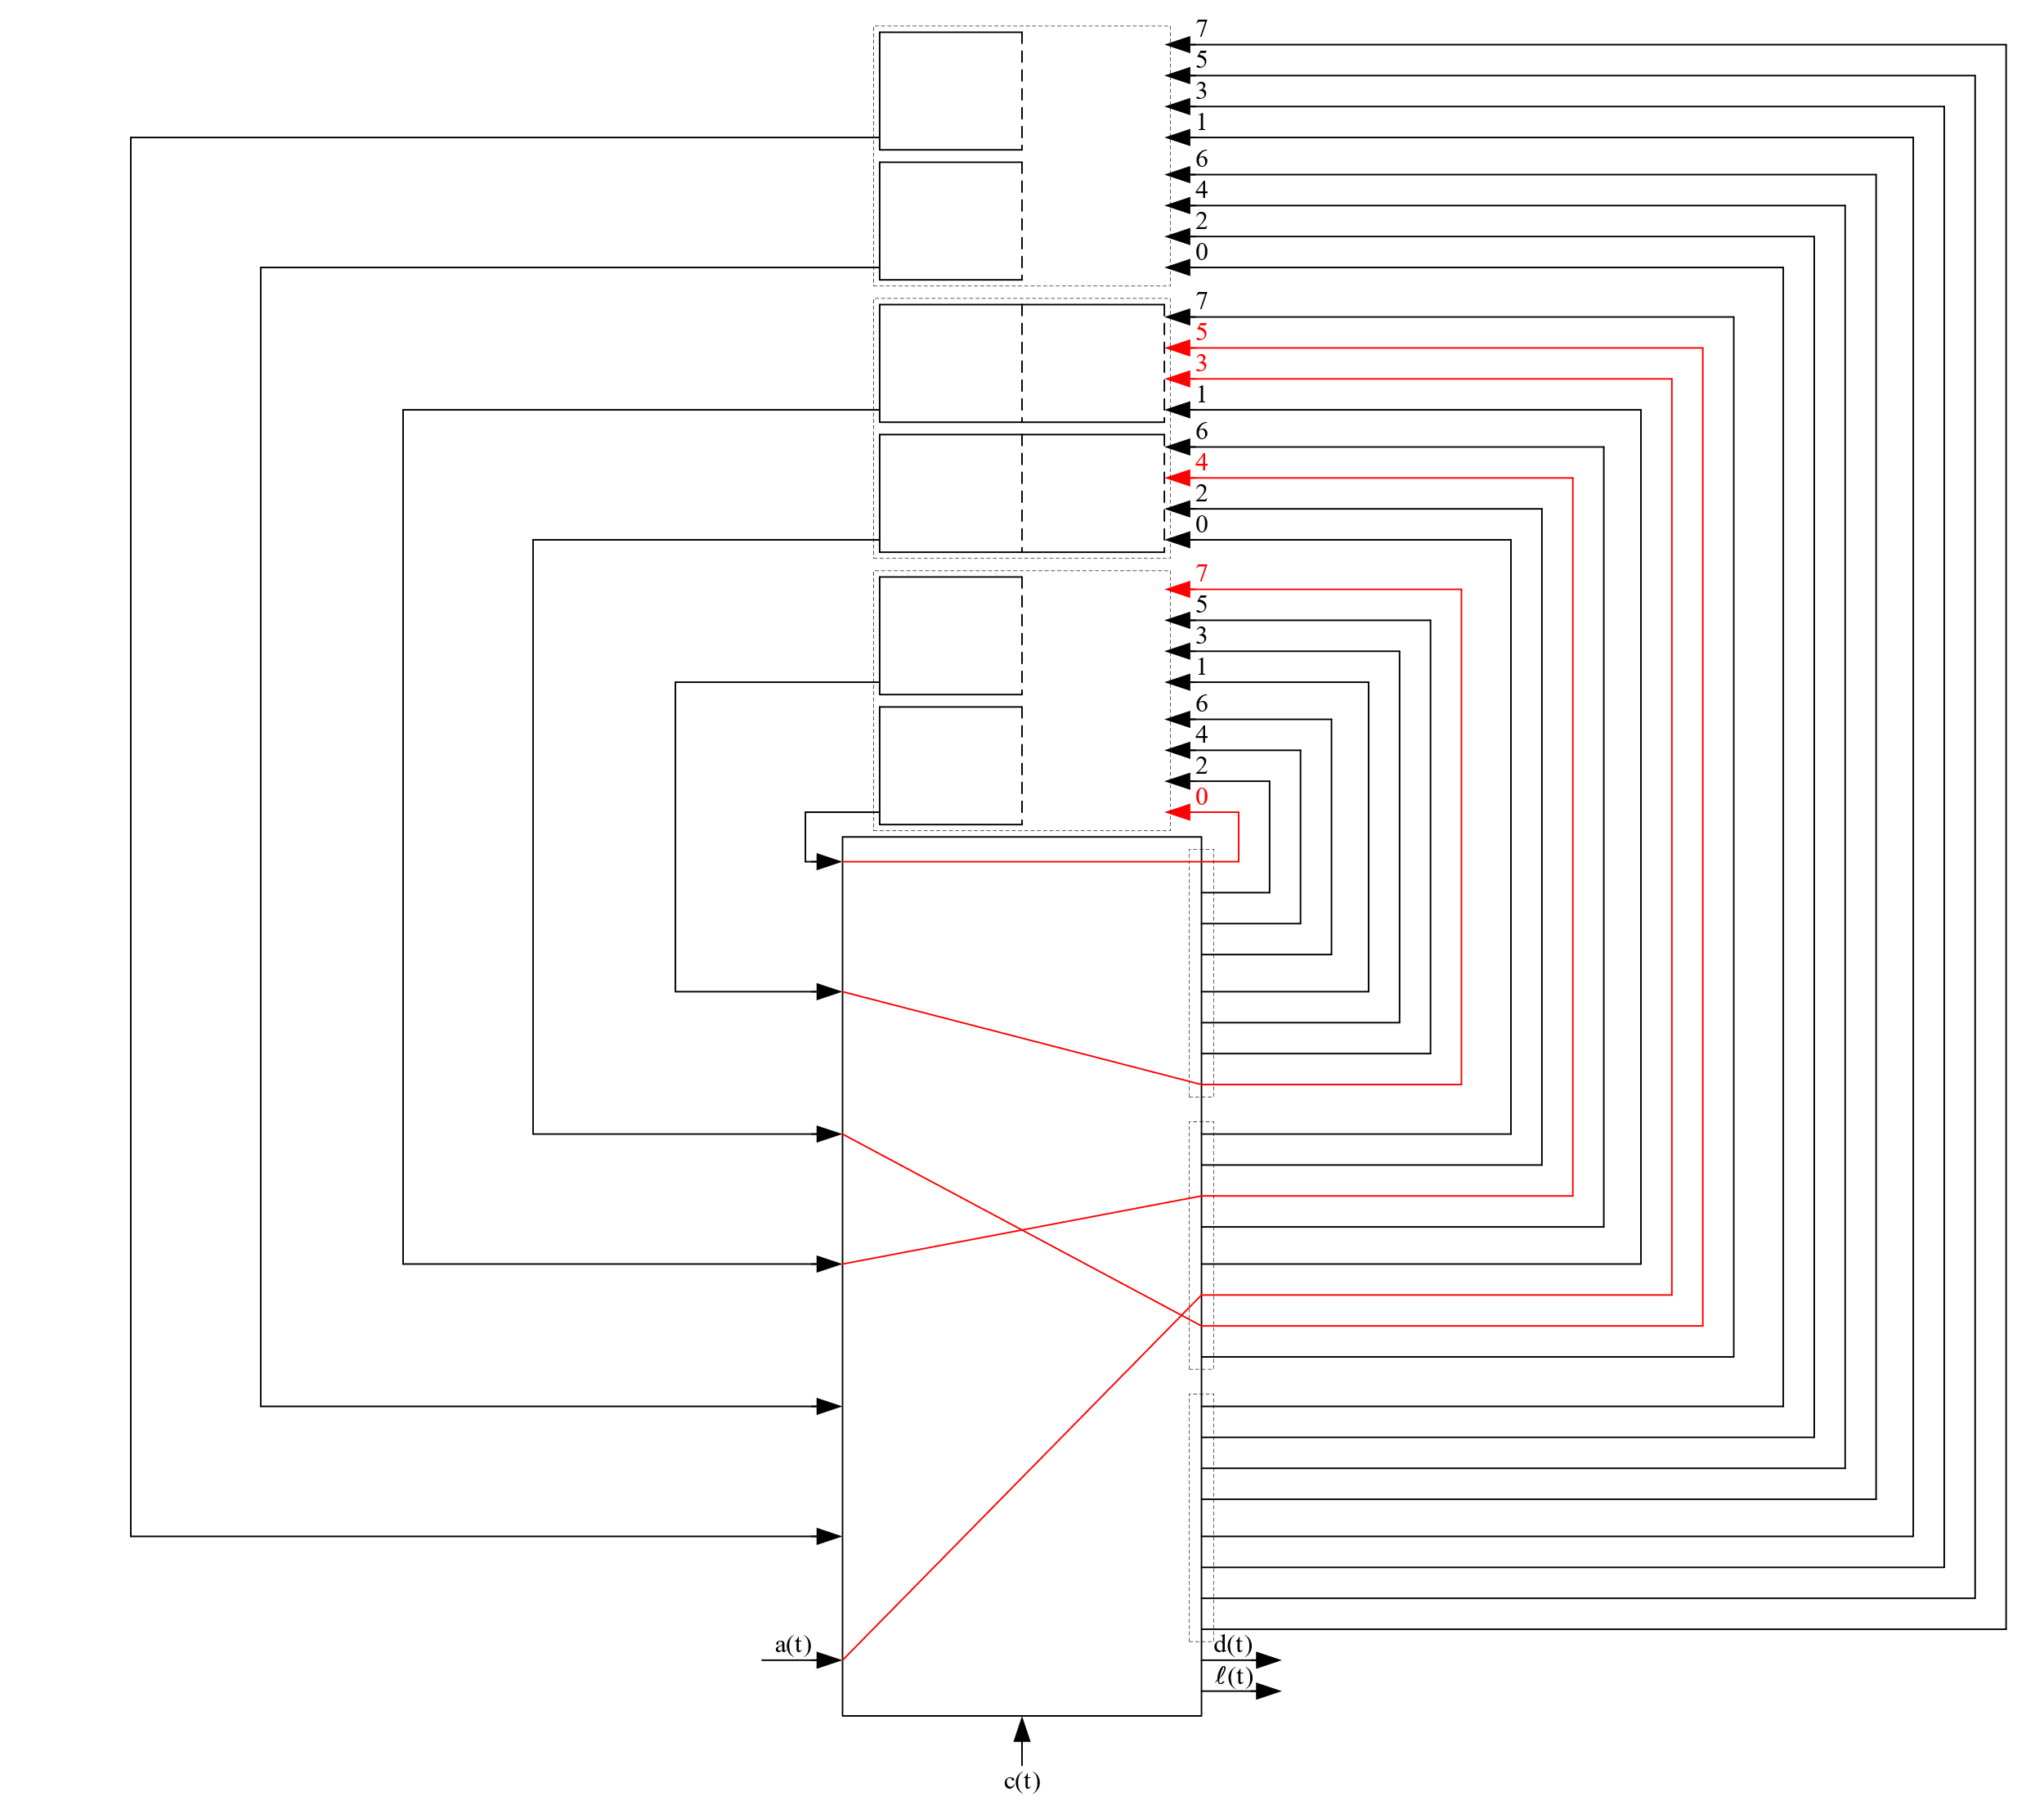
An Example: k=3, m=2, s=1, n=4
t = 5
c(t) = 0
B₁=1
Ψ₁={1, 2}
B₂=2
Ψ₂={3, 4, 5}
B₃=1
Ψ₃={6, 7}
2
1
u₁(t-1)=7
5
4
u₂(t-1)=3
u₃(t-1)=0
3

Slide 60
An Example: k=3, m=2, s=1, n=4
t = 5
c(t) = 0
3
5
B₁=1
Ψ₁={1, 2}
4
B₂=2
Ψ₂={3, 4, 5}
1
B₃=1
Ψ₃={6, 7}
2
u₁(t)=1
u₂(t)=6
u₃(t)=0

Slide 61
An Example: k=3, m=2, s=1, n=4
t = 6
c(t) = 0
3
5
B₁=1
Ψ₁={1, 2}
4
B₂=2
Ψ₂={3, 4, 5}
1
B₃=1
Ψ₃={6, 7}
2
u₁(t-1)=1
u₂(t-1)=6
u₃(t-1)=0
6

Slide 62
An Example: k=3, m=2, s=1, n=4
t = 6
c(t) = 0
3
5
B₁=1
Ψ₁={1, 2}
4
B₂=2
Ψ₂={3, 4, 5}
1
B₃=1
Ψ₃={6, 7}
2
1, 2∈Ψ₁
u₁(t-1) mod 8 = 1
u₁(t-1)+1 mod 8 = 2
u₁(t-1)=1
3, 4∈Ψ₂
u₂(t-1) mod 8 = 6
u₂(t-1)+1 mod 8 = 7
u₂(t-1)=6
6∈Ψ₃
u₃(t-1) mod 8 = 0
u₃(t-1)=0
6

Slide 63
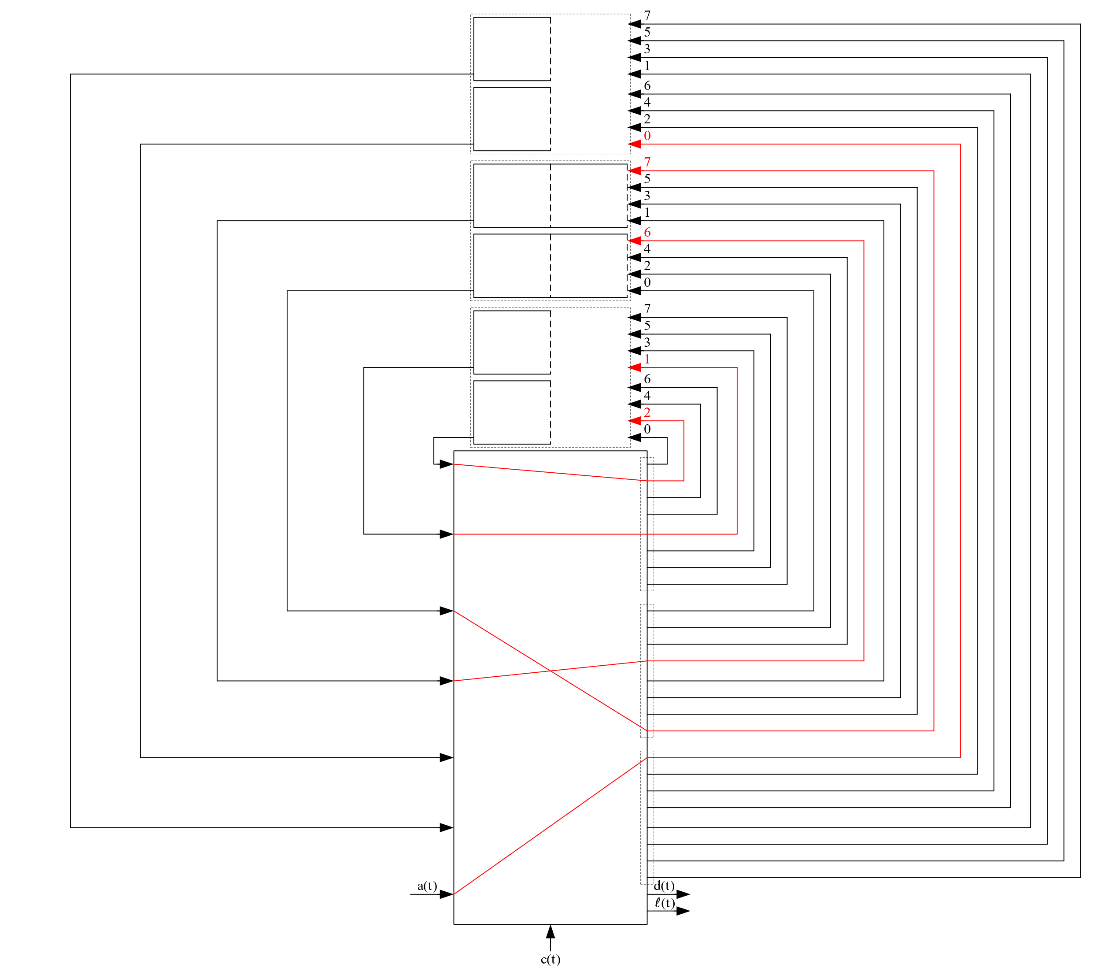
An Example: k=3, m=2, s=1, n=4
t = 6
c(t) = 0
5
B₁=1
Ψ₁={1, 2}
B₂=2
Ψ₂={3, 4, 5}
B₃=1
Ψ₃={6, 7}
2
1
u₁(t-1)=1
4
3
u₂(t-1)=6
u₃(t-1)=0
6

Slide 64
An Example: k=3, m=2, s=1, n=4
t = 6
6
c(t) = 0
5
4
B₁=1
Ψ₁={1, 2}
3
B₂=2
Ψ₂={3, 4, 5}
1
B₃=1
Ψ₃={6, 7}
2
u₁(t)=3
u₂(t)=0
u₃(t)=1

Slide 65
An Example: k=3, m=2, s=1, n=4
t = 7
6
c(t) = 0
5
4
B₁=1
Ψ₁={1, 2}
3
B₂=2
Ψ₂={3, 4, 5}
1
B₃=1
Ψ₃={6, 7}
2
u₁(t-1)=3
u₂(t-1)=0
u₃(t-1)=1
7

Slide 66
An Example: k=3, m=2, s=1, n=4
t = 7
6
c(t) = 0
5
4
B₁=1
Ψ₁={1, 2}
3
B₂=2
Ψ₂={3, 4, 5}
1
B₃=1
Ψ₃={6, 7}
2
1, 2∈Ψ₁
u₁(t-1) mod 8 = 3
u₁(t-1)+1 mod 8 = 4
u₁(t-1)=3
3, 5∈Ψ₂
u₂(t-1) mod 8 = 0
u₂(t-1)+1 mod 8 = 1
u₂(t-1)=0
6, 7∈Ψ₃
u₃(t-1) mod 8 = 1
u₃(t-1)+1 mod 8 = 2
u₃(t-1)=1
7

Slide 67
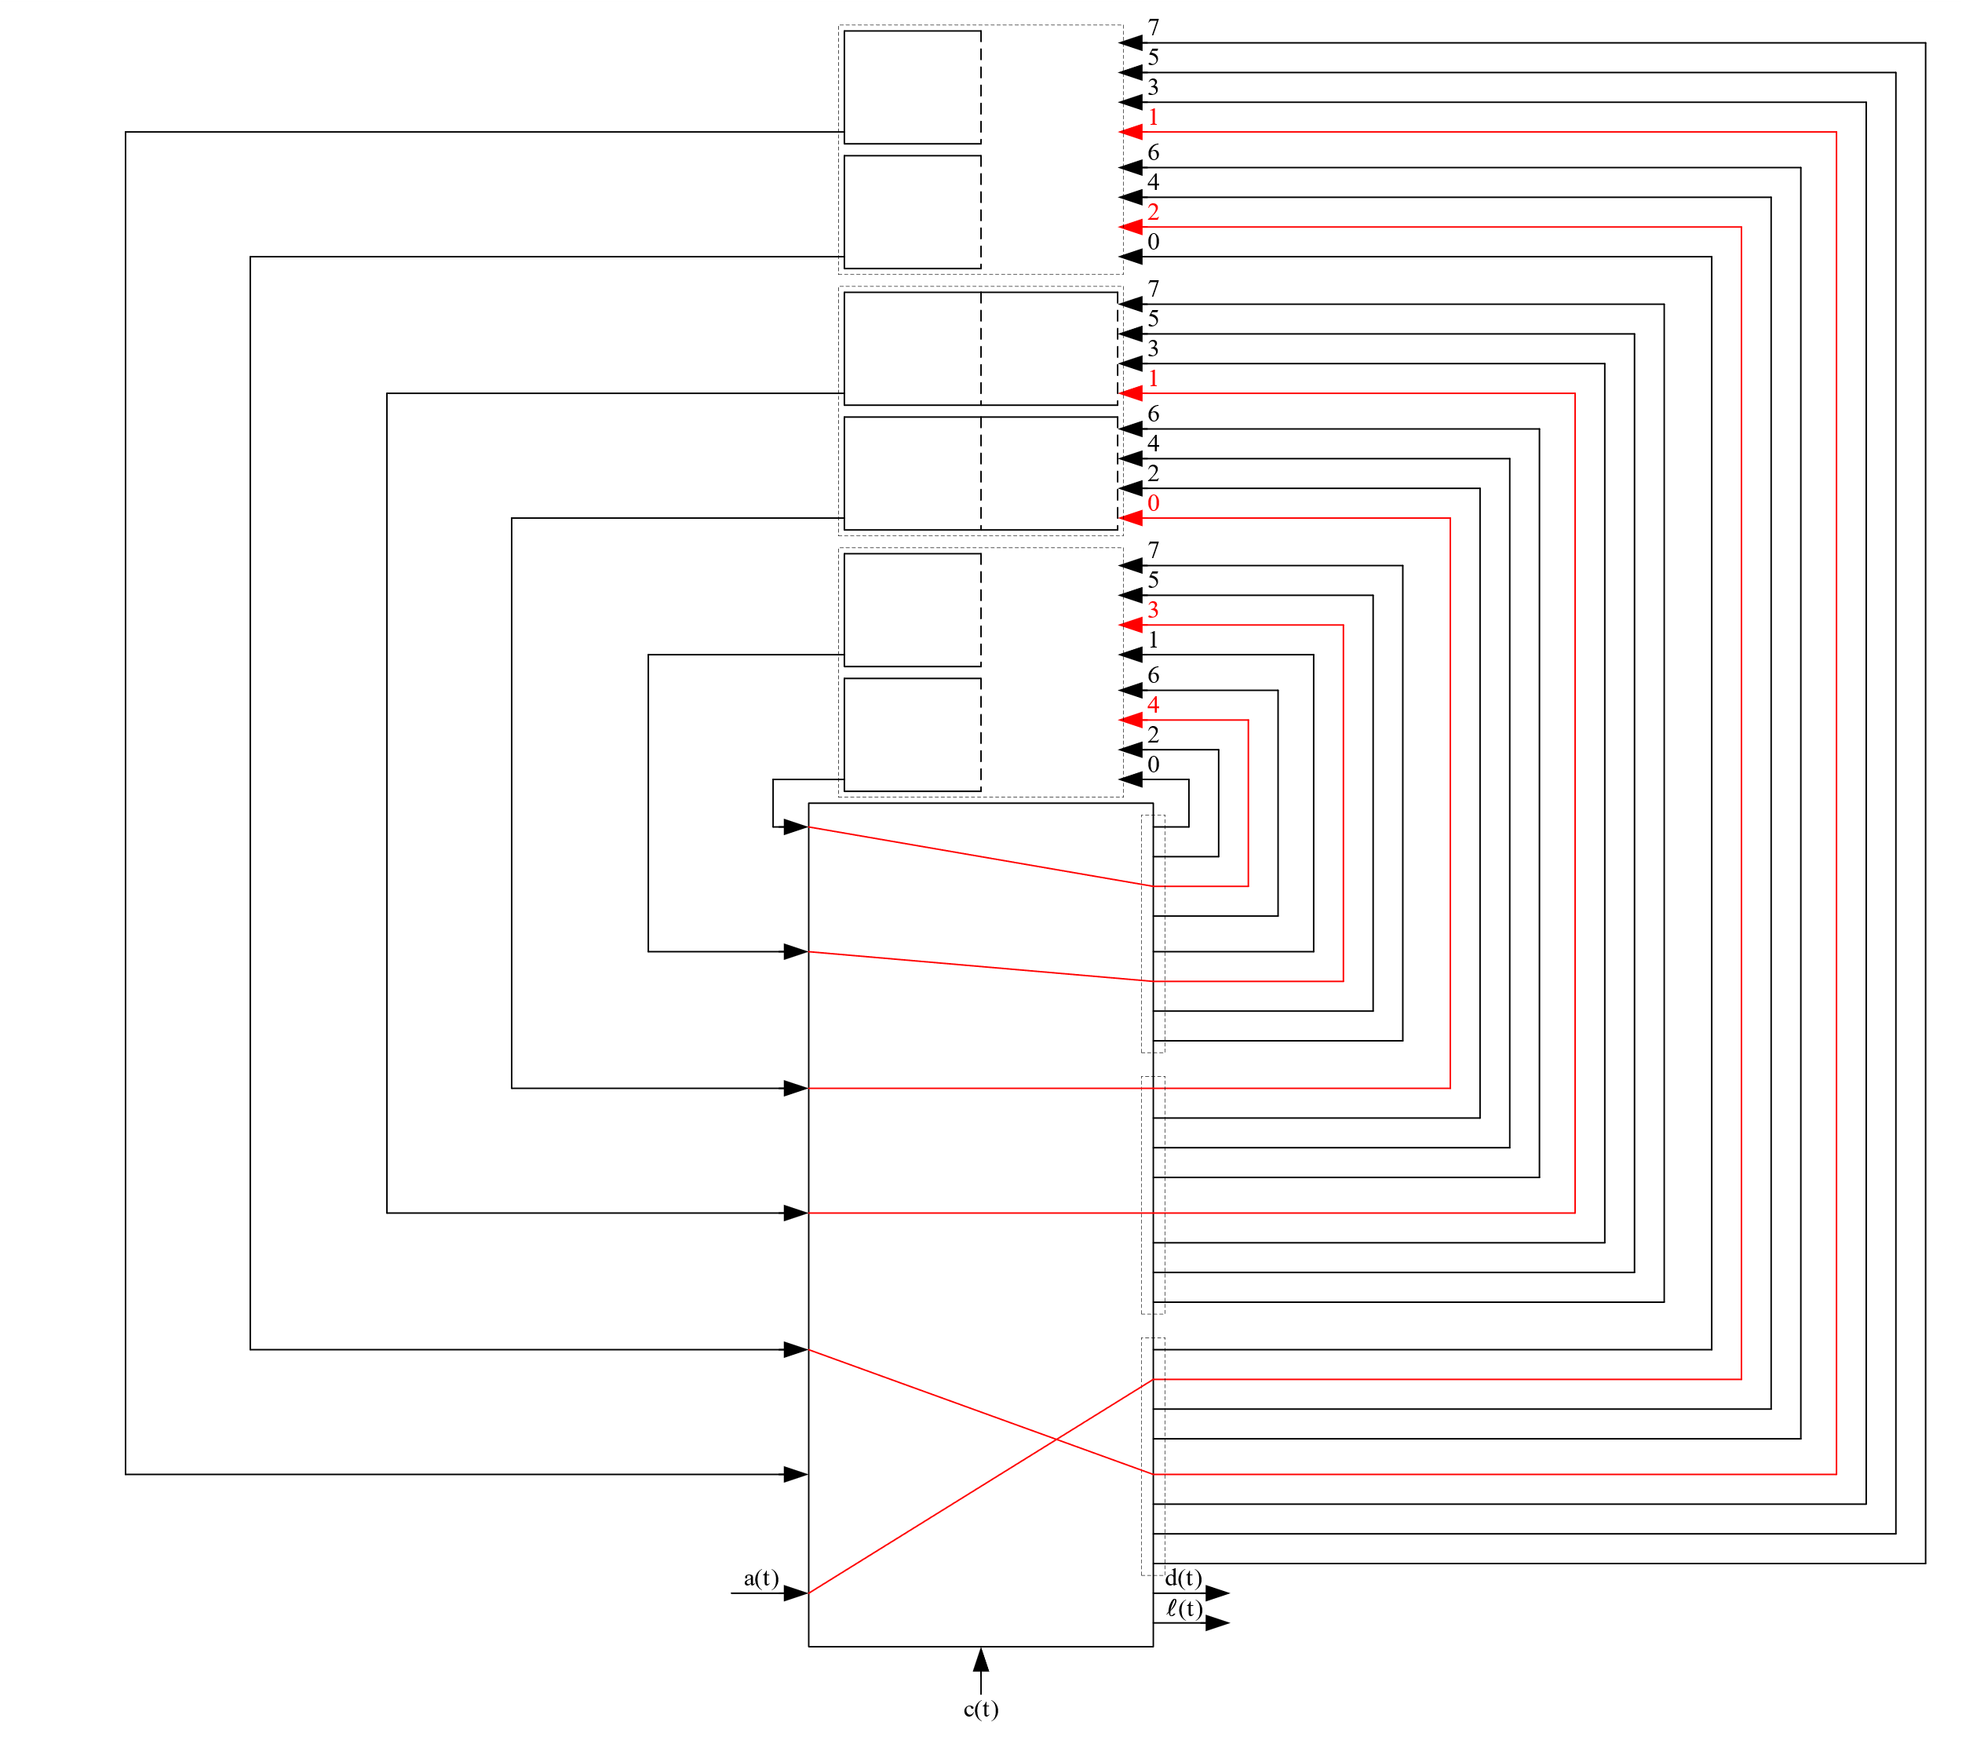
An Example: k=3, m=2, s=1, n=4
t = 7
c(t) = 0
4
B₁=1
Ψ₁={1, 2}
B₂=2
Ψ₂={3, 4, 5}
B₃=1
Ψ₃={6, 7}
2
1
u₁(t-1)=3
3
5
u₂(t-1)=0
6
u₃(t-1)=1
7

Slide 68
An Example: k=3, m=2, s=1, n=4
6
t = 7
7
c(t) = 0
4
5
B₁=1
Ψ₁={1, 2}
3
B₂=2
Ψ₂={3, 4, 5}
1
B₃=1
Ψ₃={6, 7}
2
u₁(t)=5
u₂(t)=2
u₃(t)=3

Slide 69
An Example: k=3, m=2, s=1, n=4
6
7
t = 8
7
8
c(t) = 1
4
5
6
B₁=1
Ψ₁={1, 2}
3
B₂=2
Ψ₂={3, 4, 5}
1
B₃=1
Ψ₃={6, 7}
2
u₁(t-1)=5
u₂(t-1)=2
u₃(t-1)=3
5

Slide 70
An Example: k=3, m=2, s=1, n=4
7
t = 8
8
c(t) = 1
4
6
B₁=1
Ψ₁={1, 2}
3
B₂=2
Ψ₂={3, 4, 5}
1
B₃=1
Ψ₃={6, 7}
2
u₁(t-1)=5
u₂(t-1)=2
u₃(t-1)=3
5

Slide 71
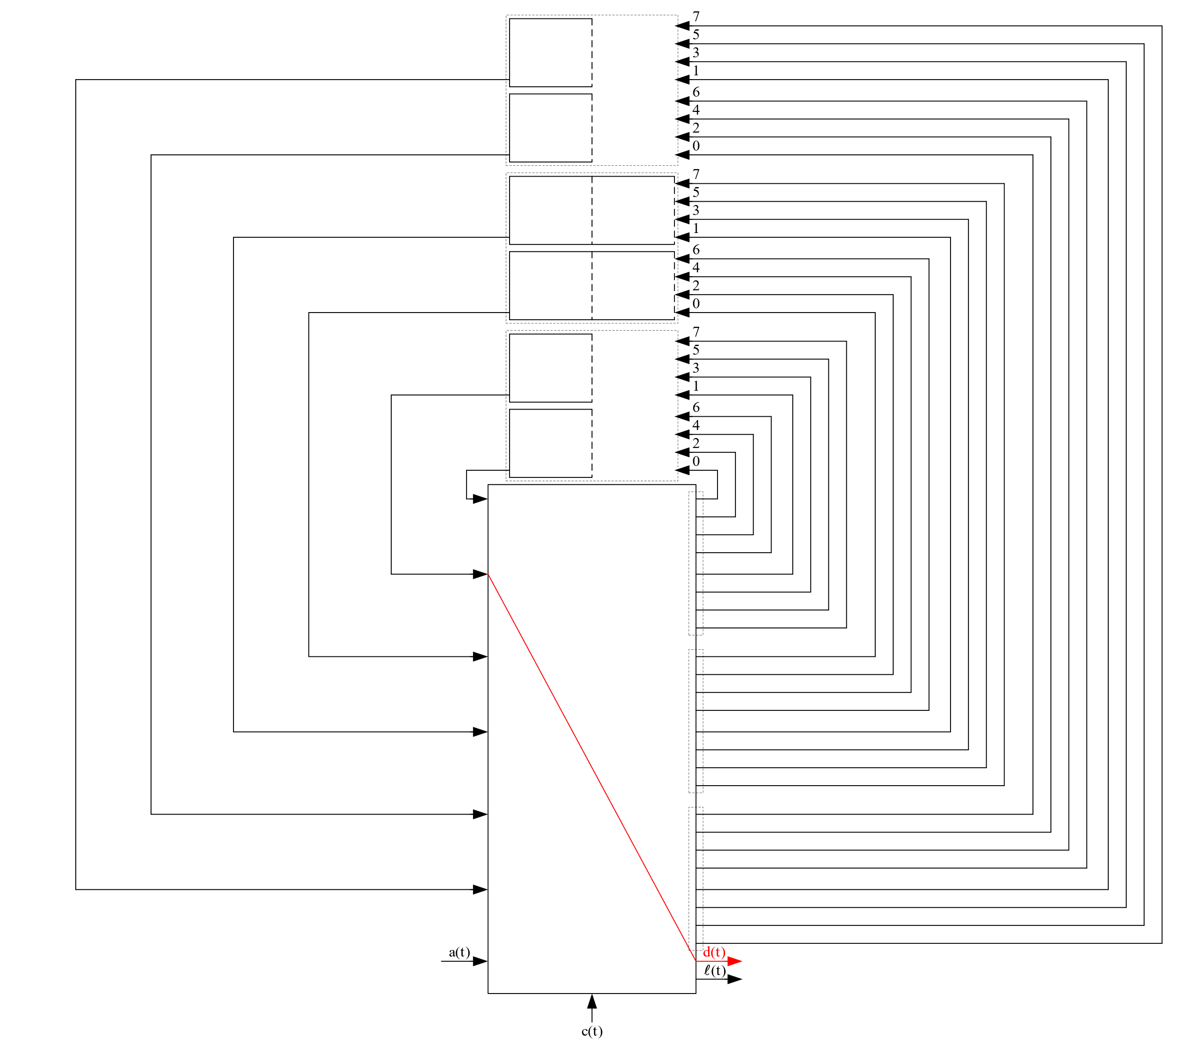
An Example: k=3, m=2, s=1, n=4
t = 8
c(t) = 1
6
5
B₁=1
Ψ₁={1, 2}
B₂=2
Ψ₂={3, 4, 5}
B₃=1
Ψ₃={6, 7}
2
1
1
u₁(t-1)=5
3
2
4
u₂(t-1)=2
3
8
7
7
u₃(t-1)=3
6
5
4

Slide 72
An Example: k=3, m=2, s=1, n=4
t = 8
c(t) = 1
5
B₁=1
Ψ₁={1, 2}
B₂=2
Ψ₂={3, 4, 5}
B₃=1
Ψ₃={6, 7}
1, 2∈Ψ₁
u₁(t-1) mod 8 = 5
u₁(t-1)+1 mod 8 = 6
1
u₁(t-1)=5
3, 4∈Ψ₂
u₂(t-1) mod 8 = 2
u₂(t-1)+1 mod 8 = 3
2
3
u₂(t-1)=2
6, 7∈Ψ₃
u₃(t-1) mod 8 = 3
u₃(t-1)+1 mod 8 = 4
7
6
u₃(t-1)=3
4
1

Slide 73
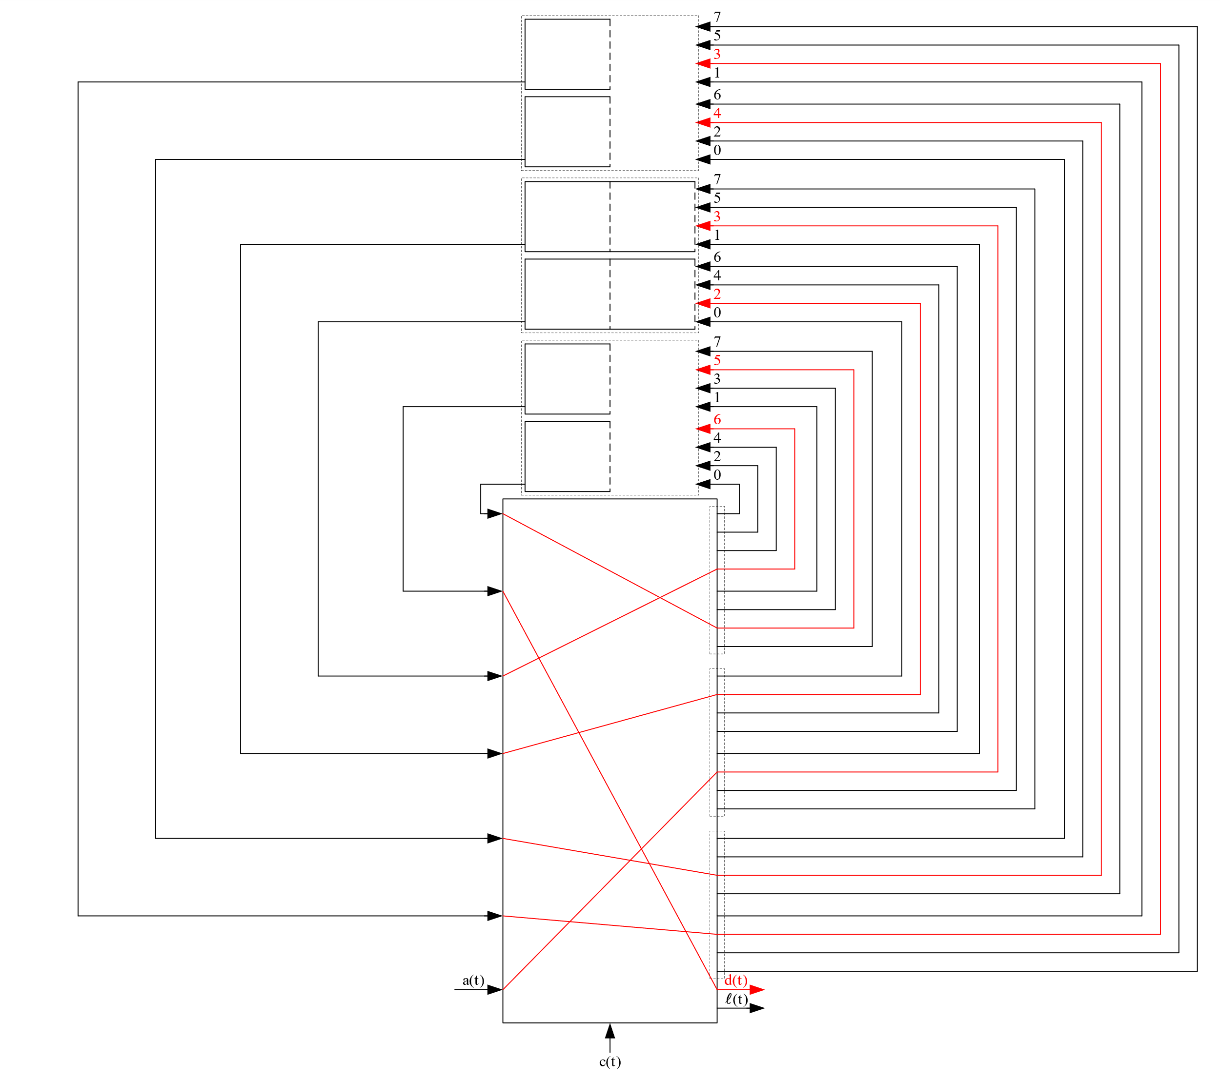
An Example: k=3, m=2, s=1, n=4
t = 8
c(t) = 1
5
B₁=1
Ψ₁={1, 2}
B₂=2
Ψ₂={3, 4, 5}
B₃=1
Ψ₃={6, 7}
1
u₁(t-1)=5
2
3
u₂(t-1)=2
7
6
u₃(t-1)=3
4
1

Slide 74
An Example: k=3, m=2, s=1, n=4
6
t = 8
7
c(t) = 1
5
4
B₁=1
Ψ₁={1, 2}
3
B₂=2
Ψ₂={3, 4, 5}
1
B₃=1
Ψ₃={6, 7}
2
u₁(t)=7
u₂(t)=4
u₃(t)=5

Slide 75
An Example: k=3, m=2, s=1, n=4
6
7
t = 9
7
8
c(t) = 0
5
6
4
5
B₁=1
Ψ₁={1, 2}
3
4
B₂=2
Ψ₂={3, 4, 5}
1
B₃=1
Ψ₃={6, 7}
2
u₁(t-1)=7
u₂(t-1)=4
u₃(t-1)=5
3

Slide 76
An Example: k=3, m=2, s=1, n=4
7
t = 9
8
c(t) = 0
6
5
B₁=1
Ψ₁={1, 2}
4
B₂=2
Ψ₂={3, 4, 5}
1
B₃=1
Ψ₃={6, 7}
2
u₁(t-1)=7
u₂(t-1)=4
u₃(t-1)=5
3

Slide 77
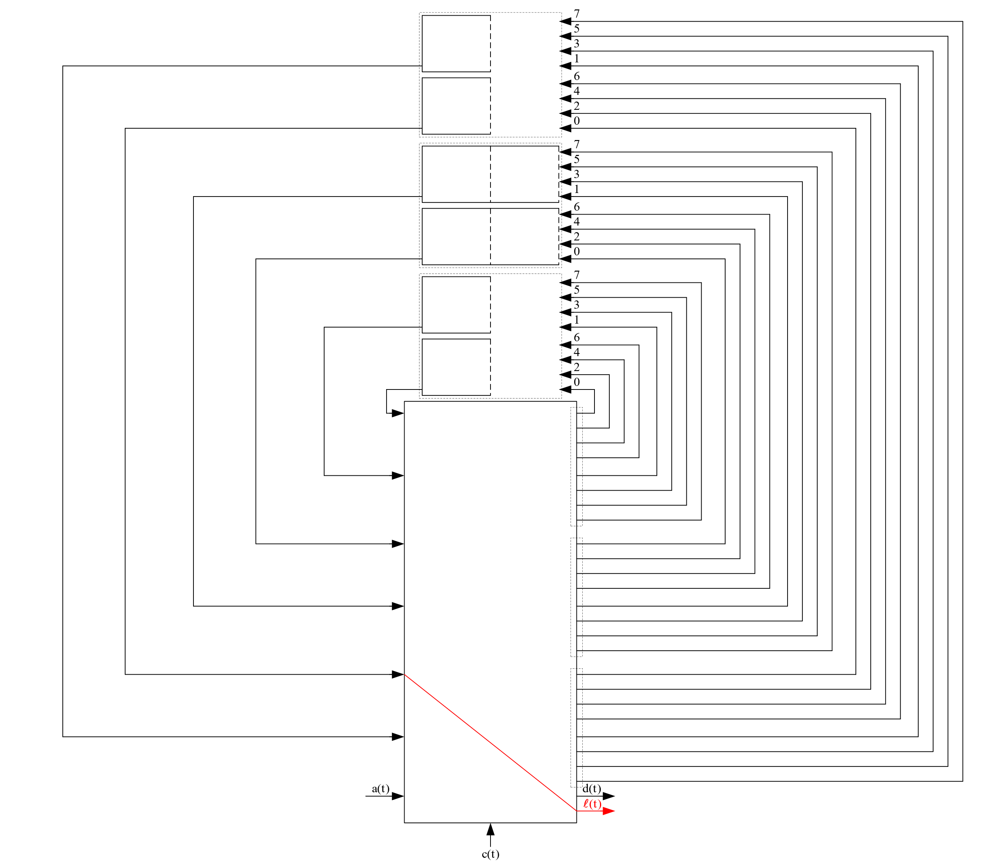
An Example: k=3, m=2, s=1, n=4
t = 9
c(t) = 0
5
B₁=1
Ψ₁={1, 2}
B₂=2
Ψ₂={3, 4, 5}
B₃=1
Ψ₃={6, 7}
2
1
u₁(t-1)=7
4
6
u₂(t-1)=4
8
7
u₃(t-1)=5
3

Slide 78
An Example: k=3, m=2, s=1, n=4
t = 9
c(t) = 0
5
B₁=1
Ψ₁={1, 2}
B₂=2
Ψ₂={3, 4, 5}
B₃=1
Ψ₃={6, 7}
1, 2∈Ψ₁
u₁(t-1) mod 8 = 7
u₁(t-1)+1 mod 8 = 0
2
1
u₁(t-1)=7
3, 4∈Ψ₂
u₂(t-1) mod 8 = 4
u₂(t-1)+1 mod 8 = 5
4
6
u₂(t-1)=4
6, 7∈Ψ₃
u₃(t-1) mod 8 = 5
u₃(t-1)+1 mod 8 = 6
7
u₃(t-1)=5
3
8

Slide 79
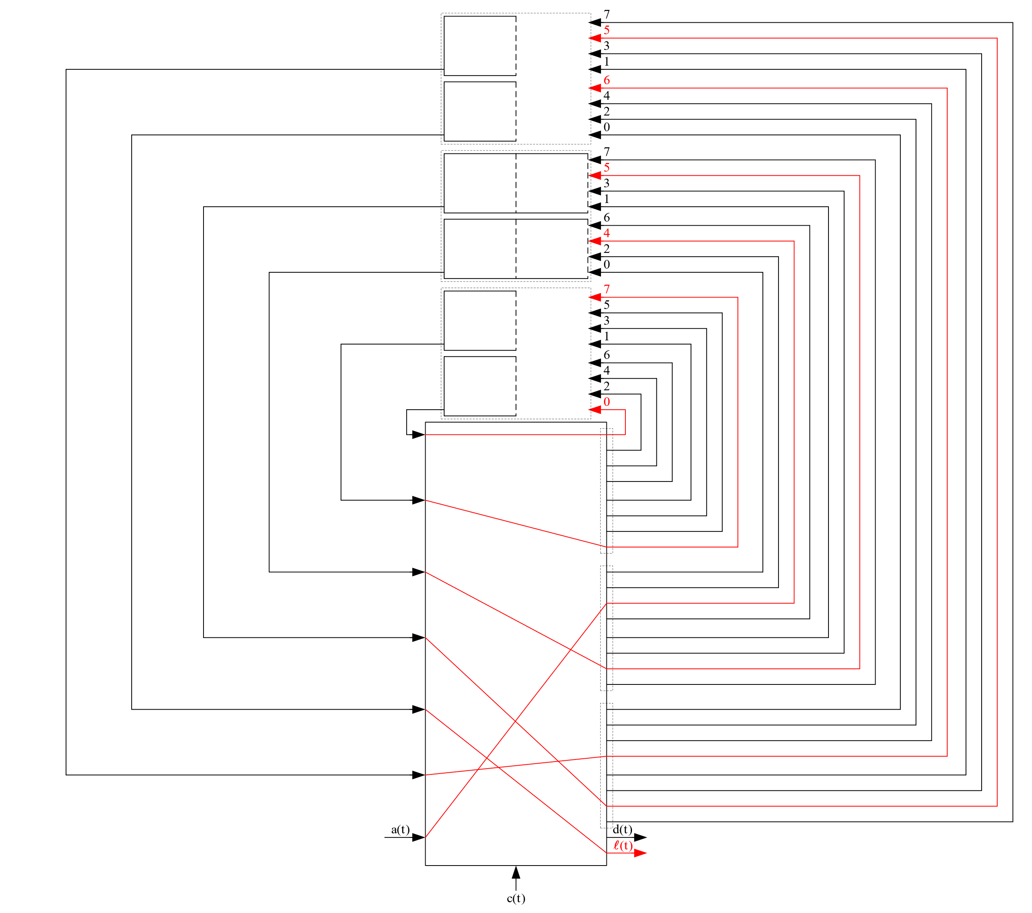
An Example: k=3, m=2, s=1, n=4
t = 9
c(t) = 0
5
B₁=1
Ψ₁={1, 2}
B₂=2
Ψ₂={3, 4, 5}
B₃=1
Ψ₃={6, 7}
2
1
u₁(t-1)=7
4
6
u₂(t-1)=4
7
u₃(t-1)=5
3
8

Slide 80
An Example: k=3, m=2, s=1, n=4
6
t = 9
7
c(t) = 0
5
4
B₁=1
Ψ₁={1, 2}
3
B₂=2
Ψ₂={3, 4, 5}
1
B₃=1
Ψ₃={6, 7}
2
u₁(t)=1
u₂(t)=6
u₃(t)=7

Slide 81
Outline
Motivation
Definition of a Priority Queue
The Operations of a Priority Queue
Our SDL Construction
An Example of Our SDL Construction
Complexity Analysis for Constructions With Maximum Buffer Sizes
Conclusion

Slide 82
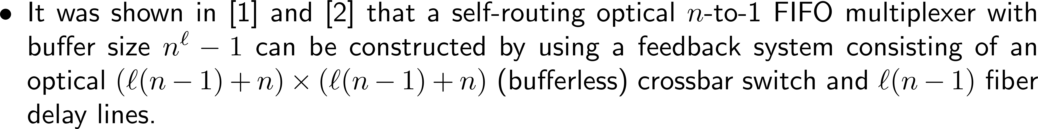
Complexity Analysis
Notes:
%By IguanaTex%
%Size: 18pts
\begin{document}
\begin{itemize}
\item In our constructions of optical priority queues we have used optical FIFO multiplexers with delay one.
\end{itemize}
\end{document}
\begin{document}
\begin{itemize}
\item An optical $n$-to-1 FIFO multiplexer with delay one and buffer size $B$
is a concatenation of an optical $n$-to-1 FIFO multiplexer with buffer size $B-1$
and a fiber delay line with delay equal to one.
\end{itemize}
\end{document}
\begin{document}
\begin{itemize}
\item It was shown in [1] and [2] that
a self-routing optical $n$-to-1 FIFO multiplexer with buffer size $n^{\ell}-1$
can be constructed by using a feedback system consisting of
an optical $(\ell(n-1)+n)\times (\ell(n-1)+n)$ (bufferless) crossbar switch
and $\ell(n-1)$ fiber delay lines.
\end{itemize}
\end{document}
\begin{document}
\begin{itemize}
\item As such, an optical $n$-to-1 FIFO multiplexer with buffer size $B-1$
can be constructed with $\ell=\lceil \log_n{B}\rceil$.
\end{itemize}
\end{document}
\begin{document}
\begin{itemize}
\item It then follows that
an optical $n$-to-1 FIFO multiplexer with delay one and buffer size $B$
can be constructed by using an
optical $((n-1)\lceil \log_n{B}\rceil+n+1)\times ((n-1)\lceil \log_n{B}\rceil+n+1)$
(bufferless) crossbar switch and $(n-1)\lceil \log_n{B}\rceil+1$ fiber delay lines.
\end{itemize}
\end{document}
%Size: 12pts
\documentclass{article}
\usepackage{amsmath, color}
\renewcommand{\familydefault}{\sfdefault}
\pagestyle{empty}
\begin{document}
\begin{minipage}{570pt}
\noindent\color{red}
[1] C.-S. Chang, D.-S. Lee, and C.-K. Tu,
``Recursive construction of FIFO optical multiplexers with switched delay lines,''
\emph{IEEE Transactions on Information Theory}\/,
vol.~50, pp.~3221--3233, December~2004.
\end{minipage}
\end{document}
\documentclass{article}
\usepackage{amsmath, color}
\renewcommand{\familydefault}{\sfdefault}
\pagestyle{empty}
\begin{document}
\begin{minipage}{570pt}
\noindent\color{red}
[2] B. Tang, X. Wang, C.-T. Nguyen, B. Ye, and S. Lu,
``Construction of subexponential-size optical priority queues with switches and fiber delay lines,''
\emph{IEEE/ACM Transactions on Networking}\/,
vol.~28, pp.~336--346, February~2020.
\end{minipage}
\end{document}

Slide 83
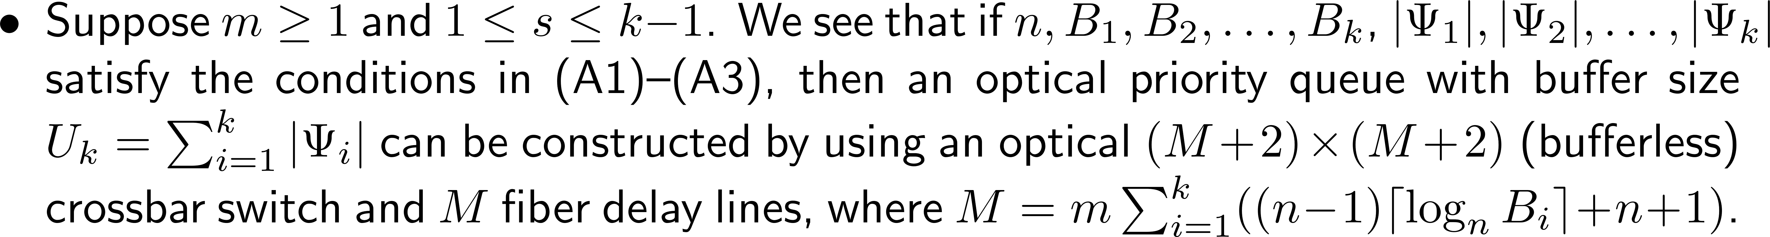
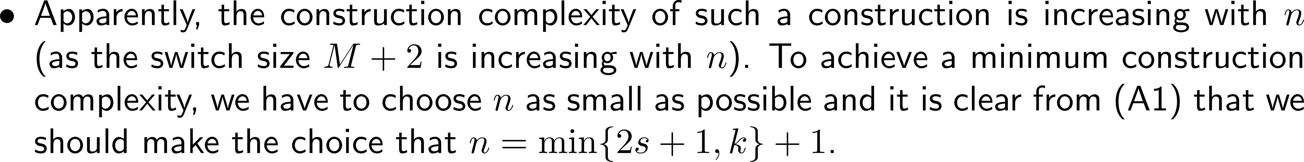
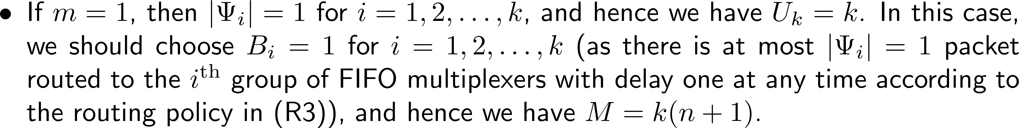
Complexity Analysis
Notes:
%By IguanaTex%
%Size: 18pts
\begin{document}
\begin{itemize}
\item Suppose $m\geq 1$ and $1\leq s\leq k-1$.
We see that
if $n,B_1,B_2,\ldots,B_k$, $|\Psi_1|,|\Psi_2|,\ldots,|\Psi_k|$
satisfy the conditions in (A1)--(A3),
then an optical priority queue with buffer size $U_k=\sum_{i=1}^{k}|\Psi_i|$
can be constructed
by using an optical $(M+2) \times (M+2)$ (bufferless) crossbar switch
and $M$ fiber delay lines,
where $M=m\sum_{i=1}^{k}((n-1)\lceil \log_n{B_i}\rceil+n+1)$.
\end{itemize}
\end{document}
\begin{document}
\begin{itemize}
\item Apparently, the construction complexity of such a construction is increasing with $n$
(as the switch size $M+2$ is increasing with $n$).
To achieve a minimum construction complexity,
we have to choose $n$ as small as possible
and it is clear from (A1) that we should make the choice that $n=\min\{2s+1,k\}+1$.
\end{itemize}
\end{document}
\begin{document}
\begin{itemize}
\item Furthermore, when the achieved buffer size is used as the performance measure of a construction,
we have to choose $|\Psi_i|$ as large as possible for $i=1,2,\ldots,k$
to maximize the achieved buffer size $U_k=\sum_{i=1}^{k}|\Psi_i|$ in our construction.
\end{itemize}
\end{document}
\begin{document}
\begin{itemize}
\item From (A3), it is clear that we should make the choice that
$|\Psi_i|=(m-1)B_i+1$ for $i=1,2,\ldots,k$.
\end{itemize}
\end{document}
\begin{document}
\begin{itemize}
\item If $m=1$, then $|\Psi_i|=1$ for $i=1,2,\ldots,k$, and hence we have $U_k=k$.
In this case, we should choose $B_i=1$ for $i=1,2,\ldots,k$
(as there is at most $|\Psi_i|=1$ packet routed to the $i^{\textrm{th}}$ group
of FIFO multiplexers with delay one at any time according to the routing policy in (R3)),
and hence we have $M=k(n+1)$.
\end{itemize}
\end{document}

Slide 84
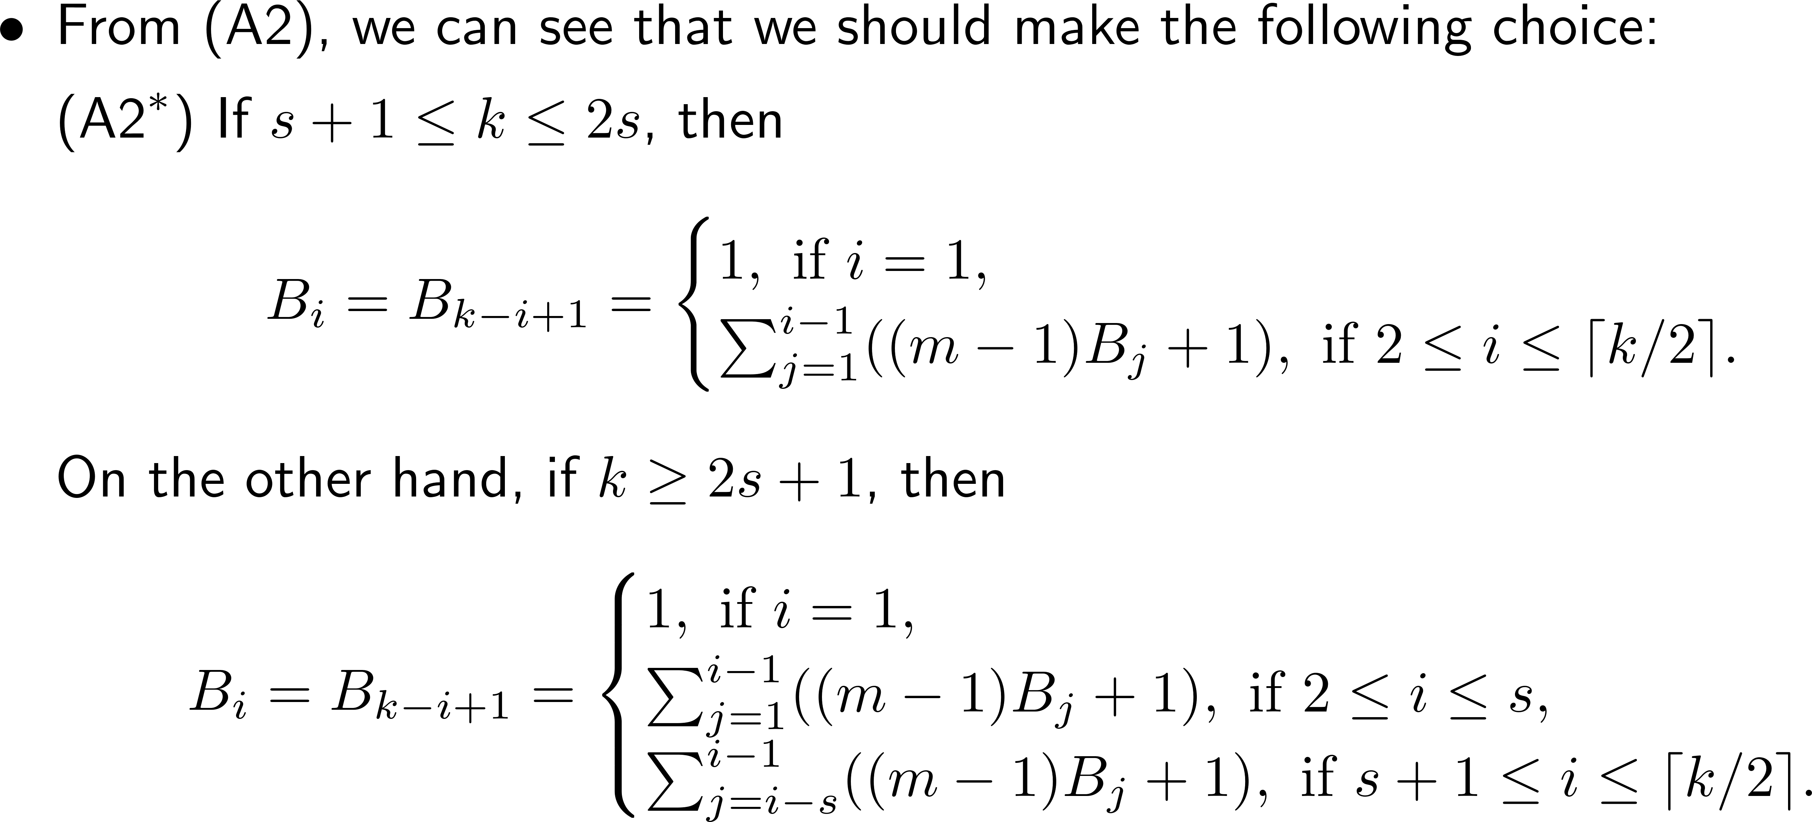
Complexity Analysis
Notes:
%By IguanaTex%
%Size: 18pts
\begin{document}
\begin{itemize}
\item Clearly this is not an interesting case as $U_k=M/(n+1)$ grows only linearly with $M$.
So we assume that $m\geq 2$ in the rest of the slides.
\end{itemize}
\end{document}
\begin{document}
\begin{itemize}
\item For $m\geq 2$, the choice $|\Psi_i|=(m-1)B_i+1$ can be made as large as possible
by choosing $B_i$ as large as possible for $i=1,2,\ldots,k$.
\end{itemize}
\end{document}
\begin{document}
\begin{itemize}
\item From (A2), we can see that we should make the following choice:
($\textnormal{A2}^*$) If $s+1\leq k\leq 2s$, then
\beq{}
B_i= B_{k-i+1}=
\bcases
1, \textrm{ if } i=1,\\
\sum_{j=1}^{i-1}((m-1)B_j+1), \textrm{ if } 2\leq i\leq \lceil k/2 \rceil.
\ecases \nn
\eeq
On the other hand, if $k\geq 2s+1$, then
\beq{}
B_i= B_{k-i+1}=
\bcases
1, \textrm{ if } i=1,\\
\sum_{j=1}^{i-1}((m-1)B_j+1), \textrm{ if } 2\leq i\leq s,\\
\sum_{j=i-s}^{i-1}((m-1)B_j+1), \textrm{ if } s+1\leq i\leq \lceil k/2 \rceil.
\ecases \nn
\eeq
\end{itemize}
\end{document}
\begin{document}
\begin{itemize}
\item We summarize the above findings in the following theorem.
\end{itemize}
\end{document}

Slide 85
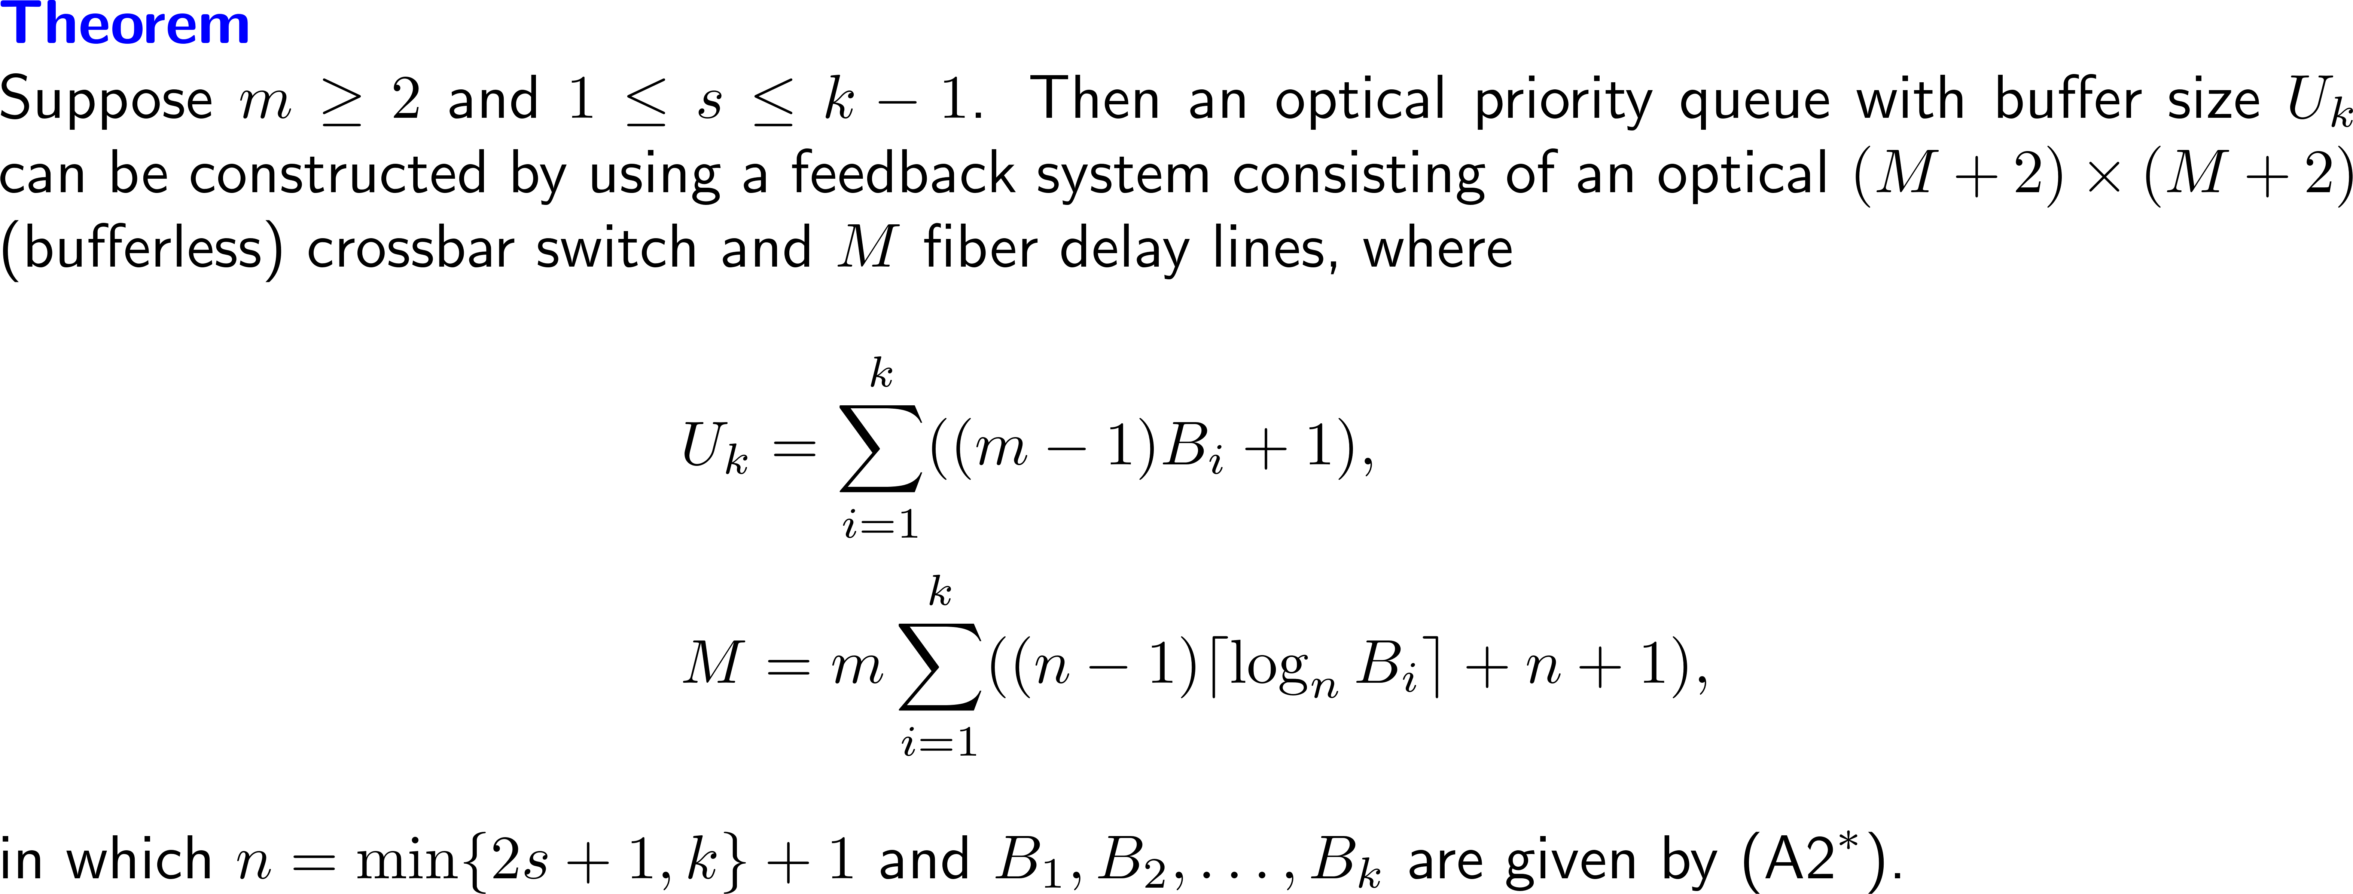
Complexity Analysis
Notes:
%By IguanaTex%
%Size: 18pts
\begin{document}
\noindent{\textbf{\color{blue}Theorem}}\\
Suppose $m\geq 2$ and $1\leq s\leq k-1$.
Then an optical priority queue with buffer size $U_k$
can be constructed by using a feedback system
consisting of an optical $(M+2)\times (M+2)$ (bufferless) crossbar switch
and $M$ fiber delay lines, where
\beq{}
\alignspace U_k=\sum_{i=1}^{k}((m-1)B_i+1),\nn \\
\alignspace M=m\sum_{i=1}^{k}((n-1)\lceil \log_n{B_i}\rceil+n+1),\nn
\eeq
in which $n=\min\{2s+1,k\}+1$ and $B_1,B_2,\ldots,B_k$ are given by ($\textnormal{A2}^*$).
\end{document}
\begin{document}
\begin{itemize}
\item To express the buffer size $U_k$ in terms of $M$,
we need the following results on the buffer sizes
$B_1,B_2,\ldots,B_k$ given by ($\textnormal{A2}^*$).
\end{itemize}
\end{document}

Slide 86
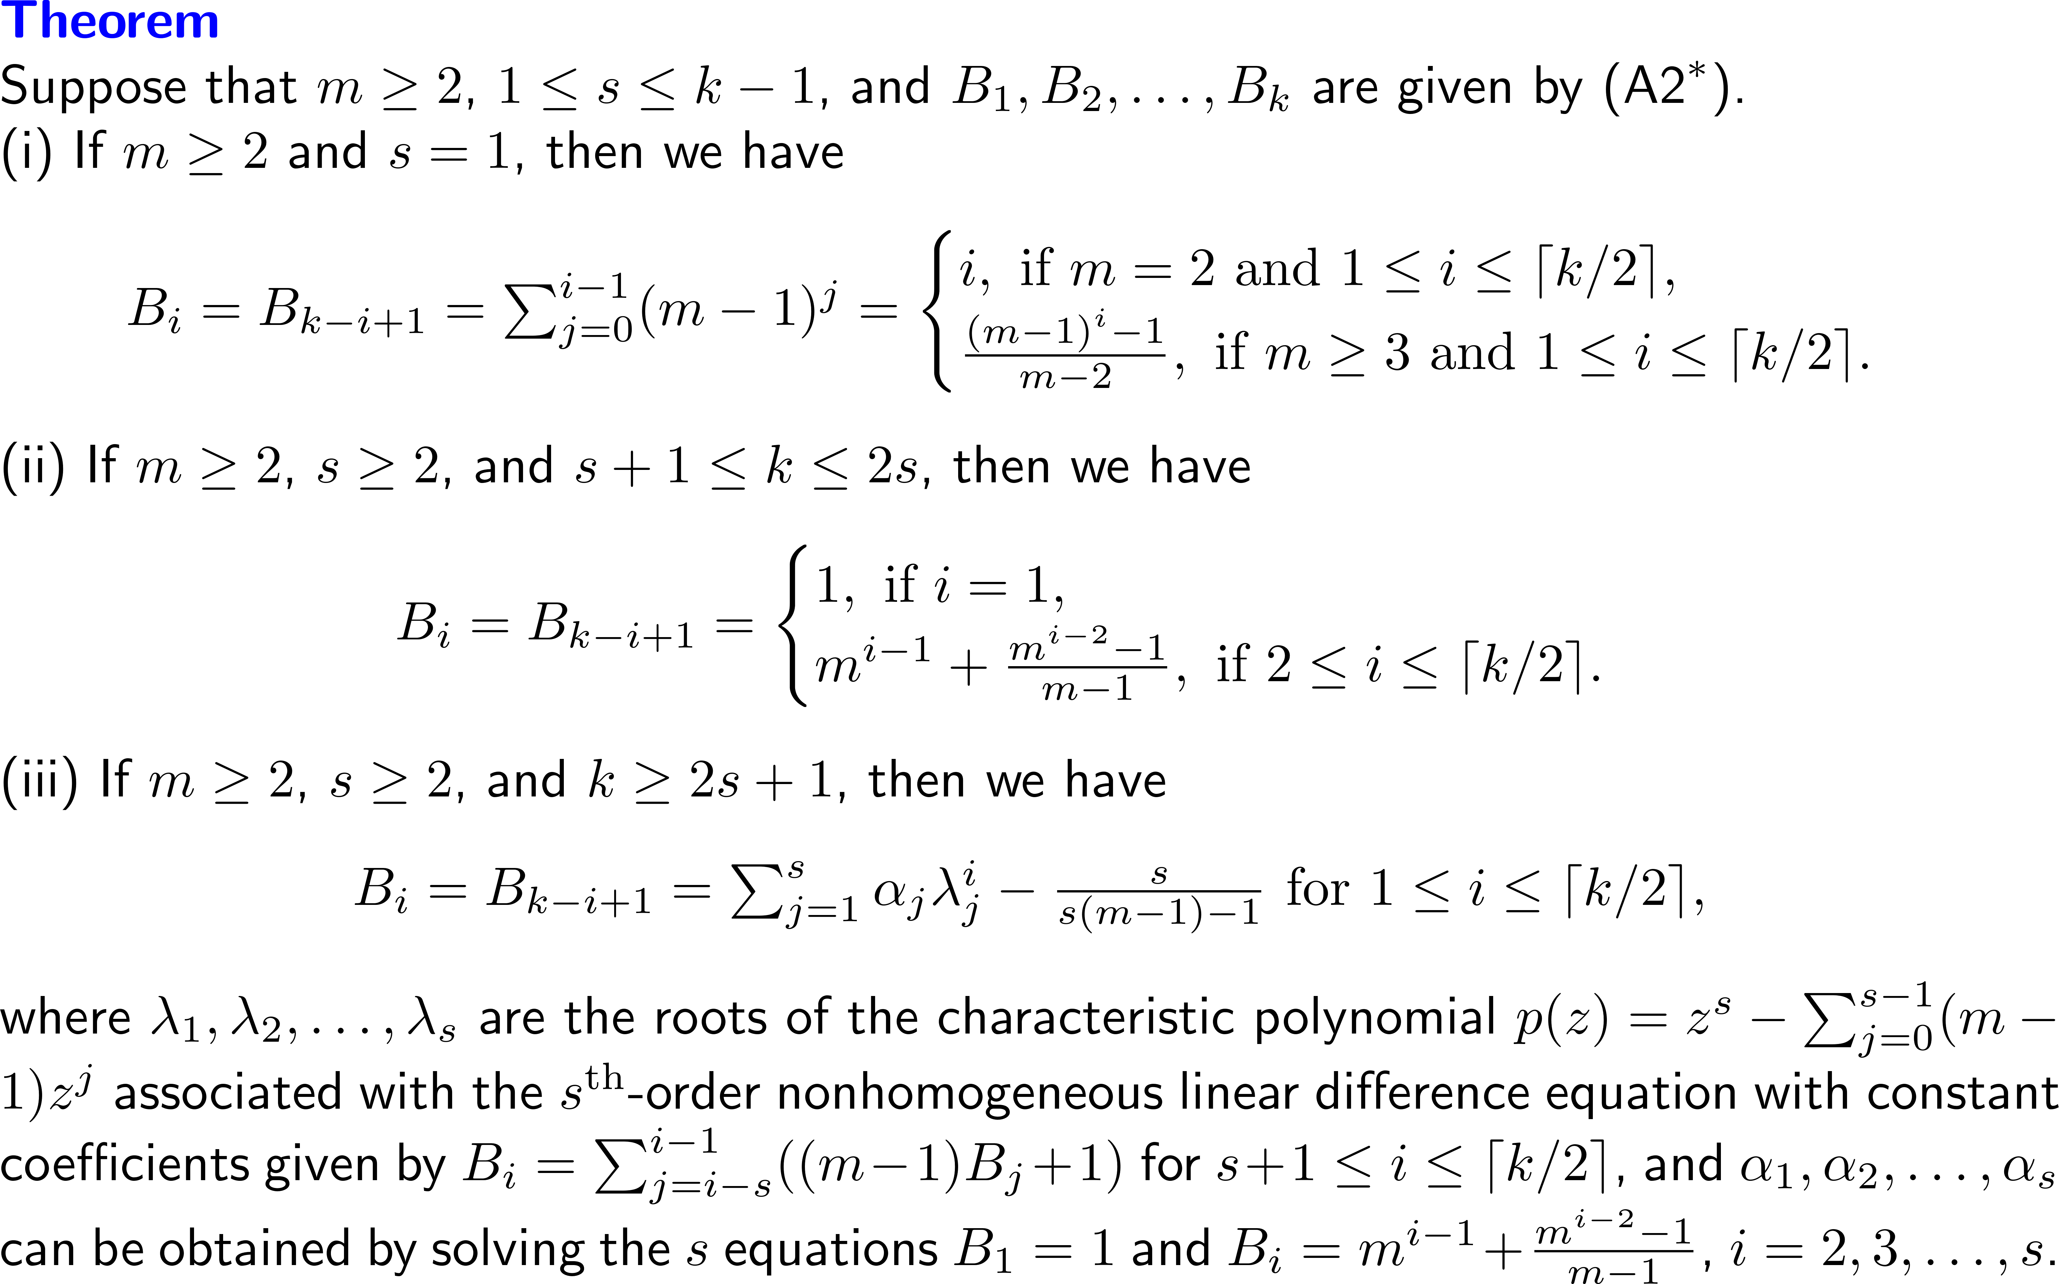
Complexity Analysis
Notes:
%By IguanaTex%
%Size: 18pts
%\usepackage[a4paper, total={380pt, 400pt}]{geometry}
\begin{document}
\noindent{\textbf{\color{blue}Theorem}}\\
Suppose that $m\geq 2$, $1\leq s\leq k-1$,
and $B_1,B_2,\ldots,B_k$ are given by ($\textnormal{A2}^*$).
\noindent(i) If $m\geq 2$ and $s=1$, then we have
\begin{center}
$
B_i=B_{k-i+1}=\sum_{j=0}^{i-1}(m-1)^j=
\bcases
i, \textrm{ if } m=2 \textrm{ and } 1\leq i\leq \lceil k/2 \rceil,\\
\frac{(m-1)^i-1}{m-2}, \textrm{ if } m\geq 3 \textrm{ and } 1\leq i\leq \lceil k/2 \rceil.
\ecases \nn
$
\end{center}
\noindent(ii) If $m\geq 2$, $s\geq 2$, and $s+1\leq k\leq 2s$, then we have
\begin{center}
$
B_i=B_{k-i+1}=
\bcases
1, \textrm{ if } i=1,\\
m^{i-1}+\frac{m^{i-2}-1}{m-1}, \textrm{ if } 2\leq i\leq \lceil k/2 \rceil.
\ecases \nn
$
\end{center}
\noindent(iii) If $m\geq 2$, $s\geq 2$, and $k\geq 2s+1$, then we have
\begin{center}
$
B_i=B_{k-i+1}=\sum_{j=1}^{s}\alpha_j\lambda_j^i-\frac{s}{s(m-1)-1}
\textrm{ for } 1\leq i\leq \lceil k/2 \rceil, \nn
$
\end{center}
where $\lambda_1,\lambda_2,\ldots,\lambda_s$ are the roots
of the characteristic polynomial $p(z)=z^s-\sum_{j=0}^{s-1}(m-1)z^j$
associated with the $s^{\textrm{th}}$-order nonhomogeneous linear difference equation
with constant coefficients given by
$B_i=\sum_{j=i-s}^{i-1}((m-1)B_j+1)$
for $s+1\leq i\leq \lceil k/2 \rceil$,
and $\alpha_1,\alpha_2,\ldots,\alpha_s$ can be obtained by solving the $s$ equations
$B_1=1$ and $B_i=m^{i-1}+\frac{m^{i-2}-1}{m-1}$, $i=2,3,\ldots,s$.
\end{document}

Slide 87
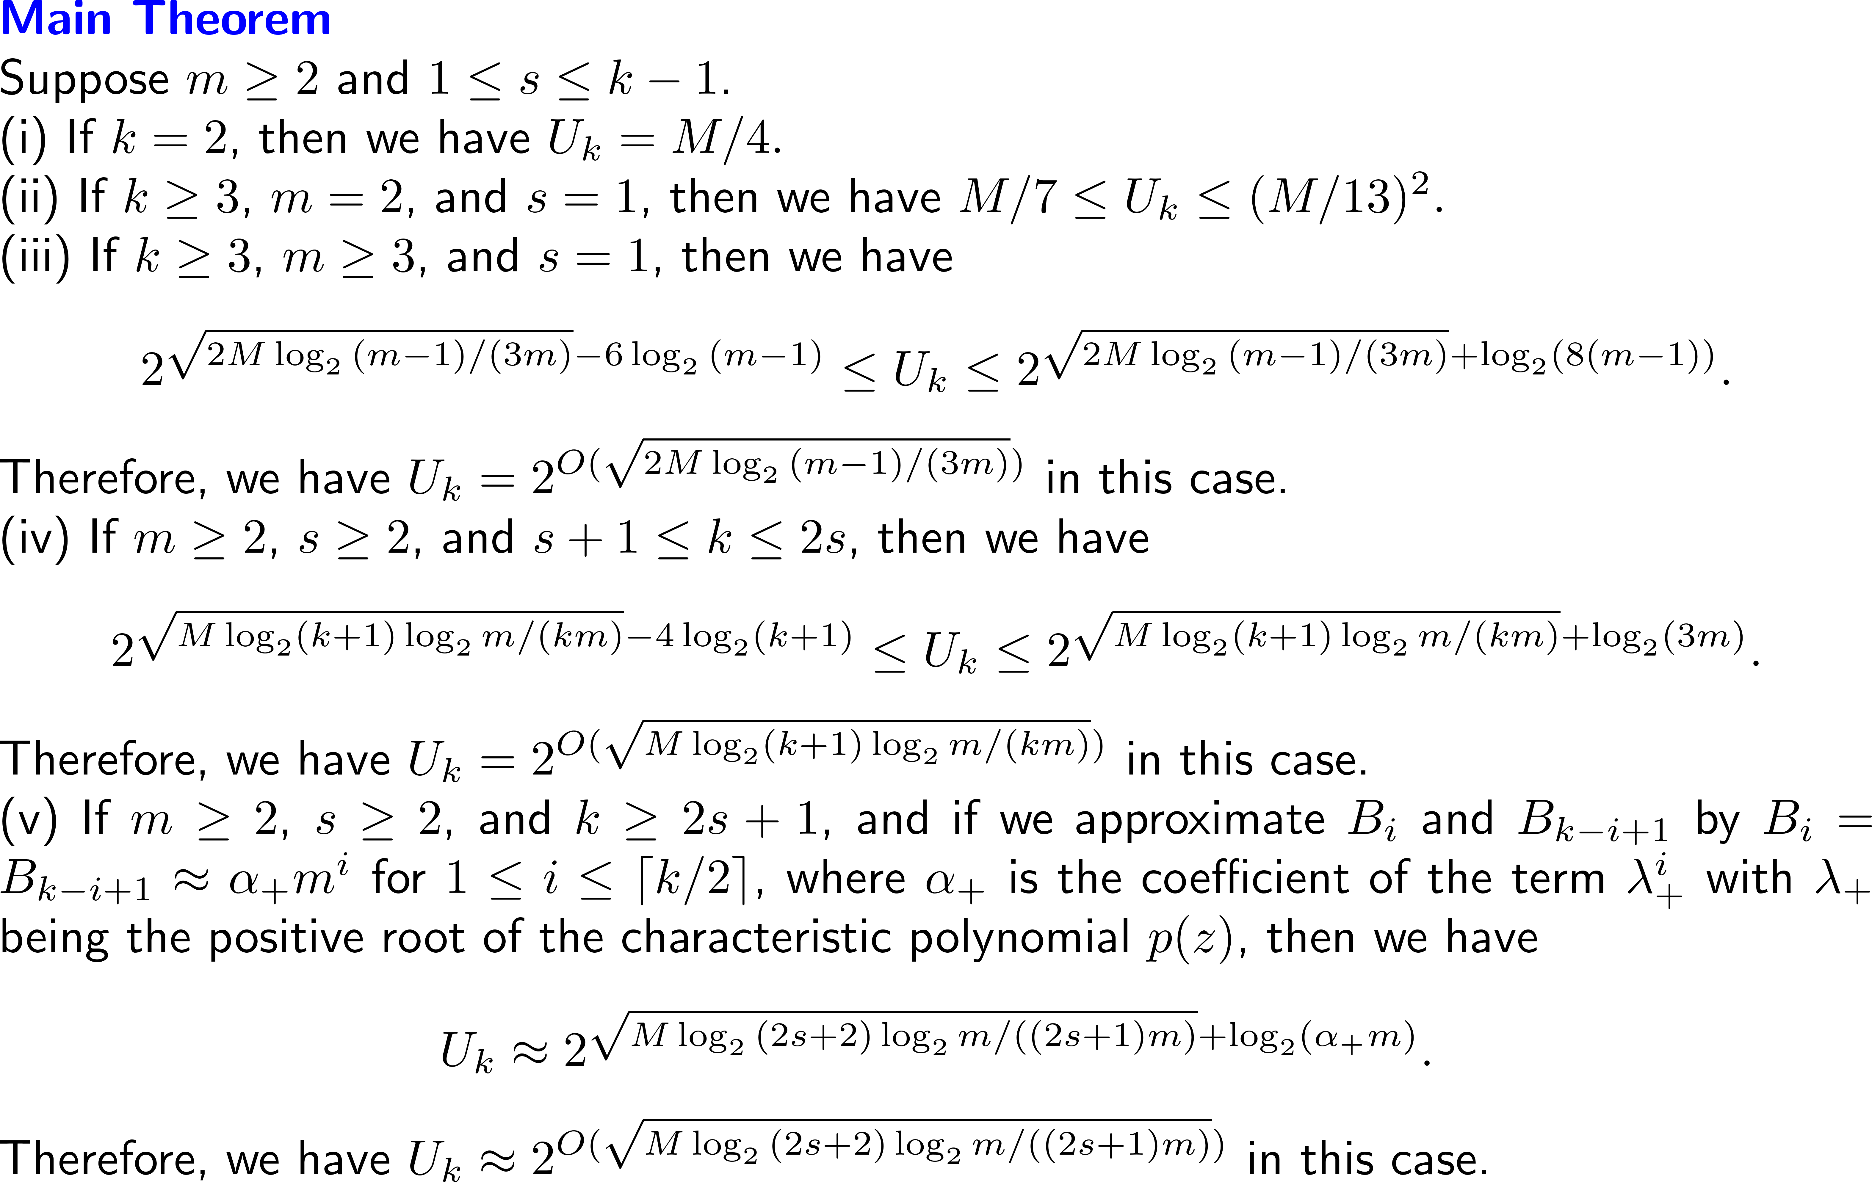
Complexity Analysis
Notes:
%By IguanaTex%
%Size: 18pts
%\usepackage[a4paper, total={380pt, 400pt}]{geometry}
\begin{document}
\noindent{\textbf{\color{blue}Main Theorem}}\\
Suppose $m\geq 2$ and $1\leq s\leq k-1$.
\noindent(i) If $k=2$, then we have
$
U_k=M/4.
$
\noindent(ii) If $k\geq 3$, $m=2$, and $s=1$, then we have
$
M/7 \leq U_k \leq (M/13)^2.
$
\noindent(iii) If $k\geq 3$, $m\geq 3$, and $s=1$, then we have
\begin{center}
$
2^{\sqrt{2M\log_2{(m-1)}/(3m)}-6\log_2{(m-1)}}
\leq U_k \leq 2^{\sqrt{2M\log_2{(m-1)}/(3m)}+\log_2(8(m-1))}.
$
\end{center}
Therefore, we have $U_k=2^{O(\sqrt{2M\log_2{(m-1)}/(3m)})}$ in this case.
\noindent(iv) If $m\geq 2$, $s\geq 2$, and $s+1\leq k\leq 2s$, then we have
\begin{center}
$
2^{\sqrt{M\log_2(k+1)\log_2{m}/(km)}-4\log_2(k+1)}
\leq U_k \leq 2^{\sqrt{M\log_2(k+1)\log_2{m}/(km)}+\log_2(3m)}.
$
\end{center}
Therefore, we have $U_k=2^{O(\sqrt{M\log_2(k+1)\log_2{m}/(km)})}$ in this case.
\noindent(v) If $m\geq 2$, $s\geq 2$, and $k\geq 2s+1$,
and if we approximate $B_i$ and $B_{k-i+1}$
by $B_i=B_{k-i+1}\approx \alpha_{+}m^i$ for $1\leq i\leq \lceil k/2 \rceil$,
where $\alpha_{+}$ is the coefficient of the term $\lambda_{+}^{i}$
with $\lambda_{+}$ being the positive root of the characteristic polynomial $p(z)$,
then we have
\begin{center}
$
U_k\approx 2^{\sqrt{M\log_2{(2s+2)}\log_2{m}/((2s+1)m)}+\log_2(\alpha_{+}m)}.
$
\end{center}
Therefore, we have $U_k\approx 2^{O(\sqrt{M\log_2{(2s+2)}\log_2{m}/((2s+1)m)})}$ in this case.
\end{document}

Slide 88
Outline
Motivation
Definition of a Priority Queue
The Operations of a Priority Queue
Our SDL Construction
An Example of Our SDL Construction
Complexity Analysis for Constructions With Maximum Buffer Sizes
Conclusion

Slide 89
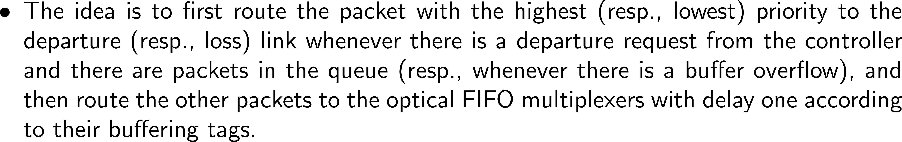
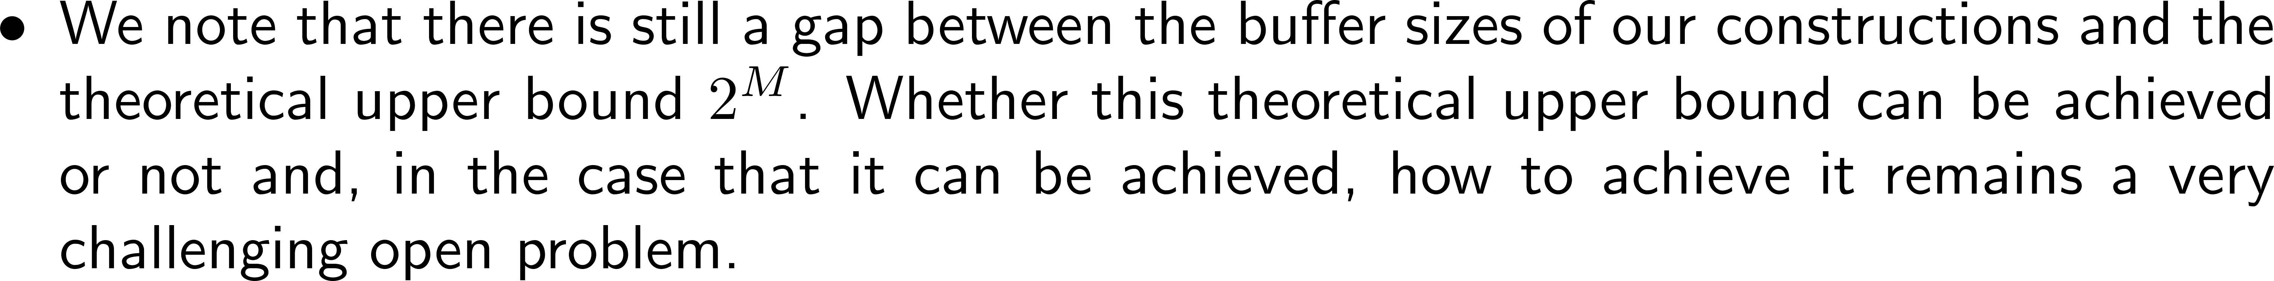
Conclusion
Notes:
%By IguanaTex%
%Size: 18pts
\begin{document}
\begin{itemize}
\item In this work, we have shown that the feedback system
can be operated as an optical priority queue
under a simple priority-based routing policy.
\end{itemize}
\end{document}
\begin{document}
\begin{itemize}
\item The idea is to first route the packet
with the highest (resp., lowest) priority to the departure (resp., loss) link
whenever there is a departure request from the controller
and there are packets in the queue (resp., whenever there is a buffer overflow),
and then route the other packets to the optical FIFO multiplexers with delay one
according to their buffering tags.
\end{itemize}
\end{document}
\begin{document}
\begin{itemize}
\item By establishing the highest-priority packet availability condition,
the lowest-priority packet availability condition,
the collision-free condition, and the no buffer overflow condition,
we are able to achieve an exact emulation of a priority queue.
\end{itemize}
\end{document}
\begin{document}
\begin{itemize}
\item We have also shown that by using a feedback system consisting of
an optical $(M+2) \times (M+2)$ (bufferless) crossbar switch and $M$ fiber delay lines,
we can achieve a buffer size of $2^{O(\sqrt{\alpha M})}$,
where $\alpha$ is a constant that depends on $m$, $s$, and $k$.
\end{itemize}
\end{document}
\begin{document}
\begin{itemize}
\item We note that there is still a gap
between the buffer sizes of our constructions and the theoretical upper bound $2^M$.
Whether this theoretical upper bound can be achieved or not
and, in the case that it can be achieved,
how to achieve it remains a very challenging open problem.
\end{itemize}
\end{document}

Slide 90
Thank you!

