Slide 1
Percolation and Network Resilience

Slide 2
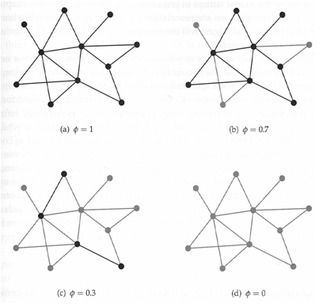
Percolation
The process of taking a network and removing some fraction of its vertices, along with the edges connected to those vertices is called (site) percolation.
Bond percolation:
Only removing some
fraction of edges.

Slide 3
16.2 Uniform Random Removal of Vertices
Occupation probability φ: The probability that a vertex is present in the network.
φ = 1 indicates that all vertices in the network are present (i.e., no vertices have been removed).
φ = 0 indicates that no vertices are present (i.e., all of them have been removed).
Percolation transition: The formation or dissolution of a giant component by varying φ.
When the network contains a giant component we say that it percolates.
Percolation threshold φ_{c}: The value φ that causes percolation transition.

Slide 4
Uniform Removal in the Configuration Model
p_{k} is the probability distribution of the degree of a vertex.
is the excess degree distribution.
u is the probability that a vertex is not connected to the giant component (cluster) via a particular neighbor.
If a vertex has degree k, the probability that the vertex does not belong to the giant component is u^{k}.

Slide 5
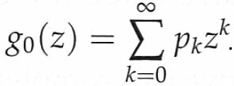
Uniform Removal in the Configuration Model
The probability that a vertex does not belong to a giant component is , where
A vertex is connected to the giant component if
the vertex is present,
and the vertex is connected to the giant component via one of its neighbors.
The probability that a vertex is connected to the giant component is

Slide 6
Uniform Removal in the Configuration Model
A vertex is not connected to the giant component via a particular neighbor A if
either A has been removed
or A is present but it is not connected to the giant component via its others neighbors.
Providing the excess degree is k, the probability of the vertex not connected to the giant component via A is

Slide 7
Uniform Removal in the Configuration Model
The probability of a vertex not connected to the giant component via a particular neighbor is
where

Slide 8
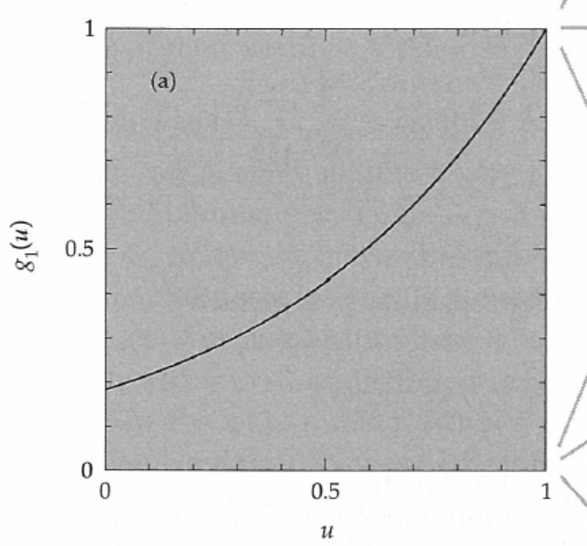
A graphical explanation

Slide 9
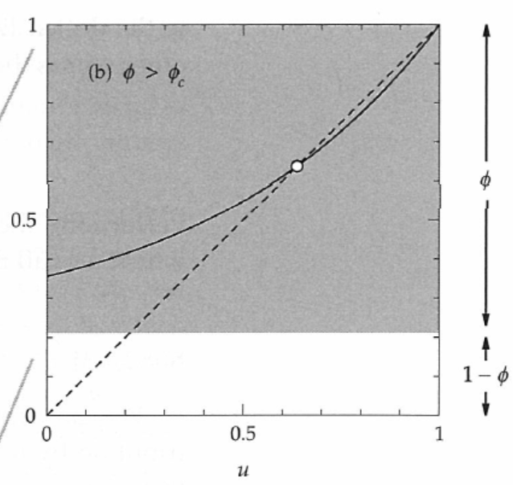
Two solutions

Slide 10
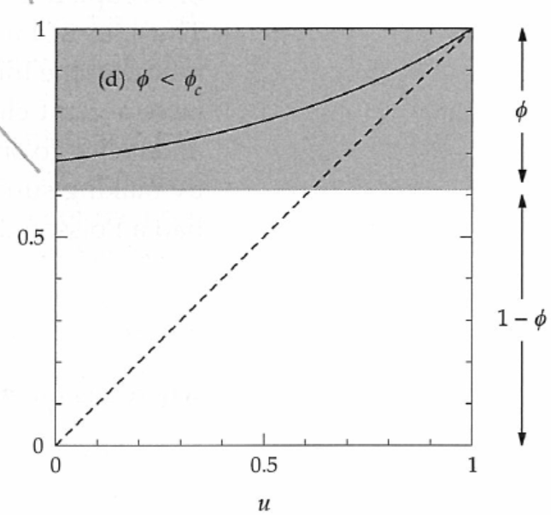
One solution

Slide 11
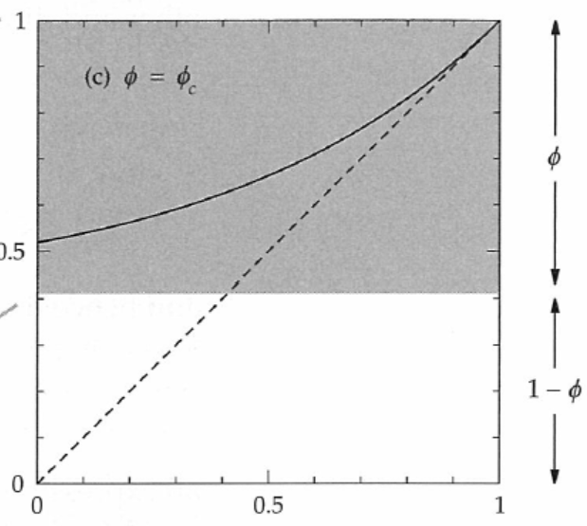
Critical case: the slope at u=1 is one

Slide 12
Percolation threshold
The percolation threshold occurs when
Hence,

Slide 13
Example: Poisson degree distribution
Assume that the network has Poisson degree distribution,
then ⟨k⟩ = c and ⟨k²⟩ = c(c+1), so
For c = 4, we would have meaning that
of the vertices would have to fail before the giant component is destroyed.

Slide 14
Power law degree distributions
Assume that the network has power-law degree distribution with exponent in the range 2<α<3, which have a finite mean ⟨k⟩, but the second moment ⟨k²⟩ diverges.
In this case, φ_{c} = 0.
There will always be a giant component no matter how many vertices are removed from the network.

Slide 15
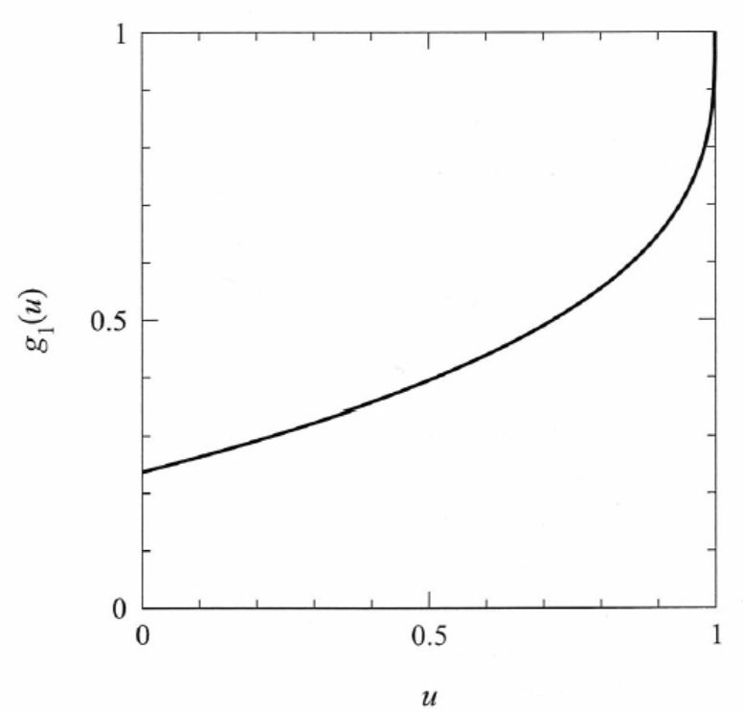
Infinite slope at u=1

Slide 16
The size of giant clusters
We consider an example where degrees are distributed according to an exponential distribution
The PGFs of degree and excess degree distributions are

Slide 17
In this example, the equation in the red box becomes the equation in the blue box
Since u=1 is a root of the equation in the blue box, we get

Slide 18
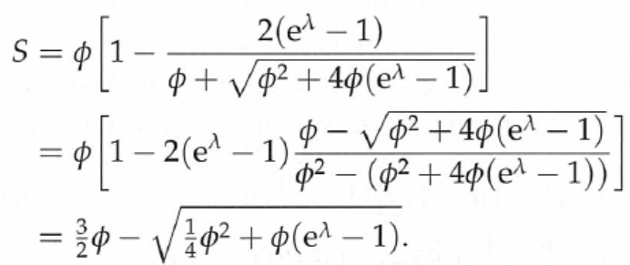
One of the roots is less than 1, ie
The size of the giant cluster is

Slide 19
The percolation threshold takes place when the slope at u=1 is one, ie
The root of the above equation is

Slide 20
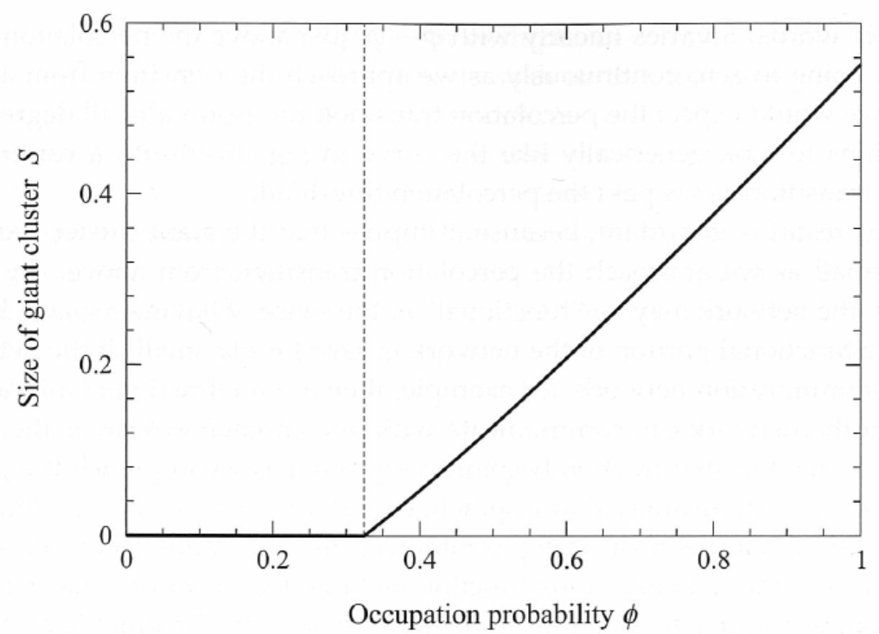
Size of the giant cluster for exponential degree distributions

Slide 21
The size of the giant cluster near the percolation threshold
In most cases, the size of the giant clusters near the percolation threshold is linear in φ
We now present an asymptotic analysis

Slide 22
Size of Giant Component near the Percolation Threshold
Suppose that g₁(u) is “well-behaved” near u = 1, ie the derivative exists

Slide 23
Size of Giant Component near the Percolation Threshold
Similarly, g₀(u) can be expanded as
In other word, S varies linearly with φ − φ_{c}.

Slide 24
Size of Giant Component near the Percolation Threshold
However, g₁(u) is not “well-behaved” near u = 1 with power-law degree distribution with exponent in the range 2<α<3.
In this case, φ_{c} = 0.
Suppose
near u = 1 with c and β < 1 positive constants.
u = 1 − φ + φ g₁(u)
⇒ 1 − u = φ (1 − g₁(u)) = φ⋅c⋅(1 − u)^{β}
⇒ 1 − u = (cφ)^{1/(1 − β)}.

Slide 25
Size of Giant Component near the Percolation Threshold
Then
close to u=1.
Hence the giant component has size
which goes to zero faster than linearly as φ → 0 since (2 − β)/(1 − β) > 1 if β < 1.

Slide 26
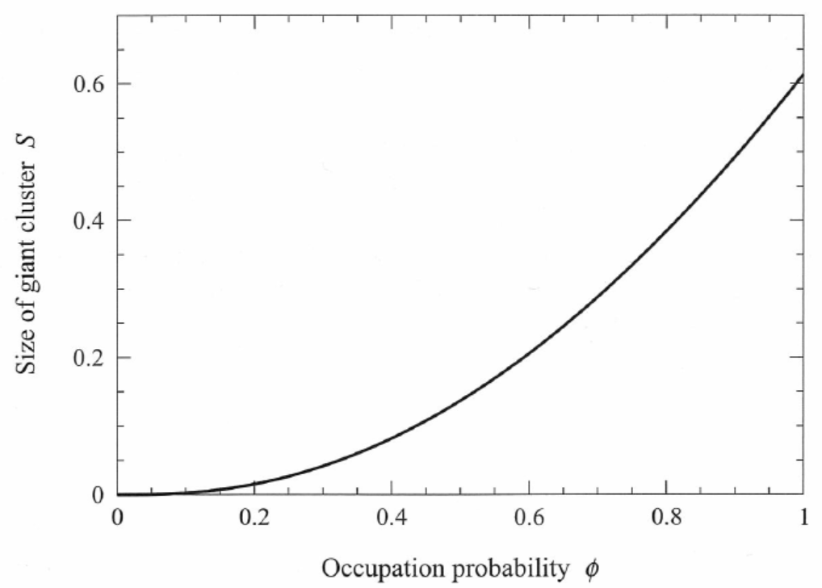
Power law degree with α=2.5

Slide 27
16.3 Non-Uniform Removal of Vertices
φ_{k}: The probability that a vertex with degree k is present in the network.
For example, if φ_{k} = 1 for all vertices with degree k < k₀ for some constant k₀, and φ_{k} = 0 for all vertices with k ≥ k₀, than all the vertices with k₀ or greater are removed.

Slide 28
Non-Uniform Removal of Vertices
The probability of a vertex with degree k being in the giant component is φ_{k} (1 − u^{k}).
The probability of a vertex being in the giant component is
where

Slide 29
Similar analysis as before
If k be the excess degree of a neighboring vertex, then the probability of the neighbor being not present is 1 − φ_{k+1}.
The probability that the neighbor is present but not connected to the giant component is φ_{k+1}u^{k}.
The probability that a vertex is not connected to the giant component via one of its neighbor is
where

Slide 30
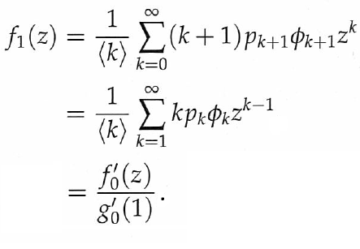
Non-Uniform Removal of Vertices
Since we have

Slide 31
An example
Example: Consider a network with exponential degree distribution
and
Then we have
and

Slide 32
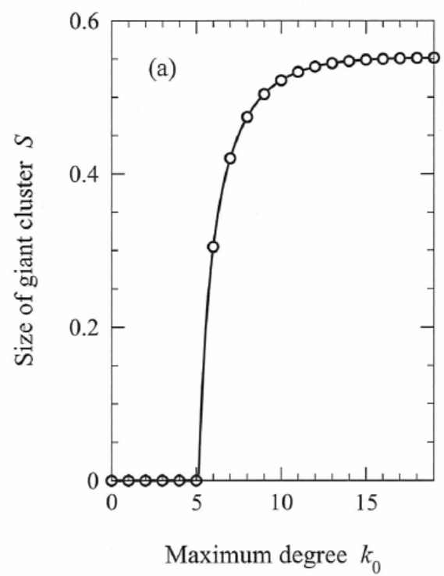
S vs. k₀
To break up the giant cluster, one may need to all vertices with degrees more than 5
This may seem to be a lot of vertices
It is not so, since most vertices have small degrees

Slide 33
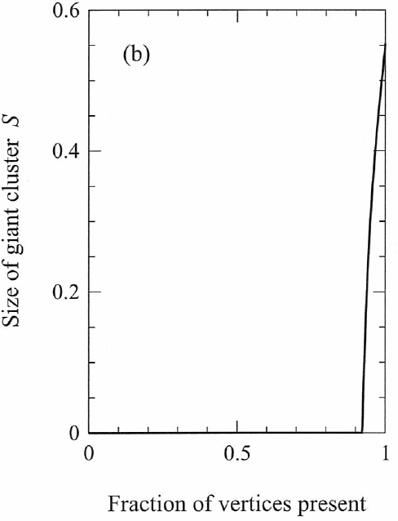
S vs. the fraction of vertices present
This figure shows that the size of the giant component in a network with exponential distribution with λ = 0.5 as vertices are removed in order of degree, starting from the highest degree.
The giant component disappears completely when only about 8% of the vertices have been removed.

Slide 34
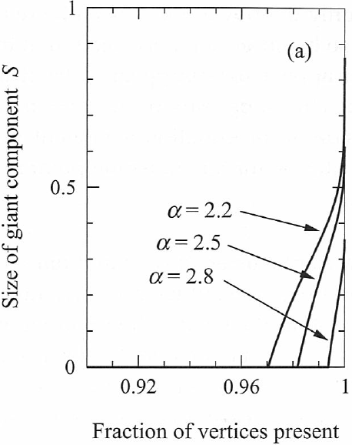
Another example: power law degree distribution
Example: Consider a network with power-law degree distribution.
This figure shows that the size of the giant component with α = 2.2, 2.5, and 2.8.
Removing 3%~4% of the highest degree vertices will destroy the network.

Slide 35
Scale free networks
Scale free networks are paradoxically both robust and fragile
They are robust to the random failure of vertices, with the giant cluster persisting no matter how many vertices are removed
They are very fragile to attacks targeted at their highest-degree vertices.

