Slide 1
An Introduction to the Multichannel Rendezvous Problem-Supplemental Material on Perfect Difference Sets
Prof. Cheng-Shang Chang (張正尚教授)
Institute of Communications Engineering National Tsing Hua University
July 2025

Slide 2
Perfect difference sets
Group
Field
Finite projective planes
Singer’s construction of perfect difference sets

Slide 3
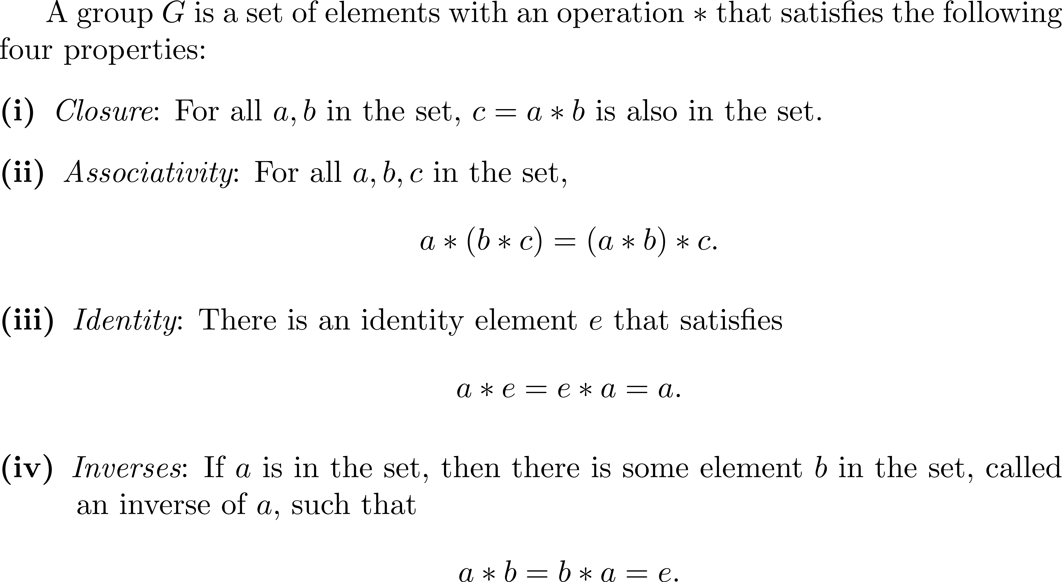
Group

Slide 4
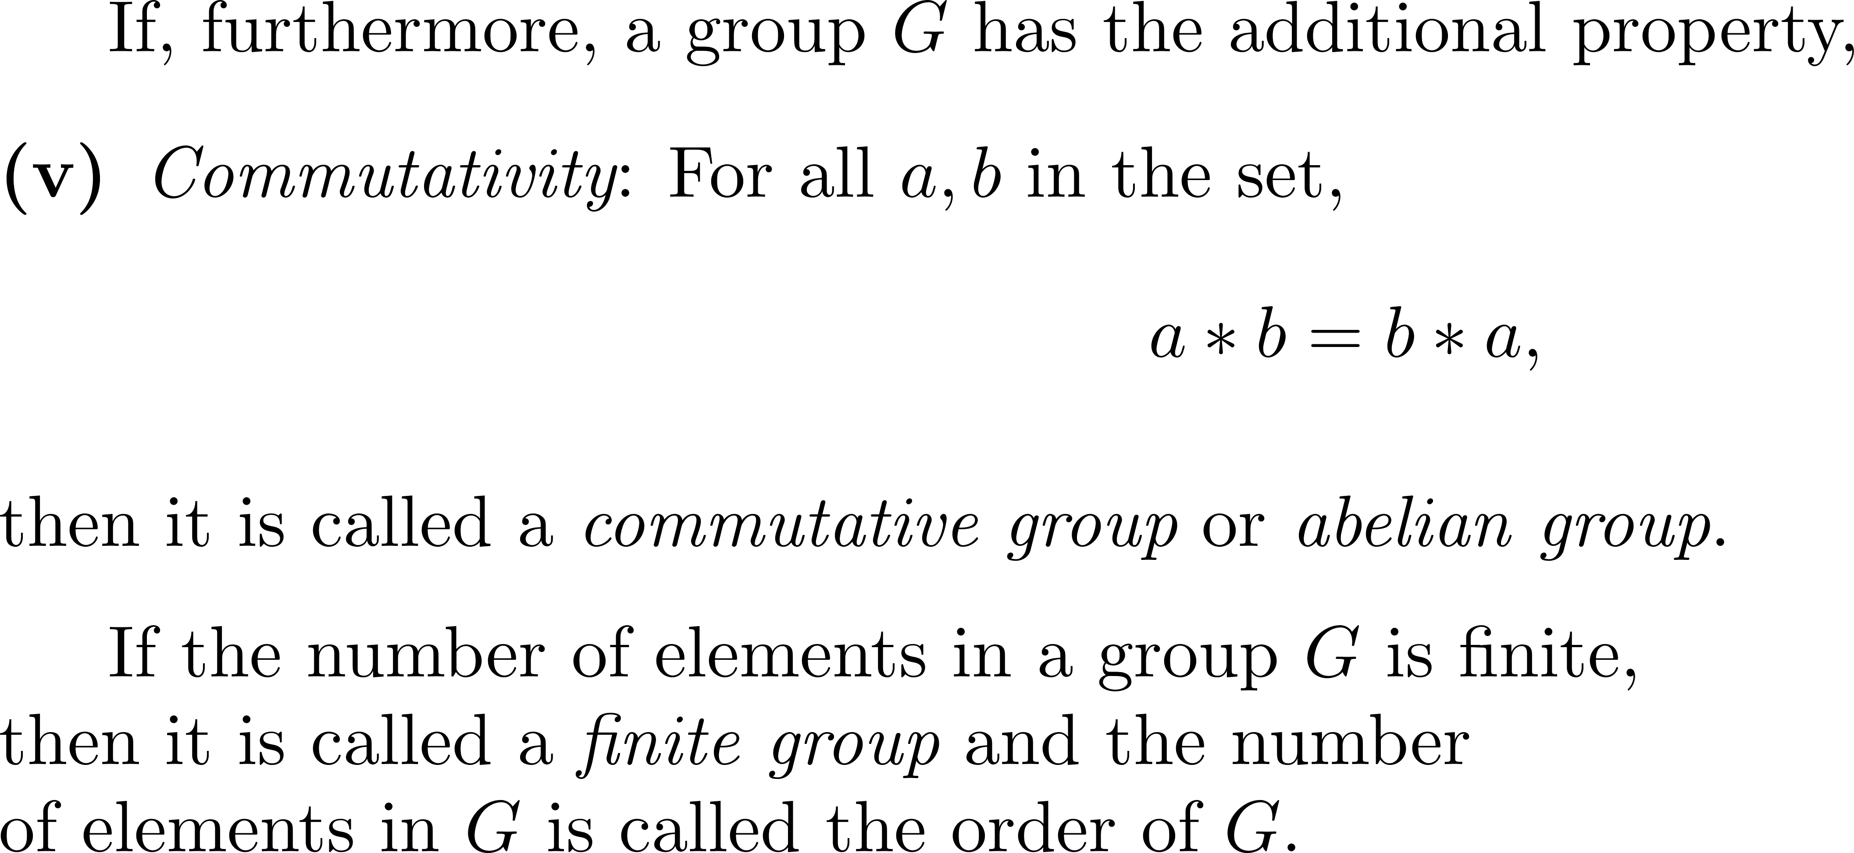
Group

Slide 5
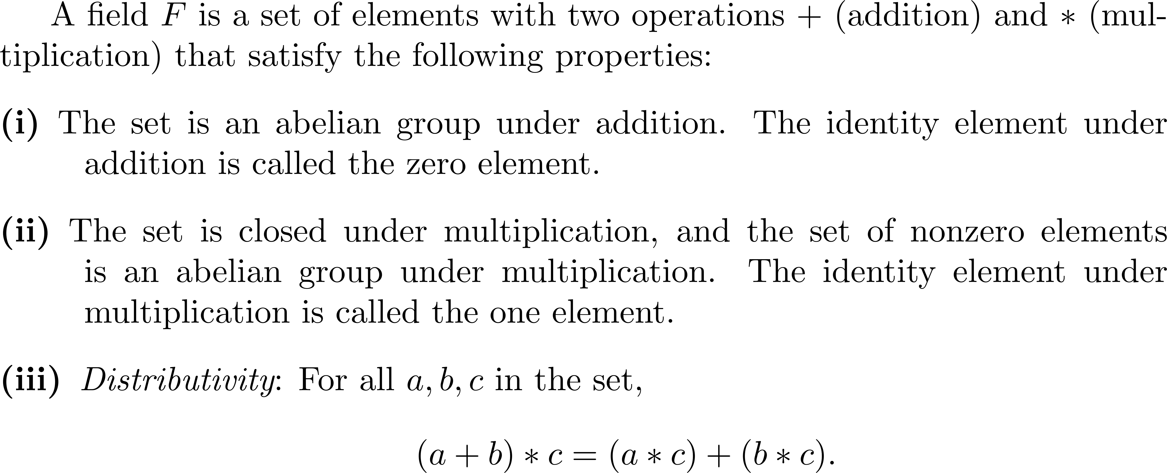
Field

Slide 6
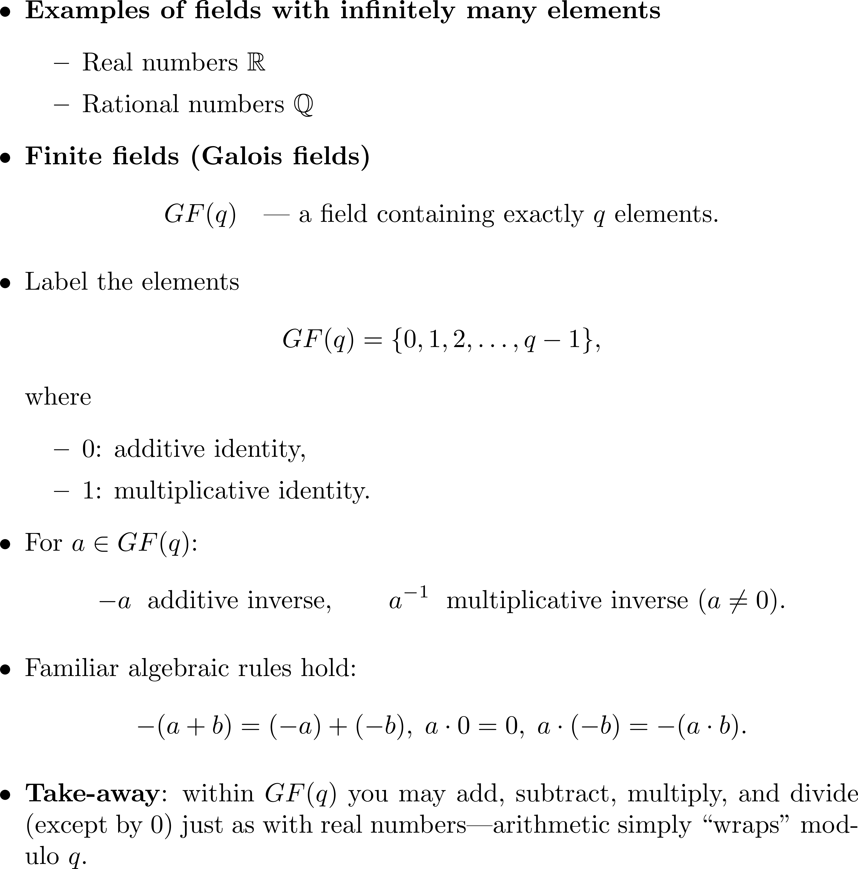

Slide 7
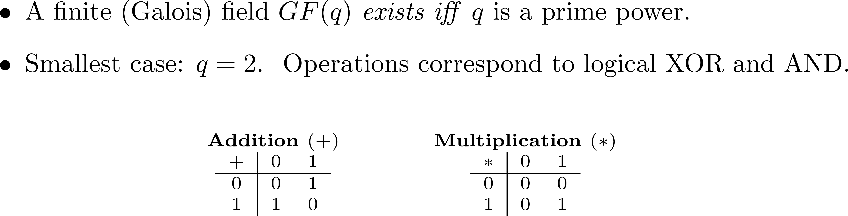
GF(2)

Slide 8
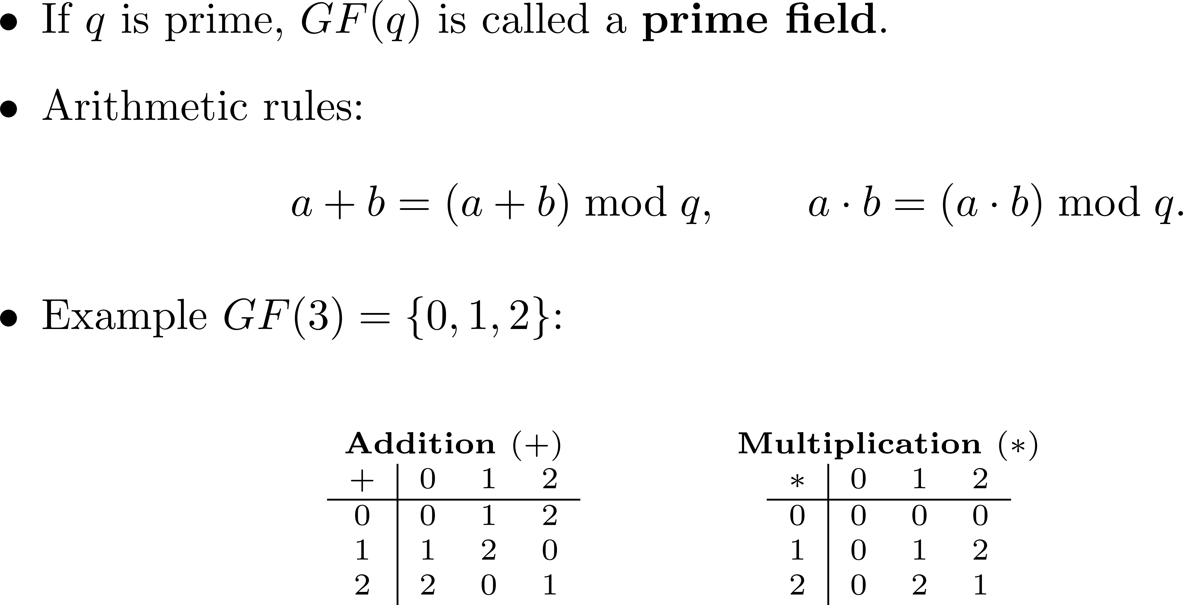
GF(3)

Slide 9
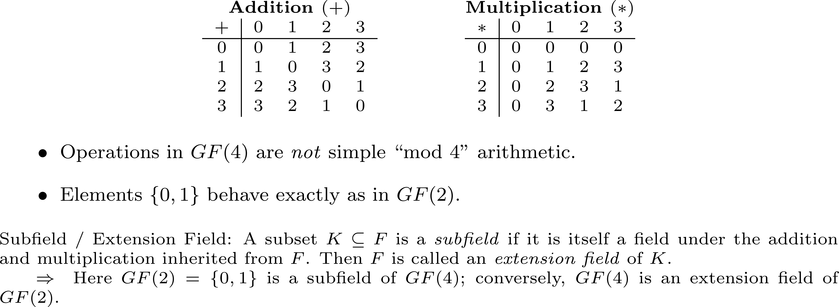
GF(4) and subfield

Slide 10
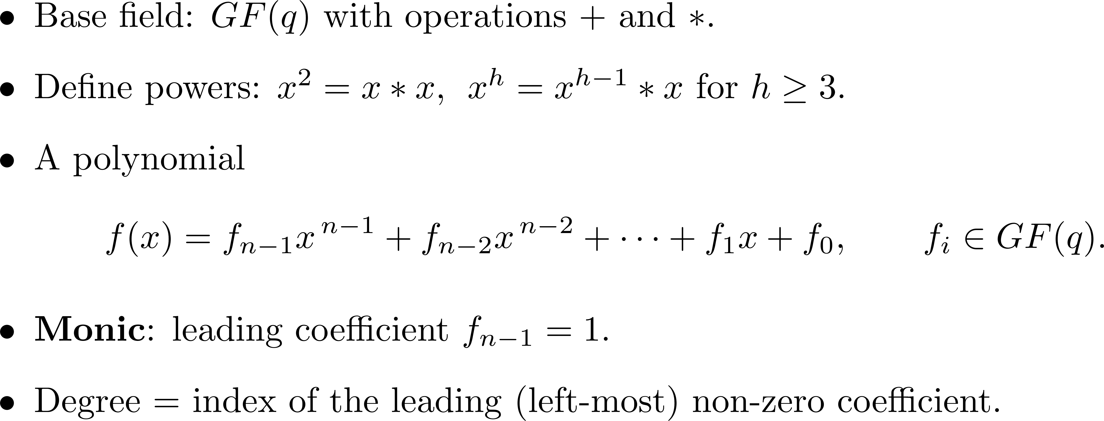
Polynomials over GF(q)

Slide 11
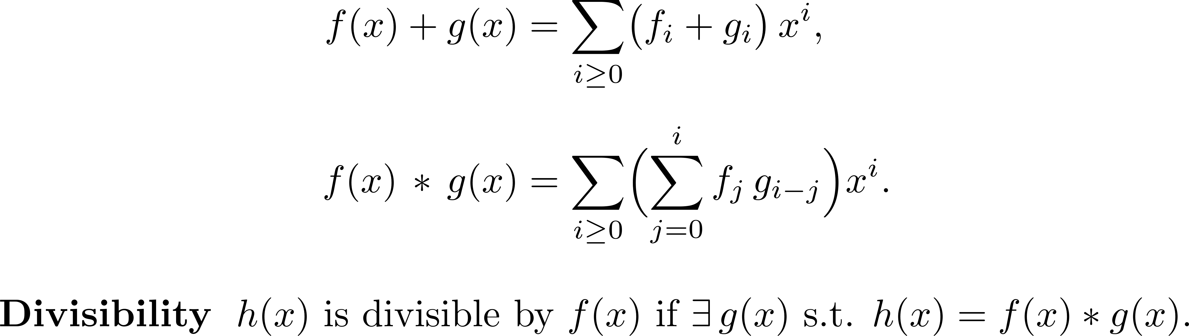
Polynomial arithmetic

Slide 12
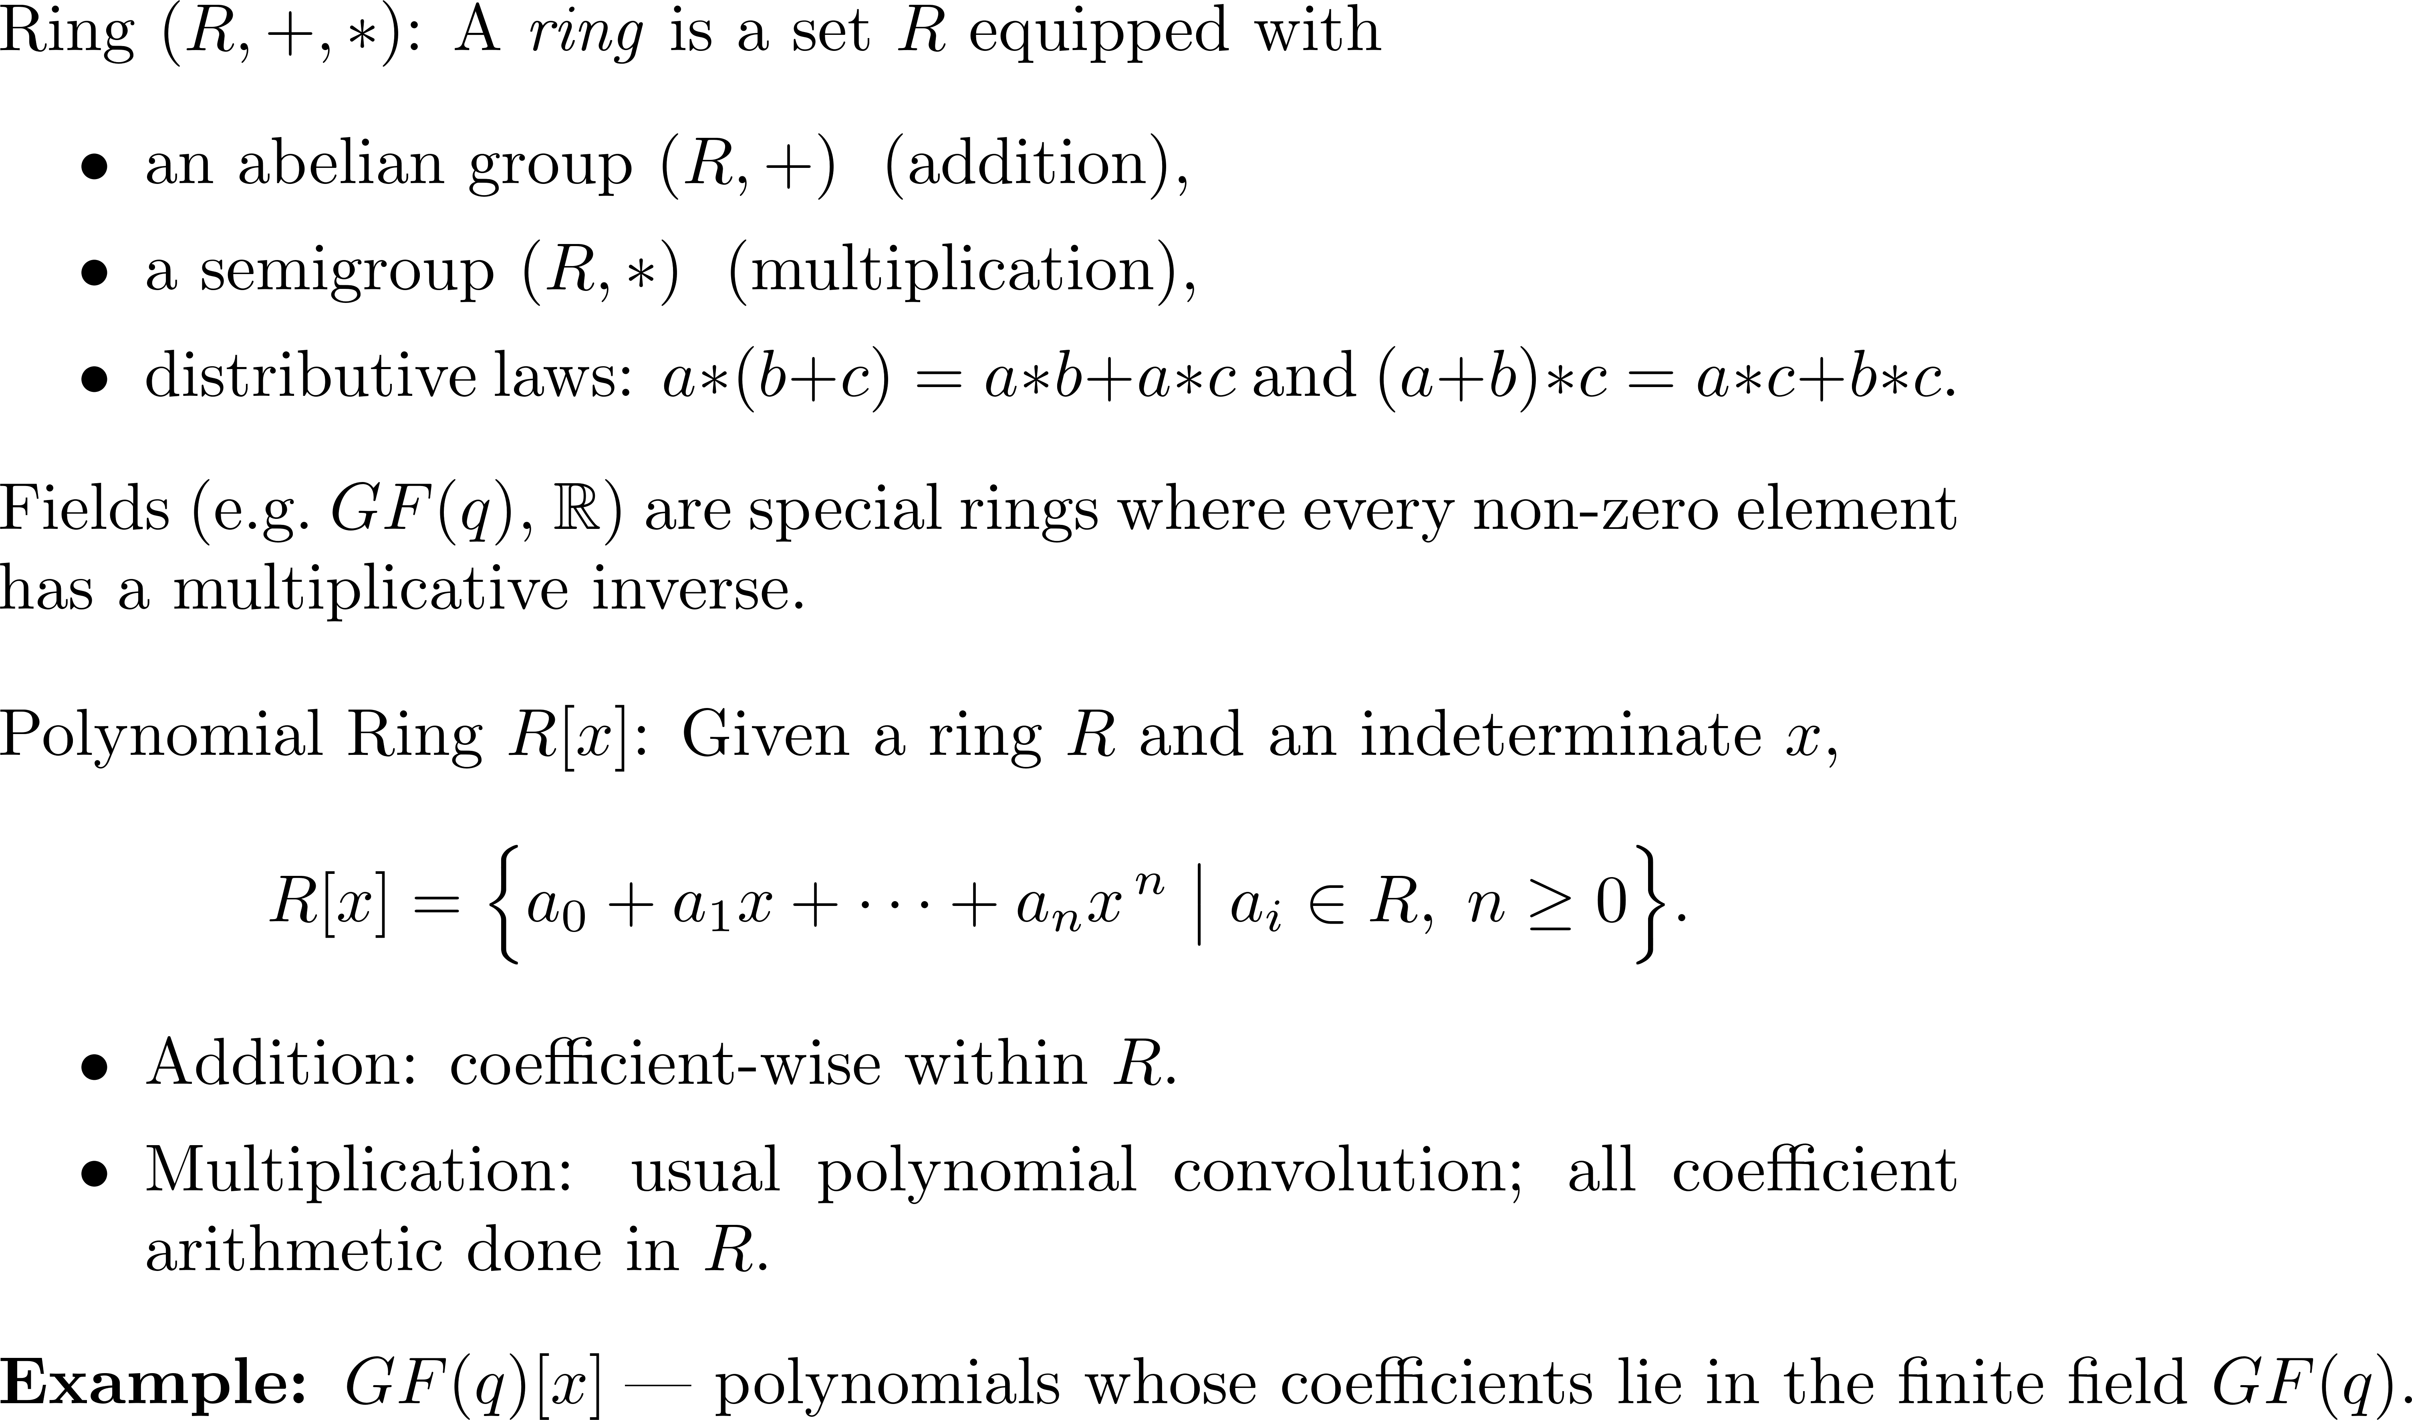

Slide 13
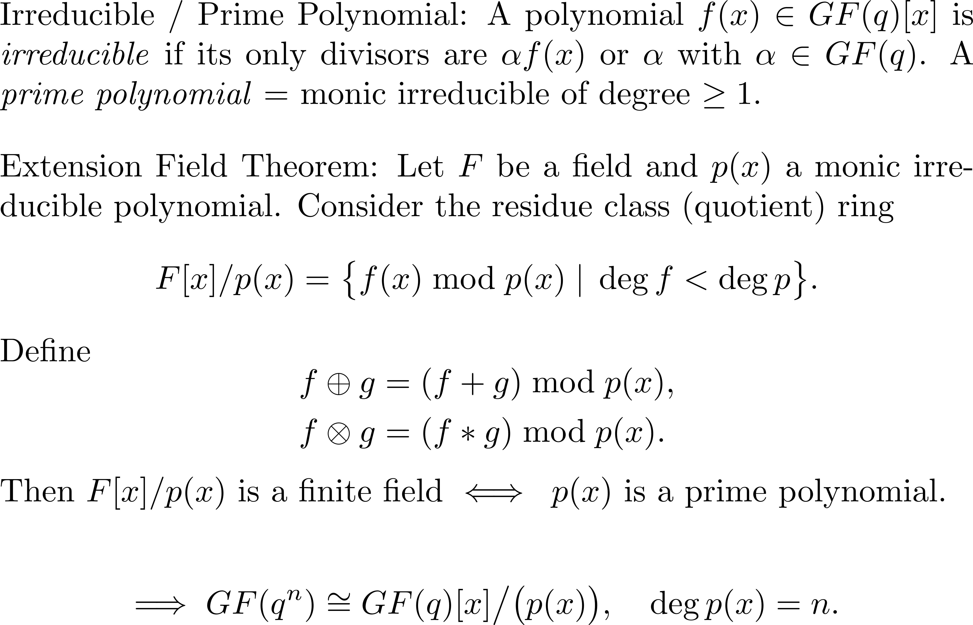
Prime polynomials and F[x]/p(x)

Slide 14
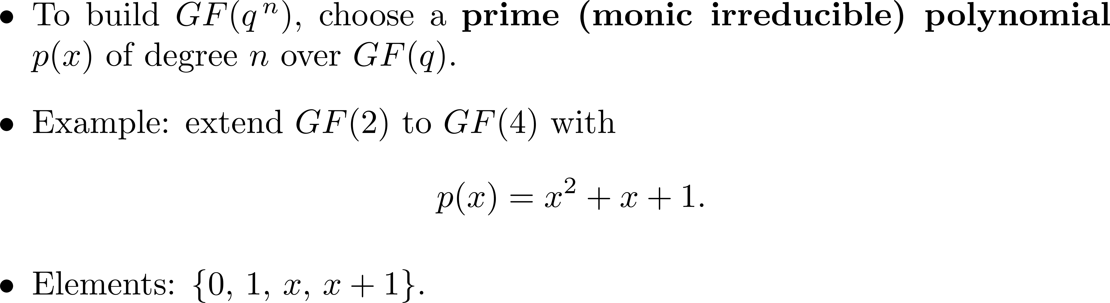
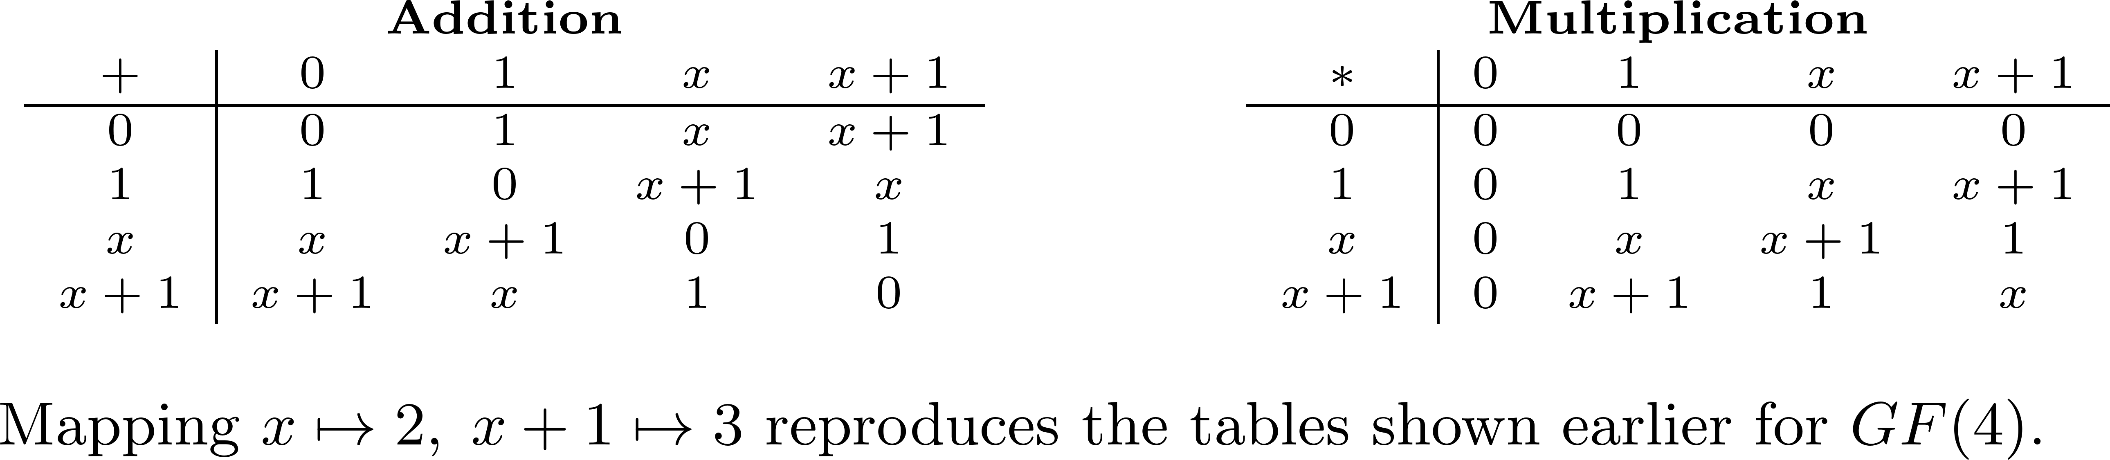
Field extension via prime polynomial

Slide 15
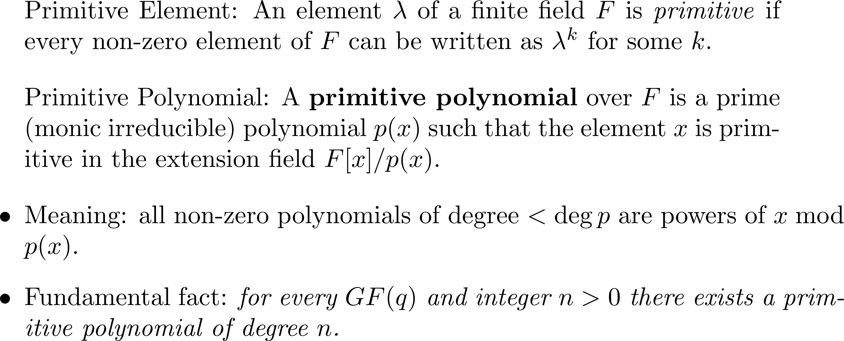
Primitive element and primitive polynomial

Slide 16
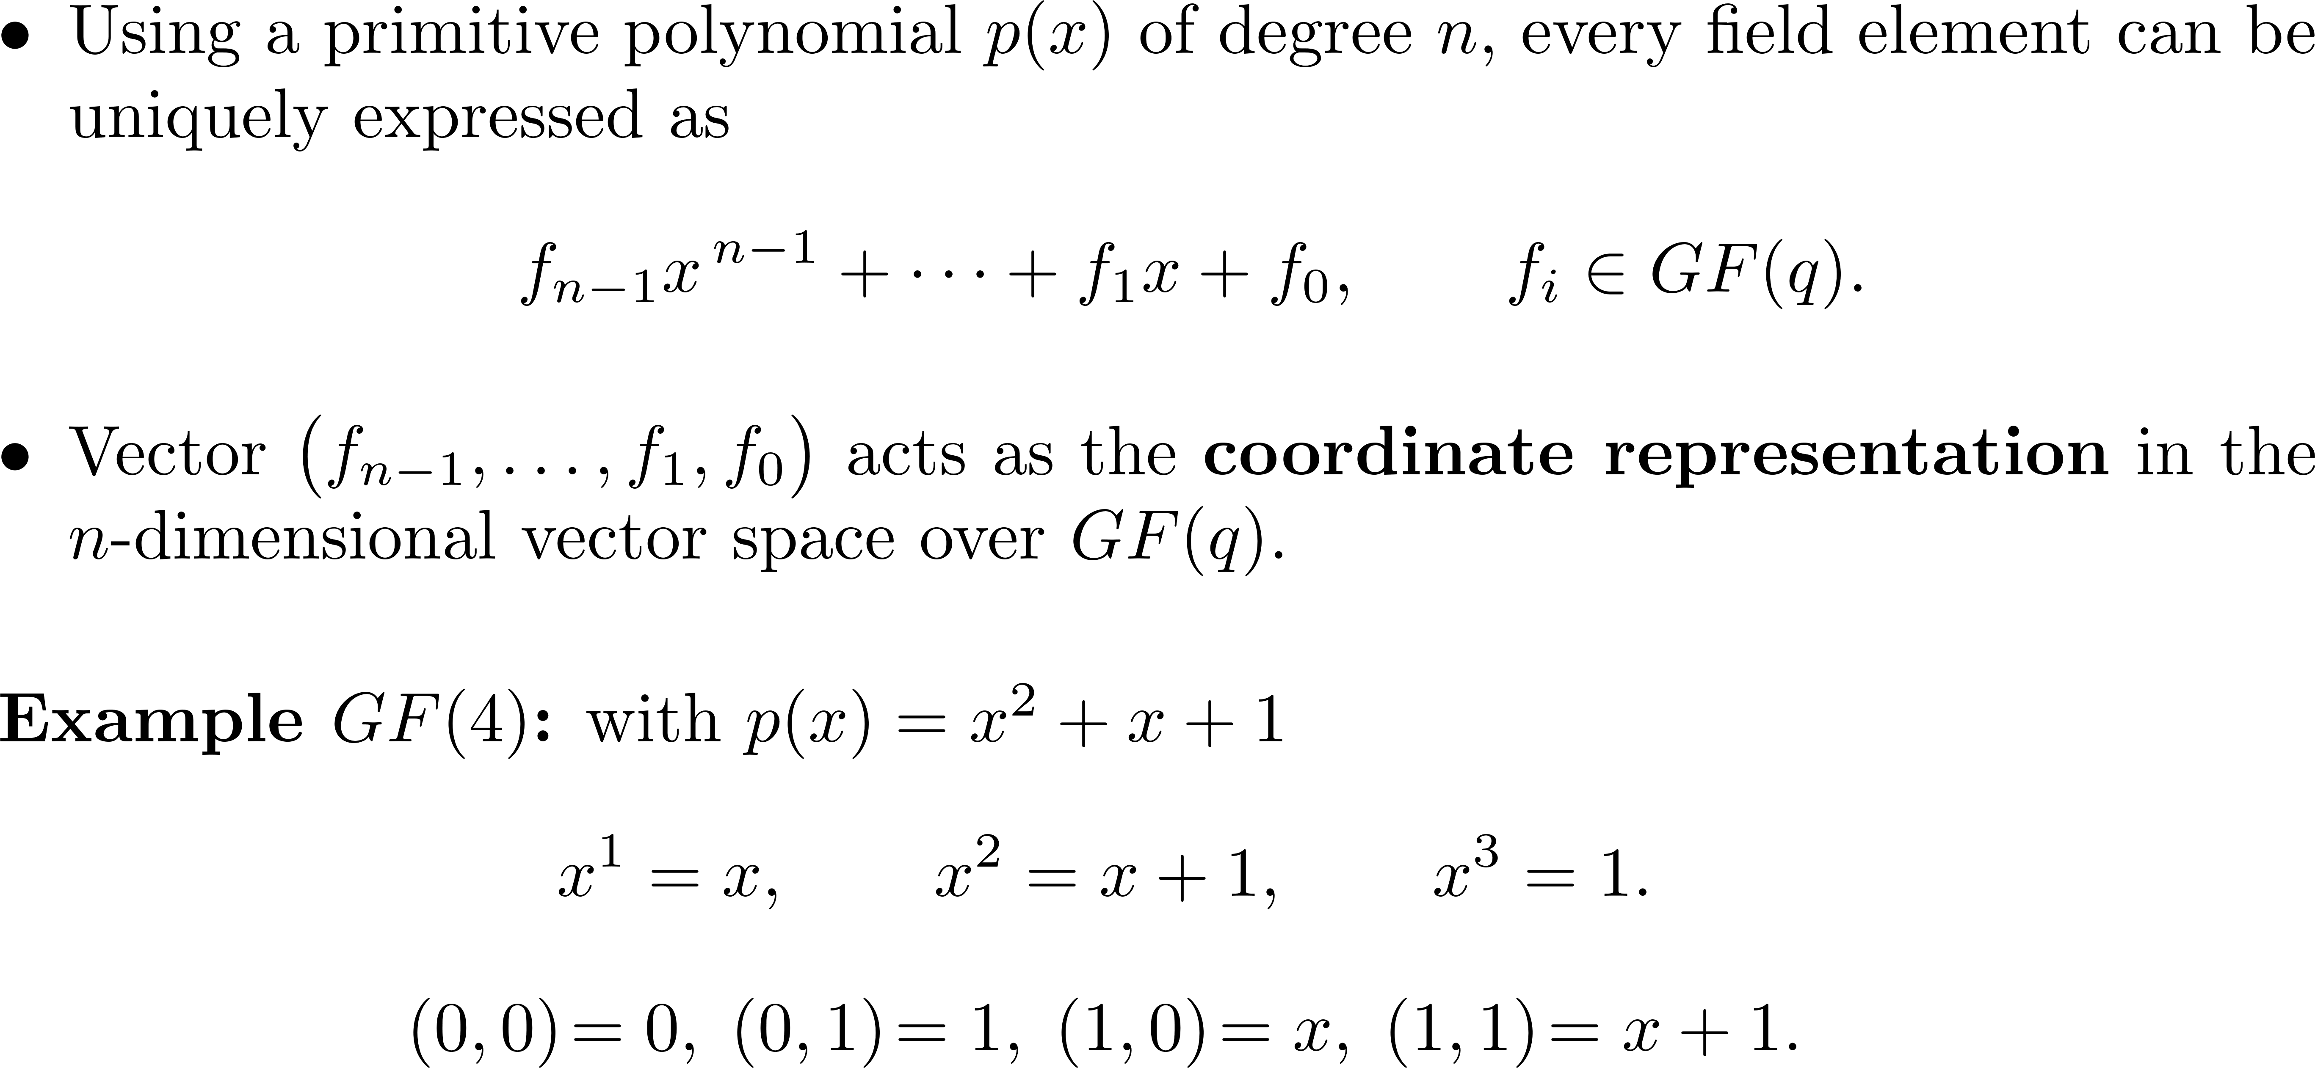
Coordinates in GF(q^{n})

Slide 17
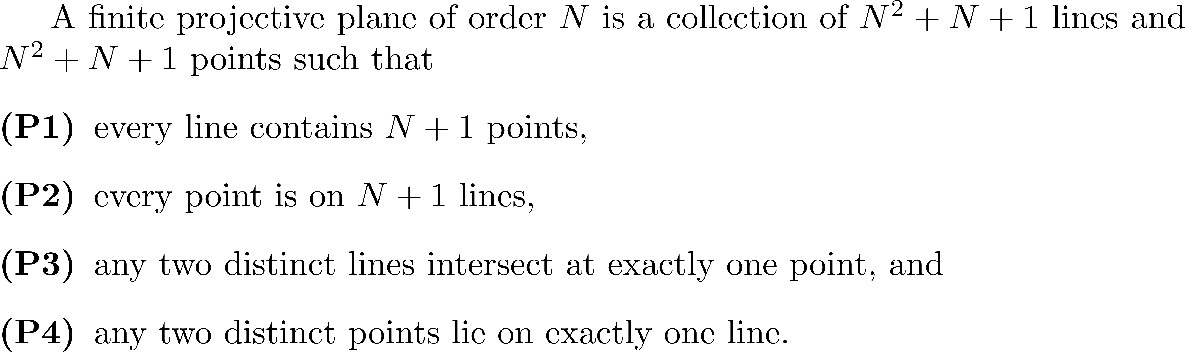
Constructions of finite projective planes PG(2,q)
The finite projective plane of order 1 is simply a triangle that consists of three points and three lines.

Slide 18
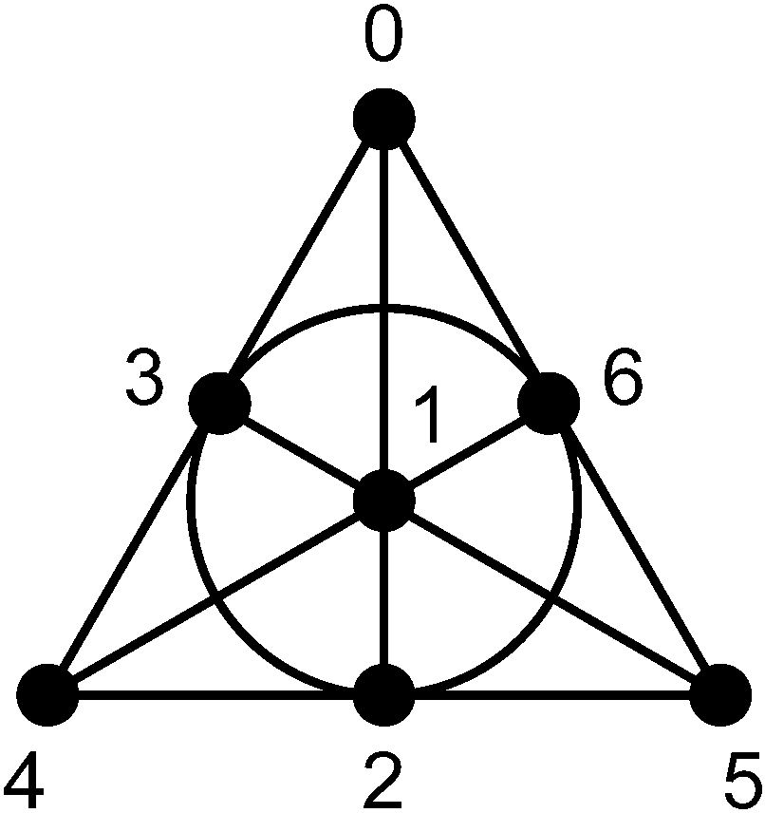
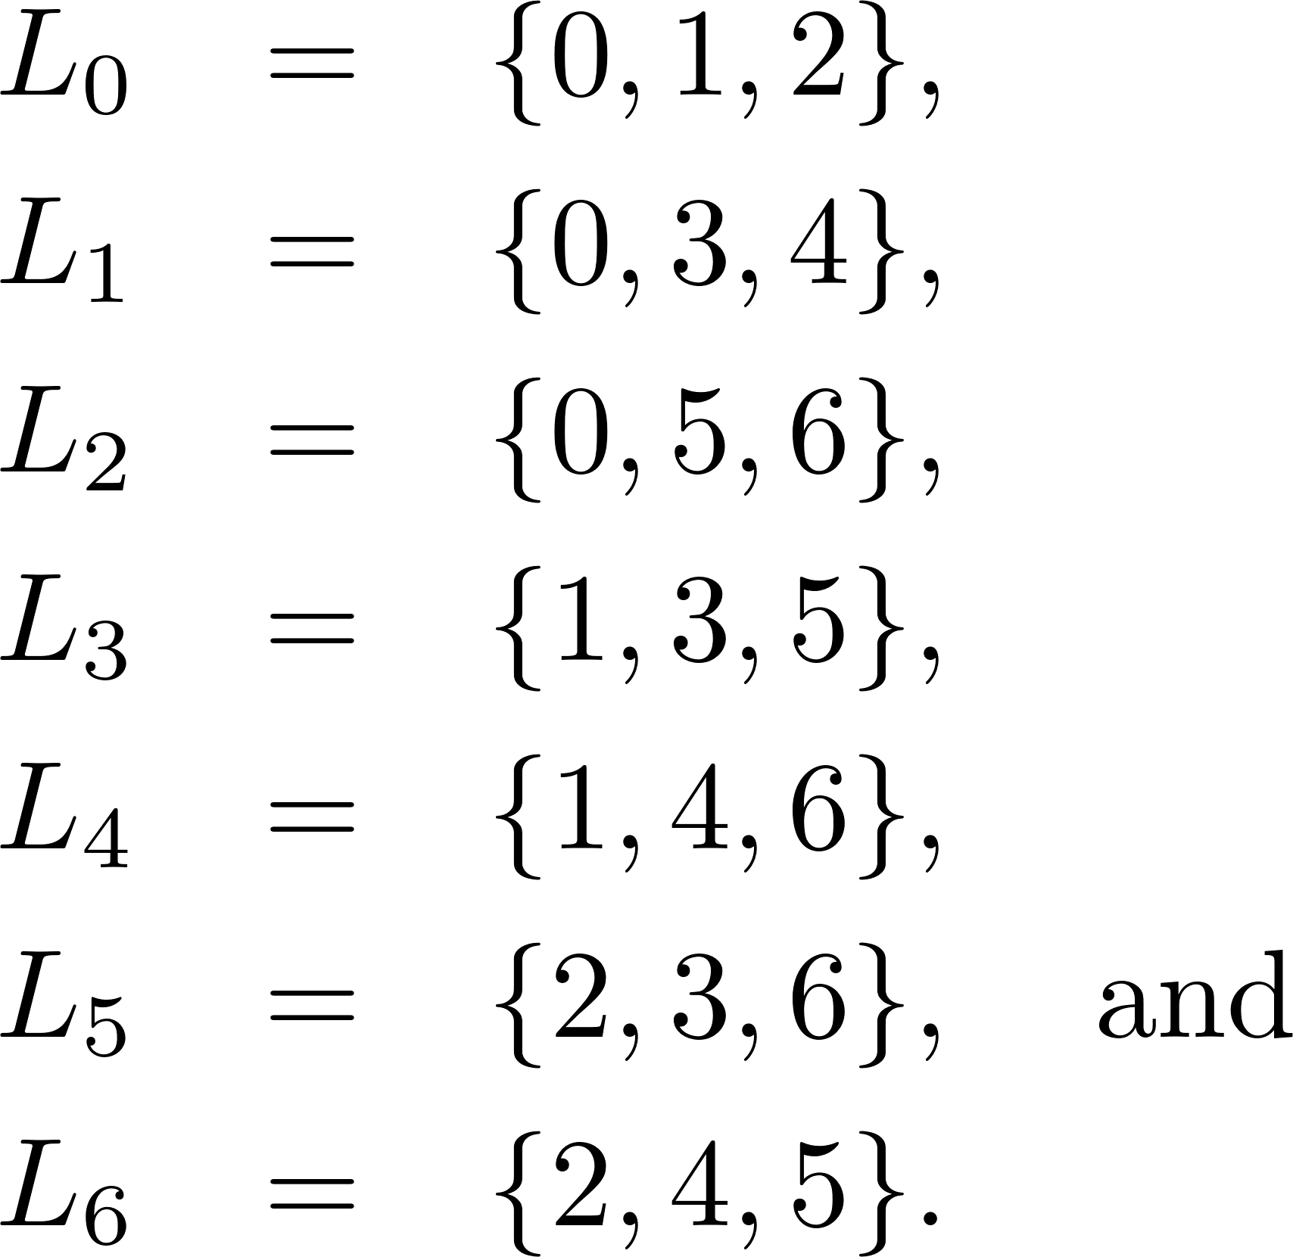
The Fano plane (order 2)

Slide 19
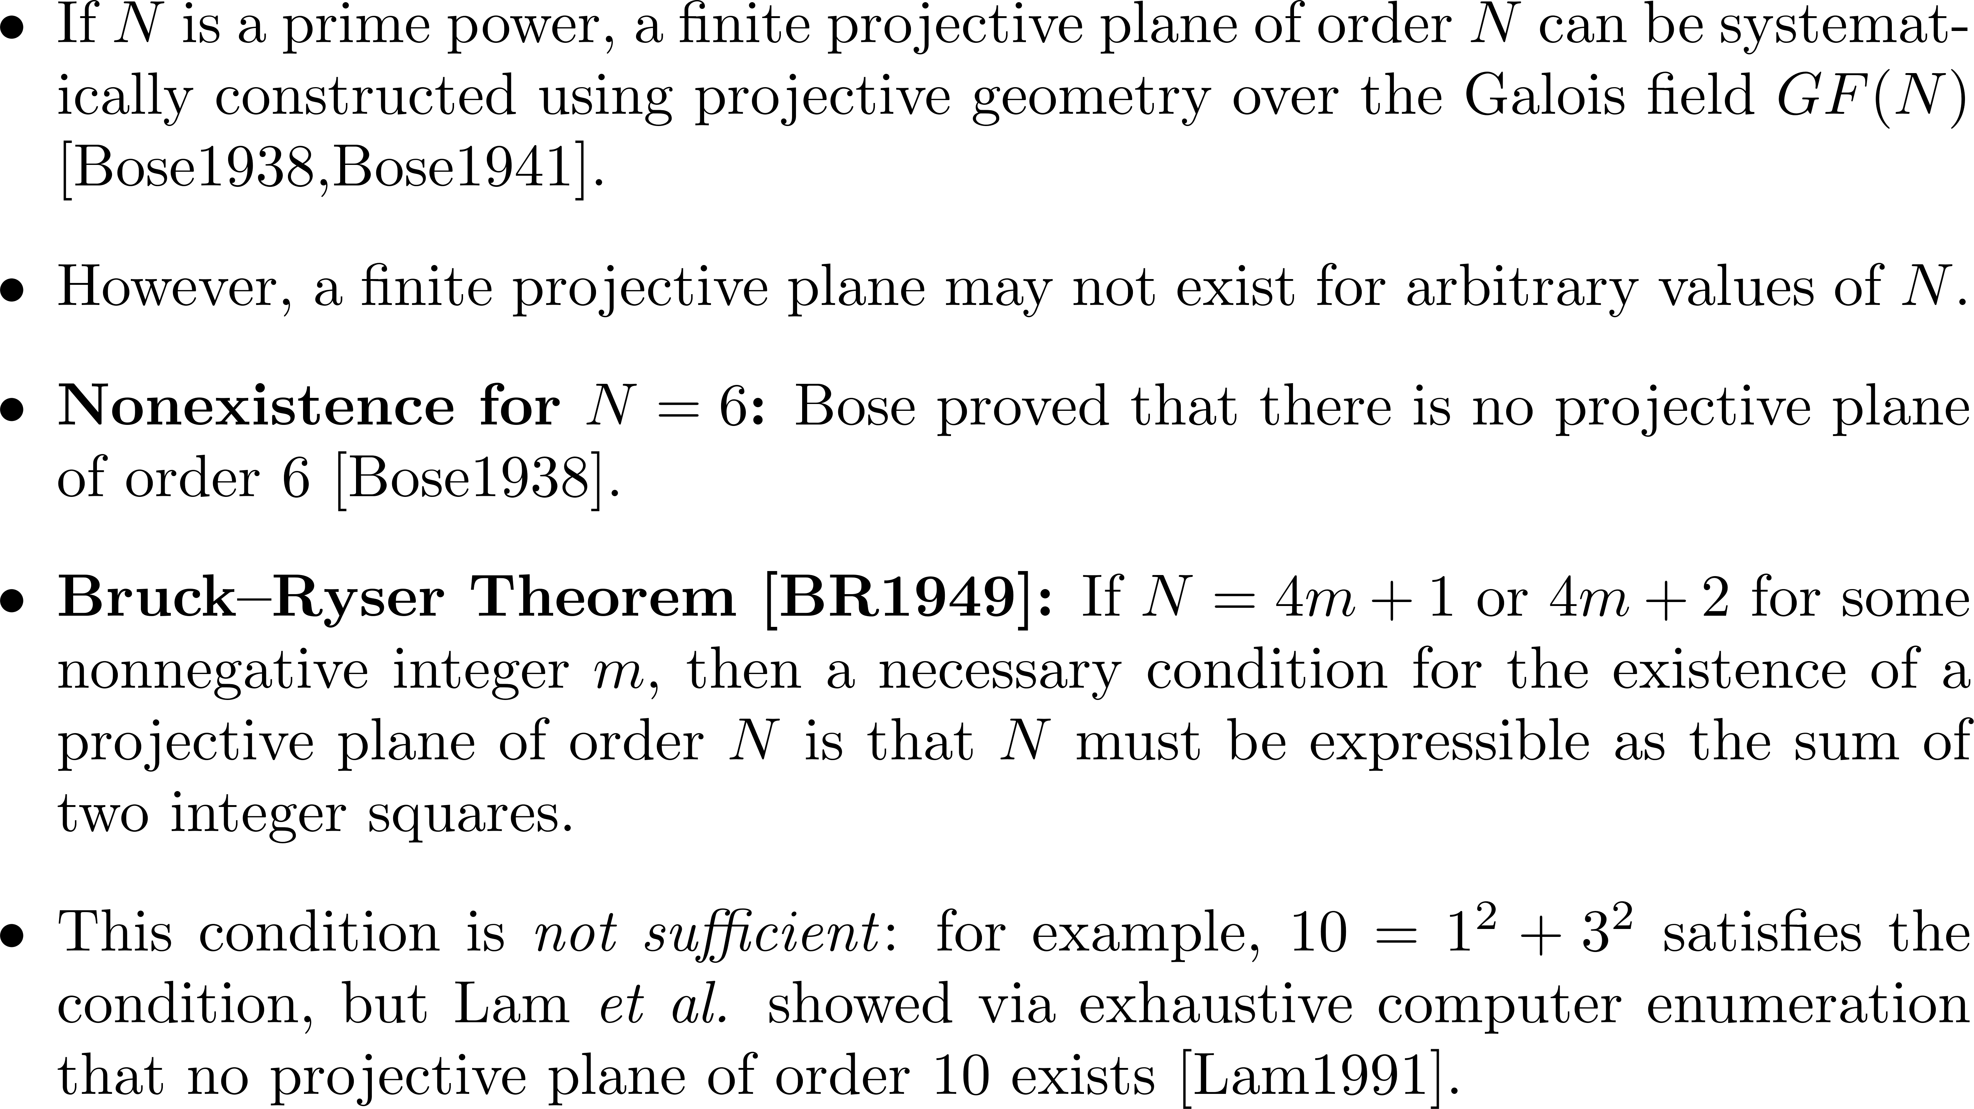
Existence of Finite Projective Planes

Slide 20
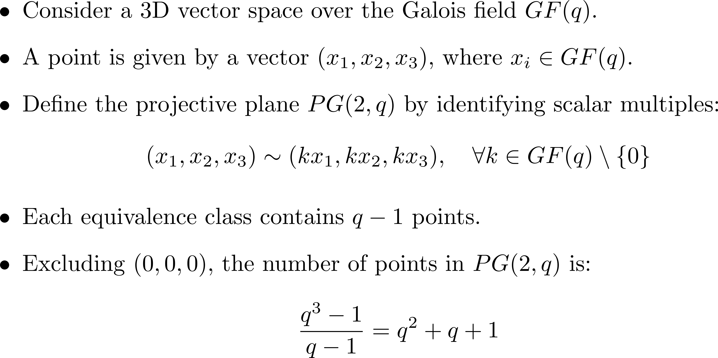
Construct a finite projective plane from a Galois field

Slide 21
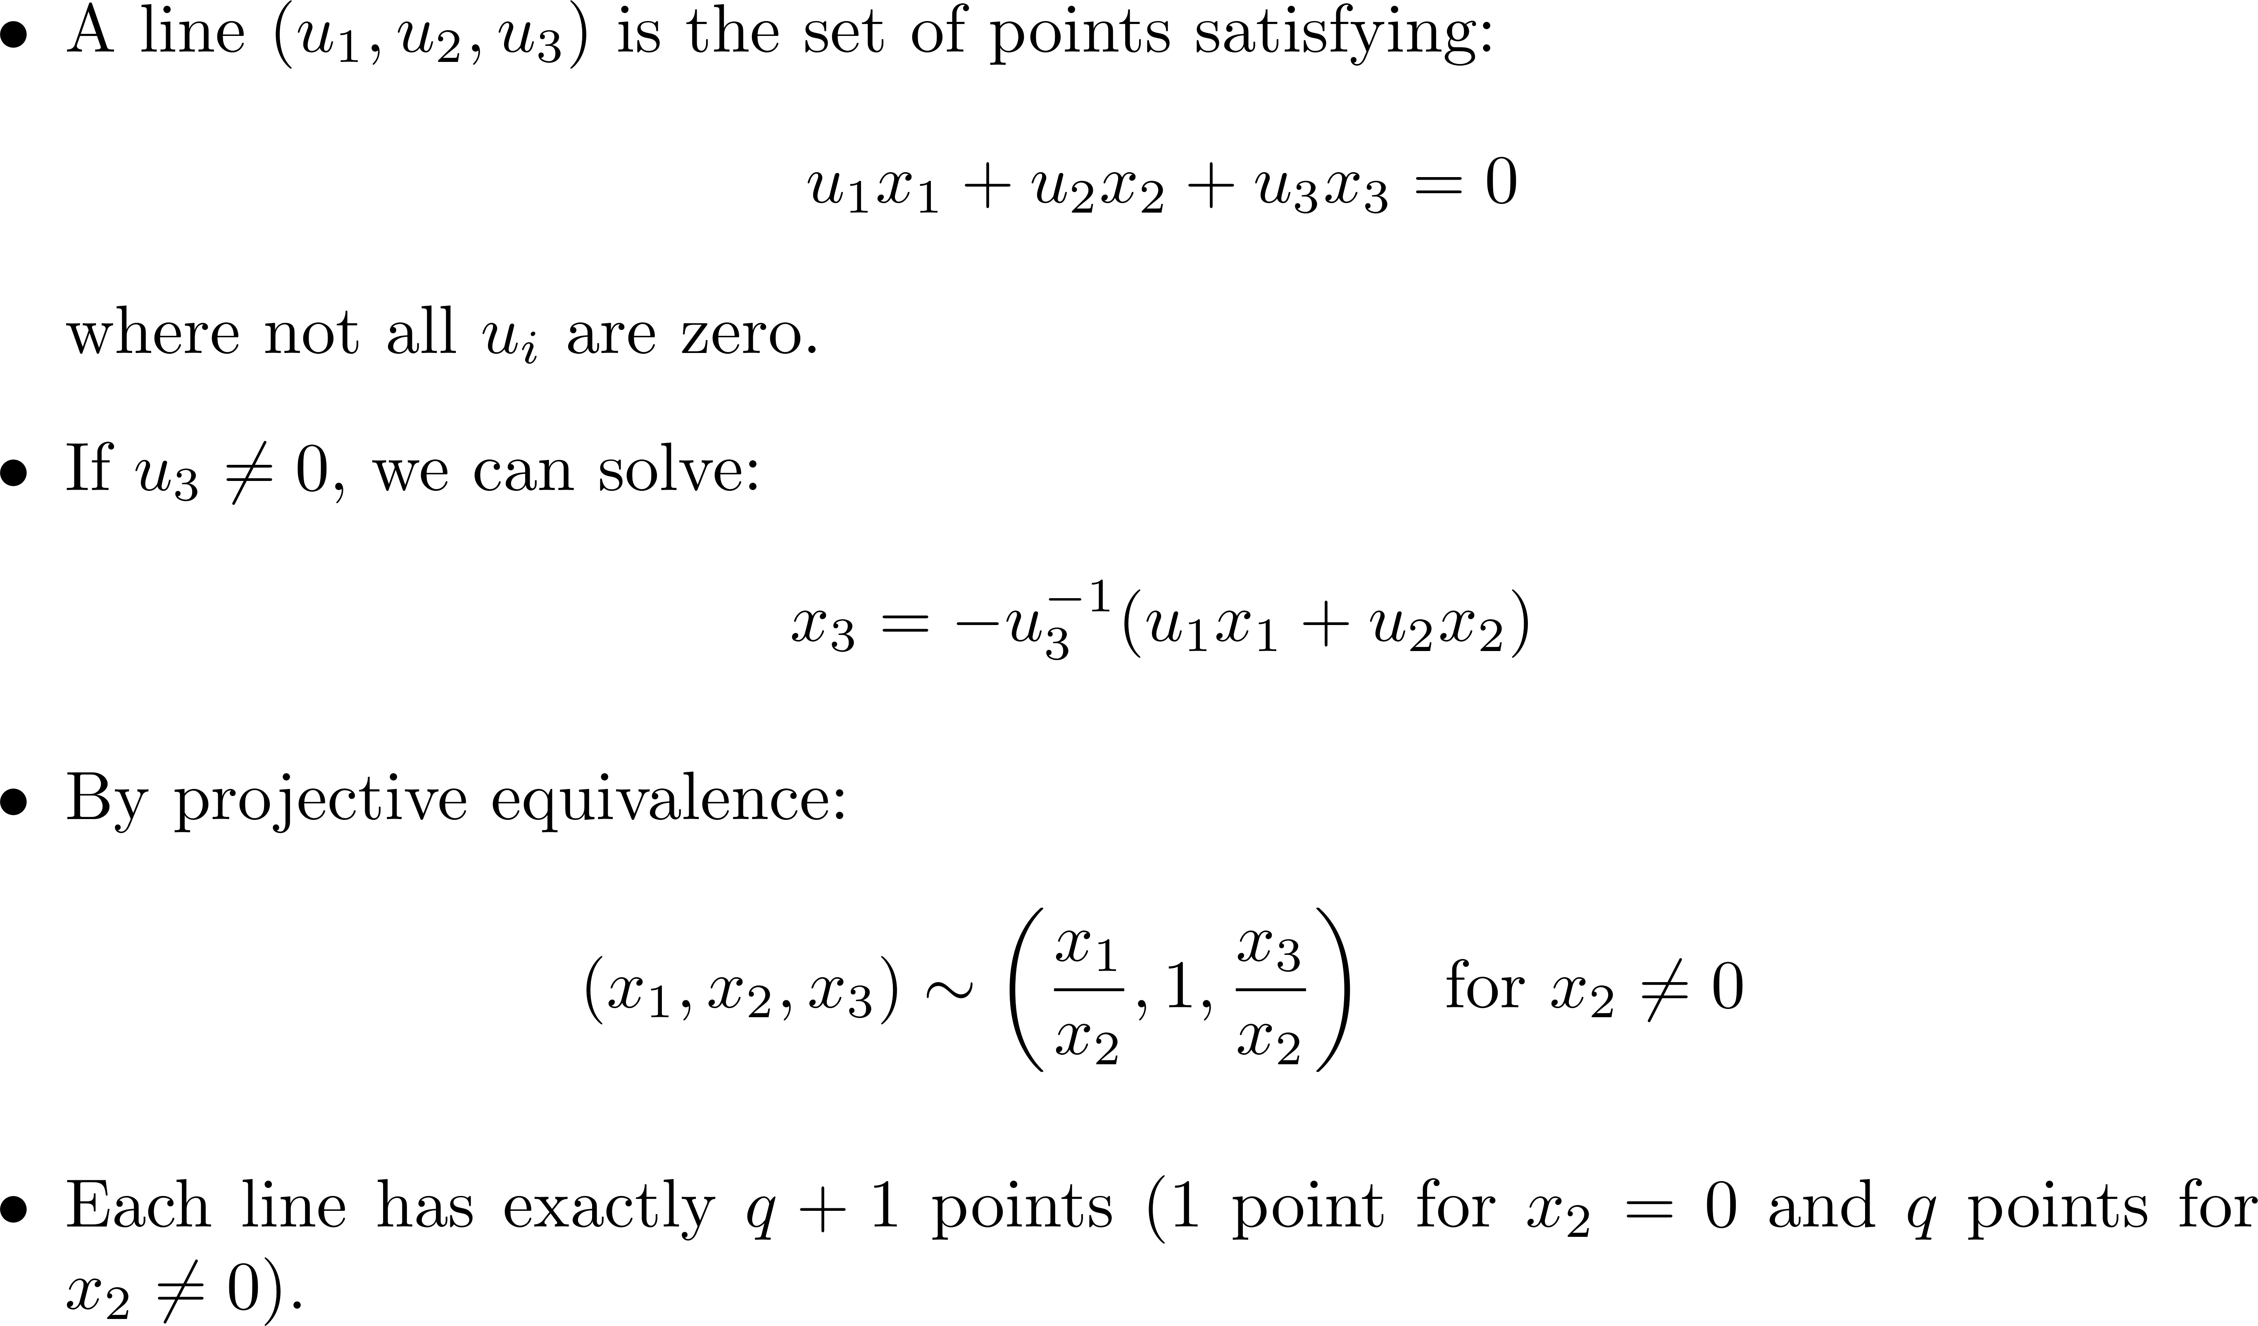
Lines and Properties of PG(2,q)

Slide 22
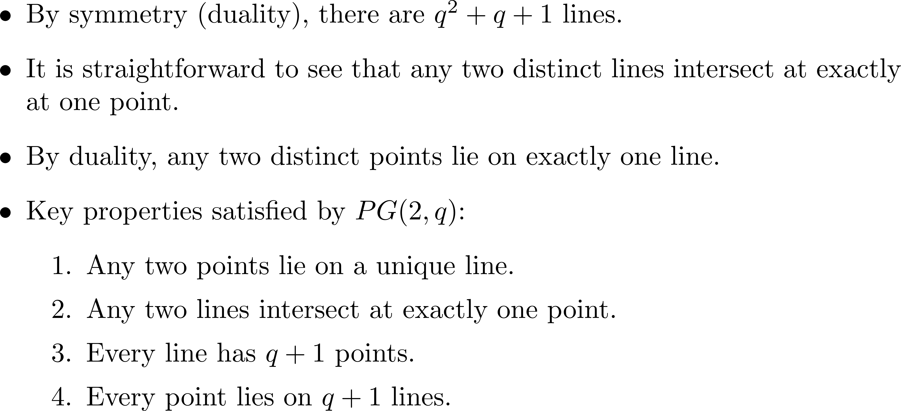

Slide 23
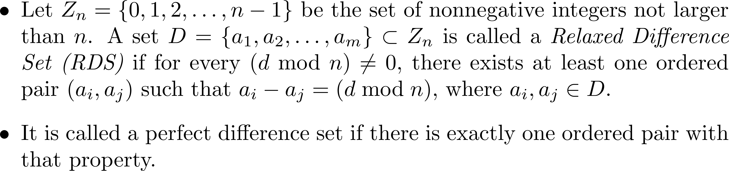
Singer’s construction of a perfect difference set from the finite projective plane PG(2,q)

Slide 24
S={1,2,4} is a (3,7)-perfect difference set
0 | 1 | 2 | 3 | 4 | 5 | 6 | 7 | 8 | 9 | 10 | 11 | 12 | 13 | 14
d=1
d=2
d=3

Slide 25
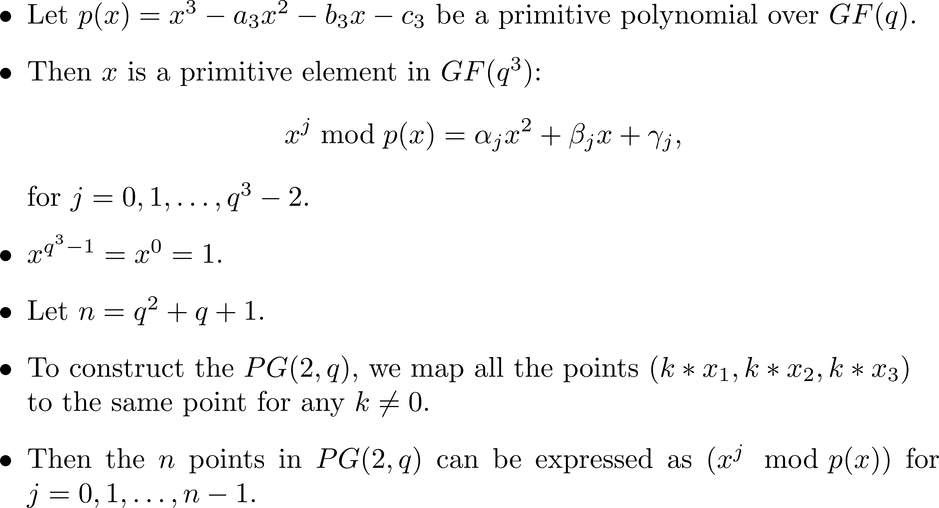
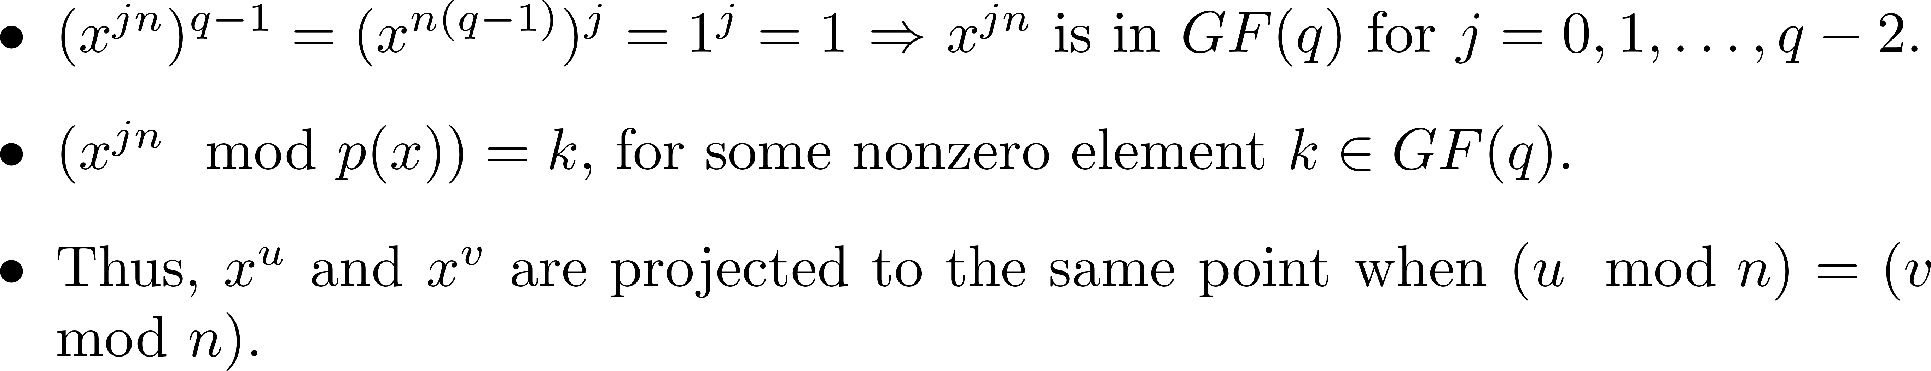
Primitive Polynomial and PG(2,q)

Slide 26
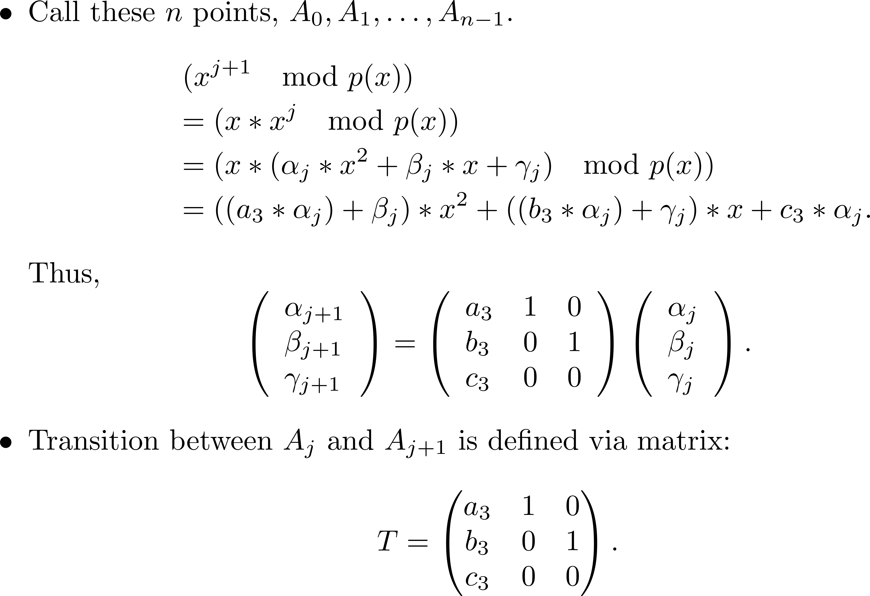

Slide 27
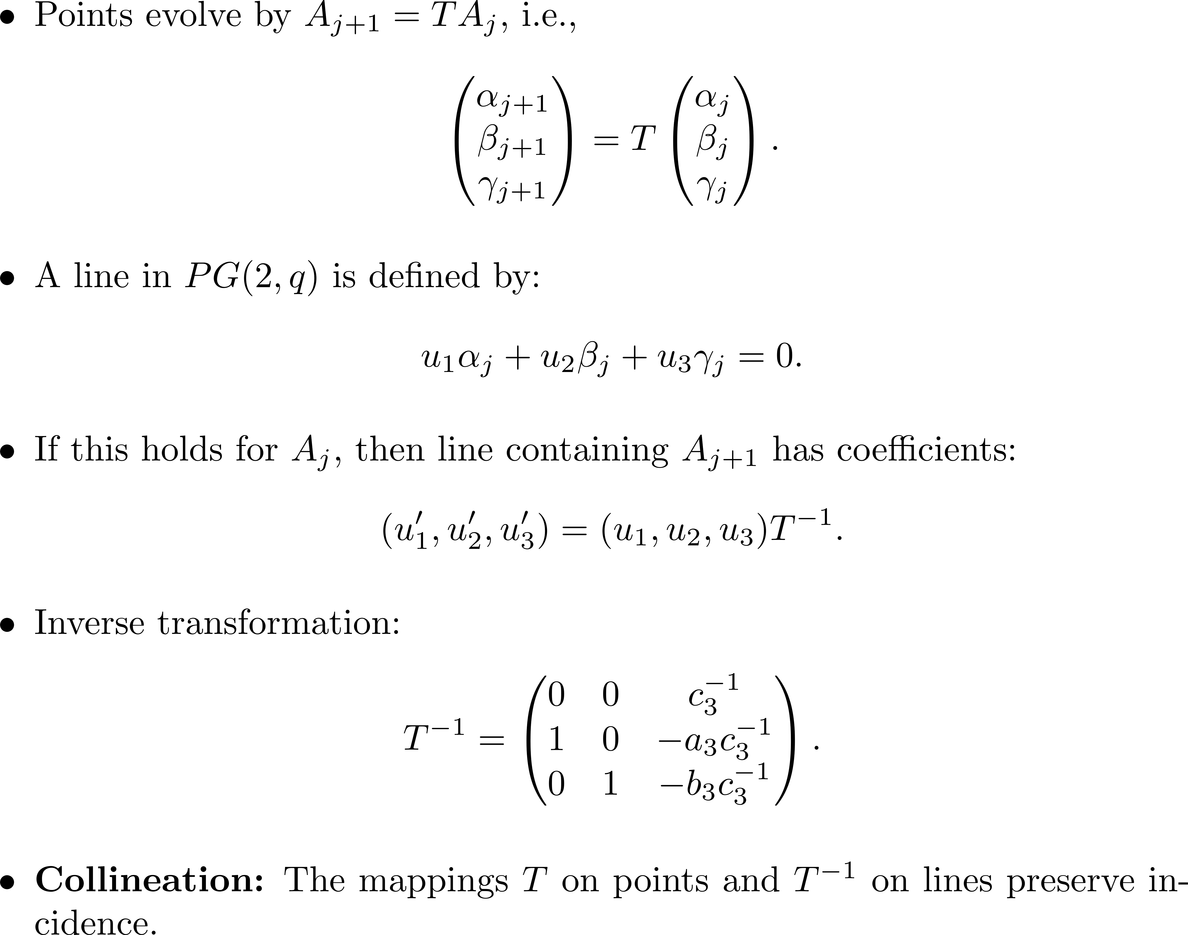
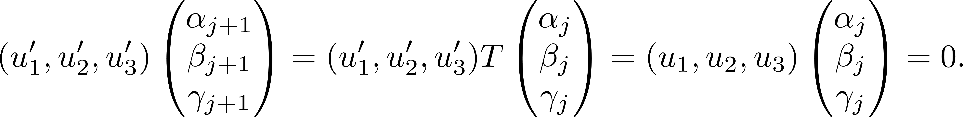
Collineation and Line Transformation

Slide 28
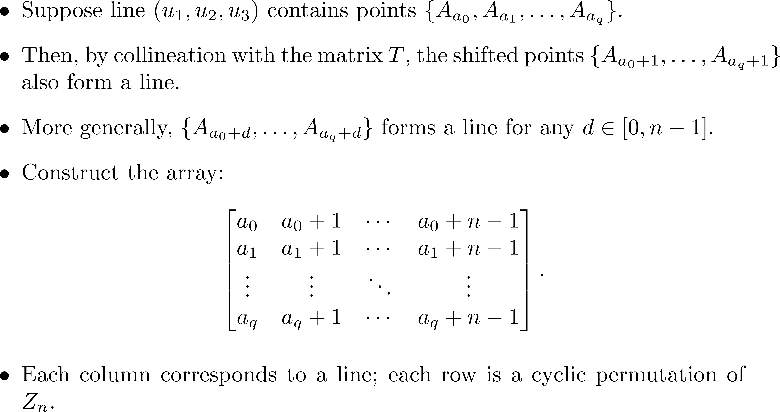
Lines via Collineation

Slide 29
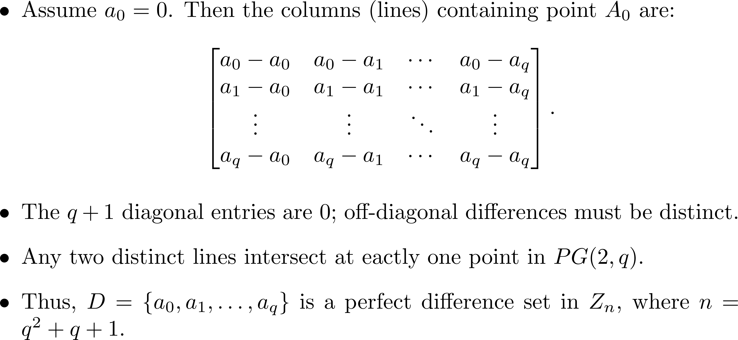
Perfect Difference Sets and PG(2,q)

Slide 30
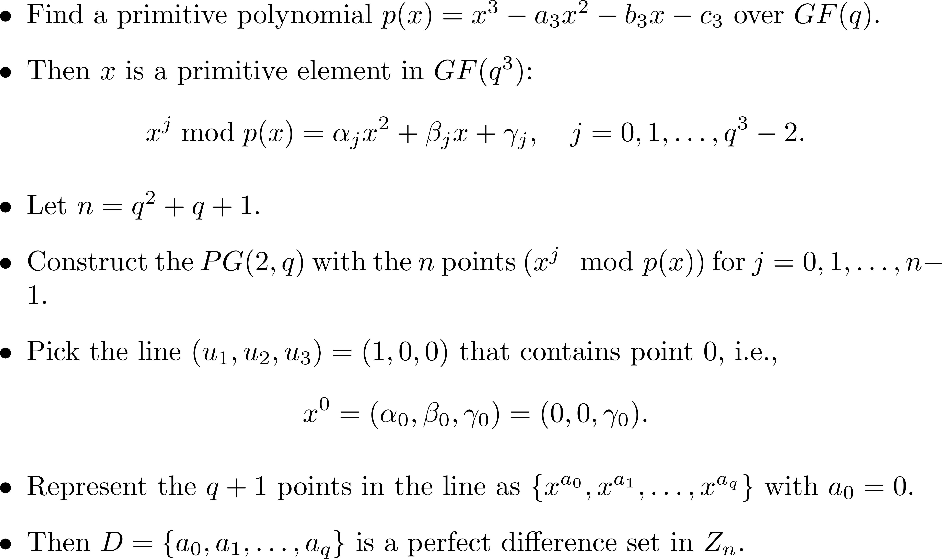
Singer’s construction

Slide 31
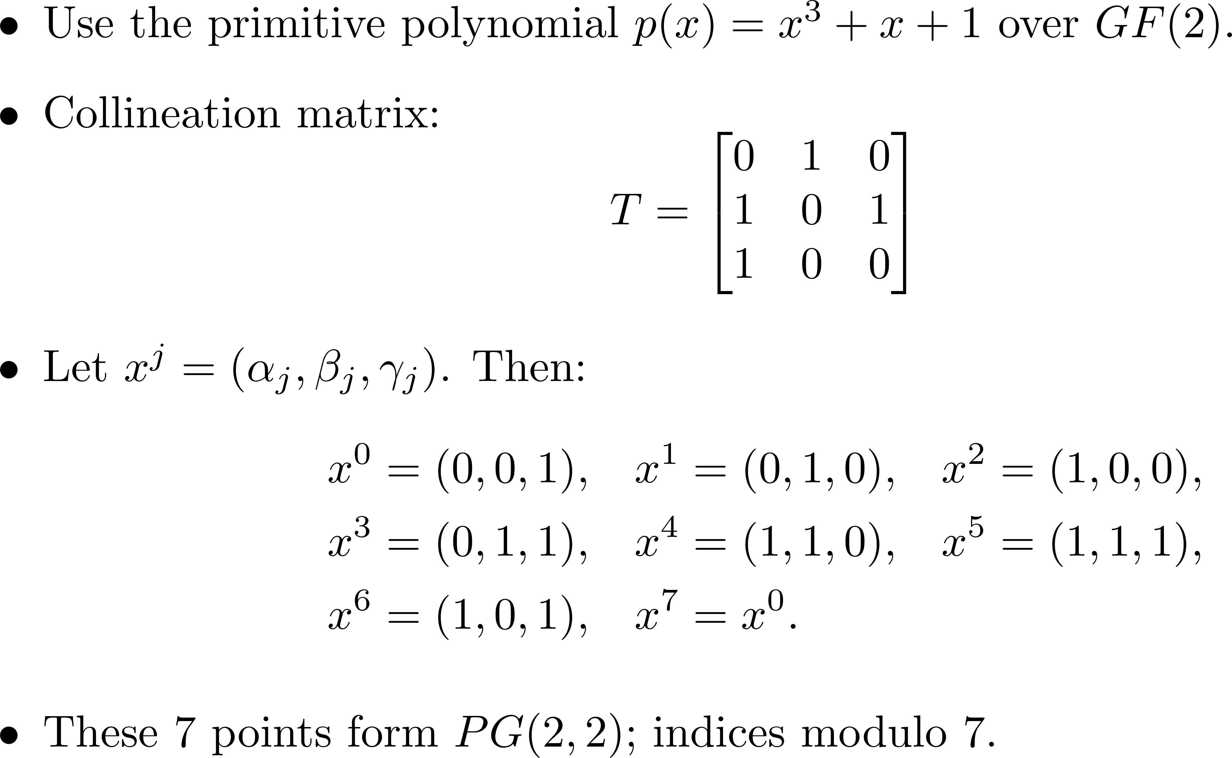
Example: Primitive Polynomial over GF(2)

Slide 32
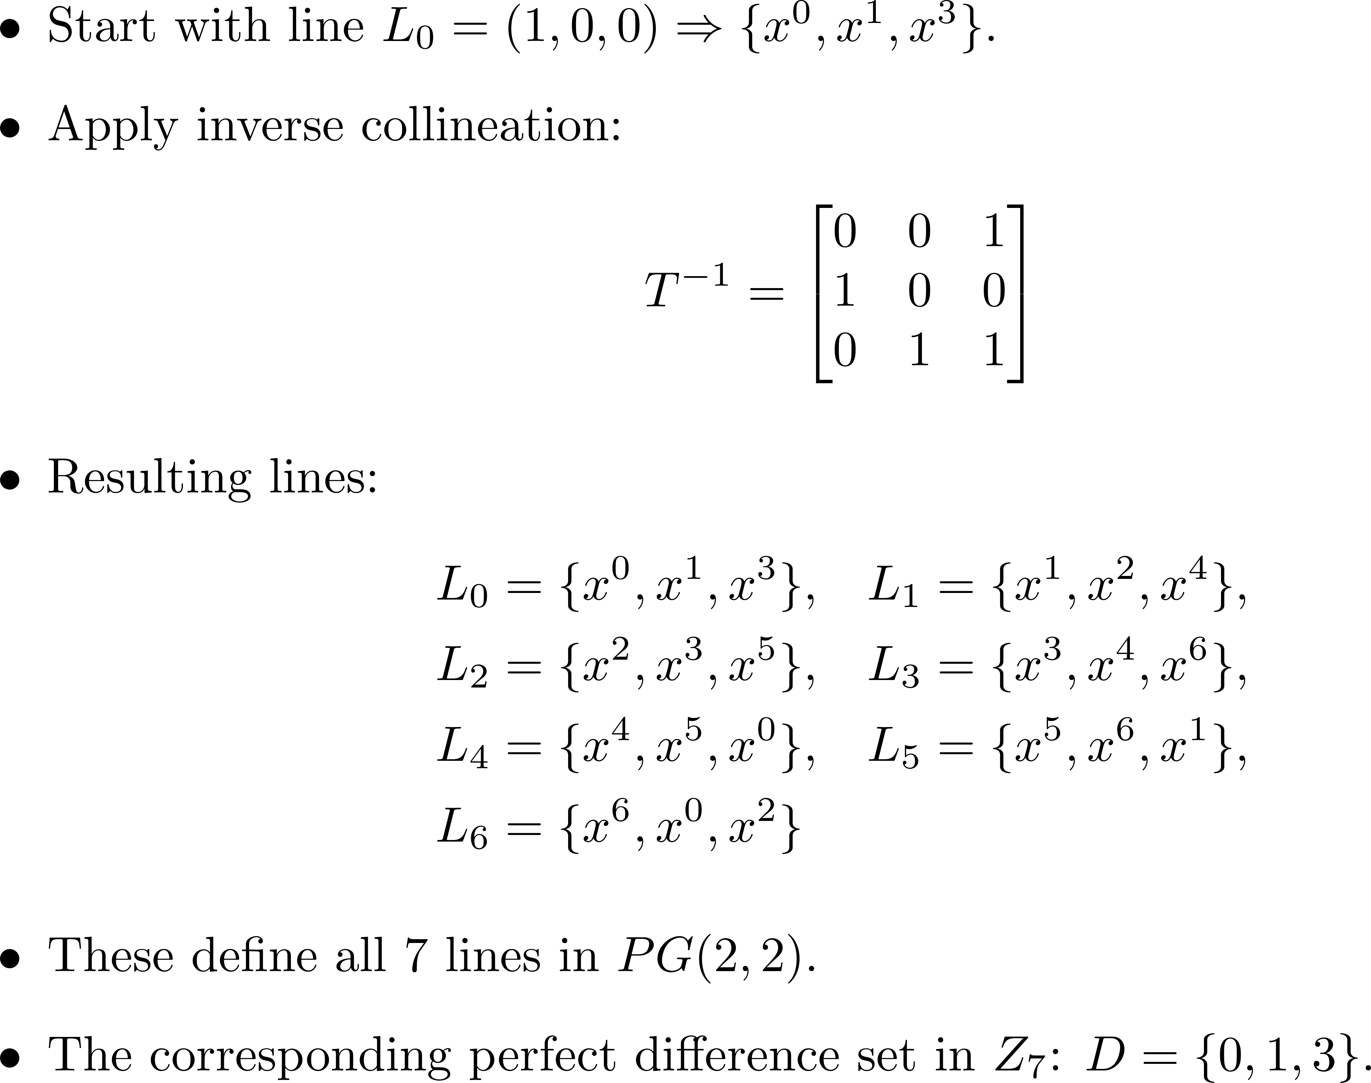
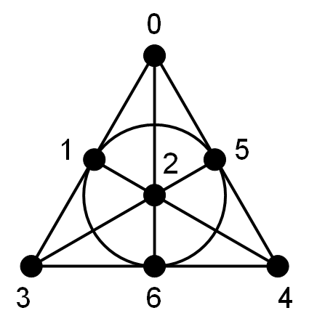
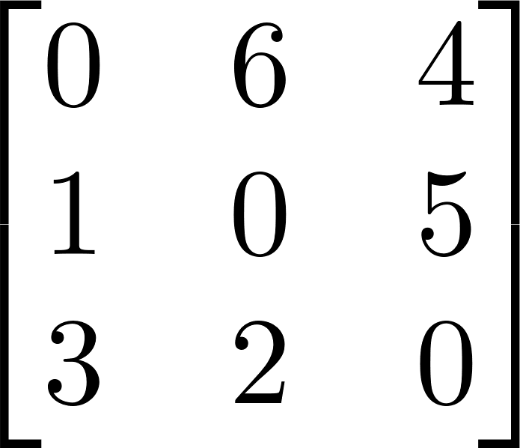
Lines and the Perfect Difference Set in Z₇

Slide 33
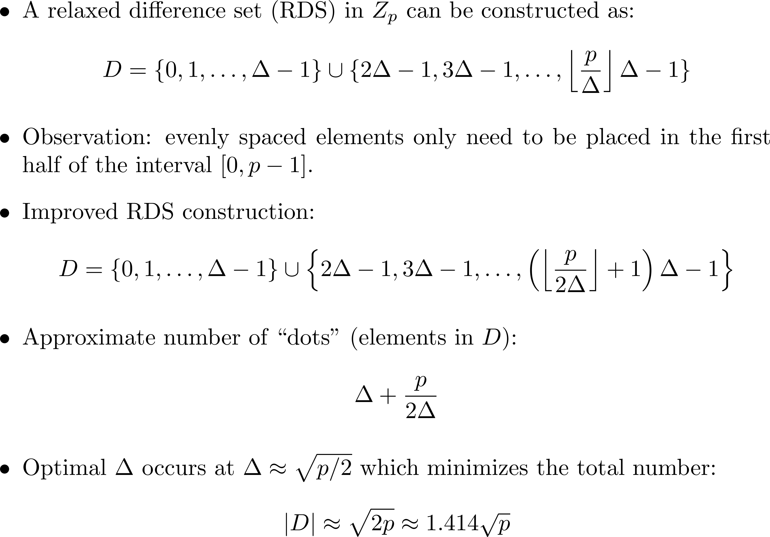
Construction of Relaxed Difference Sets (RDS)

Slide 34
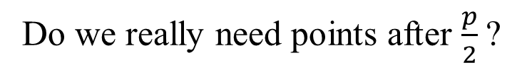
Construction of an RDS with p = 23, |D| = $\left\lceil \sqrt{p}\right\rceil$ = 5
1 | 2 | 3 | 4 | 5 | 6 | 7 | 8 | 9 | 10 | 11 | 12 | 13 | 14 | 15 | 16 | 17 | 18 | 19 | 20 | 21 | 22 | 23
Do we really need points after $\frac{p}{2}$?

Slide 35
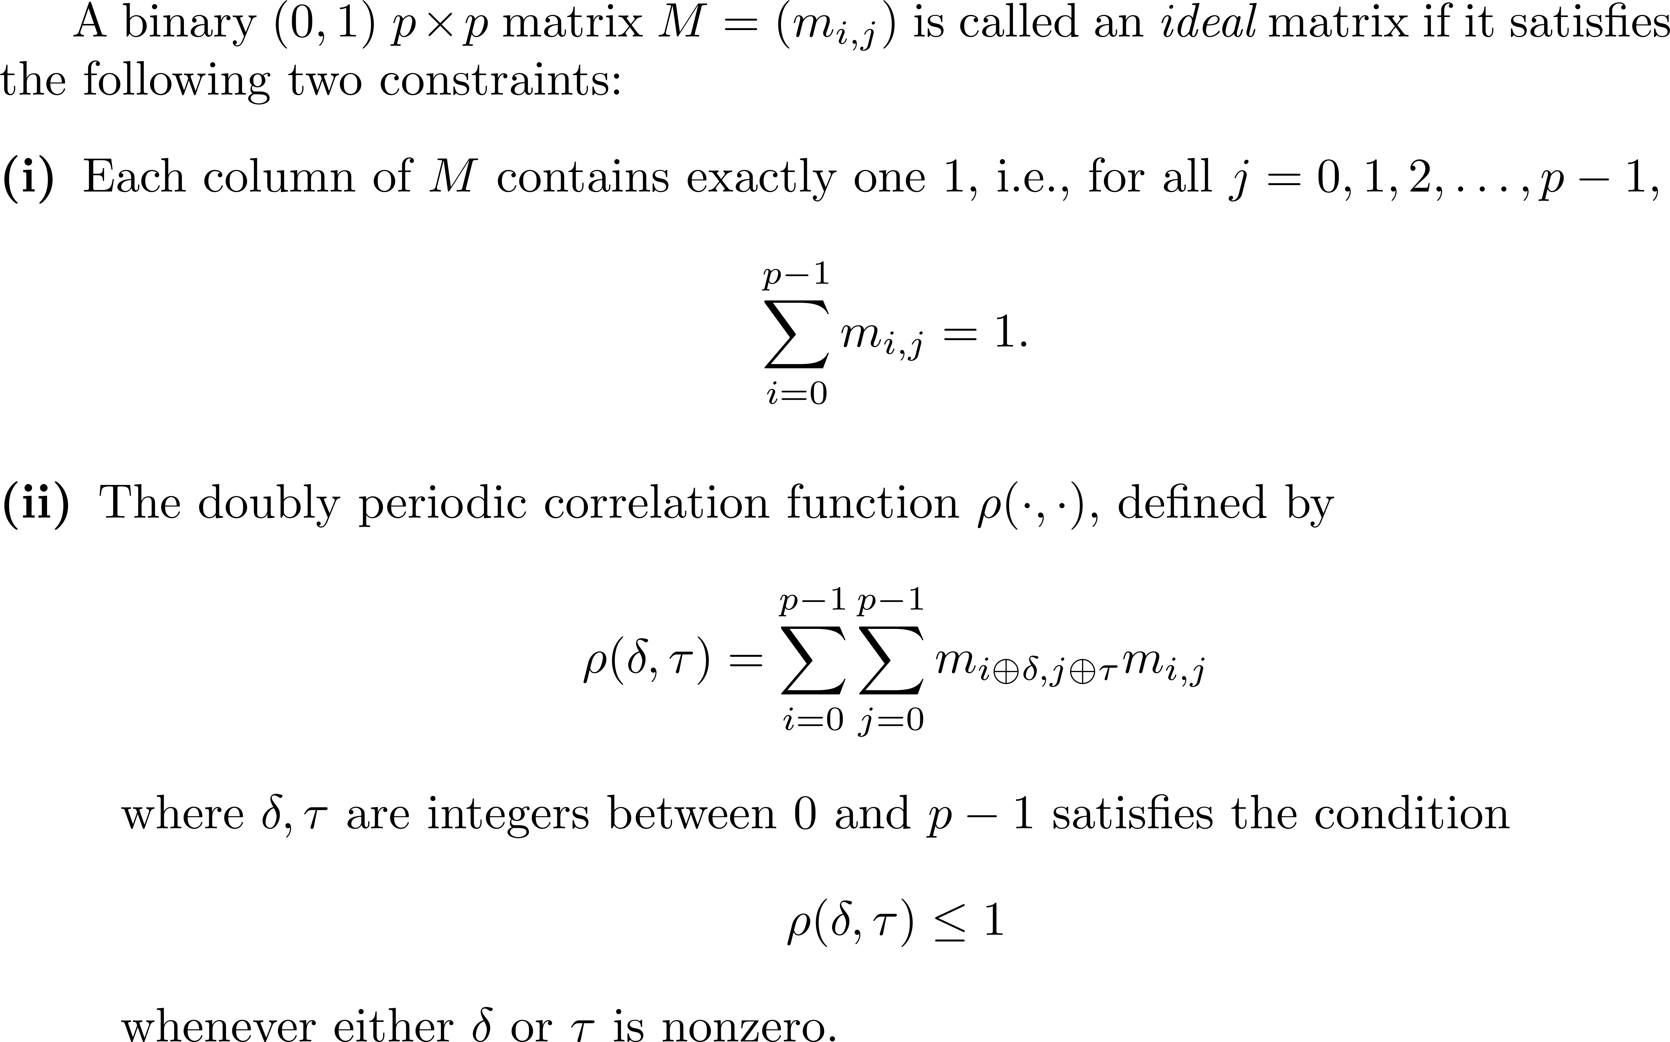
Ideal matrices

Slide 36


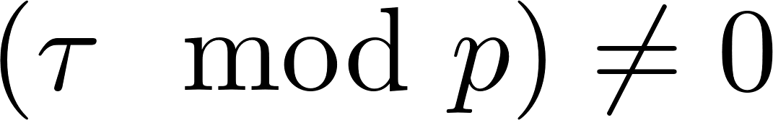
Ideal matrices
A binary (0,1) ideal matrix has the following three important properties:
(No shift) If all dots overlap.
(Purely vertical shifts) If no dot will overlap.
(The other shifts) For any other shifts, i.e., exactly one pair of dots will overlap.
A ideal matrix M can be constructed when p is a prime. (The Elliot-Butson construction)

Slide 37

Ideal matrices
Example: A ideal matrix (0-1 binary matrix).
 |  |  | 1
 |  | 1 |  | 1
 | 1 |  |  |  | 1
1 |  |  |  |  |  | 1

Slide 38


 |  |  | 1 |  |  |  |  |  |  | 1
 |  | 1 |  | 1 |  |  |  |  | 1 |  | 1
 | 1 |  |  |  | 1 |  |  | 1 |  |  |  | 1
1 |  |  |  |  |  | 1 | 1 |  |  |  |  |  | 1
 |  |  | 1 |  |  |  |  |  |  | 1
 |  | 1 |  | 1 |  |  |  |  | 1 |  | 1
 | 1 |  |  |  | 1 |  |  | 1 |  |  |  | 1
1 |  |  |  |  |  | 1 | 1 |  |  |  |  |  | 1
 |  |  | 1
 |  | 1 |  | 1
 | 1 |  |  |  | 1
1 |  |  |  |  |  | 1

Slide 39

 |  |  | 1 |  |  |  |  |  |  | 1
 |  | 1 |  | 1 |  |  |  |  | 1 |  | 1
 | 1 |  |  |  | 1 |  |  | 1 |  |  |  | 1
1 |  |  |  |  |  | 1 | 1 |  |  |  |  |  | 1
 |  |  | 1 |  |  |  |  |  |  | 1
 |  | 1 |  | 1 |  |  |  |  | 1 |  | 1
 | 1 |  |  |  | 1 |  |  | 1 |  |  |  | 1
1 |  |  |  |  |  | 1 | 1 |  |  |  |  |  | 1
 |  |  | 1
 |  | 1 |  | 1
 | 1 |  |  |  | 1
1 |  |  |  |  |  | 1

Slide 40

 |  |  | 1 |  |  |  |  |  |  | 1
 |  | 1 |  | 1 |  |  |  |  | 1 |  | 1
 | 1 |  |  |  | 1 |  |  | 1 |  |  |  | 1
1 |  |  |  |  |  | 1 | 1 |  |  |  |  |  | 1
 |  |  | 1 |  |  |  |  |  |  | 1
 |  | 1 |  | 1 |  |  |  |  | 1 |  | 1
 | 1 |  |  |  | 1 |  |  | 1 |  |  |  | 1
1 |  |  |  |  |  | 1 | 1 |  |  |  |  |  | 1
 |  |  | 1
 |  | 1 |  | 1
 | 1 |  |  |  | 1
1 |  |  |  |  |  | 1

Slide 41
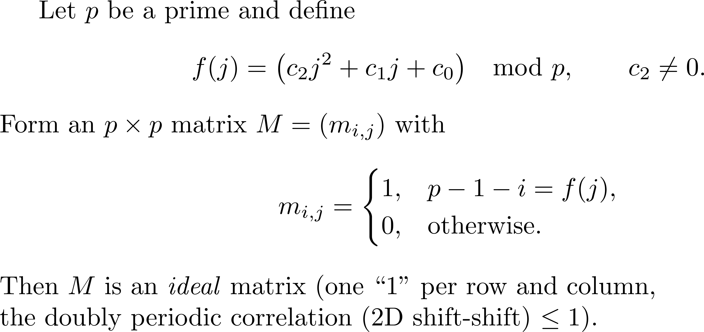
The Elliot-Butson construction of ideal matrices

Slide 42
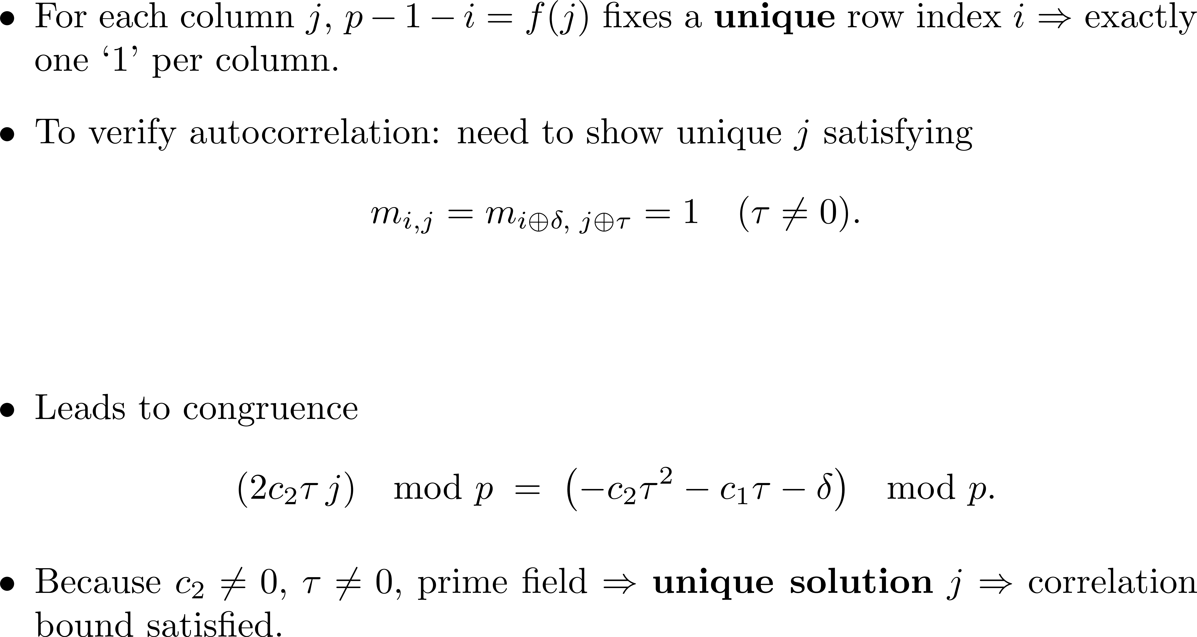
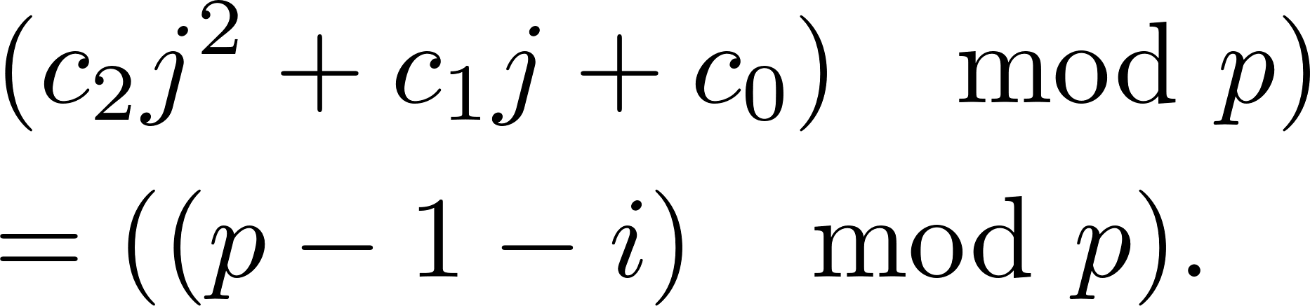
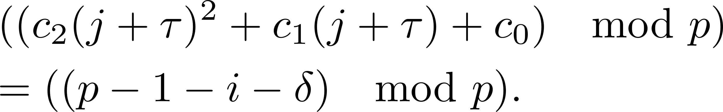
Proof

Slide 43
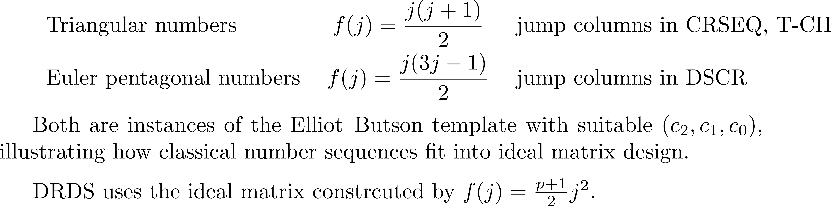
Examples

