Slide 1
An Introduction to the Multichannel Rendezvous Problem-Supplemental Material on Difference Sets, Ideal Matrices and Orthogonal Latin Squares
Prof. Cheng-Shang Chang (張正尚教授)
Institute of Communications Engineering National Tsing Hua University
July 2025

Slide 2
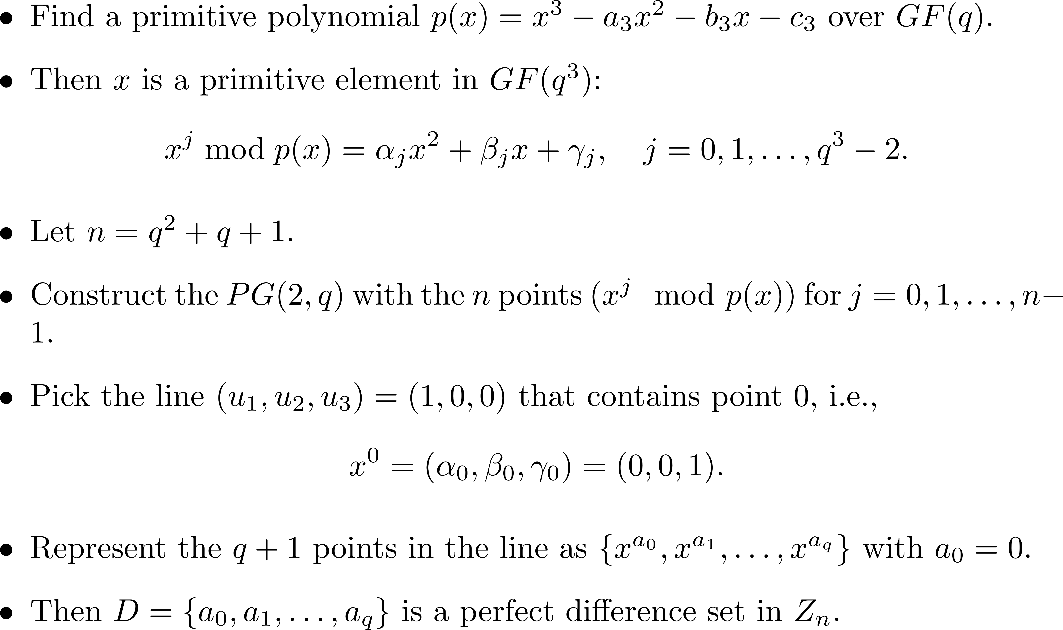
Singer’s construction

Slide 3
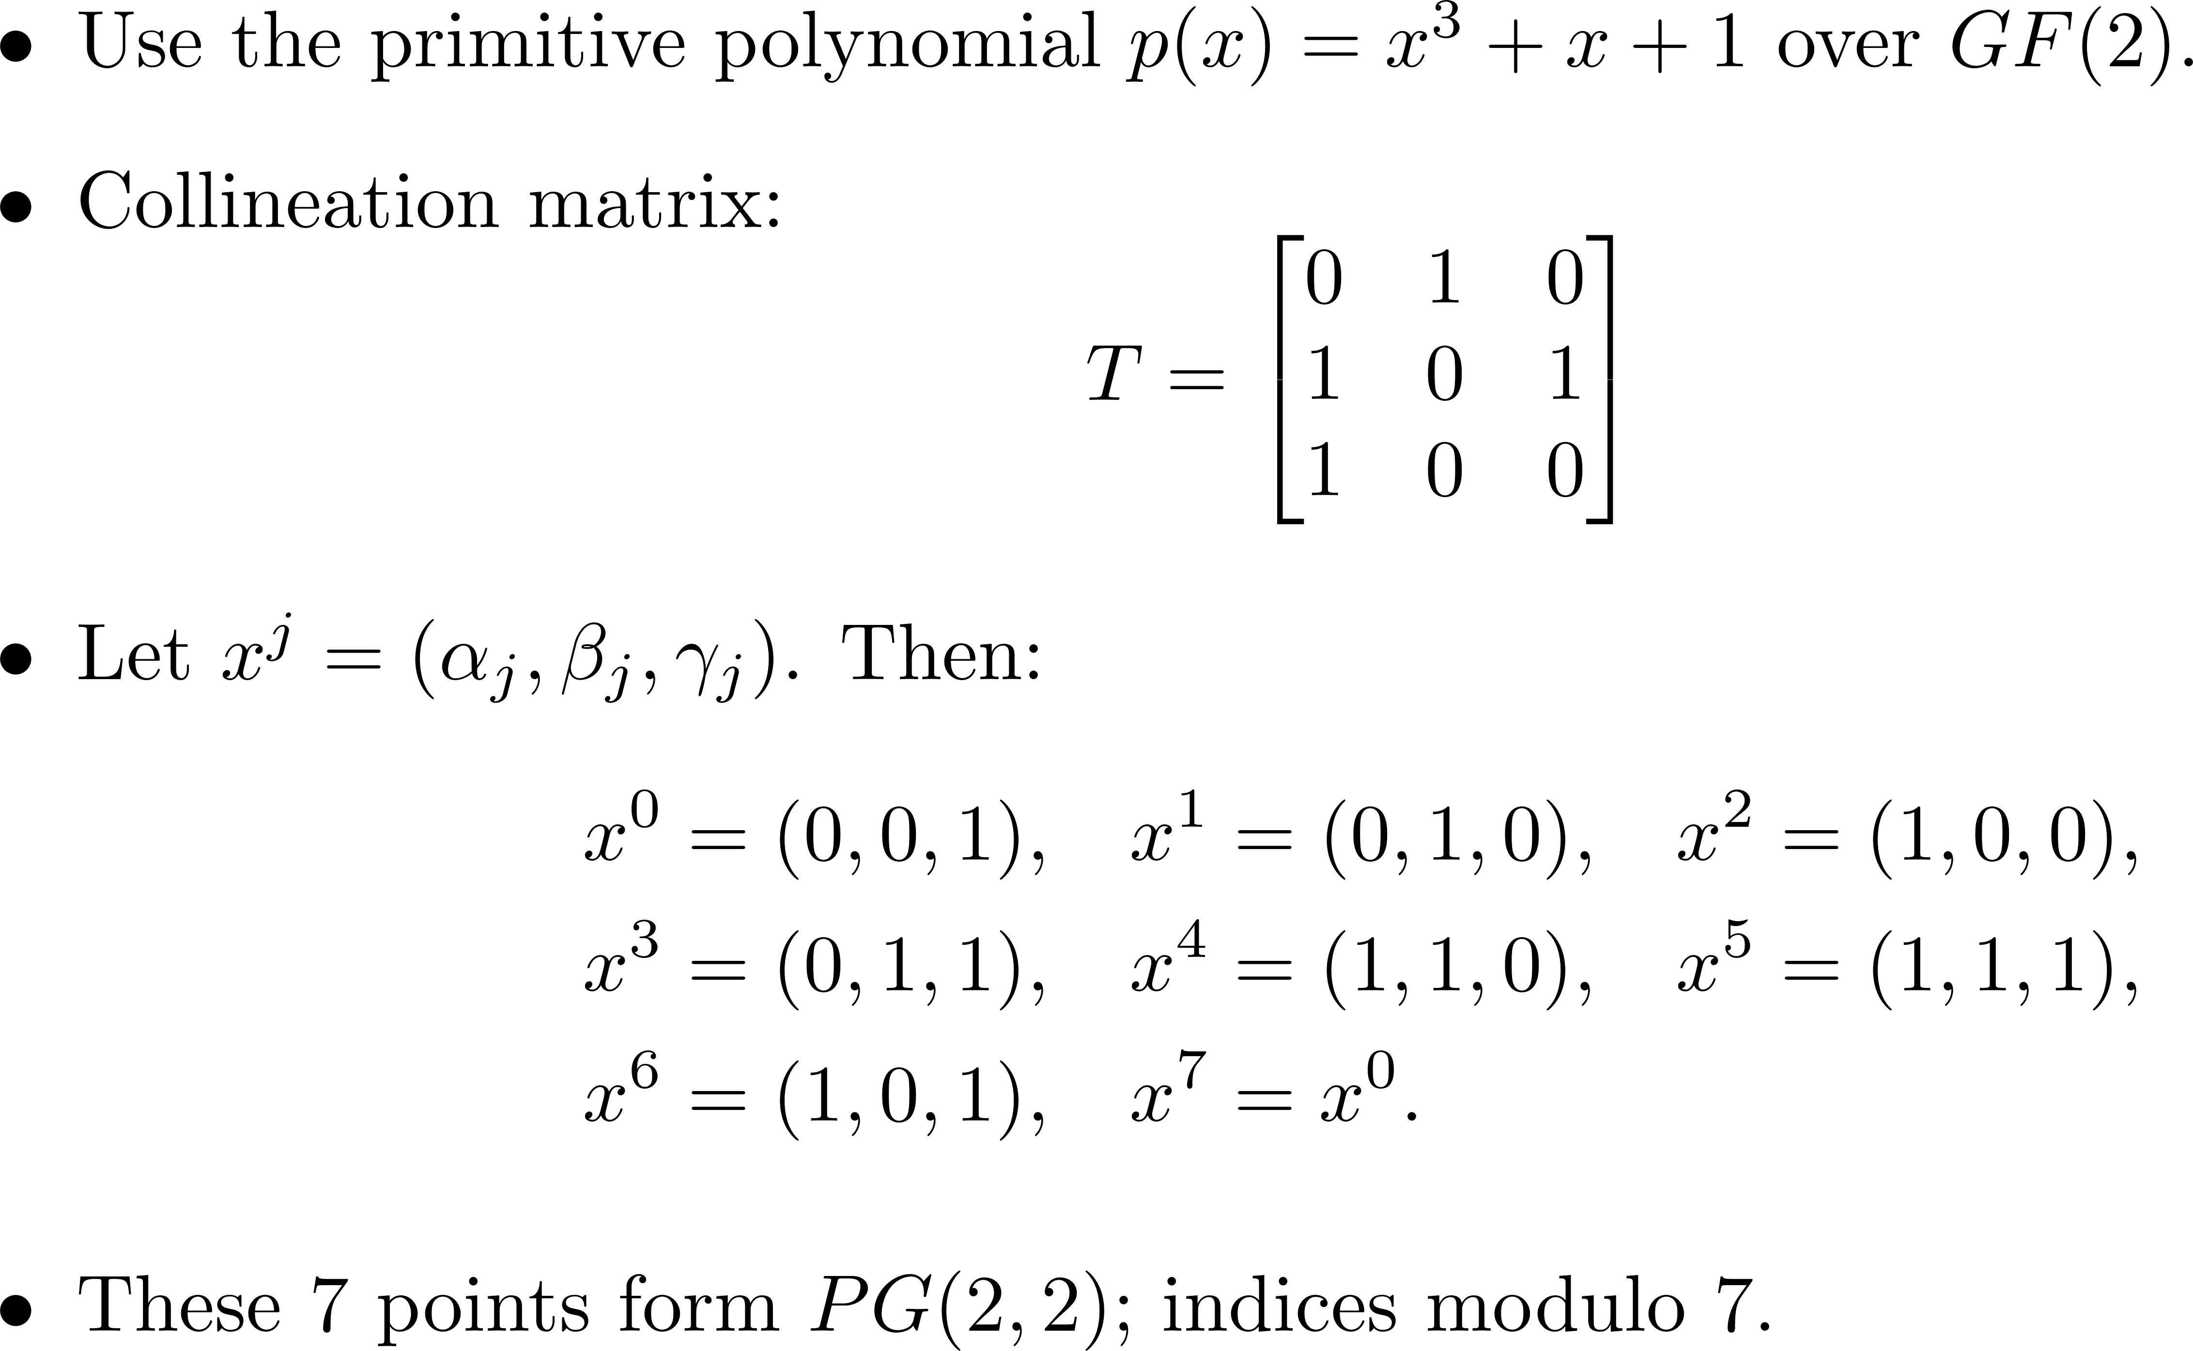
Example: Primitive Polynomial over GF(2)

Slide 4
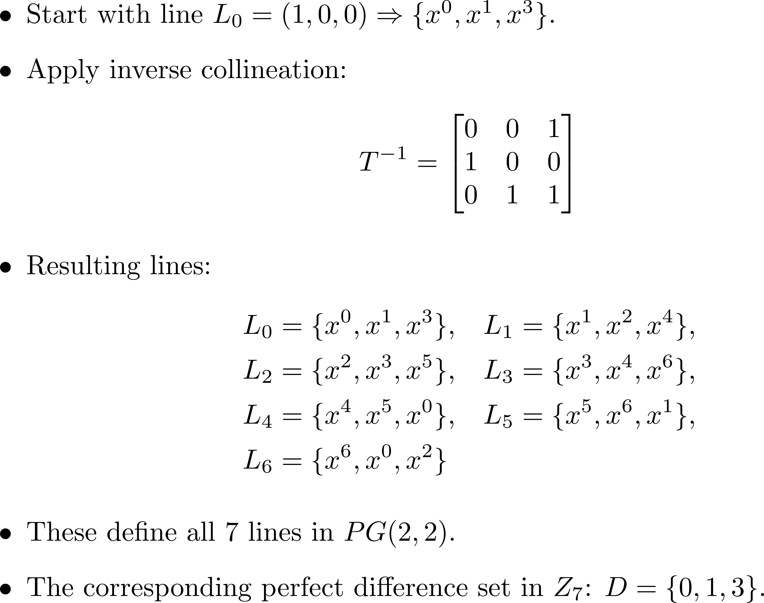
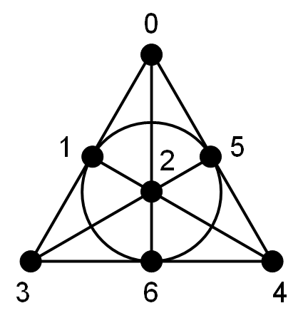
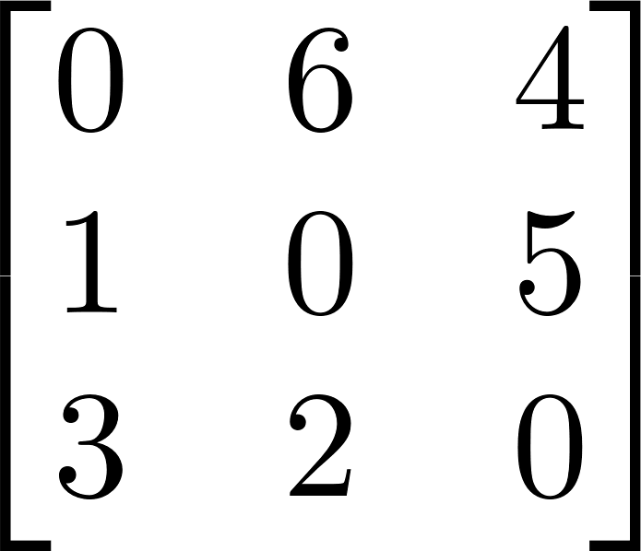
Lines and the Perfect Difference Set in Z₇

Slide 5
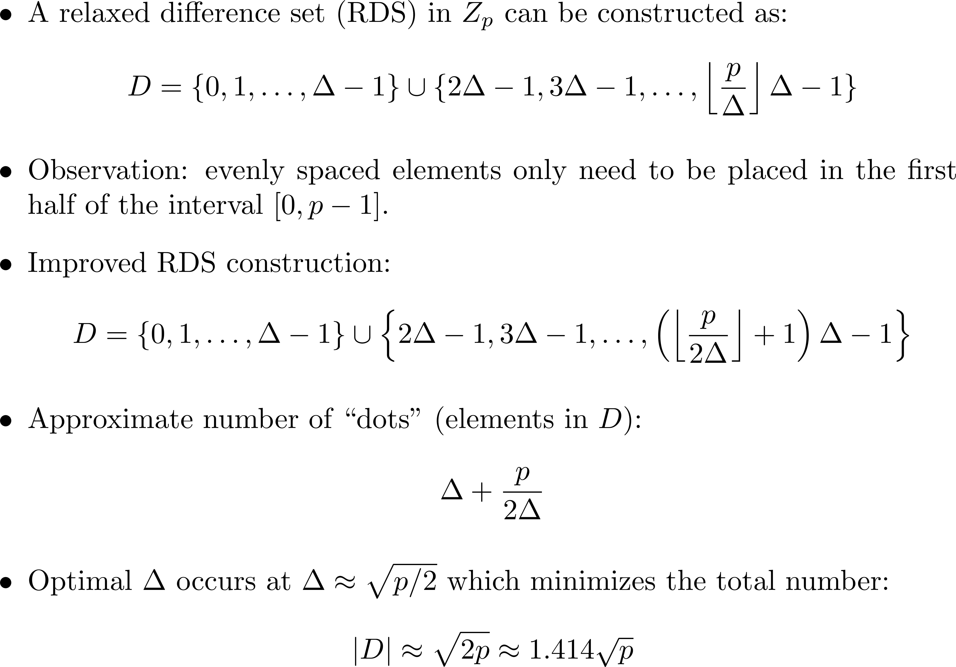
Construction of Relaxed Difference Sets (RDS)

Slide 6
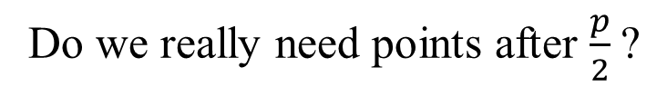
Construction of an RDS with p = 23, |D| = $\left\lceil \sqrt{p}\right\rceil$ = 5
1 | 2 | 3 | 4 | 5 | 6 | 7 | 8 | 9 | 10 | 11 | 12 | 13 | 14 | 15 | 16 | 17 | 18 | 19 | 20 | 21 | 22 | 23
Do we really need points after $\frac{p}{2}$?

Slide 7
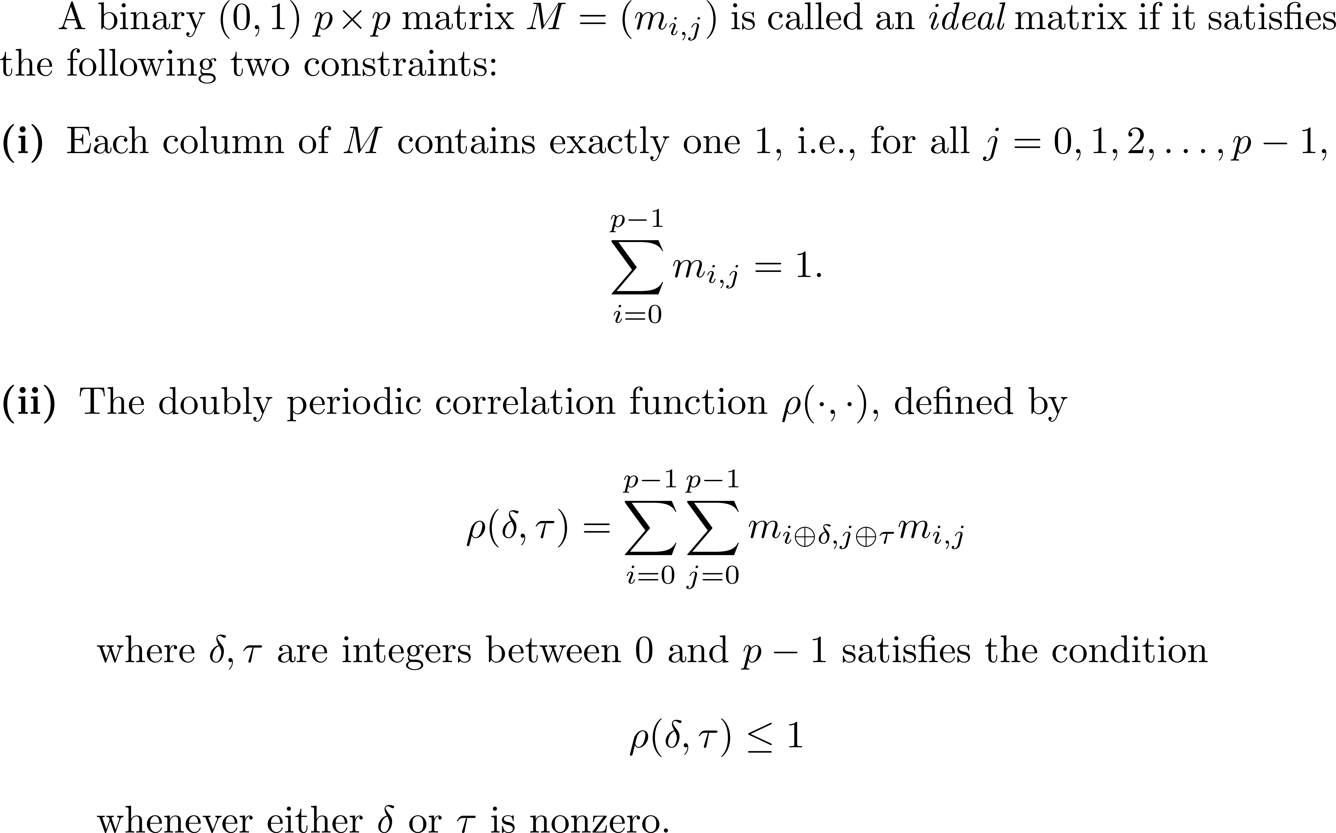
Ideal matrices

Slide 8


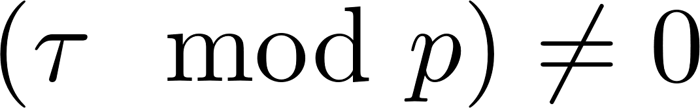
Ideal matrices
A binary (0,1) ideal matrix has the following three important properties:
  (No shift) If all dots overlap.
  (Purely vertical shifts) If
  no dot will overlap.
  (The other shifts) For any other shifts, i.e.,
  exactly one pair of dots will overlap.
A ideal matrix M can be constructed when p is a prime. (The Elliot-Butson construction)

Slide 9

Ideal matrices
Example: A ideal matrix (0-1 binary matrix).
 |  |  | 1
 |  | 1 |  | 1
 | 1 |  |  |  | 1
1 |  |  |  |  |  | 1

Slide 10


 |  |  | 1 |  |  |  |  |  |  | 1
 |  | 1 |  | 1 |  |  |  |  | 1 |  | 1
 | 1 |  |  |  | 1 |  |  | 1 |  |  |  | 1
1 |  |  |  |  |  | 1 | 1 |  |  |  |  |  | 1
 |  |  | 1 |  |  |  |  |  |  | 1
 |  | 1 |  | 1 |  |  |  |  | 1 |  | 1
 | 1 |  |  |  | 1 |  |  | 1 |  |  |  | 1
1 |  |  |  |  |  | 1 | 1 |  |  |  |  |  | 1
 |  |  | 1
 |  | 1 |  | 1
 | 1 |  |  |  | 1
1 |  |  |  |  |  | 1

Slide 11

 |  |  | 1 |  |  |  |  |  |  | 1
 |  | 1 |  | 1 |  |  |  |  | 1 |  | 1
 | 1 |  |  |  | 1 |  |  | 1 |  |  |  | 1
1 |  |  |  |  |  | 1 | 1 |  |  |  |  |  | 1
 |  |  | 1 |  |  |  |  |  |  | 1
 |  | 1 |  | 1 |  |  |  |  | 1 |  | 1
 | 1 |  |  |  | 1 |  |  | 1 |  |  |  | 1
1 |  |  |  |  |  | 1 | 1 |  |  |  |  |  | 1
 |  |  | 1
 |  | 1 |  | 1
 | 1 |  |  |  | 1
1 |  |  |  |  |  | 1

Slide 12

 |  |  | 1 |  |  |  |  |  |  | 1
 |  | 1 |  | 1 |  |  |  |  | 1 |  | 1
 | 1 |  |  |  | 1 |  |  | 1 |  |  |  | 1
1 |  |  |  |  |  | 1 | 1 |  |  |  |  |  | 1
 |  |  | 1 |  |  |  |  |  |  | 1
 |  | 1 |  | 1 |  |  |  |  | 1 |  | 1
 | 1 |  |  |  | 1 |  |  | 1 |  |  |  | 1
1 |  |  |  |  |  | 1 | 1 |  |  |  |  |  | 1
 |  |  | 1
 |  | 1 |  | 1
 | 1 |  |  |  | 1
1 |  |  |  |  |  | 1

Slide 13
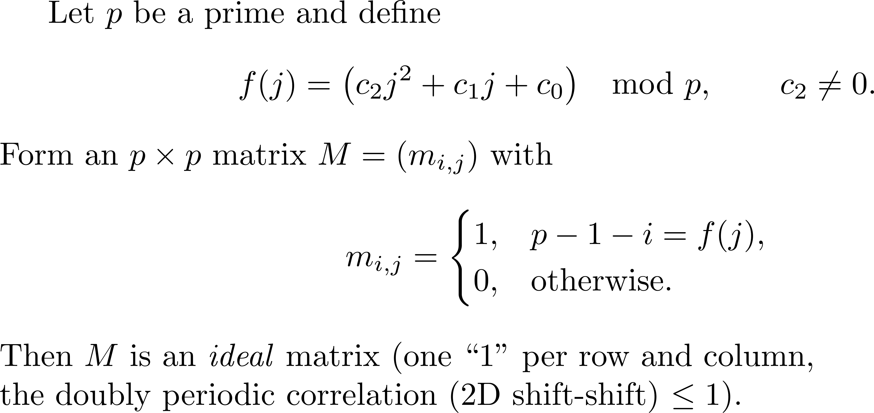
The Elliot-Butson construction of ideal matrices

Slide 14
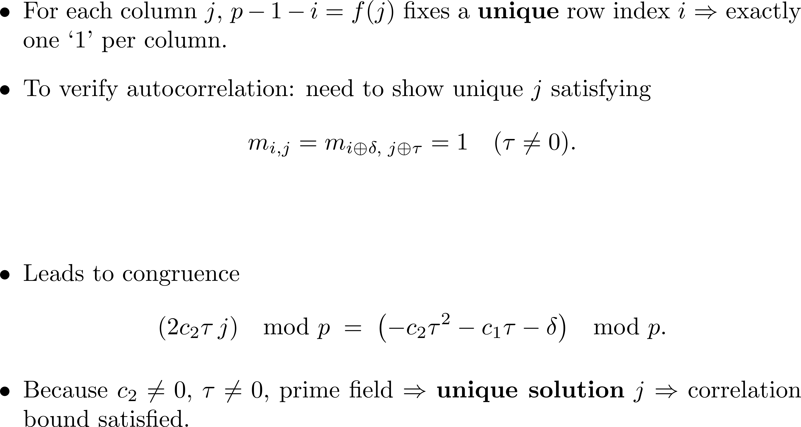
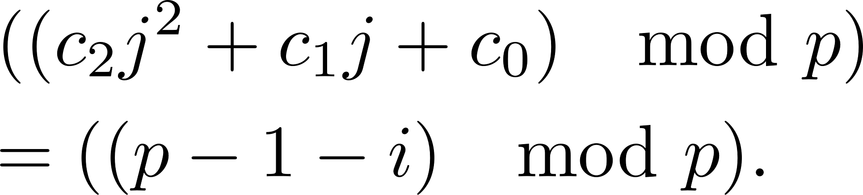
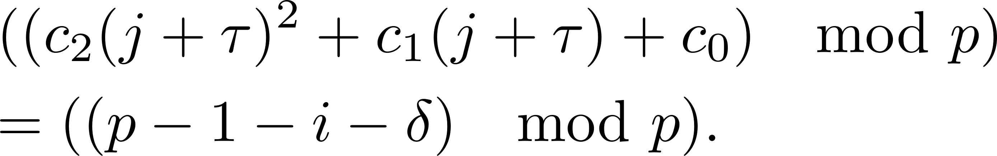
Proof

Slide 15
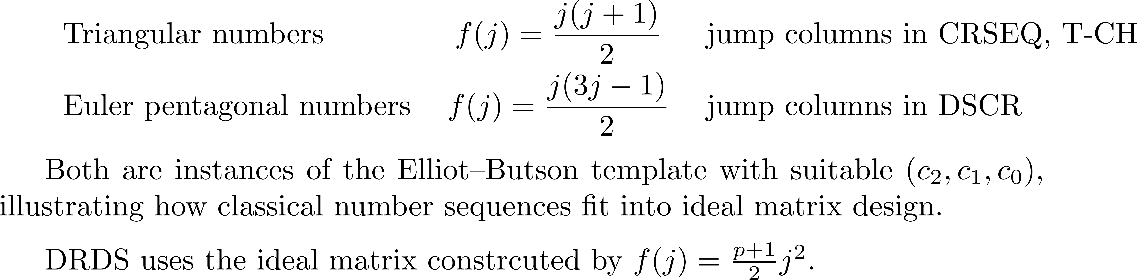
Examples

Slide 16
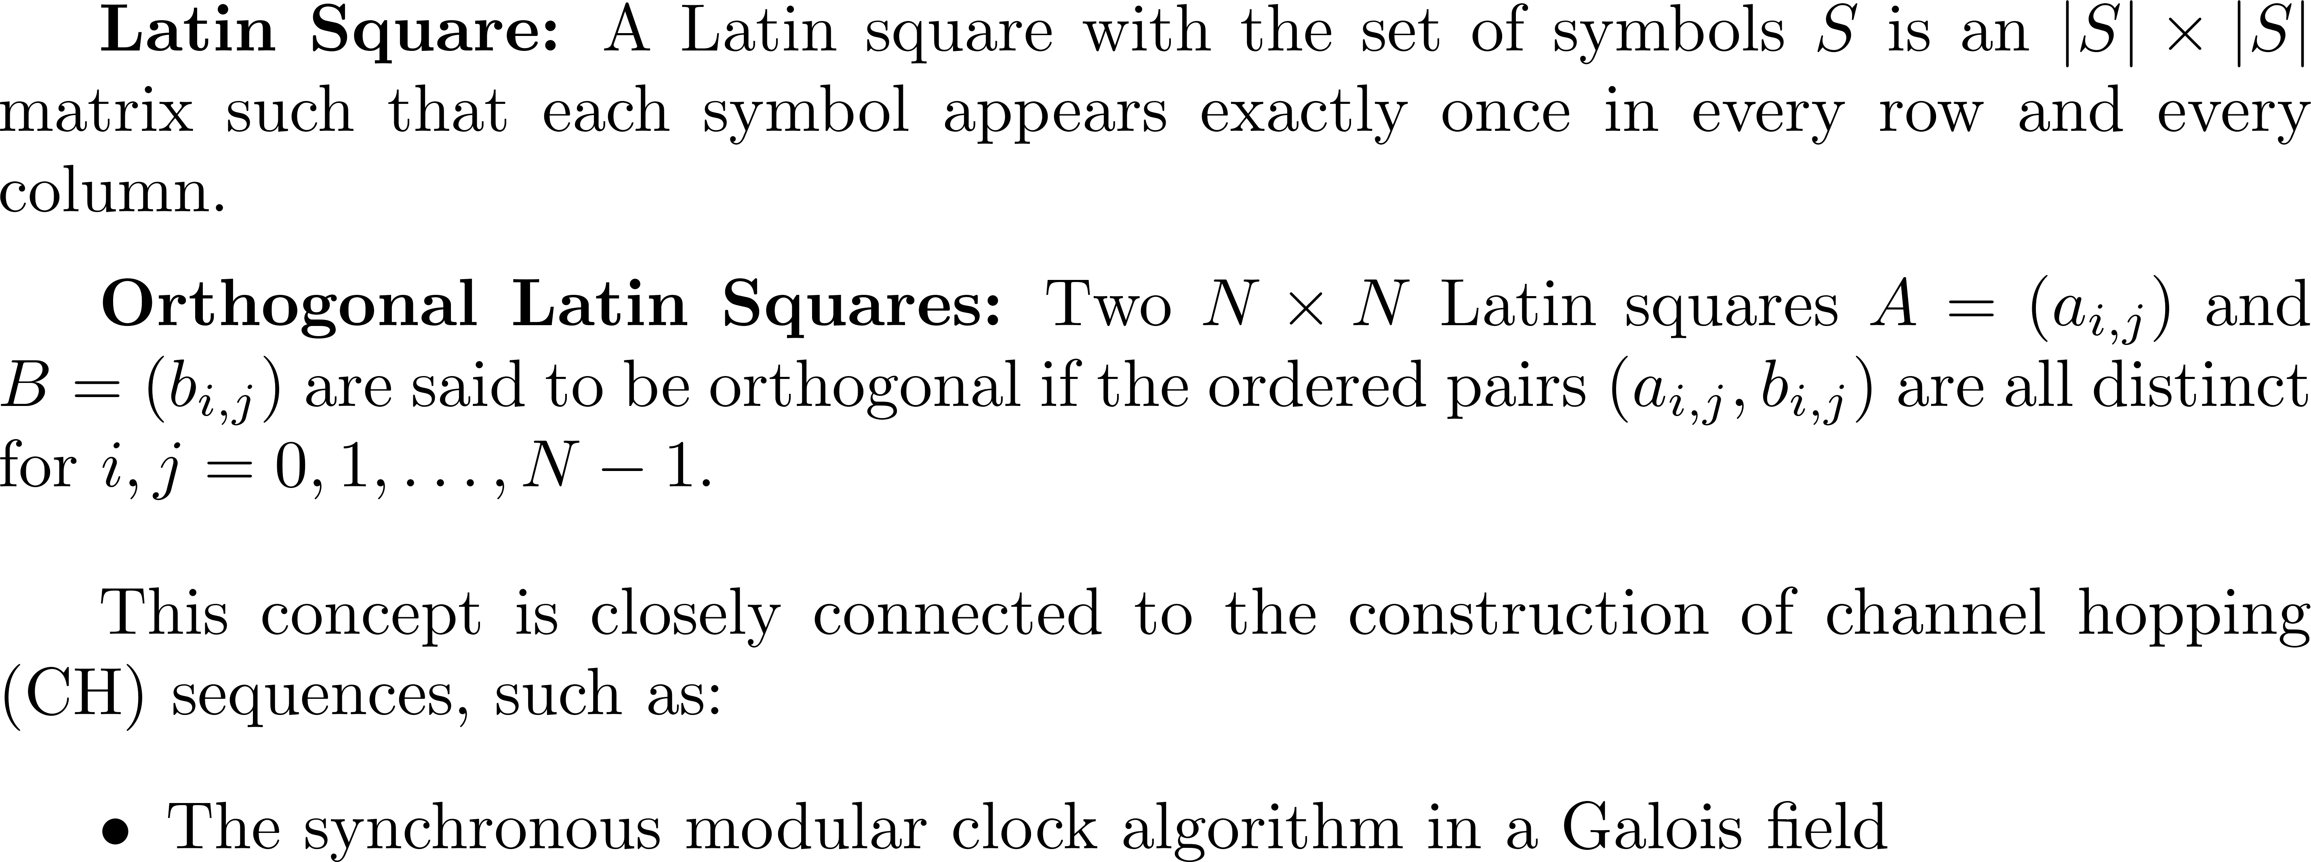
Constructions of orthogonal Latin squares

Slide 17
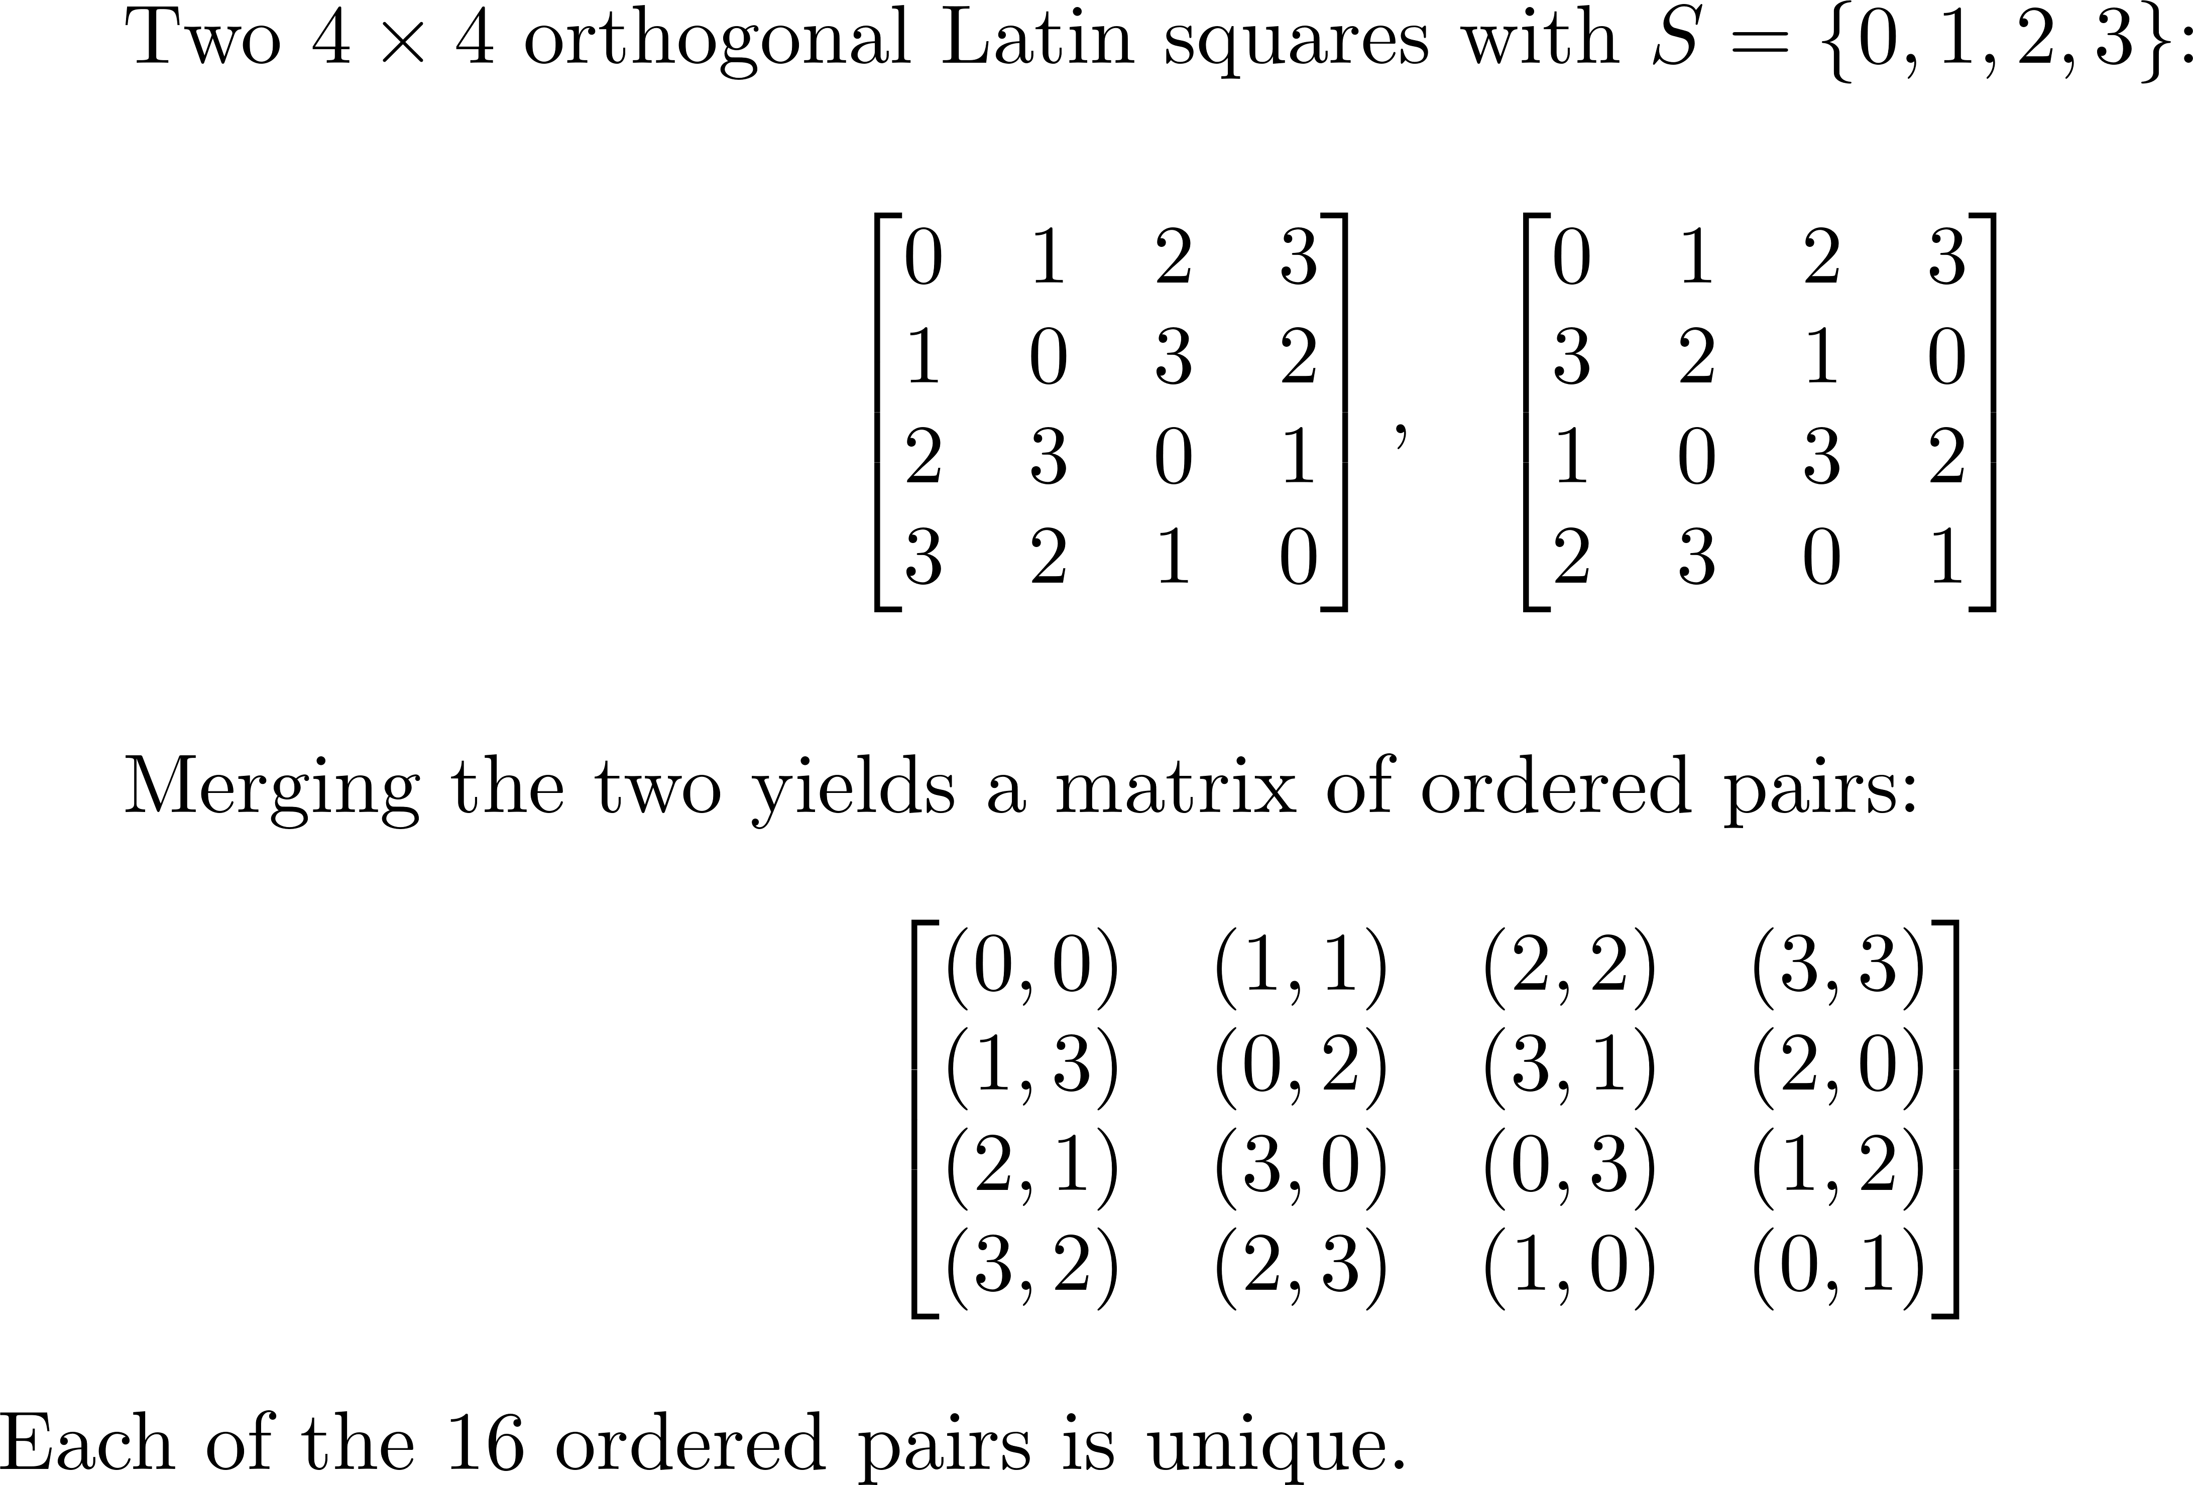
Example: Orthogonal Latin Squares for N=4

Slide 18
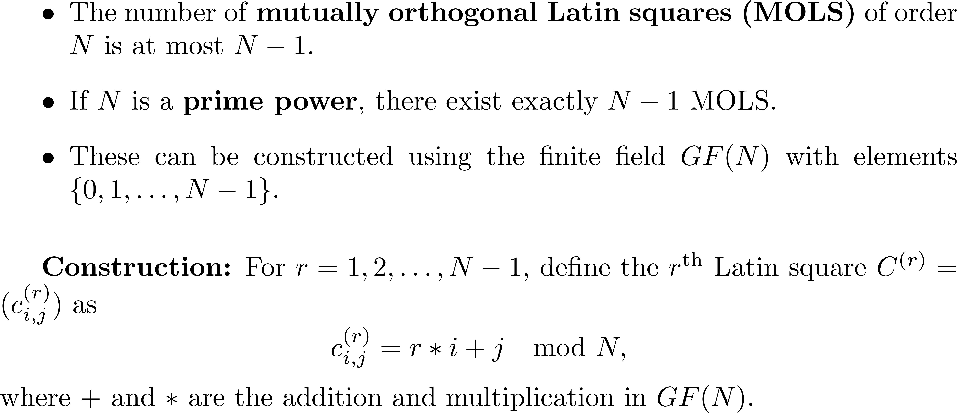
Construction of Mutually Orthogonal Latin Squares Using Galois Fields

Slide 19
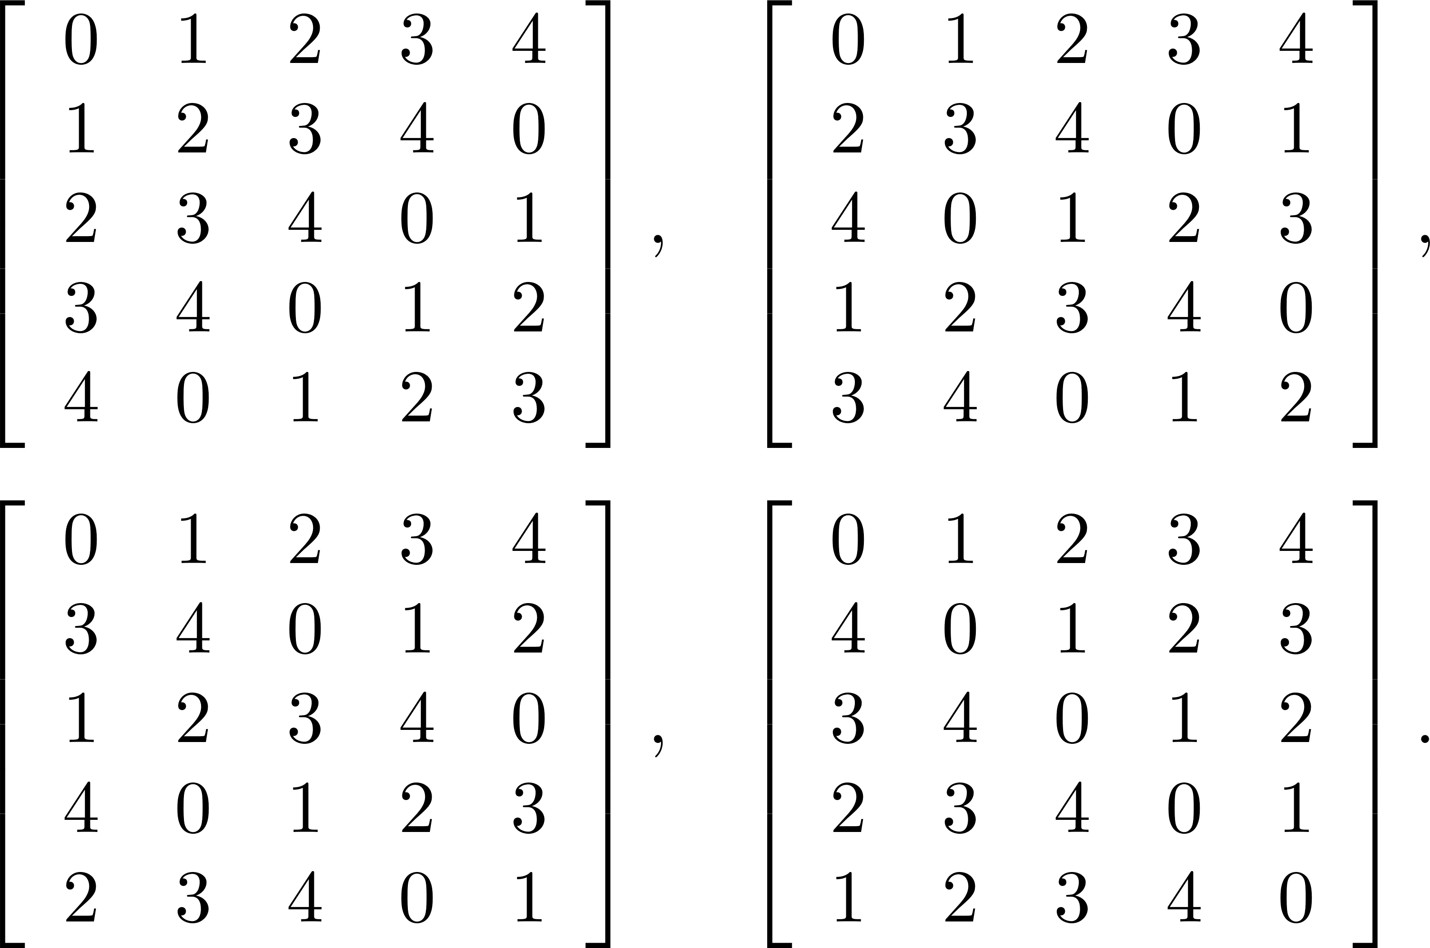




For N=5, the four orthogonal Latin squares are as follows:

Slide 20
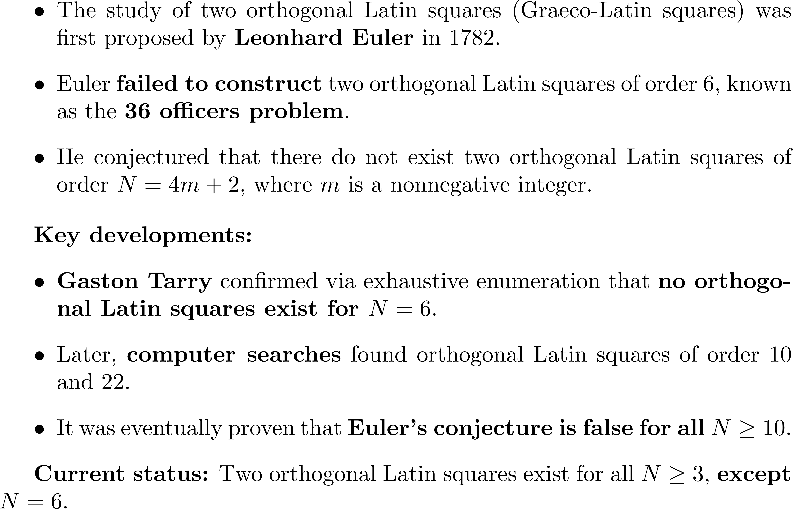
Historical Background

Slide 21
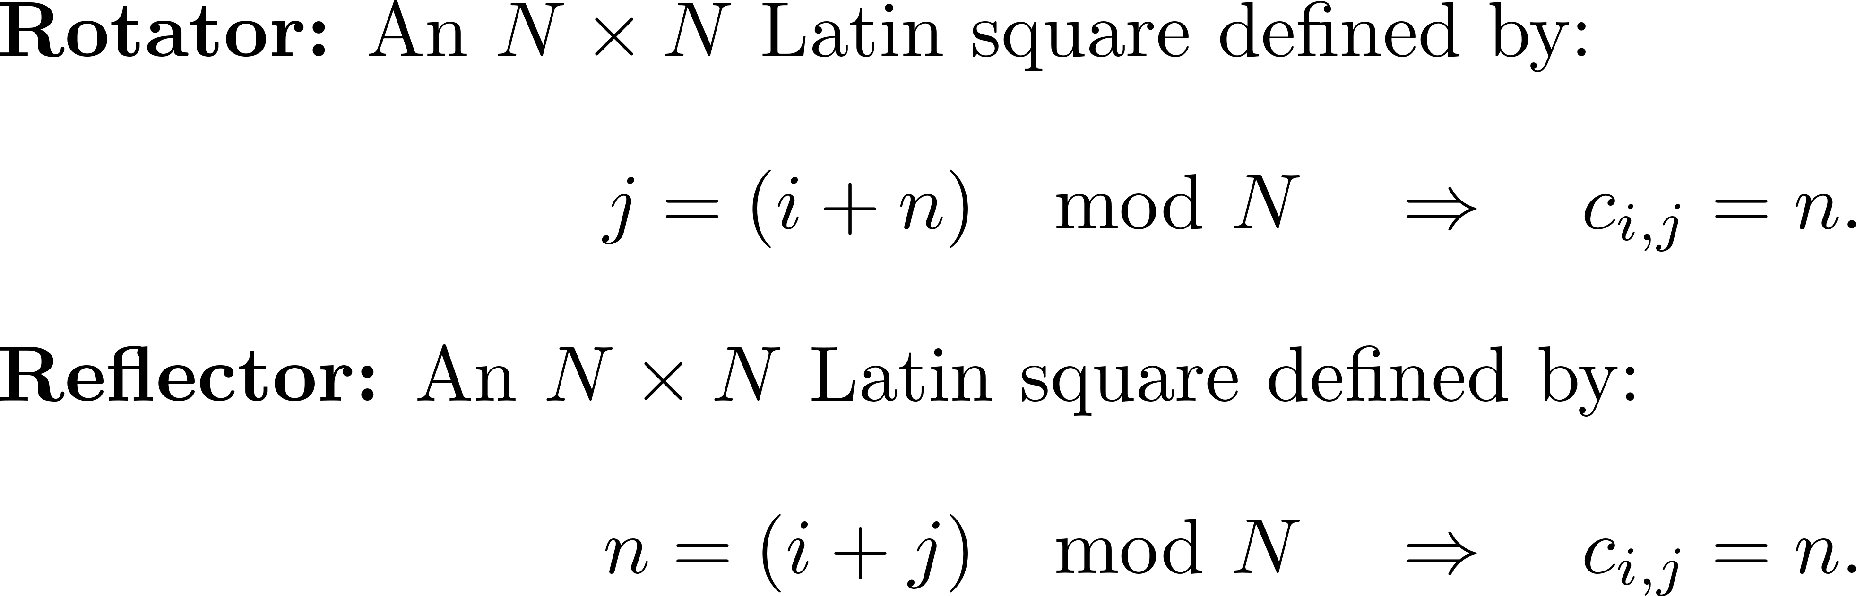
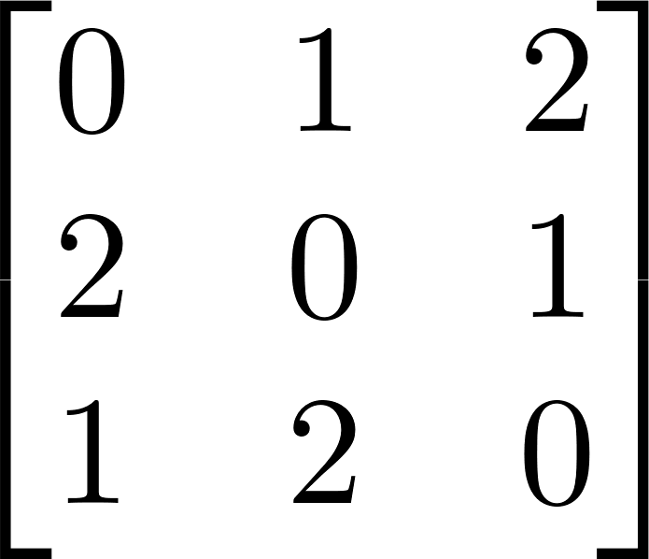
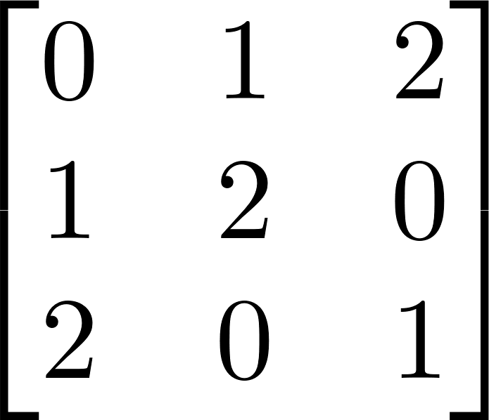
Constructing Orthogonal Latin Squares via Rotators and Reflectors

Slide 22
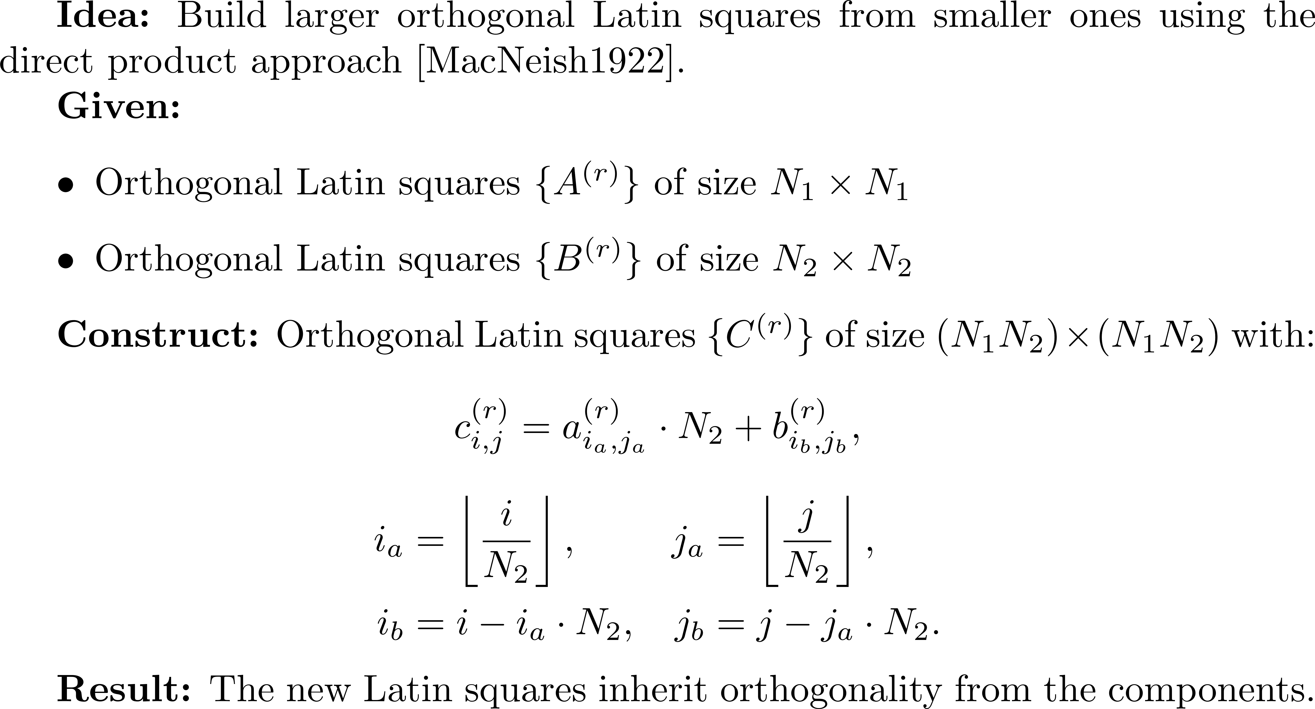
MacNeish's Direct Product Construction

Slide 23
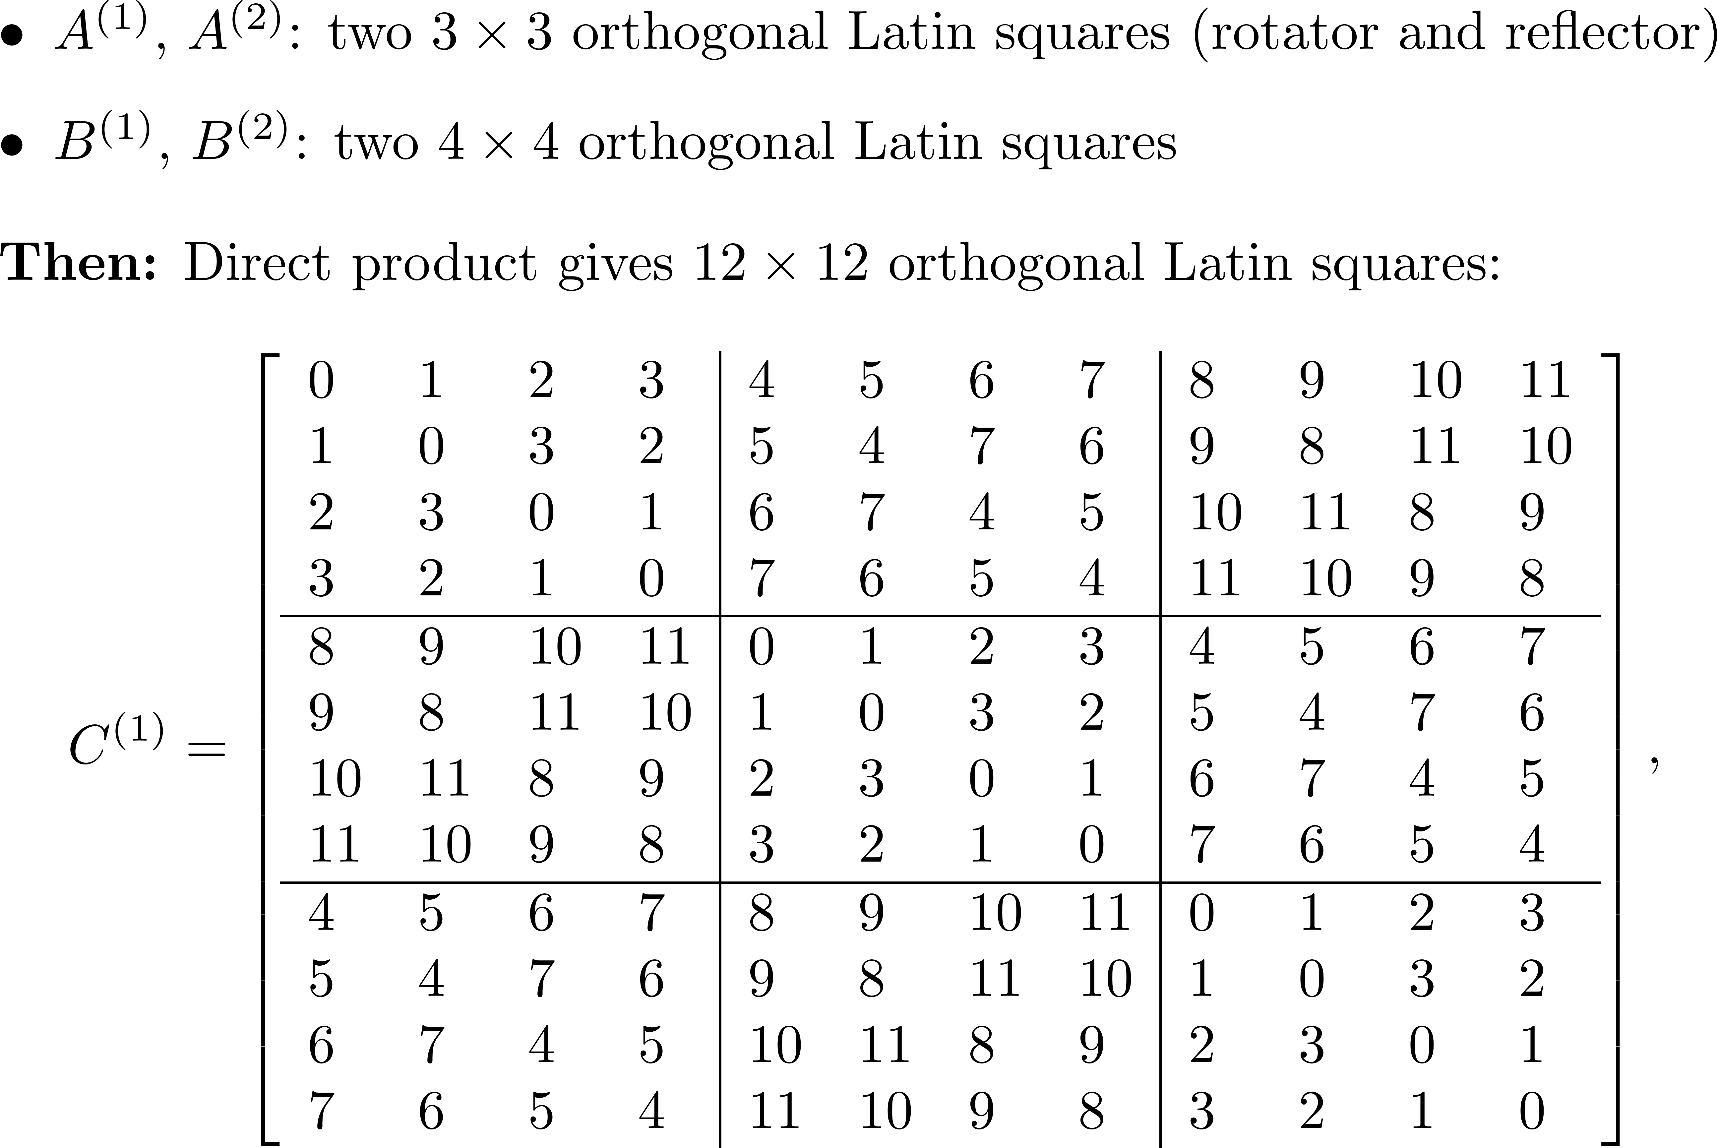

Slide 24
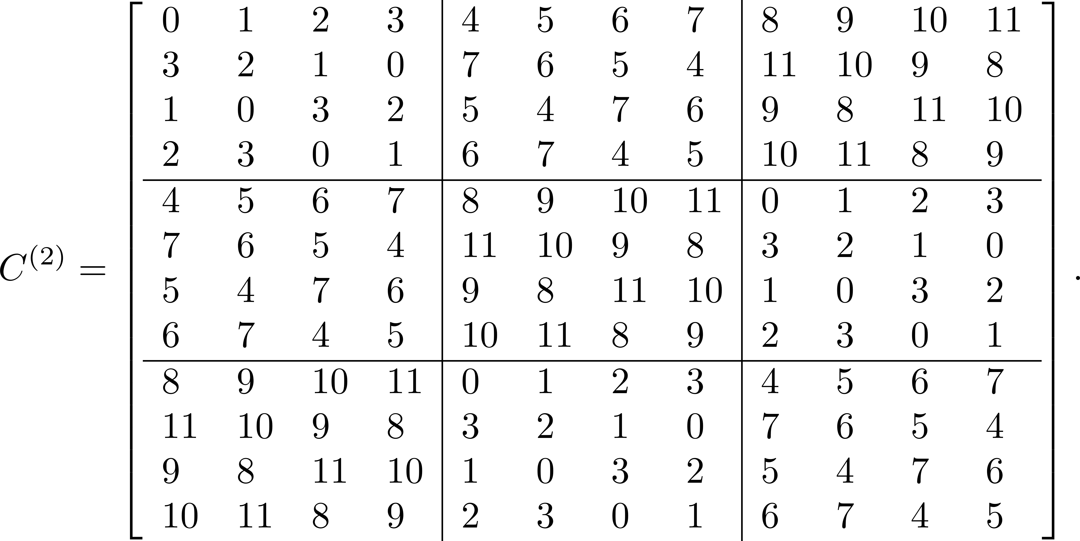

Slide 25
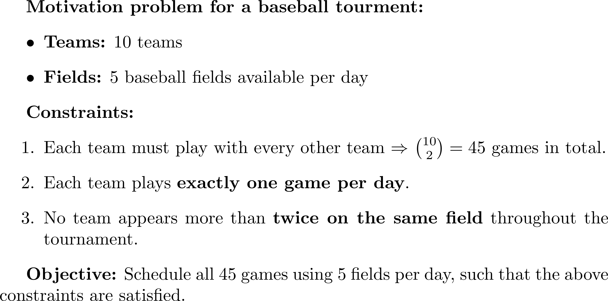
Tournament Design

Slide 26
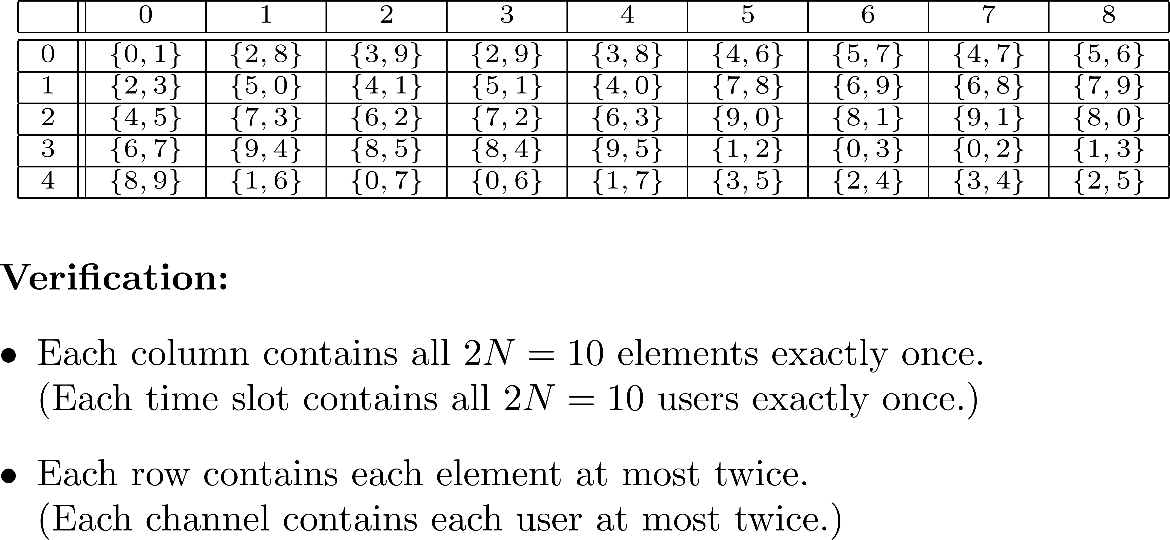
Time slots
Channels

Slide 27
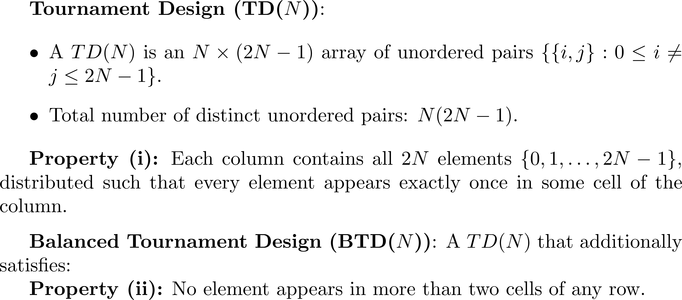
Tournament Design and Balanced Tournament Design

