Slide 1
Centrality
Social network analysis
Which are the most important or central vertices in a network?
Degree centrality: the degree of a vertex
Citation network: the number of citations of a paper is simply its in-degree.

Slide 2
Eigenvector Centrality
Not all neighbors are equivalent.
A vertex’s importance is increased by having connections to other vertices that are themselves important.
The idea is to define the centrality of a vertex as the sum of the centralities of its neighbors.
Suppose we guess initially vertex i has centrality x_{i}(0)
Then a better one is

Slide 3
Eigenvector Centrality
Write x(0) as a linear combination of the eigenvectors v_{i} of the adjacency matrix A
The limiting centrality should be proportional to the leading eigenvector v₁.

Slide 4
Definition
Bonacich (1987)
Let k₁ be the leading eigenvalue of A.
The centralities of all the vertices satisfy
Eigenvector centralities are nonnegative (easy to see from the limit of the multiplication of A and an initial nonnegative guess x(0)).
Normalization problem (require the sum to be a constant)

Slide 5
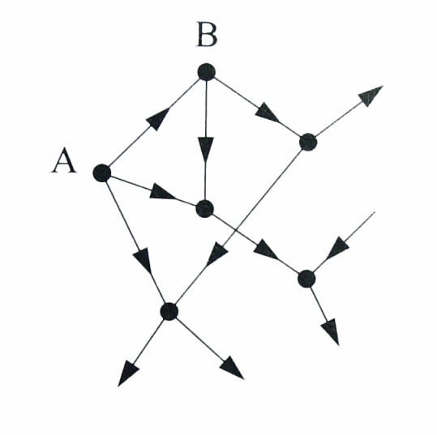
Eigenvector centrality for directed networks
Can be extended to directed networks (e.g., web pages).
The problem of zero centrality in a directed network
  A has centrality 0 as there are no incoming edges (seems reasonable for a web page)
  But B has one incoming edge from A. The centrality of B is still 0 because A has centrality 0.
  The centralities are all 0 in an acyclic network.

Slide 6
Katz centrality
Give every vertex a small amount of centrality for free.
are positive constants.
In matrix terms,
where 1 is the vector (1,1,…,1)^{T}.
Katz centrality: set β=1

Slide 7
Choosing the constant α
k₁ is the largest eigenvalue of A
Then
This is because v₁ (the eigenvector of A corresponding to k₁) is an eigenvector of with eigenvalue 0.
The range
Computing the Katz centrality by iterating
is better than inverting the matrix directly.

Slide 8
PageRank
Trademark of Google
A variation of Katz centrality
Divided by the out-degree
The problem of a vertex with zero out-degree
Easy fix: since a vertex with zero out-degree contribute zero to the centralities of other vertices. We may simply set

Slide 9
PageRank
In matrix terms,
D is a diagonal matrix with
Google uses β=1 and α=0.85 (no theory behind this choice).
Need to make sure that the value of α should be less than the inverse of the largest eigenvalue of AD⁻¹.
Special case when β=0 and α=1. PageRank reduces to the degree centrality.

Slide 10
Web surfing
Initially, every web page is chosen randomly with the same probability.
With probability α, perform a random walk on the web by randomly choosing a hyperlink in a page.
With probability 1-α, stop the random walk and restart the web surfing.
PageRank is simply the steady state probability that a web page is visited by this web surfing.
Phase type distribution of a random variable

Slide 11
Web surfing
Let β=1-α.
P^{T} is the transition probability matrix a Markov chain.
The steady state probability vector can be computed via

Slide 12
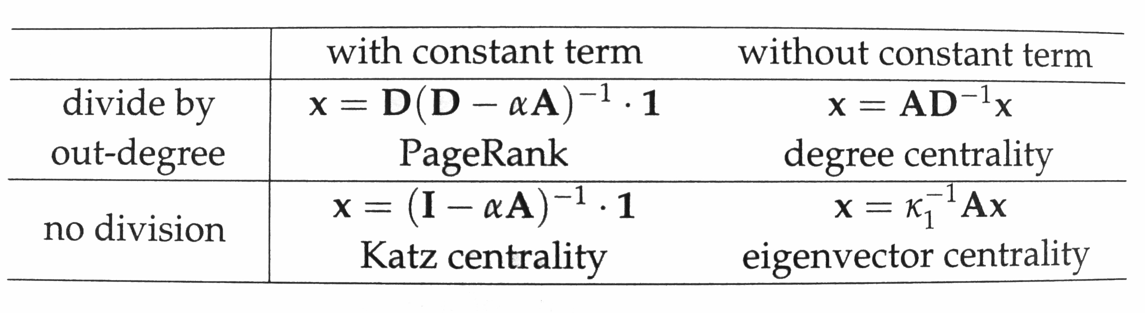
Four centrality measures

Slide 13
Hubs and authorities
Every vertex has two types of centralities: hub centrality and authority centrality.
Authorities: vertices that contain useful (or important) information (e.g., an important scientific paper)
Hubs: vertices that tells where the best authorities are (e.g. a good review paper)
Hyperlink-induced topic search (HITS) first proposed by Kleinberg 1999 in J. ACM

Slide 14
Hubs and authorities
The authority centrality of a vertex (denoted by x_{i}) is defined to be proportional to the sum of the hub centralities of the vertices (denoted by y_{j}) that point to it:
The hub centrality of a vertex is defined to be proportional to the sum of the authorities centralities of the vertices it points to:

Slide 15
Hubs and authorities
In matrix terms,
Note that both AA^{T} and A^{T}A have the same eigenvalues.
AA^{T} is the cocitation matrix and the authority centrality is the eigenvector centrality of the cocitation network.
A^{T}A is bibliographic coupling matrix and the hub authority is the eigenvector centrality of the bibliographic coupling network.

Slide 16
Closeness centrality
Measure the mean distance from a vertex to other vertices.
d_{ij} is the length of a geodesic path from vertex i to vertex j.
The mean geodesic distance from vertex i to other vertices
When j=i, d_{ii} =0. It is better to use

Slide 17
Closeness centrality
The mean geodesic distance gives low values for more central verticies.
Closeness centrality C_{i}:
Problems:
  The values are too closely spaced. Movie database: Christopher Lee 2.4138, Donald Pleasense 2.4164.
  If the network is disconnected, then the closeness centralities are all 0. If we only average over vertices in a component, then it favors small components.

Slide 18
Harmonic mean closeness centrality
This solves the problem of disconnected networks.
It also gives more weights to vertices that are close to vertex i than to those far away.
Can be used for the study of small world effect by defining the harmonic mean distance

Slide 19
Betweenness centrality
Measure the extent to which a vertex lies on paths between other vertices.
Let be 1 if vertex i lies on the geodesic path from s to t.
The betweenness centrality x_{i} is given by
Vertices with high betweenness centrality may have considerable influence within a network by virtue of their control of information passing between others.

Slide 20
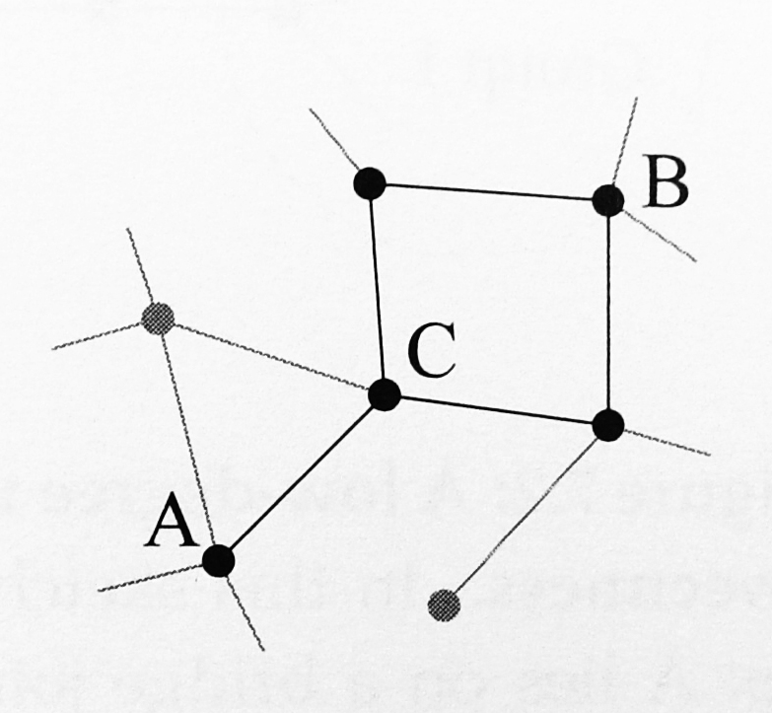
Modification
The problem with more than one geodesic paths between s and t.
Let g_{st} be the number of geodesic paths between s and t.
The (modified) betweenness measure of vertex i is

Slide 21
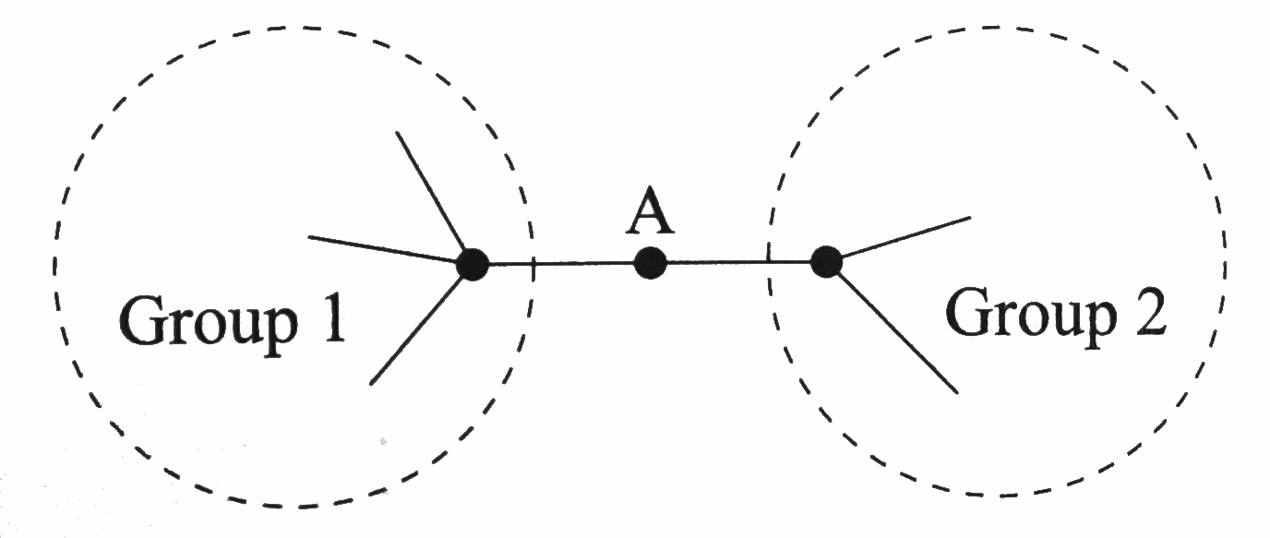
Broker in social networks
Vertex A lies on a bridge between two groups in a network.
Vertex A has high betweenness centrality
But it does not have high degree centrality or eigenvector centrality.

Slide 22
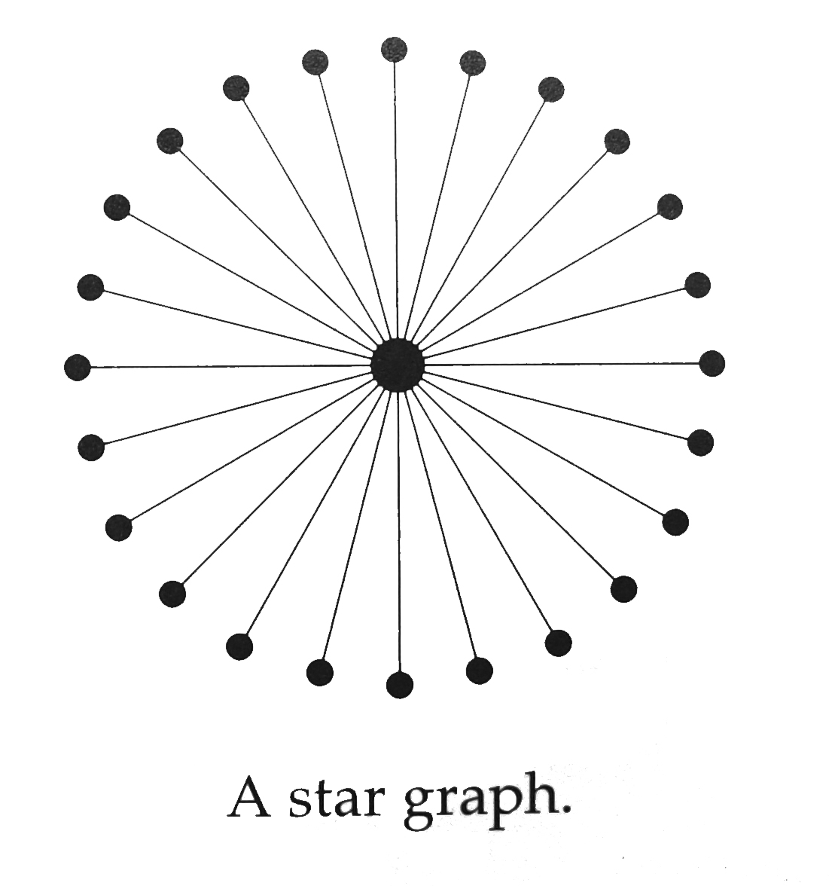
Maximum betweenness
Maximum betweenness: consider a star graph with n nodes
The central vertex has n-1 vertices attached to it.
The central vertex is on every geodesic path between two different vertices and the path from the central vertex to itself.
The betweenness of the central vertex is n(n-1)+1=n²-n+1.

Slide 23
Minimum betweenness
In a connected network, there are n-1 geodesic paths to a particular vertex (and the other way around).
Adding the path from the vertex to itself results in the minimum 2(n-1)+1 betweenness centrality.
This happens when a vertex is a leaf (an isolated vertex with a single connection to the network) of a network.
The ratio of largest and smallest possible betweenness values is

Slide 24
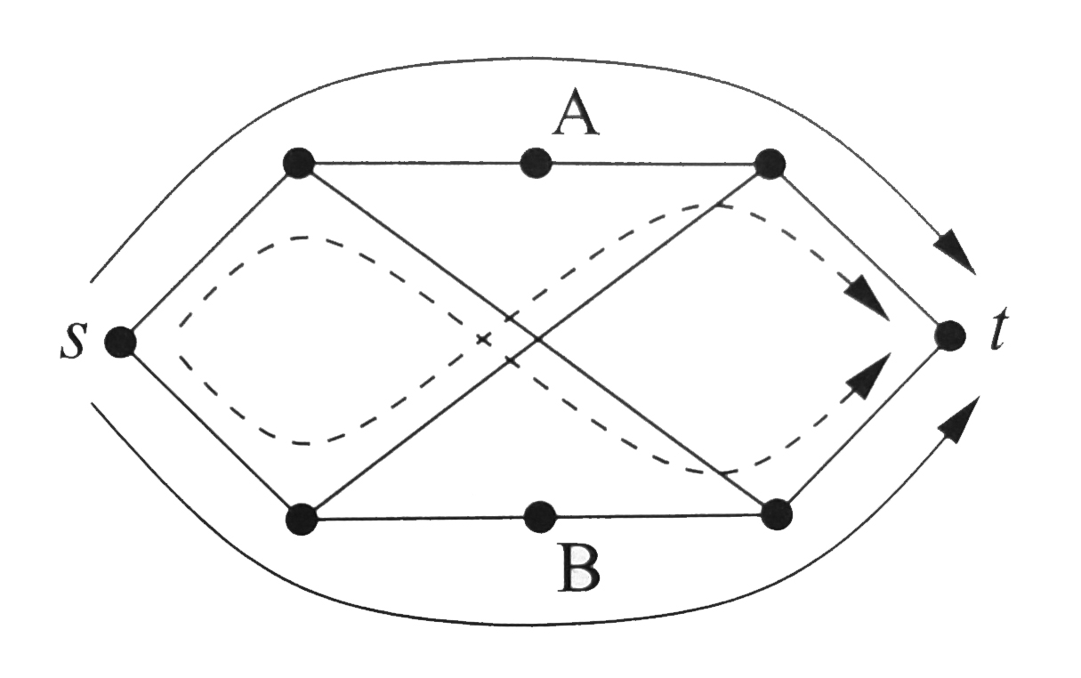
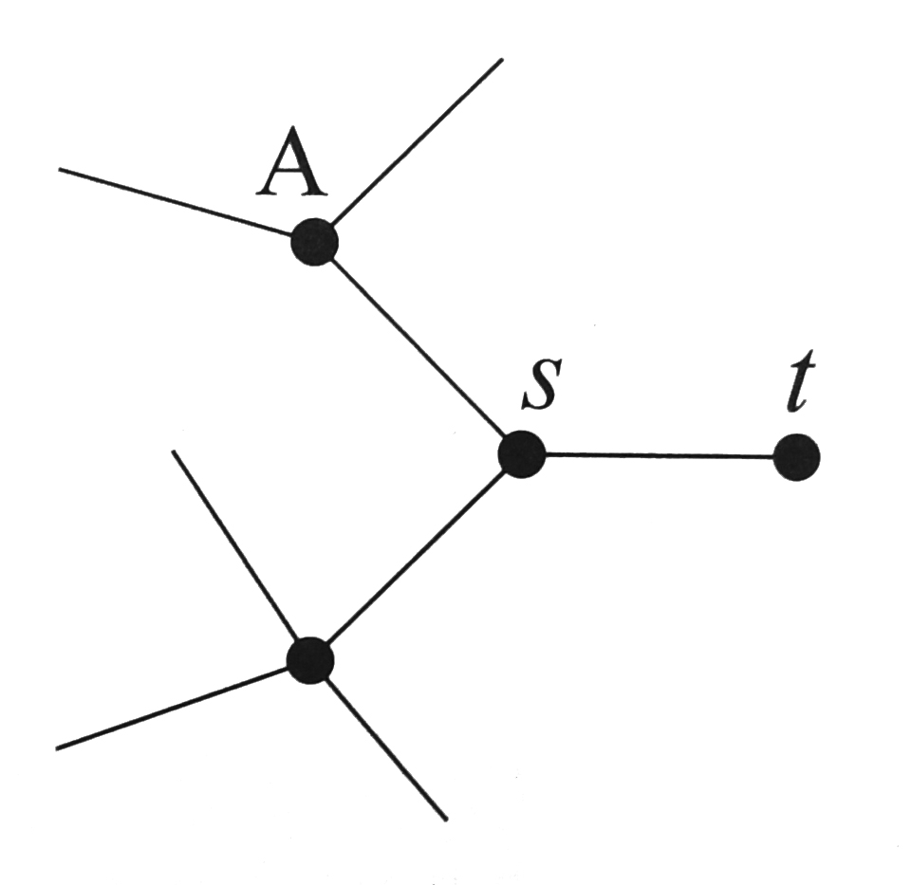
Other betweenness centralities
Maximum flow betweenness: is the number of flows through vertex i from s to t. The problem is the way to choose maximum flows is not unique.
Random-walk betweenness: is the expected number of visits of vertex i from s to t.

