Slide 1
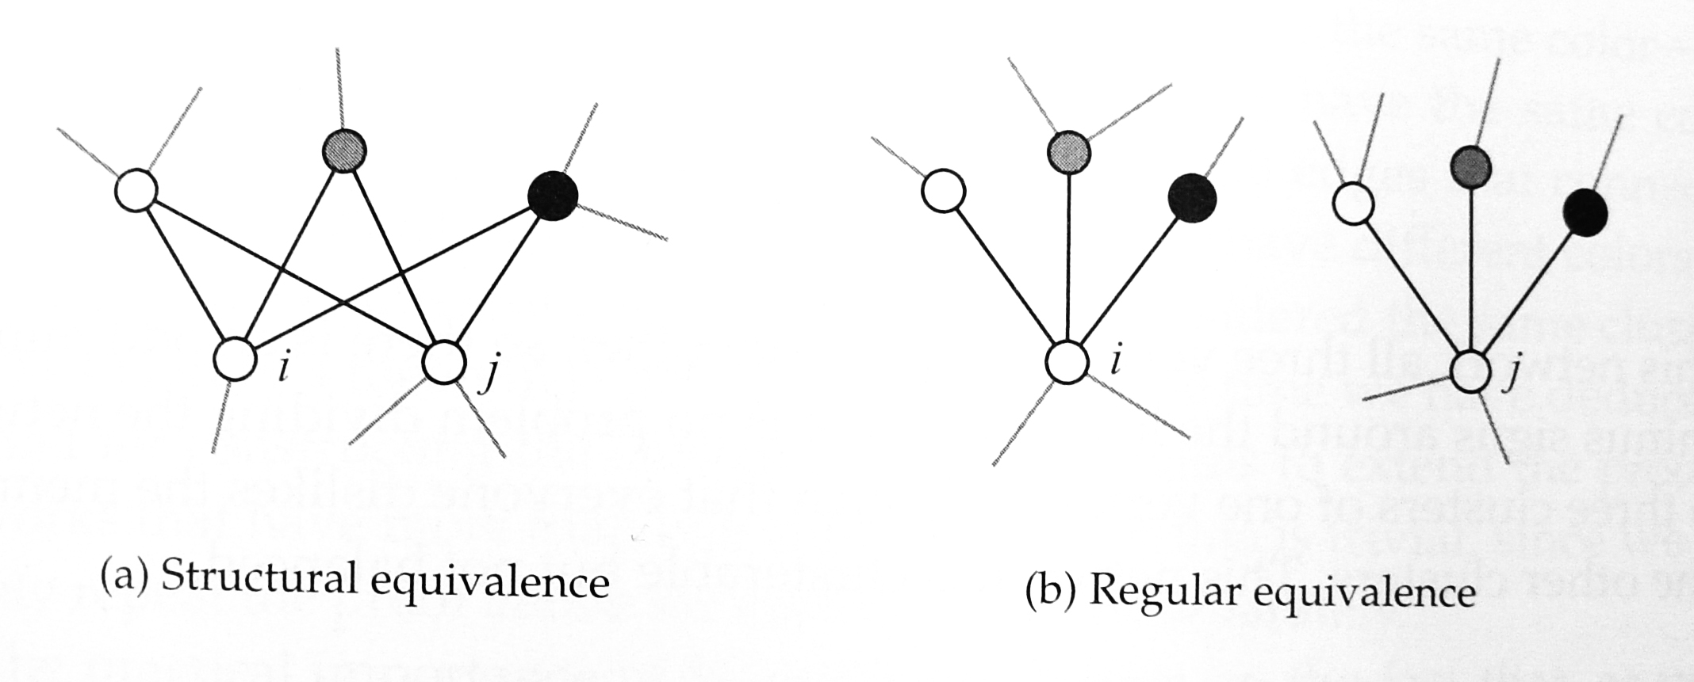
Similarity
Structural equivalence: two vertices are structurally equivalent if they share many of the same network neighbors.
Regular equivalence: two vertices have neighbors who are themselves similar

Slide 2
Cosine similarity
Cosine similarity is a measure of structural equivalence on undirected networks.
Define n_{ij} as the number of common neighbors of vertices i and j
The ij^{th} element of the matrix A².
It is closely related to the cocitation measure (in directed networks).
The problem of normalization?

Slide 3
Cosine similarity
Inner product of two vectors x and y
Salton regards the i^{th} row and j^{th} row of the adjacency matrix as two vectors.
Cosine similarity between vertices i and j

Slide 4
Pearson coefficient
An alternative way to normalize the count of common neighbors is to compare it with the expected value of that count in a random network.
For a large random network (n is large), the expected common neighbors between vertices i and j is k_{i}k_{j}/n (as the probability of vertex i’s neighbor is also a neighbor of vertex j is roughly k_{j}/n when n is large in a random network)

Slide 5
Pearson coefficient
Let X_{i} be the indicator random variable that a randomly chosen vertex is a neighbor of vertex i.

Slide 6
Pearson coefficient
Pearson correlation coefficient

Slide 7
Other measures of structural equivalence
Euclidean distance
Maximum Euclidean distance between vertices i and j is
Normalized Euclidean distance

Slide 8
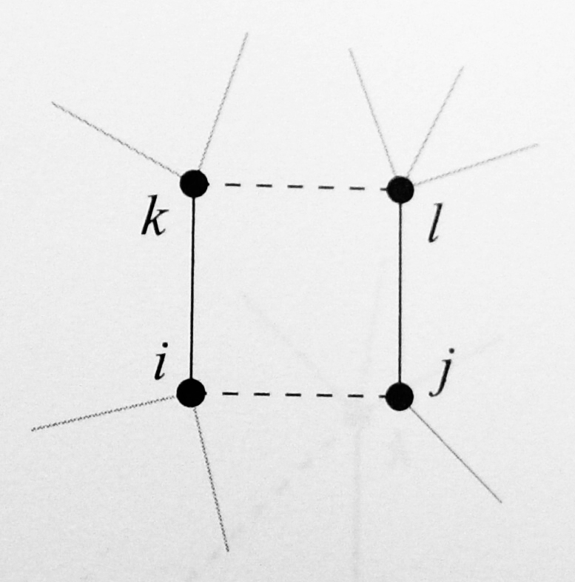
Regular equivalence
The basic idea is to define the similarity score such that i and j have high similarity if they have neighbors k and l that themselves have high similarity.
In matrix form,
It is related to eignevectors.

Slide 9
The problem of “self-similarity”
It does not give high score for “self-similarity”
Fix the problem by introducing an extra diagonal term
In matrix form,
Iteration yields

Slide 10
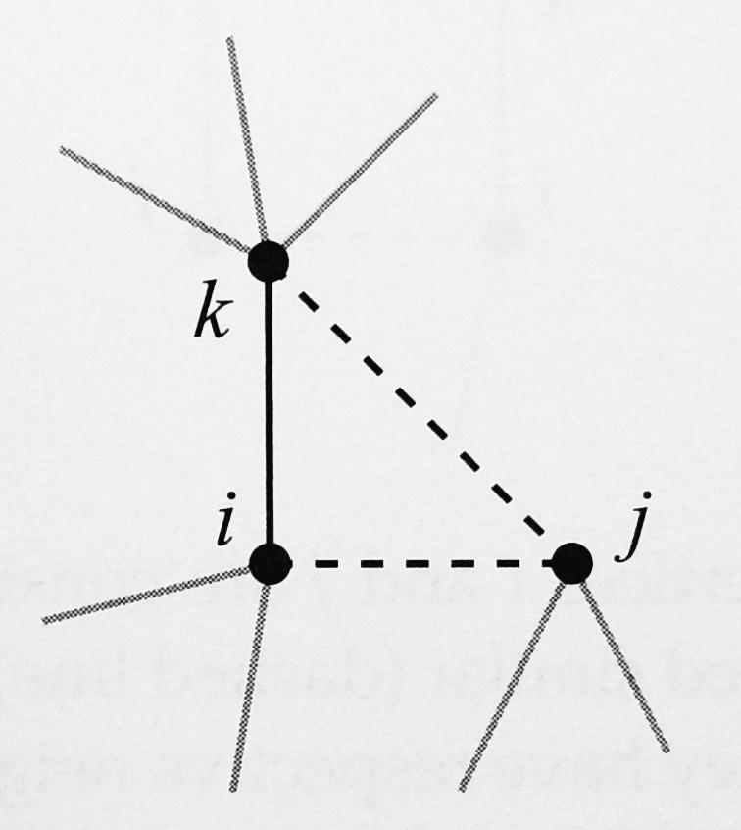
The problem of paths of even length
A better definition of regular equivalence: vertices i and j are similar if i has a neighbor k that is itself similar to j.
In matrix form,

Slide 11
Katz’s similarity
is in fact related to the Katz centrality.
The i^{th} row sum of σ is simply the Katz centrality of vertex i.
Remove the bias in favor of high degree

Slide 12
Generalization of regular equivalence
In view of all these definitions of regular equivalence, they are all weighted counts of paths between two vertices.
In the paper by Cheng-Shang Chang, Chin-Yi Hsu, Jay Cheng, and Duan-Shin Lee, we consider the probability that two vertices appear at the two ends of a randomly selected path.
If the similarity measure between any pair of vertices can be represented by a nonnegative matrix, then one can normalize the matrix by the sum of all its elements to obtain a bivariate distribution.

