Slide 1
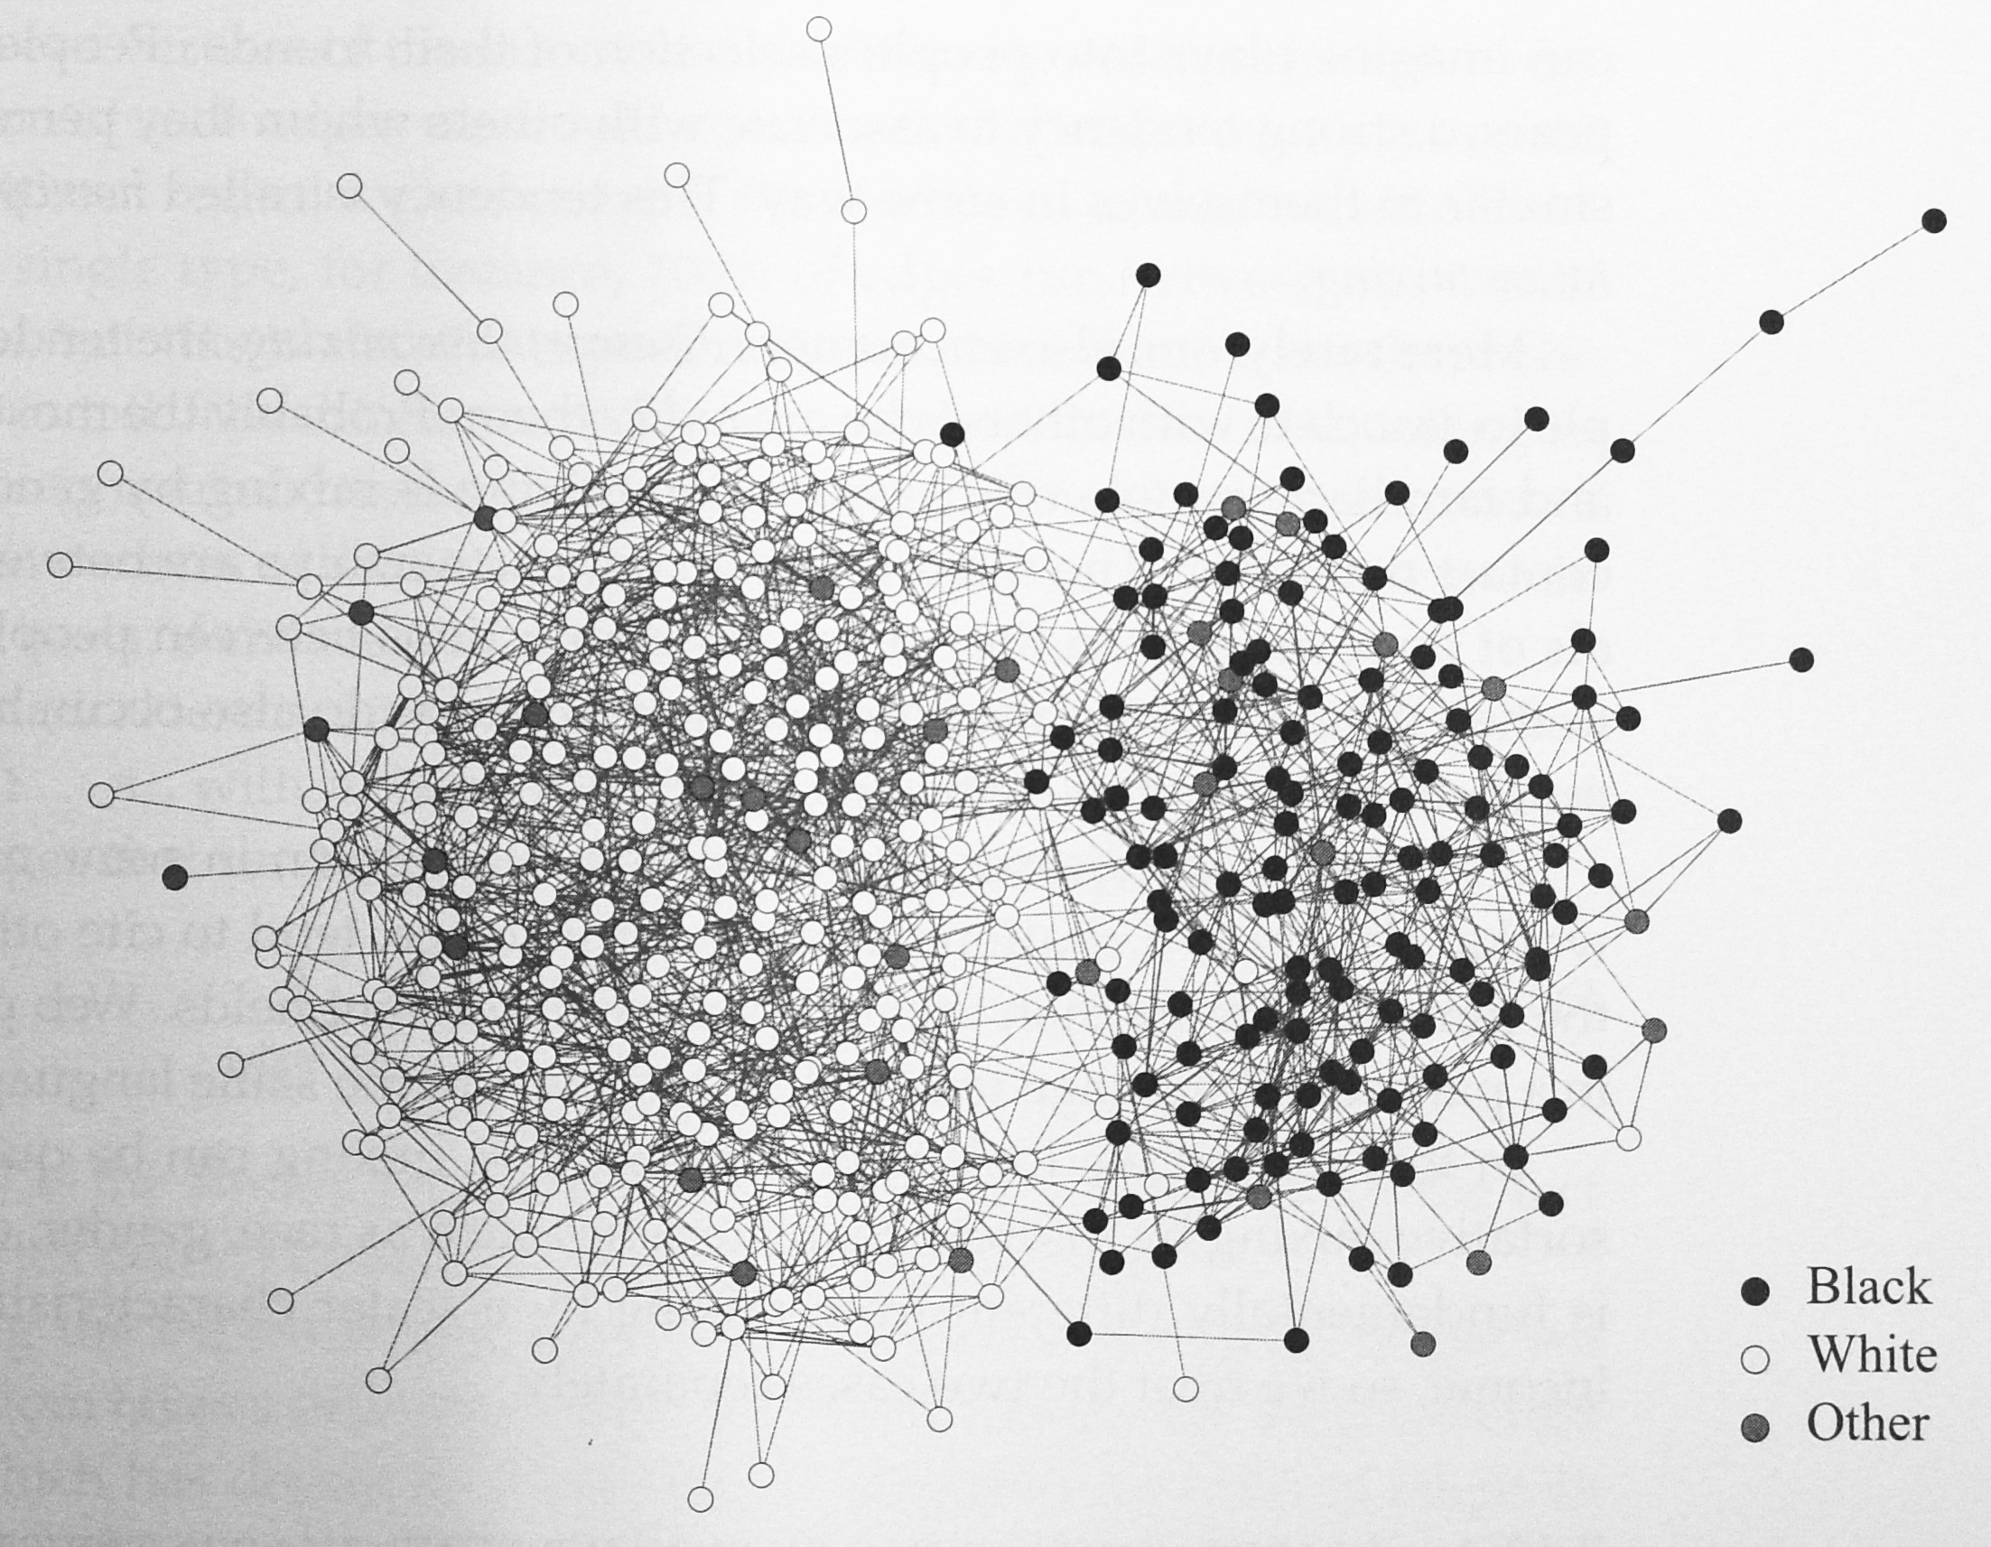
Homophily and assortative mixing
People has strong tendency to associate with others who they perceive as being similar to themselves in some way.
Friendship network at a US high school: vertices are colored by race

Slide 2
Disassortative mixing
The tendency for people to associate with other who are unlike them.
Sexual partnerships are between individuals of opposite sex.

Slide 3
Assortative mixing by enumerative characteristics
Modularity matrix B with
Graph partition: assign each vertex to a class.
Let c_{i} be the class of vertex i.
Modularity associated with a graph partition
Modularity is always less than 1. One can then normalize it with the maximum modularity to define an assortativity coefficient.

Slide 4
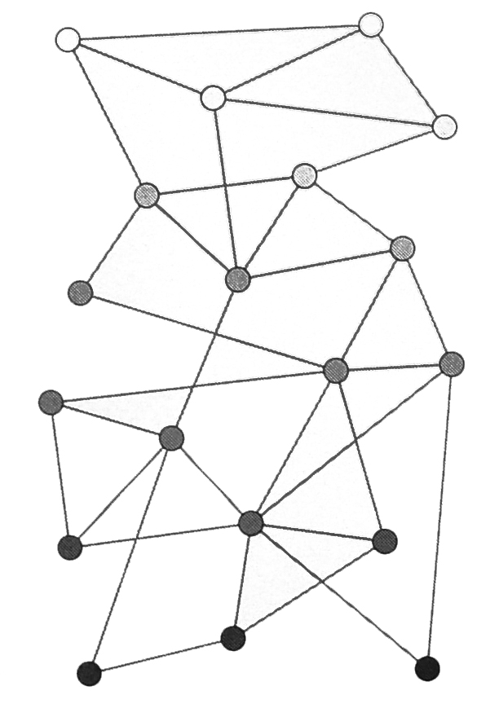
Assortative mixing by scalar characteristics
Each vertex is assigned a value (e.g., age, degree, etc)
A stratified network in which most connections run between vertices at or near the same level.

Slide 5
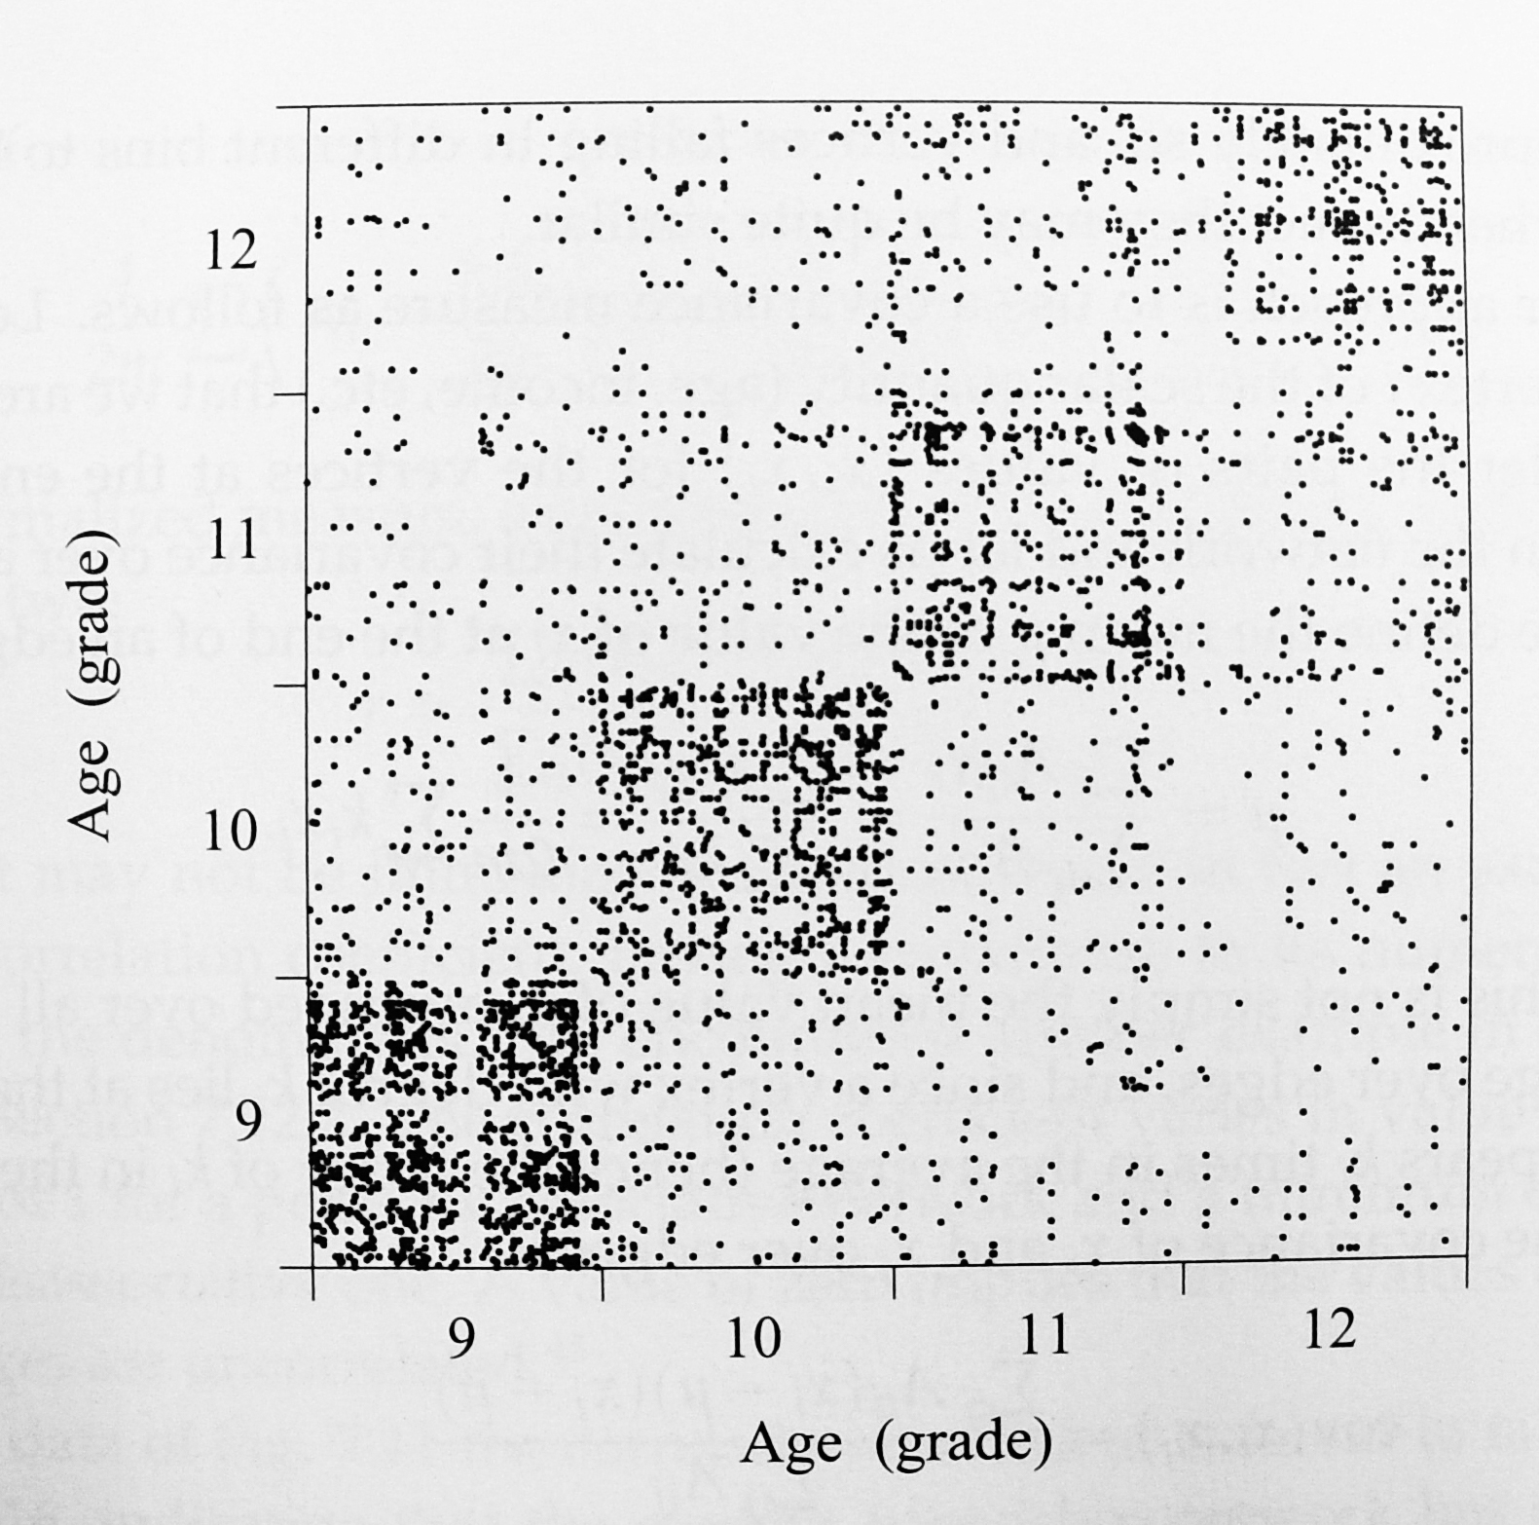
Ages of pairs of friends in high school

Slide 6
Assortativity coefficient
Vertex i is assigned value x_{i}.
The assortativity coefficient r is in fact an example of a Pearson correlation coefficient (will be shown by a simple probabilistic argument)

Slide 7
Assortative mixing by degree
It is a special case of assortative mixing by scalar characteristics.
The assigned value of each vertex is simply its degree.
Core/periphery structure in an assortative network: a clump of core of such high-degree nodes surrounded by a less dense periphery of nodes with lower-degree.

Slide 8
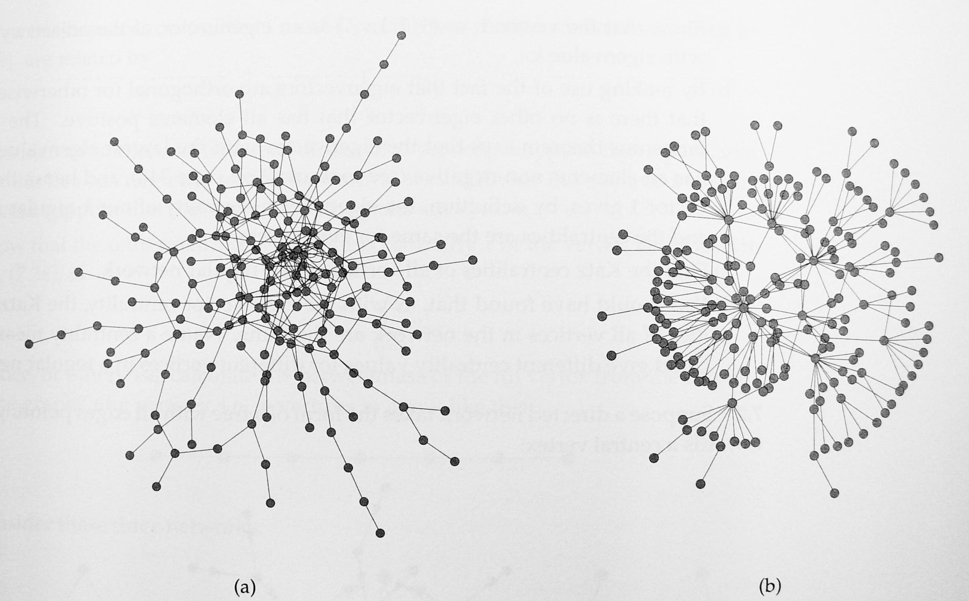
Assortative and disassortative networks

