Slide 1
Research of Network Science
Prof. Cheng-Shang Chang (張正尚教授)
Institute of Communications Engineering National Tsing Hua University
Hsinchu Taiwan
Email: cschang@ee.nthu.edu.tw
http://www.ee.nthu.edu.tw/cschang

Slide 2
Outline
What is network science?
Three research topics in our research team:
Synchronization and desynchronization
Network formation
Structure of networks (Community detection)

Slide 3
What is network science?
2005 National Research Council of the National Academies
“Organized knowledge of networks based on their study using the scientific method”
Social networks, biological networks, communication networks, power grids, …

Slide 4
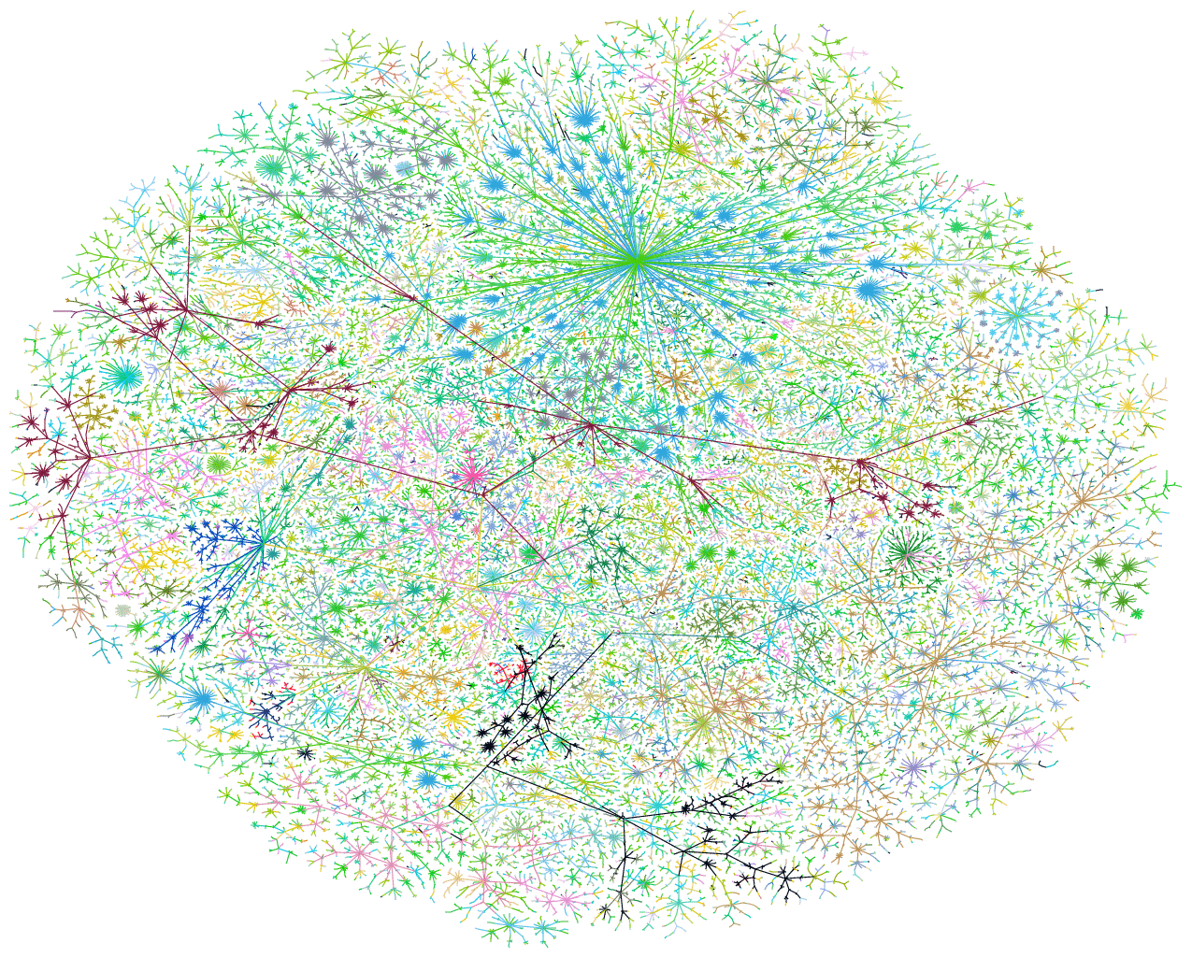
A visualization of the network structure of the Internet at the level of “autonomous systems” (Newman, 2003)

Slide 5
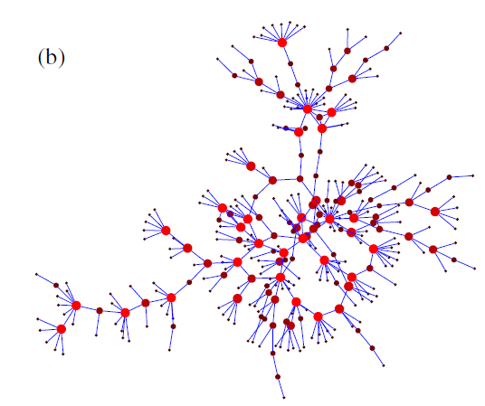
A social network (Newman, 2003)

Slide 6
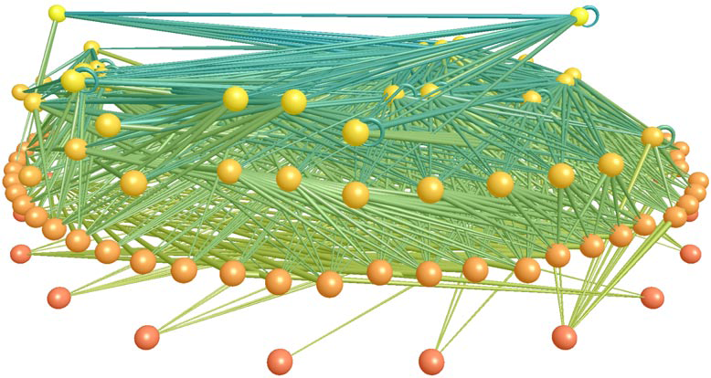
A food web of predator-prey interactions between species in a freshwater lake (Newman, 2003)

Slide 7
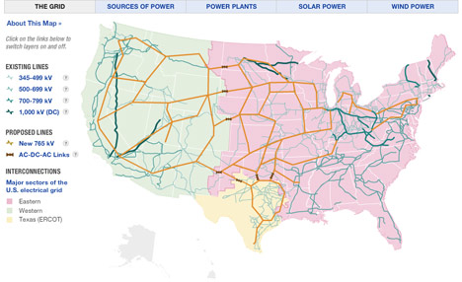
Power grid map http://www.treehugger.com/files/2009/04/nprs-interactive-power-grid-map-shows-whos-got-the-power.php

Slide 8
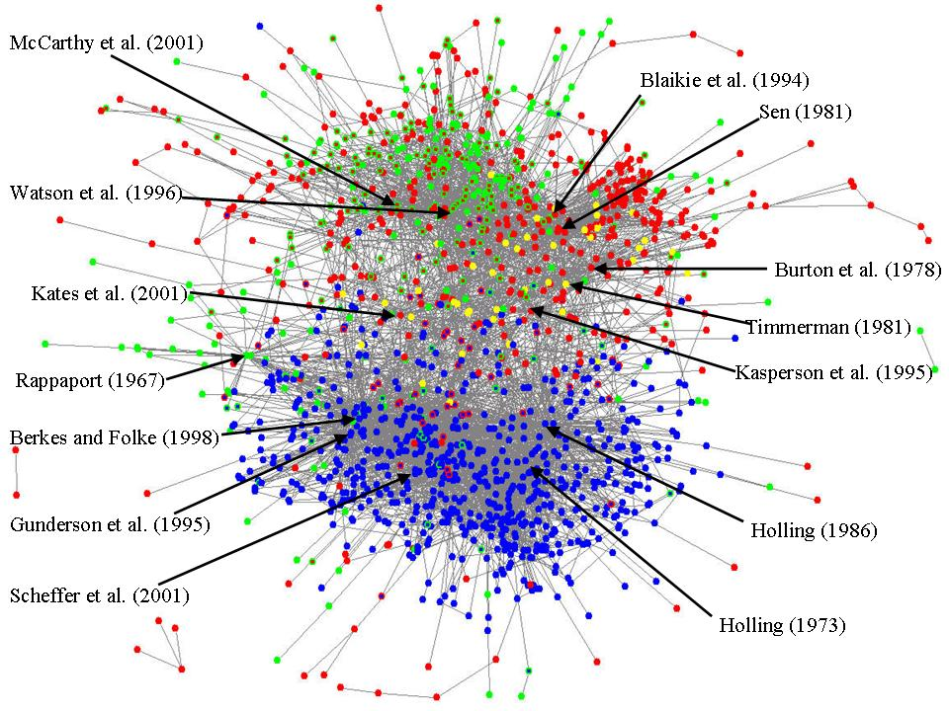
Citation networks http://www.public.asu.edu/~majansse/pubs/SupplementIHDP.htm

Slide 9
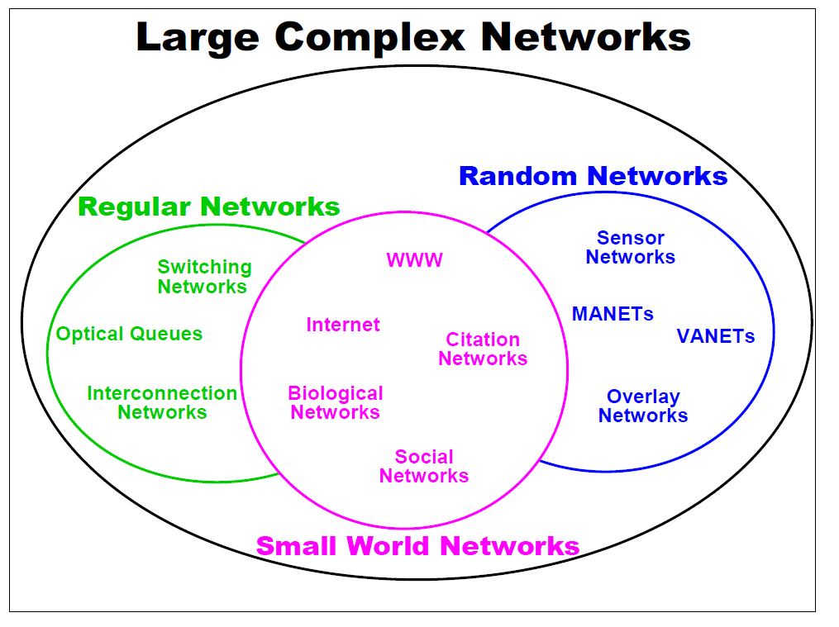

Slide 10
Two key ingredients
The study of a collections of nodes and links (graphs) that represent something real
The study of dynamic behavior of the aggregation of nodes and links
Mathematical tools: linear algebra, differential equations, probability

Slide 11
Synchronization and desynchronization
Phenomenon of mutual synchronization
The flashing of fireflies in south Asia.
Spreading identical oscillators into a round-robin schedule.
Desynchronization has many applications
Resource scheduling in wireless sensor networks.
Fair resource scheduling as Time Division Multiple Access.

Slide 12
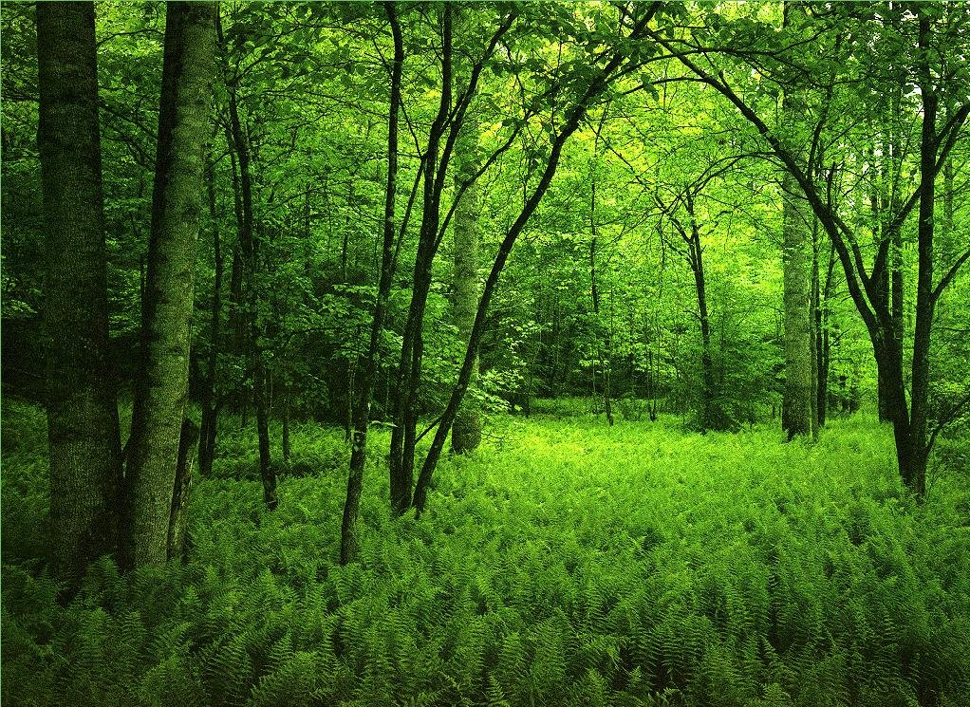


Slide 14
Desynchronization algorithms
The DESYNC-STALE algorithm
Fire!

Slide 15
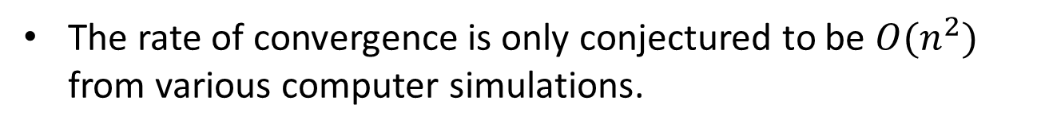
Desynchronization algorithms
The DESYNC-STALE algorithm
When a node reaches the end of the cycle, it fires and
resets its phase back to 0.
It waits for the next node to fire and jump to a new phase
according to a certain function.
The jumping function only uses the firing information of the node fires before it and the node fires after it.
The rate of convergence is only conjectured to be ${O(n}^{2})$ from various computer simulations.

Slide 16

Desynchronization algorithms
Fire!
$$φ=0$$
When a node reaches the end of the cycle, it fires and
resets its phase back to 0.

Slide 17
Desynchronization algorithms
It waits for the next node to fire and jump to a new phase
according to a certain function.
Fire!

Slide 18
Desynchronization algorithms
The jumping function only uses the firing information of the node fires before it and the node fires after it.
Fire!

Slide 19
Network formation
Erdos-Renyi random graph
Configuration model
Preferential attachment
Small world
Formation of social networks by random triad connections

Slide 20
Formation of Social Networks by Random Triad Connections
Join work with Prof. Duan-Shin Lee
Director of the Institute of Communications Engineering
National Tsing Hua University

Slide 21
A Network Formation Model for Social Networks
National Tsing-Hua University
At time zero, the network consists of a clique with m₀ vertices.
At time t, which is a non-negative integer, a new vertex is attached to one of the existing vertices in the network.
The attached existing vertex is selected with equal probability.
This step is called the uniform attachment step.
Each neighbor of the attached existing vertex is attached to the new vertex with probability a and not attached with probability 1-a.
This step is called the triad formation step.
Friends’ friends are more likely to be friends.
Institute of Communications Engineering

Slide 22
Uniform Attachment and Triad Formation
National Tsing-Hua University
t = 0
when
Institute of Communications Engineering

Slide 23
Uniform Attachment and Triad Formation
National Tsing-Hua University
do nothing with probability 1-a
t = 1
when
uniform attachment
triad formation with probability a
triad formation with probability a
Institute of Communications Engineering

Slide 24
Uniform Attachment and Triad Formation
National Tsing-Hua University
t = 2
when
Institute of Communications Engineering

Slide 25
Detecting Community
Community :
It is the appearance of densely connected groups of vertices, with only sparser connections between groups.
Modularity (Girman and Newman 2002) :
It is a property of a network and a specifically proposed division of that network into communities.
It measures when the division is a good one, in the sense that there are fewer than expected edges between communities.

Slide 26
Detecting Community
Example :

Slide 27
Research problems
How is life formed? Is the emergence of life through random rewiring of DNAs according a certain microrule?
How powerful is a person in a community? How much is he/she worth? Can these be evaluated by the people he/she knows?
How can one bring down the Internet? What is the best strategy to defend one’s network from malicious attacks? How are these related to the topology of a network?
Why is there a phase change from water to ice? Can this be explained by using the percolation theory? Does the large deviation theory play a role here?

